Slide 1
Equation of Continuity

Slide 3
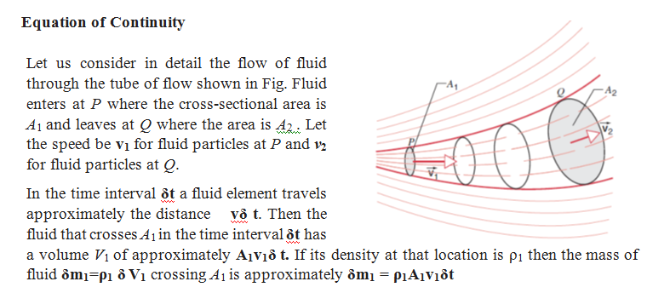

Slide 5
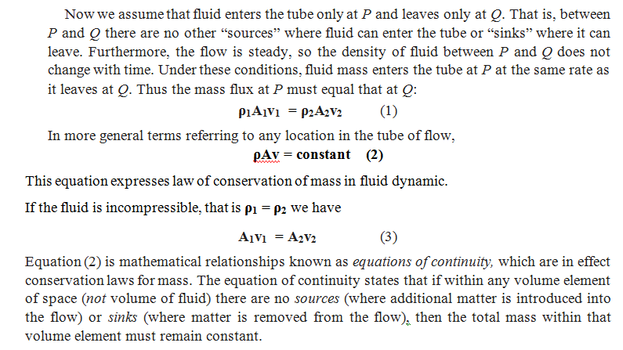

Slide 6
