Slide 1
Types of wings
Dr. M. Asam Riaz
Assistant Professor
Entomology, College of Agriculture, University of Sargodha, Sargodha, Pakistan

Slide 2
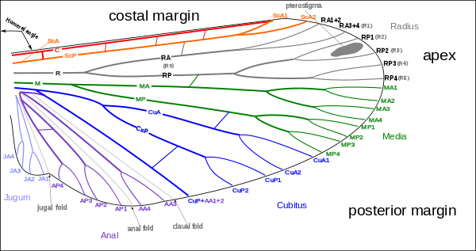

Slide 3
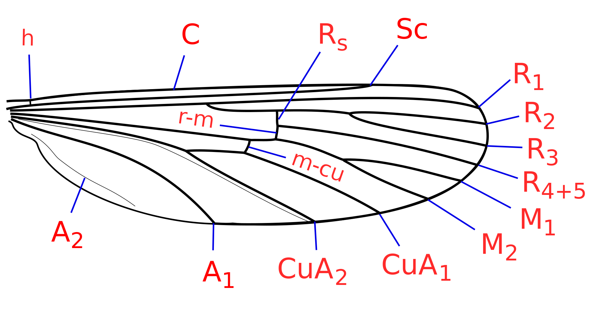
Wing venation
Longitudinal veins
Costa (C) (Unbranched)
Subcosta (Sc) (2 branched)
Radius (R) (R1 and rs-4 branched)
Media (M) (MA and MP, 6 branched)
Cubitus (Cu) (2 branched
Anals (A)
Cross veins
Humeral (h) (costa to subcosta)
Radial (r) (R1 to radial sector)
Sectorial (s) (R3 to R4)
Radiomedial (r-m) (R to M)
Medial (m) (M2 to M3)
Mediocubital (m-cu) (M to Cu)

Slide 4
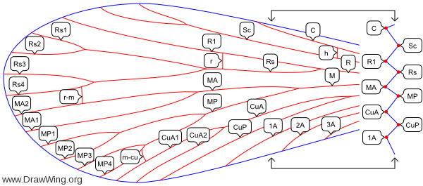

Slide 5
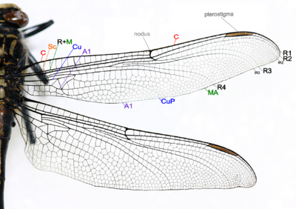
Dragonfly

Slide 6
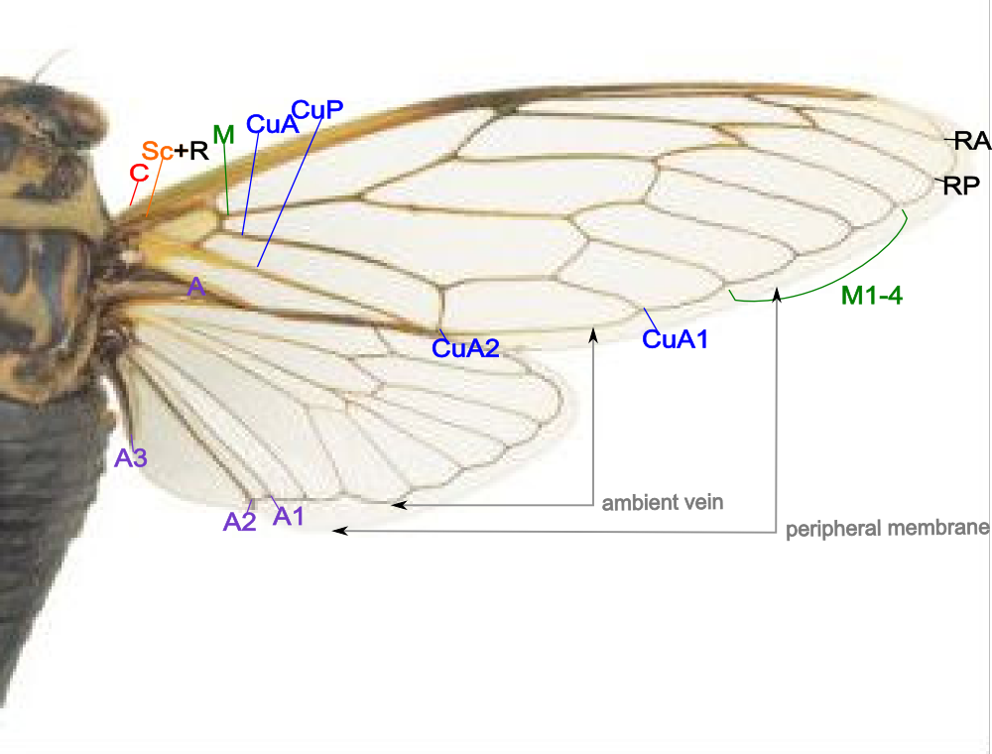
Cicada

Slide 7
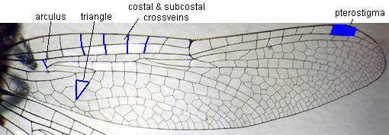

Slide 8
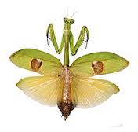
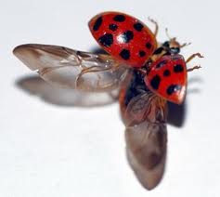
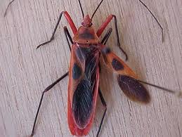
Modification of wings
Tegmina:
Fore wing modified into long, narrow, hard and thick structure
e.g., grasshopper, cockroaches, mantids, crickets
Elytra:
FW modified into very thick and hard structure
e.g., beetle, weevil, earwigs
Hemelytra:
basal part of FW is thick and hard
Apical part is thin and membranous
e.g., true bugs (red cotton bug)
mantid
Lady bird beetle
Bug

Slide 9
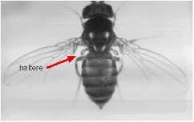
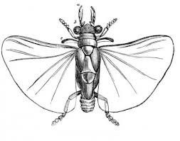
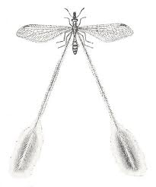
Halteres:
HW modified into tiny, knobbed structures
e.g., flies, male coccids (mango mealy bug)
Pseudohalteres:
FW modified into halters
e.g., male stylopids
Filohalteres:
HW modified into long and thread-like structures
e.g., lacewings (Croce sp.)

Slide 10
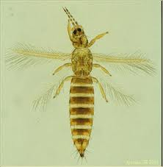
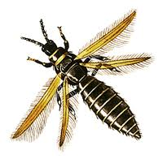
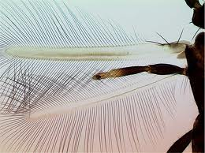
Strippy:
wings modified into strips or rod-like structures
Fringed with long hair
e.g., thrips
Membranous:
HW thin and broad like membrane
e.g., grasshopper, locusts, crickets, earwigs, beetles

Slide 11
Types of larvae
 | Type | Body shape | Thoracic legs | Abdominal legs | Cerci | Example
 | Campodeiform | Flattened | Present (Long legs) | Absent | Present | Diving beetle
2. | Carabiform | Flattened | Present (Short legs) | Absent | Absent | Fireflies
3. | Eruciform | Cylindrical | Present | Present (2 to 5 pairs) | Absent | Butterflies,moths
4. | Scarabaeiform | Cylindrical and C-shaped | Present | Absent | Absent | Gram dhora, scarab beetle
5. | Elateriform | Cylindrical, thin, elongate | Present ( short legs) | Absent | Absent | Click beetle
6. | Platyform | Broad | Absent | Absent | Absent | Syrphid beetle
7. | Vermiform | Cylindrical, elongate, narrowing anteriorly | Absent | Absent | Absent | Flies, fleas, parasitic wasp

