Slide 1
TERATOLOGY OF FALLOT

Slide 2
Teratology of fallot is most common cyanotic congenital heart lesion (5-7%) which is compatible
With life

Slide 3
COMPONENTS
The condition is characterized by combination of four defects
Ventricular septal defect
Pulmonic stenosis
Over riding of aorta or dextraposed aorta
Right ventricular hypertrophy

Slide 5
Pathophysiology
Physiologically the pulmonic stenosis causes right ventricular hypertrophy and increase in right ventricular pressure
When right ventricular pressure is as high as the left ventricular pressure or aortic pressure a right to left shunt appears to decompress the right ventricle

Slide 6
Once the right and left ventricle become identical,increasing severity of pulmonic stenosis
reduces the flow of blood into pulmonary artery
and increases the right to left shunt
as systolic pressure between two ventricle are identical there is no left to right shunting and vsd is silent

Slide 7
The flow of blood from right ventrice into pulmonary artery occurs across pulmonary stenosis producing EJECTION SYSTOLIC MURMUR
More severe the pulmonic stenosis the less the flow into pulmonary artery and bigger the right to left shunt more the cyanosis

Slide 8
The severity of cyanosis is directly proptional to the severity of pulmonic stenosis
The VSD of TOF is always large enough to allow
free exit to right to left shunt
Congestive failure never occurs in TOF.

Slide 9
CLINICAL MANIFESTATION
Depends on size of vsd and degree of right ventricular flow obstruction
Blue baby ( cyanosis of lips and nail bedswith dyspnea is found initially with crying and exertion)
Tired easily with exertion
May have difficulty in feeding

Slide 10
Signs of chronic hypoxemia
Harsh systolic murmur,often accompanied by thrill
In radiograph heart is boot shaped (because of poor development of pulmonary artery)

Slide 11
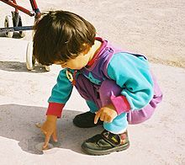
SQUATTING(a compensatory mechanism)is uniquely characteristic of right to left shunt.It increases the peripheral vascular resistance and diminishes right to left shunt and increases pulmonary blood flow

Slide 12
TET SPELLS
Tet spells(hyper cyanotic spells) due to cerebral anoxia – it consist of irritability,dyspnea ,cyanosis,flaccidity with or without unconsciousness.It is found in morning after awakening,during or after feeding and painful procedures

Slide 13
CAUSES OF SPELL
Due to contraction or spasm in muscles of right ventricle just under the pulmonary valve.when this muscle contracts,it further narrows the channelfor blood flow in lungs.As a result oxygen delivery becomes further reduced.this causes a spell

Slide 14
CLUBBING

Slide 15
DIAGNOSTIC EVALUATION
HISTORY
PHYSICAL EXAMINATION
cyanosis
clubbing

Slide 16
HEART SOUND
normal first heart sound
Single second heart sound
An ejection systolic murmur
ECG Right axis deviation and right ventricular hypertrophy
ECHOCARDIOGRAPHY Identify large overriding aorta,right ventricular hypertrophy,and outflow obstruction
CARDIAC CATHERIZATION

Slide 17
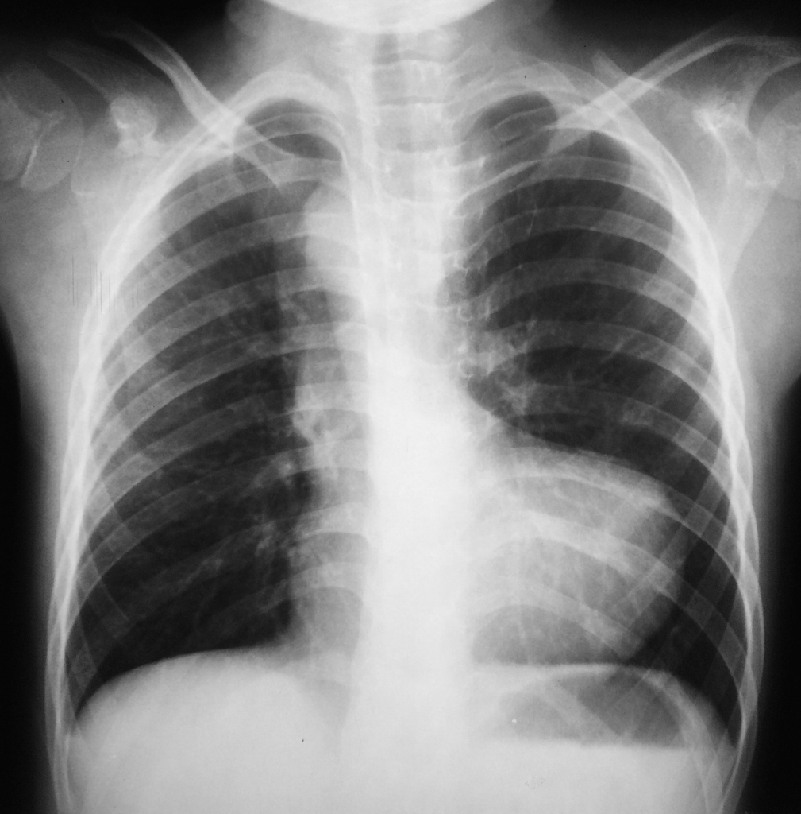
BOOT SHAPED HEART(It means apex is lifted up and there is concavity in region of pulmonary artery)
OLIGAEMIC LUNG FIELDS
Hilar vessels are few,large right ventricle,lung vessels are also few

Slide 18
Medical management
Monitring for hyoxemia
Hemaglobin levels and hematocrit values muay evaluated to assess the anemia
Monitring for hypercyanptic episodes ( 10-15 minutes)
Ballon dilatation of right ventricular outflow tract

Slide 19
TREATMENT OF SPELLS
KNEE CHEST POSITION
OXYGEN INHALATION
SODA BICARBONATE TO CORRECT ACIDOSIS
MORPHINE SULPHATE
BETA RECEPTOR BLOCKING AGENT

Slide 20
SURGICAL MANAGEMENT
BLALOCK-TAUSSING OPERATION
connection between right subclavian artery and right pulmonary artery which increases amount of oxygenated blood to lungs
POTTS SHUNT
descending aorta is anastmosed to pulmonary artery
WATERSTONTS SHUNT
ascending aorta and right pulmonary artery anastmosis

Slide 21
COMPLICATIONS
BRAIN ABSCESS
BACTERIAL ENDOCARDITIS
VENTRICULAR ARRHYTHMIAS

