Slide 2
Topic:
PlANT DEMOGRAPHY

Slide 3
What is demography?
Demography (from prefix demo- from Ancient Greek δῆμος dēmos meaning "the people", and -graphy from γράφω graphō, implies "writing, description or measurement") is the statistical study of populations, especially human beings. ... Demographics are quantifiable characteristics of a given population.

Slide 4
Continue....
The study of species populations including their size, growth, density, distribution, statistics regarding birth, disease and death and change of population size over time

Slide 5
Continue....
Father of demography:
John Graunt, 1620-1674,is known as the father of demography.
Big three of demography:
Birth b) Death c) Migration

Slide 6
What is plant demography?
The study of species populations including their size, growth, density, distribution, statistics regarding birth, disease and death and change of population size over time. What is plant demography? Change in population's size over time.

Slide 7
Continue...
Demography is the branch of ecology that studies the growth and regulation of animal and plant populations, resulting from the individual processes of birth, death, immigration and emigration in natural, managed or artificial environments.

Slide 8
Importance of demography
Ecological demographic principles are building blocks in most ecological theory and application. If scientific ecology needs a coherent set of demographic principles to refer to, applied science also calls for them:

Slide 9
Continue...
a solid demographic theory is necessary:
to support the conservation of biotic diversity,
to develop sound pest control strategies,
to understand disease spread,
and to decide optimum harvesting levels of economically important populations.

Slide 10
Continue...
The basic object of study in ecological demography (ED) is the life cycleof the individual organism – i.e., the species-specific set of laws that determine the characteristics and timing of birth and death. The life cycle is the prime determinant of the demographic characteristics of a population.

Slide 11
Plant demography includes counting:
1. Number of genetically distinct individuals
2. Number of vegitatively reproduced individuals
3. Number of leaves, branches, tillers, stems, flowers. etc
4. Movement of seeds into and out of the population and storage in the soil

Slide 12
How can we predict population change over time?
By determining birth and death rates of an individual, age, and when it reproduces
Mathematical equation for change of a population over time
Mathematical equation for change of a population over time(dN/dt) = (r) * N (net increase) = r = (births - deaths)N = number of reproducing individuals in the population

Slide 13
Population growth models
There are two population growth models;
Discrete breeding
Continuous breeding

Slide 14
Discrete breeding
Populations reproduce once in their lifetime (big-bang reproduction)
Example:
Annual plants. II)Insects
they allocate most of their energy to reproduction and they die after reproduction

Slide 15
Continuous breeding
Reproduce more than once in their lifetime (Repeated reproduction)
Example:
Perennial plants. II.Mammals
They allocate energy to growth and establishing themselves first and delay reproduction for later.

Slide 16
Mathematical models
Two mathematical models are used to predict population growth for both of the breeding models.
Exponential growth model
Logistic growth model

Slide 17
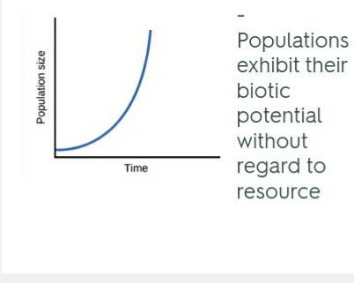
Exponential growth model

Slide 18
Logistic growth model

Slide 19
Factors that affect population size
Following are the important factors that affect population size;
Immigration
Birth Rate
Emigration
Mortality

Slide 20
Plant Demography and Ecological Theory
The meanings of 'theory' in ecology are examined and illustrated with six examples from plant ecology. The application of demographic theory to plants (and other modular organisms) depends on recognition of two levels of populational organisation - the genet (N) and the modular unit of structure (η)

Slide 21
Continue...
Examples are given to illustrate the theory that a plant is a population of parts that are born and die and the ways in which such theory can be applied to field studies.

