Slide 1
Introduction to Earthquake Engineering Lec#2
Engr. Muhammad Mubashir Ajmal
Department of Civil Engineering, University of Sargodha, Sargodha

Slide 2
List of Content
Seismic waves
Measuring instruments
Strong ground motions
Characteristics of strong ground motions
Department of Civil Engineering, University of Sargodha, Sargodha

Slide 3
How Ground Shakes???
Seismology:
Seismology is the study of earthquakes and seismic waves that move through and around the earth.
Seismic Waves:
Large strain energy released during an earthquake travels as seismic waves in all directions through the Earth’s layers.
They are the energy that travels through the earth and is recorded on seismographs.
These waves are of two types:
Department of Civil Engineering, University of Sargodha, Sargodha

Slide 4
How Ground Shakes???
1. Body Waves:
Body waves can travel through the earth's inner layers.
They are of two types:
P-Waves:
Under P-waves, material particles undergo extensional and compressional strains along direction of energy transmission.
The first kind of body wave is the P wave or primary wave.
This is the fastest kind of seismic wave, and, consequently, the first to 'arrive' at a seismic station.
The P wave can move through solid rock and fluids, like water or the liquid layers of the earth.
Department of Civil Engineering, University of Sargodha, Sargodha

Slide 5
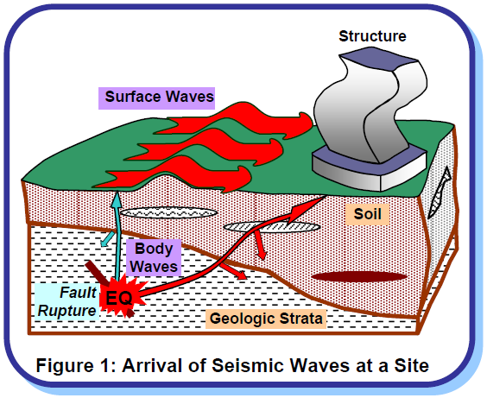
How Ground Shakes???
Department of Civil Engineering, University of Sargodha, Sargodha

Slide 6
How Ground Shakes???
It pushes and pulls the rock it moves through just like sound waves push and pull the air. Have you ever heard a big clap of thunder and heard the windows rattle at the same time? The windows rattle because the sound waves were pushing and pulling on the window glass much like P waves push and pull on rock.
Sometimes animals can hear the P waves of an earthquake. Dogs, for instance, commonly begin barking hysterically just before an earthquake 'hits' (or more specifically, before the surface waves arrive). Usually people can only feel the bump and rattle of these waves.
P waves are also known as compressional waves, because of the pushing and pulling they do. Subjected to a P wave, particles move in the same direction that the wave is moving in, which is the direction that the energy is traveling in, and is sometimes called the 'direction of wave propagation'.
Department of Civil Engineering, University of Sargodha, Sargodha

Slide 7
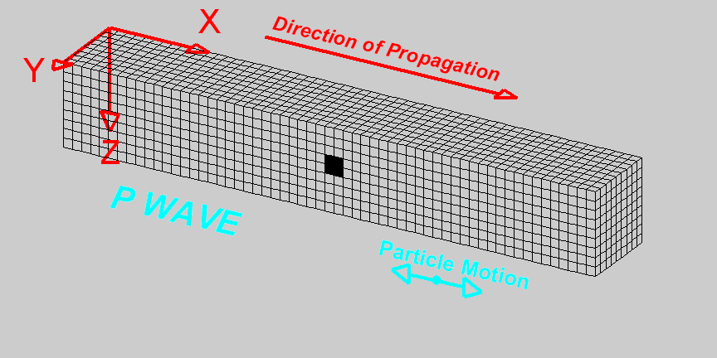
How Ground Shakes???
Department of Civil Engineering, University of Sargodha, Sargodha

Slide 8
How Ground Shakes???
S waves:
The second type of body wave is the S wave or secondary wave, which is the second wave you feel in an earthquake.
An S wave is slower than a P wave and can only move through solid rock, not through any liquid medium.
S waves move rock particles up and down, perpendicular to the direction that the wave is traveling in (the direction of wave propagation).
Department of Civil Engineering, University of Sargodha, Sargodha

Slide 9
How Ground Shakes???
Surface waves:
Surface waves consist of Love waves and Rayleigh waves.
They are restricted to near earth’s surface.
Travelling only through the crust, surface waves are of a lower frequency than body waves, and are easily distinguished on a seismogram as a result.
Though they arrive after body waves, it is surface waves that are almost entirely responsible for the damage and destruction associated with earthquakes.
This damage and the strength of the surface waves are reduced in deeper earthquakes.
Department of Civil Engineering, University of Sargodha, Sargodha

Slide 10
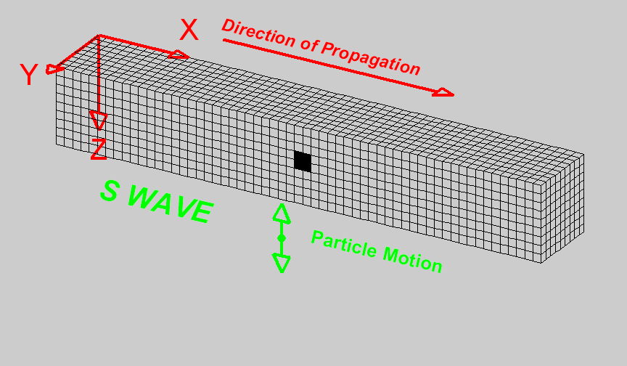
How Ground Shakes???
Department of Civil Engineering, University of Sargodha, Sargodha

Slide 11
How Ground Shakes???
Love Waves:
Love waves cause surface motions similar to that by S-waves, but with no vertical component.
The first kind of surface wave is called a Love wave, named after A.E.H. Love, a British mathematician who worked out the mathematical model for this kind of wave in 1911.
It's the fastest surface wave and moves the ground from side-to-side. Confined to the surface of the crust, Love waves produce entirely horizontal motion.
Department of Civil Engineering, University of Sargodha, Sargodha

Slide 12
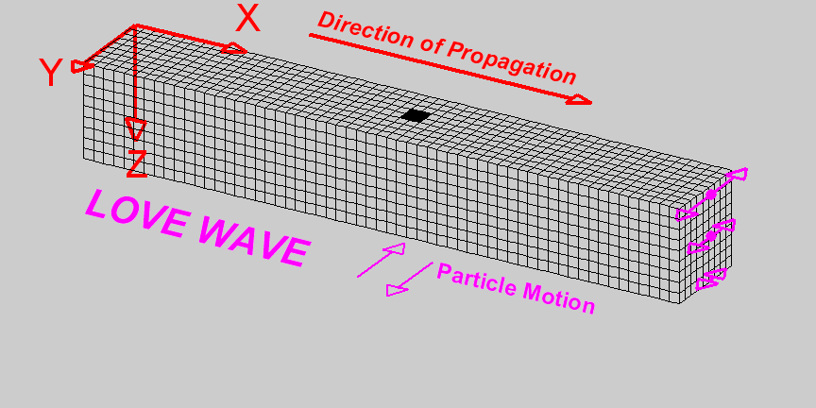
How Ground Shakes???
Department of Civil Engineering, University of Sargodha, Sargodha

Slide 13
How Ground Shakes???
Rayleigh Waves:
Rayleigh wave makes a material particle oscillate in an elliptic path in the vertical plane (with horizontal motion along direction of energy transmission).
The other kind of surface wave is the Rayleigh wave, named for John William Strutt, Lord Rayleigh, who mathematically predicted the existence of this kind of wave in 1885.
A Rayleigh wave rolls along the ground just like a wave rolls across a lake or an ocean.
Because it rolls, it moves the ground up and down, and side-to-side in the same direction that the wave is moving.
Most of the shaking felt from an earthquake is due to the Rayleigh wave, which can be much larger than the other waves.
Department of Civil Engineering, University of Sargodha, Sargodha

Slide 14
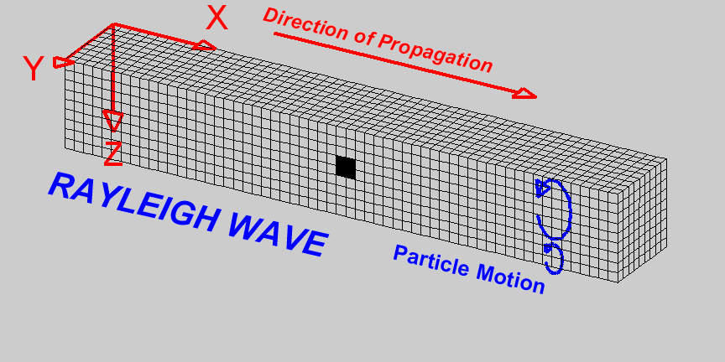
How Ground Shakes???
Department of Civil Engineering, University of Sargodha, Sargodha

Slide 15
How Ground Shakes???
P-waves are fastest, followed in sequence by S-, Love and Rayleigh waves.
For example, in granites, P and S-waves have speeds ~4.8 km/sec and ~3.0km/sec, respectively.
S-waves do not travel through liquids. S-waves in association with effects of Love waves cause maximum damage to structures by their racking motion on the surface in both vertical and horizontal directions.
When P- and S-waves reach the Earth's surface, most of their energy is reflected back.
Some of this energy is returned back to the surface by reflections at different layers of soil and rock.
Shaking is more severe (about twice as much) at the Earth's surface than at substantial depths.
This is often the basis for designing structures buried underground for smaller levels of acceleration than those above the ground.
Department of Civil Engineering, University of Sargodha, Sargodha

Slide 16
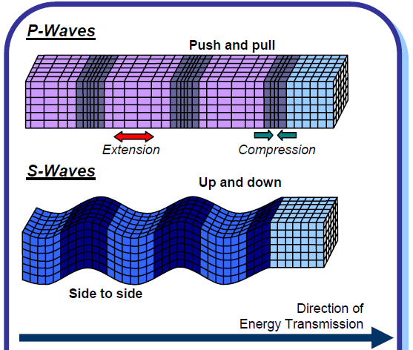
How Ground Shakes???
Department of Civil Engineering, University of Sargodha, Sargodha

Slide 17
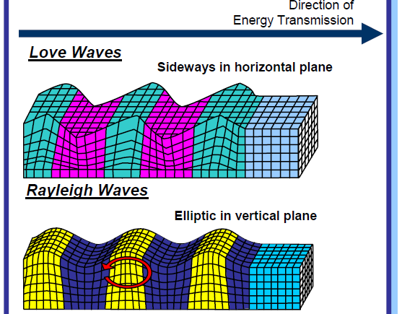
How Ground Shakes???
Department of Civil Engineering, University of Sargodha, Sargodha

Slide 18
How Ground Shakes???
Measuring Instruments:
The principle on which it works is simple and is explicitly reflected in the early seismograph (Figure 3) – a pen attached at the tip of an oscillating simple pendulum (a mass hung by a string from a support) marks on a chart paper that is held on a drum rotating at a constant speed.
A magnet around the string provides required damping to control the amplitude of oscillations.
The instrument that measures earthquake shaking, a seismograph, has three component
Sensor: The pendulum mass, string, magnet and support together constitute the sensor
Recorder: the drum, pen and chart paper constitute the recorder
Timer: the motor that rotates the drum at constant speed forms the timer
Department of Civil Engineering, University of Sargodha, Sargodha

Slide 19
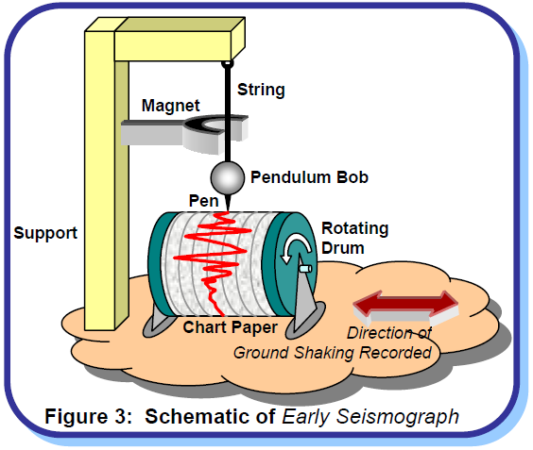
How Ground Shakes???
Department of Civil Engineering, University of Sargodha, Sargodha

Slide 20
How Ground Shakes???
One such instrument is required in each of the two orthogonal horizontal directions.
For measuring vertical oscillations, the string pendulum (Figure 3) is replaced with a spring pendulum oscillating about a fulcrum.
Some instruments do not have a timer device (i.e., the drum holding the chart paper does not rotate).
Such instruments provide only the maximum extent (or scope) of motion during the earthquake; for this reason they are called seismoscopes.
The analog instruments have evolved over time, but today, digital instruments using modern computer technology are more commonly used.
The digital instrument records the ground motion on the memory of the microprocessor that is in-built in the instrument.
Department of Civil Engineering, University of Sargodha, Sargodha

Slide 21
How Ground Shakes???
Strong Ground Motions:
Shaking of ground on the Earth’s surface is a net consequence of motions caused by seismic waves generated by energy release at each material point within the three-dimensional volume that ruptures at the fault.
These waves arrive at various instants of time, have different amplitudes and carry different levels of energy.
Thus, the motion at any site on ground is random in nature with its amplitude and direction varying randomly with time.
Large earthquakes at great distances can produce weak motions that may not damage structures or even be felt by humans.
But, sensitive instruments can record these. This makes it possible to locate distant earthquakes.
However, from engineering viewpoint, strong motions that can possibly damage structures are of interest.
This can happen with earthquakes in the vicinity or even with large earthquakes at reasonable medium to large distances.
Department of Civil Engineering, University of Sargodha, Sargodha

Slide 22
How Ground Shakes???
Characteristics of Strong Ground Motions:
The motion of the ground can be described in terms of displacement, velocity or acceleration.
The variation of ground acceleration with time recorded at a point on ground during an earthquake is called an accelerogram.
The nature of accelerograms may vary (Figure 4) depending on energy released at source, type of slip at fault rupture, geology along the travel path from fault rupture to the Earth’s surface, and local soil (Figure 1).
They carry distinct information regarding ground shaking; peak amplitude, duration of strong shaking, frequency content (e.g., amplitude of shaking associated with each frequency) and energy content (i.e., energy carried by ground shaking at each frequency) are often used to distinguish them.
Department of Civil Engineering, University of Sargodha, Sargodha

Slide 23
How Ground Shakes???
Peak amplitude (peak ground acceleration, PGA) is physically intuitive.
For instance, a horizontal PGA value of 0.6g (= 0.6 times the acceleration due to gravity) suggests that the movement of the ground can cause a maximum horizontal force on a rigid structure qual to 60% of its weight.
In a rigid structure, all points in it move with the ground by the same amount, and hence experience the same maximum acceleration of PGA.
Horizontal PGA values greater than 1.0g were recorded during the 1994 Northridge Earthquake in USA.
Usually, strong ground motions carry significant energy associated with shaking of frequencies in the range 0.03-30Hz (i.e., cycles per sec).
Department of Civil Engineering, University of Sargodha, Sargodha

Slide 24
How Ground Shakes???
Generally, the maximum amplitudes of horizontal motions in the two orthogonal directions are about the same.
However, the maximum amplitude in the vertical direction is usually less than that in the horizontal direction.
In design codes, the vertical design acceleration is taken as 1 2 to 2 3 of the horizontal design acceleration.
In contrast, the maximum horizontal and vertical ground accelerations in the vicinity of the fault rupture do not seem to have such a correlation.
Department of Civil Engineering, University of Sargodha, Sargodha

Slide 25
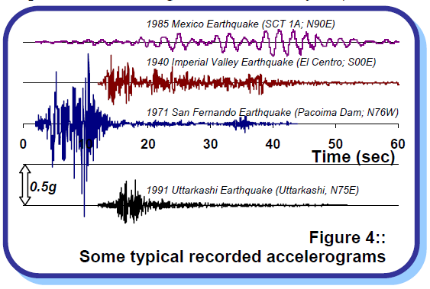
How Ground Shakes???
Department of Civil Engineering, University of Sargodha, Sargodha

Slide 26
Department of Civil Engineering, University of Sargodha, Sargodha

