Slide 1
Road Traffic Injuries
Lesson 2
By
Dr Nadir Ali Rana

Slide 2
Learning Outcomes
RTA injuries to different parts of body
Identification of Injuries sustained to Drivers, Front seat co passenger and occupants
Investigation of RTA in medicolegal cases
Medical certificates for drivers.

Slide 3
CHEST
Steering wheel injury
Externally there is patterned abrasion / contusion or no visible injury at all
Internally transverse sternal and bilateral rib fractures (Flail Chest)
Lungs – punctured wounds due to fractured ribs
Heart – contusion, laceration, rupture
Aortic – rupture
Liver – laceration

Slide 4
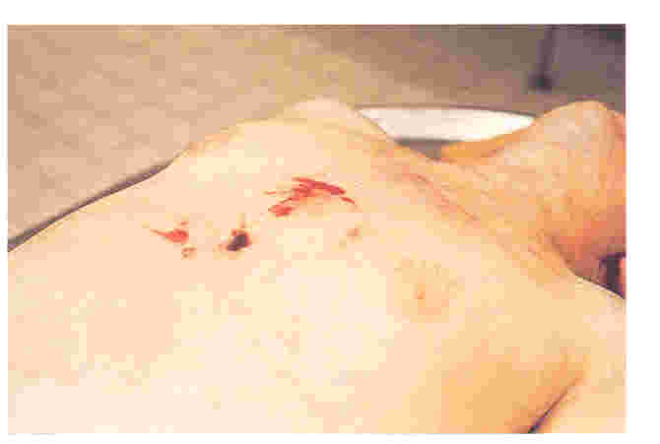
Steering Wheel Injury

Slide 5
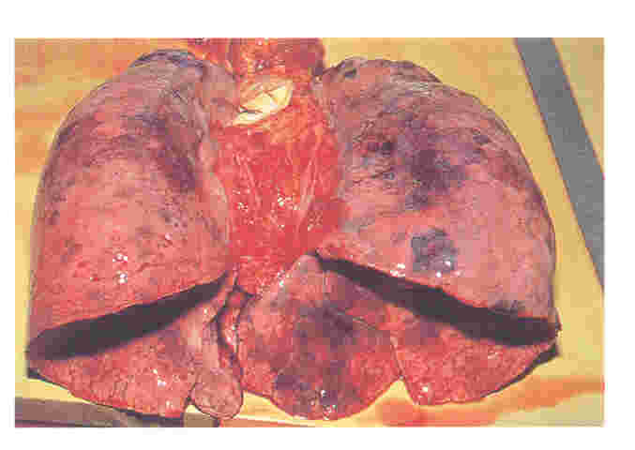
Pulmonary Contusion in a Car Driver.

Slide 6
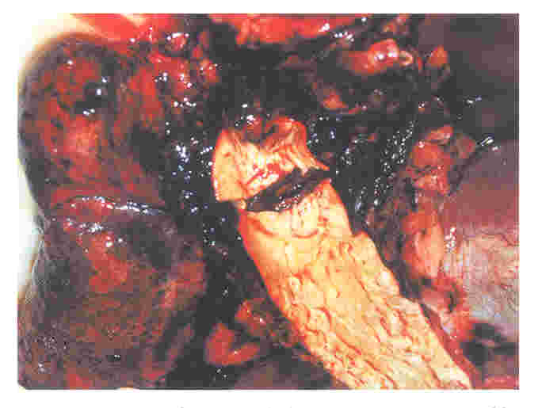
Rapture of Aorta in a Car Occupant

Slide 7
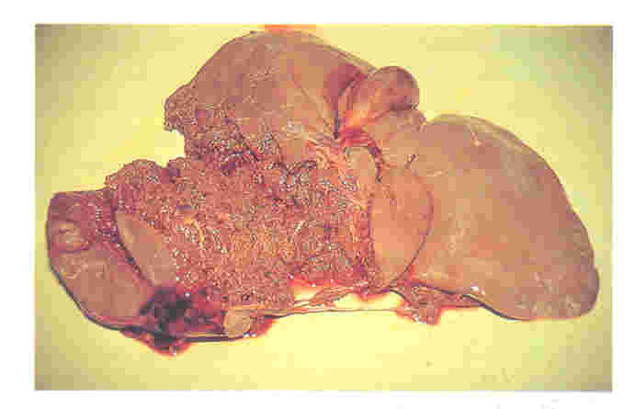
Crushing of Liver – Driver

Slide 8
UPPER LIMBS
Wrist or forearm fractures
LOWER LIMBS
Fracture of patella or femur
Ankle fracture

Slide 9
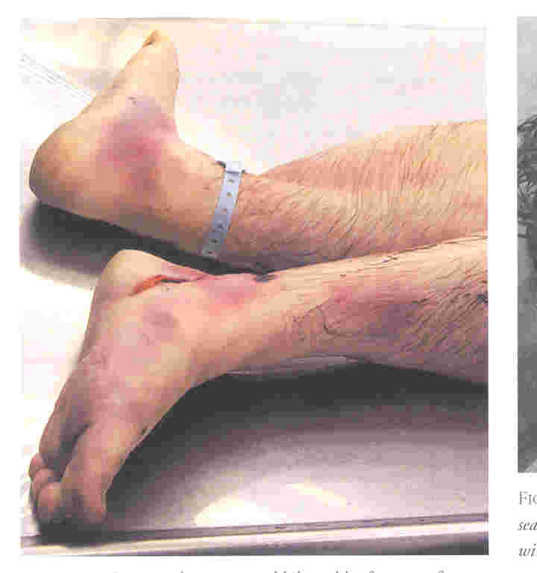
Injuries to car driver in a frontal impact

Slide 10
IDENTIFICATION OF DRIVER
The only occupant
By position in the vehicle (unless transposed)
Imprint of brake & accelerator pedal on sole of foot /shoe.
By Blood stain; Blood grouping; DNA Typing, hair and finger print matching.
Specific pattern of injuries
Witness to crash having no vested interest.

Slide 11
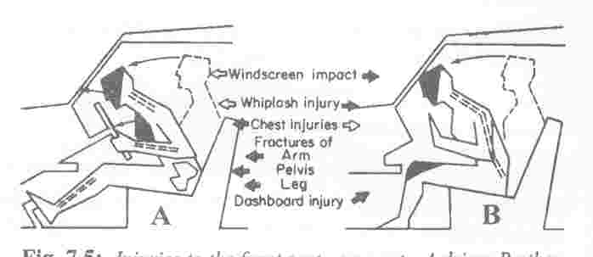
Mechanism of Injuries to Front Seat Occupants

Slide 12
Front seat co - passenger
Head striking wind screen or dash board. (Lacerations, Bruises Fractures etc).
Facial injuries by direct impact.
Fracture femur and / or pelvis (If appreciates earlier)
Dash board injuries to knee.
Fracture dislocation of cervical vertebra “Whip Lash Injury”
Injuries by flying glass (Bird foot claw Injury) Other injuries depending on object in vehicle

Slide 13
REAR SEAT OCCUPANTS
No Screen, No dash board, No Steering wheel. Passengers are thrown forward impacting back of front seat
Injuries are due to striking with;
Sides
Top
Back of front seat or its occupants
Ejection from doors
A child sitting on back seat may come on the front compartment between the seats and sustain injuries due to the objects mounted there.

Slide 14
INVESTIGATION OF RTA
Investigation team comprises of three types of experts:
Forensic medical examiner (doctor).
Vehicle examiner.
Forensic science examiner

Slide 15
EXAMINATIONS
EXAMINATION OF VICTIM
Type of Injury
Any peculiar character
Height of Injury from heel
Any foreign material on skin or wound

Slide 16
EXAMINATION OF CLOTHING
Damage as tears
Fresh contamination ( oil- grease)
Foreign body fragment ( glass – paint)
EXAMINATION OF VEHICLE
Damage ( height from ground)
Blood – flesh or hair on vehicle
Signs of attempt to remove the damage or clean the vehicle

Slide 17
POINTS FAVOURING SUICIDE BY ROAD CRASH
Single occupant.
Crash into fixed object.
Evidence of over speeding.
Absence of brakes application.
Impact with fix object in dead center of vehicle.
Straight road& clear weather.
Suicide note.

Slide 18
Firm imprint of depressed accelerator of shoe / absent impression due to brakes.
Pedestrian walking or running in front of vehicle.
Additional suicidal method (Drug + Accident or Injury + Accident).
Psychological Autopsy.

Slide 19
MEDICAL CERTIFICATION OF DRIVER
Driver should be
Physically fit
Psychologically fit
Disease free
Drug free
Fatigue free

Slide 20
REQUIREMENTS FOR A DRIVING LICENSE
AGE LIMIT:
Lower age limit for
Motorcycle/motorcar – 18 yrs.
Paid employee for motor car – 21 yrs.
Heavy vehicles – 22 yrs.
PHYSICAL AND MENTAL FITNESS.
DRIVING SKILL.

Slide 21
Diseases & disabilities causing disqualification for driving license
Epilepsy
Lunacy (Insanity)
Heart disease likely to produce sudden attack of giddiness or fainting.
Dimness of vision
Color blindness
Night blindness
Deafness
Leprosy

Slide 22
MEDICAL CERTIFICATE FOR DRIVING LICENSE
(TO BE FILLED UP BY A REGISTERED MEDICAL PRACTITIONER)
What is the applicant’s apparent age?..............
Is the applicant subject to epilepsy, vertigo or any mental ailment likely to affect his efficiency?...............................
Does the applicant suffer from heart or lung disorder which might interfere with the performance of his duties as a driver?....................................................

Slide 23
Is there any defect of vision? If so, has it been corrected by suitable spectacles?...............................
Can the applicant readily distinguish the pigmentary colour red and green? .................................................
Does the applicant suffer from night blindness? …………………………..
Does the applicant have any deformity or loss of members which would prevent his hearing of ordinary sound signals? ………………………………….

Slide 24
Has the applicant any deformity or loss of members which would interfere with the efficient performance of his duties as a driver? ……………………………
Does he show any evidence of being addicted to the excessive use of alcohol, tobacco or drugs?.....................
Is he generally fit as regards
(a) bodily health, and
(b) eyesight?......................
Marks of identification:………………..

Slide 25
I certify that to the best of my knowledge and belief the applicant ………………. is the person herein as above described and that the attached photograph is reasonably correct likeness of applicant.
Signature:…………….
Name:…………………
Designation:………….
Note: Special attention should be directed to distant vision and to the condition of the arms and hands and joints of both extremities.
Space for
photograph

