Slide 2
CONTENTS
CEREALS STORAGE
Old methods of storage
Modern method of storage
Dry milling
Process of dry milling
Milling products

Slide 3
CEREALS STORAGE
Cereals grains are preserved and stored to prevent any quality loss
Different cereal grains are stored according to their requirements
Storage can be short term and long term
Due to improper storage conditions, loss of grain is nearly 20% of the whole production

Slide 4
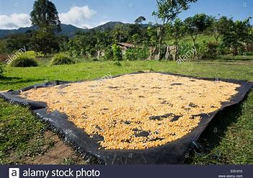
CEREALS STORAGE

Slide 5
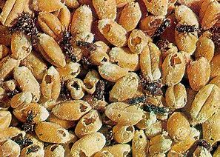
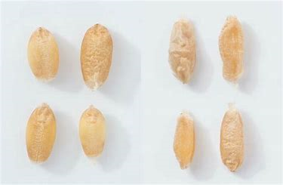
CEREALS STORAGE
The main of aim storing cereals is
To protect the quality of grains
To reduce the grain losses
To conserve the grain for proper use

Slide 6
CEREALS STORAGE
Before storage, there are many protectional points from damage
Harvesting of crops on time
Immediate drying of crops on farm
Settling of new and old crops separately
Cleaning of crops from foreign materials
Careful selection of storage site and storage structure

Slide 7
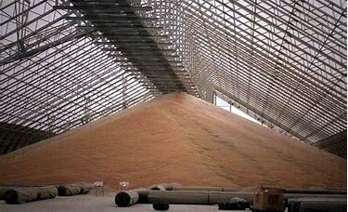
CEREALS STORAGE
During the choice of storage, some factors like environmental, biological, must be considered above other
Storage techniques
Bulk storage
Cereals can be stored in bulks in both vertical and horizontal warehouse
In this, more cereal grains can be stored in less unit area
It requires unskilled labor and hence saves the cost

Slide 8
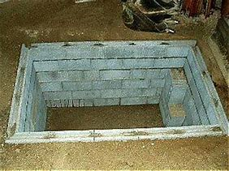
CEREALS STORAGE
2. Underground pits
They can protect grain from damage for many years
These pits are airtight
In it, polyethylene, hay, stalk etc are placed under and over grains
This technique protect the grain from air contact

Slide 9
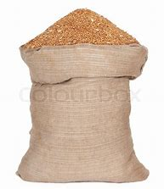
CEREALS STORAGE
3. Storage in bags
It is the most conventional technique mostly used for flour, rice and legumes
In this bags made of sack is used
It is easy to take samples from different sacks
Less amount of product is saved as compared
with bulk storage

Slide 10
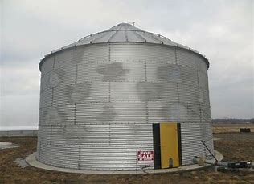
CEREALS STORAGE
4.Storage in silos
It is most preferred technique
it keeps the condition hygienic during storage
More product is stored
Silos made up of wood, concrete and steel
are available

Slide 11
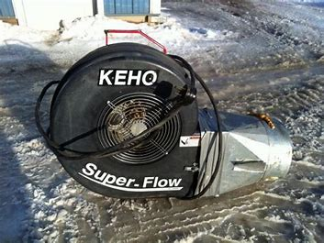
CEREALS STORAGE
4.Grain aeration
Ambient air of suitable quantity is supplied to the bulk of grains
Mechanical aeration by means of fans is achieved
On commercial scale, highly recommended
to preserve grains

Slide 12
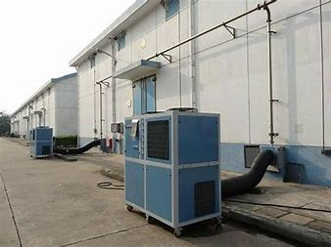
CEREALS STORAGE
5.Refrigrated storage
In summers, to achieve temperature of less 18 °C to reduce insect activity
In this method, ambient air is cooled and then passed over the bulk grains via existing aeration system

Slide 13
CEREALS STORAGE
6. Modified Atmosphere Technology
Modified atmosphere (MA) and controlled atmosphere (CA) treatments have been proved not only to control insects but also to preserve the quality of the commodity with no residues after treatment.
In warm climates, for cereal grain stored in bags or in bulk, this new gaseous technology is applied

Slide 14
CEREALS STORAGE
7. Hermetic Storage
Hermetic storage is based on bio-generated atmospheres
Respiratory metabolism of insects is disturbed
Low O2 and high CO2 environment kills insect and mite pests, and prevents aerobic fungi from growing

Slide 15
DRY MILLING OF GRAINS
Dry milling of grain is mainly utilized to manufacture consumer and industrial based products
The milling process separates the grain into four distinct physical components: the germ, flour, fine grits, and coarse grits
The main objective of the dry-milling process is to separate the endosperm, which is mainly composed of starch, from the germ and pericarp fibers as much as possible

Slide 16
DRY MILLING OF GRAINS
Features of dry milling includes
Physical separation (size/density) based on mass
No use of chemicals
Maximizing surface area of solids for processing
The most utilized grinding mills include pin, hammer, and disk mills, but many machines are utilized for more specific processes

Slide 17
DRY MILLING OF GRAINS
USES
1)Grits
Breakfast cereals
Snack foods
Pet foods
Breads

Slide 18
DRY MILLING OF GRAINS
2) Flour
Baby foods
Baking mixes
Batters
Desserts
Thickening agents

Slide 19
DRY MILLING OF GRAINS
3) Germ
Grain based oil
Vitamin carriers
Mayonnaise
Potato chips
Soups
Sauces
Livestock feed

Slide 20
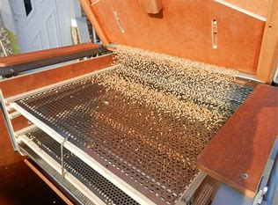
DRY MILLING OF GRAINS
Dry Milling includes following steps
1)Cleaning the wheat
The first milling steps involve equipment that separates grain from seeds and other grains, removes foreign materials that might have originated during the farmer’s harvest such as metal, sticks, stones and straw; and scours the kernels of wheat

Slide 21
DRY MILLING OF GRAINS
2)Tempering wheat Now the wheat is ready to be conditioned for milling,this is called tempering
Moisture is added in precise amounts to toughen the bran and mellow the inner endosperm. This makes the parts of the kernel separate more easily and cleanly. The length of soaking time can range from 6-24 hours

Slide 22
DRY MILLING OF GRAINS
3)Grinding wheat The wheat kernels are now ready to be milled into flour. The modern milling process is a gradual reduction of the wheat kernels through a process of grinding and sifting
Wheat kernels are measured or fed from the bins to the “roller mills”
Passing through the corrugated “first break” rolls begins the separation of bran, endosperm (starch) and germ
The broken particles of wheat are elevated through pneumatic tubes and then dropped into huge, vibrating, box-like sifters where they are shaken through a series of bolting cloths or screens to separate the larger from the smaller particles

Slide 23
DRY MILLING OF GRAINS
4)Bleaching the flour Toward the end of the line in the millstream, if the flour is to be “bleached,” the finished flour flows through a device that releases a bleaching-maturing agent in measured amounts
In the bleaching process, flour is exposed to chlorine gas or benzoyl peroxide to whiten and brighten flour color. The bleaching agents react and do not leave harmful residues or destroy nutrients

