Slide 1
Smoking and Chewing Products

Slide 2
True Narcotics
Narcotic plants contain alkaloids that are valuable in medicine when used in exceedingly small amounts.
They are used to relieve pain, produce sleep and quiet anxiety.
However, serious physiological effects can easily result if they are not used with the utmost discretion.
Narcotic drugs vary markedly in their effects on the human body.
Cocaine and opium act as sedatives on mental activity and bring about a state of physical and mental comfort.
A lowering, and even suspension, of emotion and perception, accompanies this.
Sometimes complete suppression of consciousness results.
Cannabis, peyote, fly agaric, caapi and the solanaceous narcotics cause cerebral excitation and cause hallucinations, visions and illusions.
Their use causes intoxication and may be accompanied or followed by unconsciousness or other symptoms of abnormal brain function.
Kavakava is a sleep-producing drug that also produces a hypnotic state.

Slide 3
Coca
Coca, Erythroxylon coca, is the source of the drug cocaine.
Chewing or the whole or finely powdered leaves of the plant is an ancient custom among the Amerindians of the Andes and the western half of the Amazon Basin.
The use of coca gradually spread among the common people in South America and Pizarro found it in widespread use in 1553.
Some evidence suggests that cocaine was used in Ancient Egypt.
The use of coca aids one to resist physical and mental fatigue and to work for long periods without food or drink.
The chewing of coca is followed after a short period of rest by greatly stimulated activity.
The narcotic acts directly on the central nervous system, causing immediate psychic exaltation to such an extent that the consumer is able to forget hunger or other pain.
It is habit forming and may lead to physical deterioration, sickness and even death as it favors malnutrition.

Slide 4
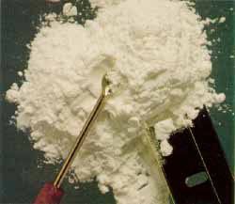
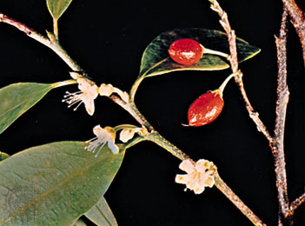
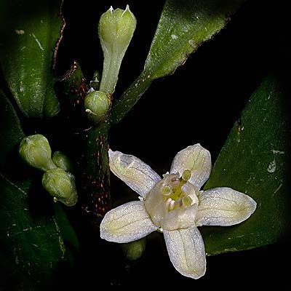
Erythroxylon coca

Slide 5
Opium
Opium is an ancient narcotic that is the dried juice that exudes from injured capsules of the opium poppy, Papaver somniferum.
Its origin is probably Asia Minor, but it has spread to the West.
It had also reached Iran, India and China by the 8th Century.
When properly utilized, opium and the alkaloids derived from it are valuable medicinally and have proved a blessing to humans in the relief of pain.
Excessive use of the drug and the resulting opium addiction has been and continue to be the cause of unbelievable suffering.
No other drug has caused so much corruption and tragedy.
In China the usual method of consumption was opium smoking by placing a small pellet in the bowl of a special pipe and inhaling the fumes.
In this way more morphine is said to be absorbed and the effects on the body may be greater.
In Europe and the United States, although opium, morphine, heroin, codeine and other derivatives are used as medicines, the smuggling and use of these narcotics are matters of utmost concern.

Slide 6
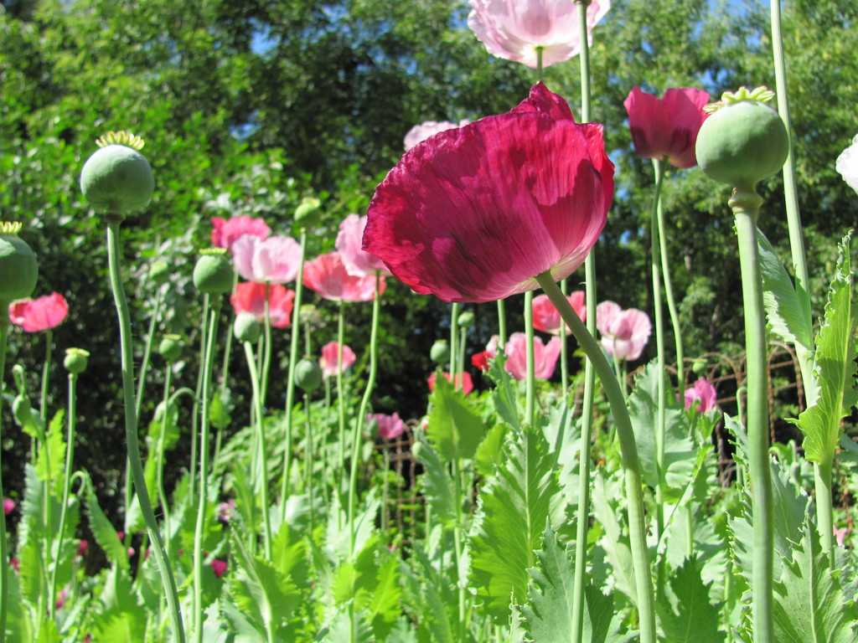
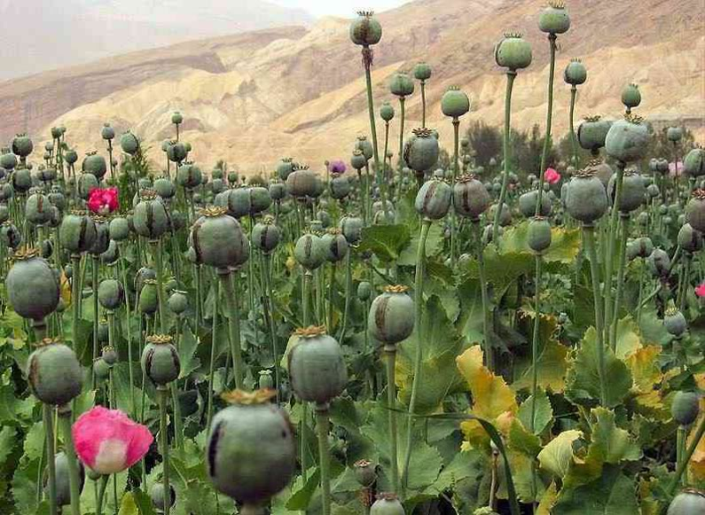
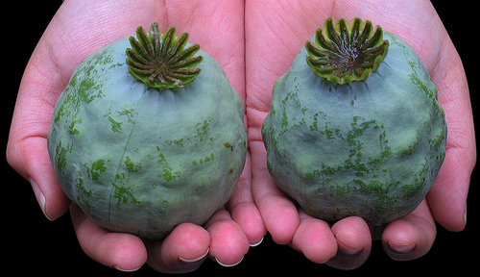
Papaver somniferum

Slide 7
Cannabis
The hemp plant, Cannabis sativa, is the source of a textile fiber and a drying oil also yields a narcotic drug.
The dried flowering tops of females plants, pressed together into solid masses, constitute the official “cannabis indica.”
The drug can be used in medicine to relieve pain and in the treatment of hysteria and various nervous disorders.
The active principle is resinous in nature and contains 3-4 very powerful alkaloids.
The use of hemp as a narcotic is old and extends back to 3,000 B.C., first in China and later in India.
The pure, undiluted sticky yellow resin, which is naturally exuded from the flowering tops of cultivated female plants, is known as charas or hashish. Charas is smoked.
Bhang consists of the tops of wild plants, which have lower resin content in a water or milk mixture. It is also smoked.
In America this type of hemp is known as marijuana.
Ganja is a specially cultivated and harvested grade of hemp used for smoking and in beverages and candies.
Cannabis in its different forms can produce serious side effects for the consumer. It causes a stupefying and hypnotic effect, accompanied by hallucinations, agreeable and often erotic dreams, and a general state of ecstasy

Slide 8
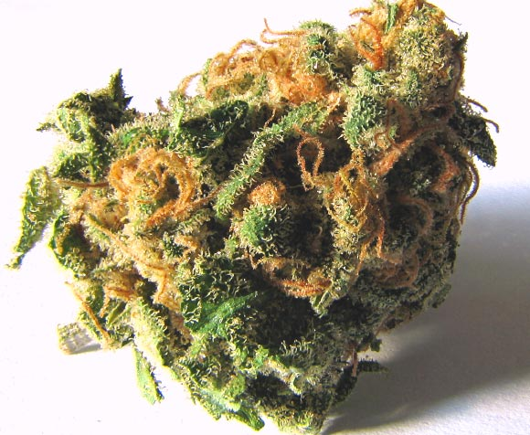
Cannabis sativa

Slide 9
Peyote
The cactus, Lophophora williamsii, is the source of peyote or mescal buttons.
It is indigenous to northern Mexico and the southwestern United States.
Peyote contains several powerful alkaloids with narcotic properties.
Amerindians of the region have used peyote for hundreds of years during their religious ceremonies.
Despite serious opposition the habit is actively practiced among some Amerindian groups that still maintain a sacred cult. Peyote produces a state of ease and well-being, accompanied by visions and hypnotic trances.
Users find themselves in a world full of new sensations and pleasures.
Peyote also has also been used extensively for its presumed medicinal value as it is supposed to cure bodily ills.

Slide 10
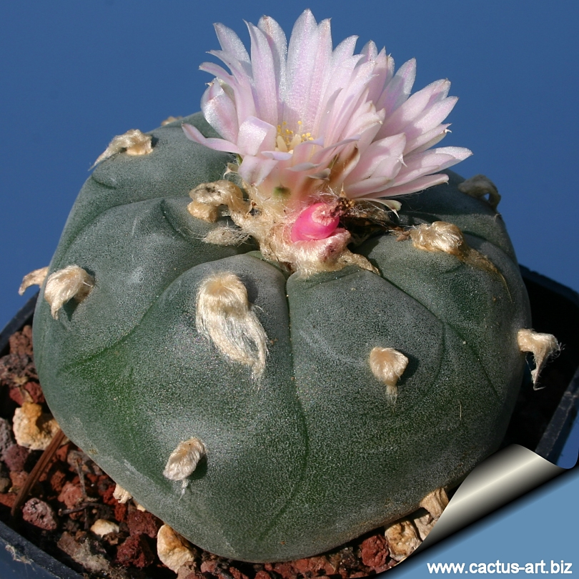
Lophophora williamsii

Slide 11
Fly Agaric
Fly agaric, Amanita muscaria, is known in Asia, America and Europe as one of the most poisonous fungi.
Despite this quantities of this mushroom are consumed in Siberia and other parts of Northeastern Asia for its intoxicating effect.
Dried agarics are chewed until soft, rolled into cylinder like pieces and swallowed.
Using this fungus produces hallucinations and illusions accompanied by giddiness, involuntary words and actions and finally unconsciousness.
Two small fungi are enough to produce an intoxication that will last a whole day.
Prolonged use of this narcotic will completely shatter the nervous system, yet cravings for the drug among its addicts is very great.

Slide 12
Amanita muscaria

Slide 13
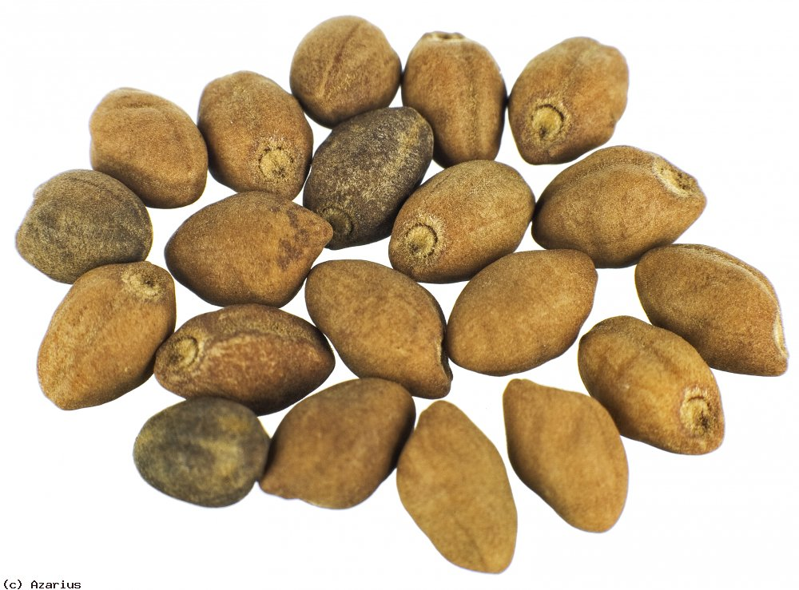
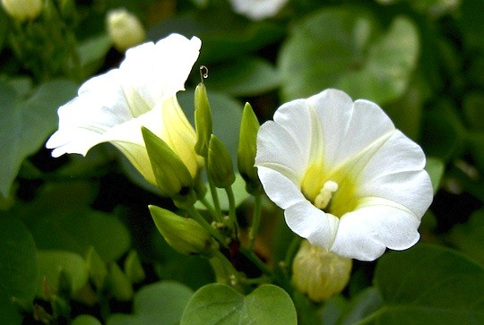
Ololiuqui
The native people of southwestern Mexico were using a narcotic plant in religious ceremonies and as an intoxicant in Pre-Columbian times.
Ololiuqui is a decoction made from the seeds of Rivea corymbosa.
It is still used primarily in Oaxaca in medicine as a means of divination and as a narcotic.
Ololiuqui induces a hypnotic sleep or coma with hallucinations and a feeling of ecstasy, but with no unpleasant aftereffects.

Slide 14
Caapi
Amerindians living in the Amazon Basin utilize Banisteriopsis caapi, B. inebrians, B. quilensis and species of the genus Tetrapterys as the source of a narcotic beverage.
These plants are called caapi in Brazil, ayahusca in Peru & Ecuador and yaje in Columbia.
They are lianas that grow naturally in the virgin forests and are sometimes cultivated in native villages.
To prepare the beverage the lower part of the stem is cut off, cleaned, macerated and boiled or utilized as a cold decoction.
Caapi is used in religious ceremonies.
It produces visions, dreams and other mental disorientations.
It is also an excitant and induces courage.

Slide 15
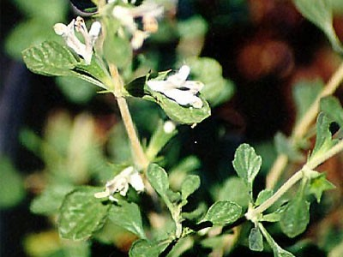
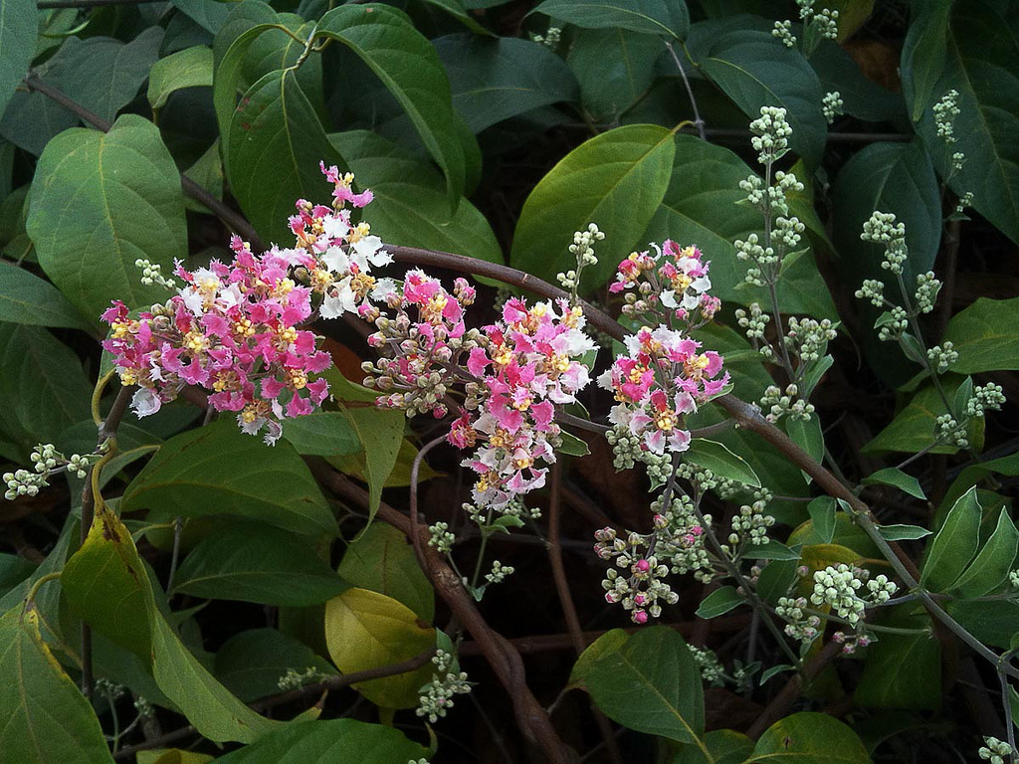
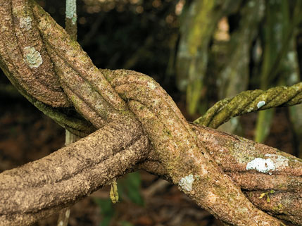
Banisteriopsis caapi
Banisteriopsis inebrians

Slide 16
Solanaceous Narcotics
Certain plants in the family Solanaceae contain alkaloids that produce disorders of the brain and excitation when smoked or consumed.
The genus Datura has been and still is extensively used in all the continents except Australia for its narcotic and hypnotic properties.
The Jimson weed, Datura stramonium, the source of the drug stramonium.
It is still a favorite source for “knockout drops” in the tropics.
The maikoa, D. arborea, and Datura sanguinea are subtropical shrubs of South America that have been used by various groups of the westernmost Amazon Region for their narcotic properties.
The Aztecs in Mexico as a medicine and in their religious ceremonies used Datura innoxia. It is still used by some of the local inhabitants.
Other species are also used elsewhere, all of them producing comparable effects, such as sense illusions and motor disturbances as well as senseless activities and loss of memory.

Slide 17
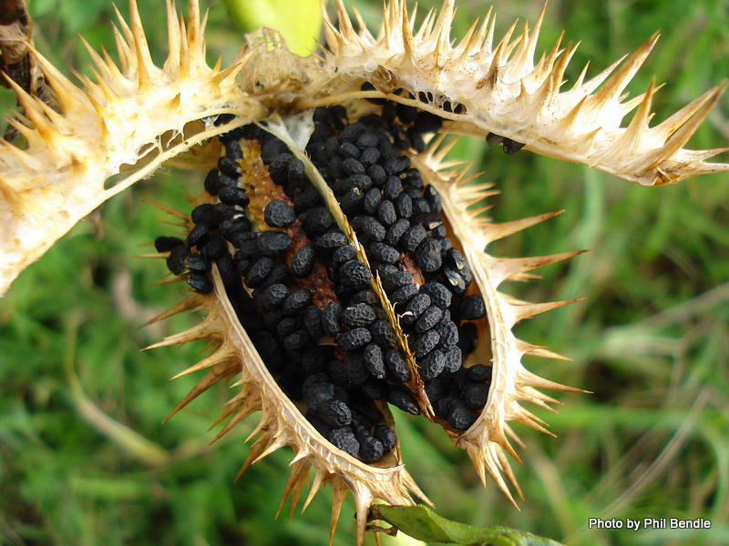
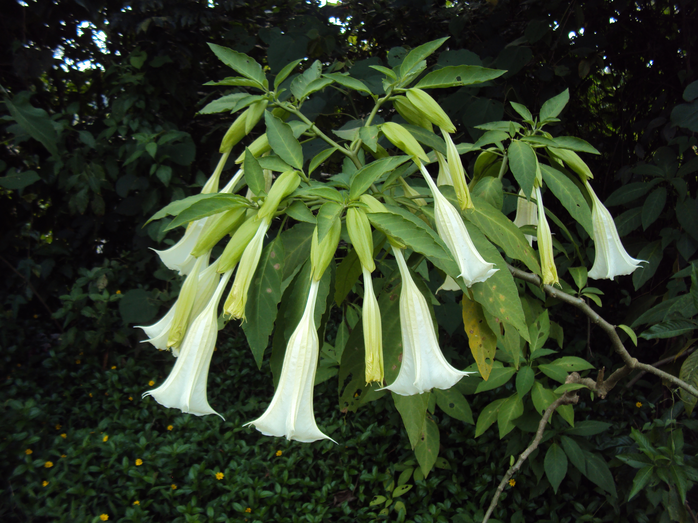
Datura stramonium
Datura arborea

Slide 18
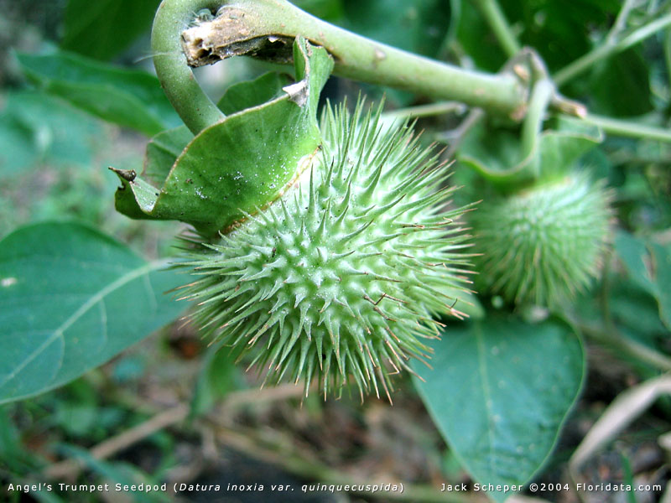
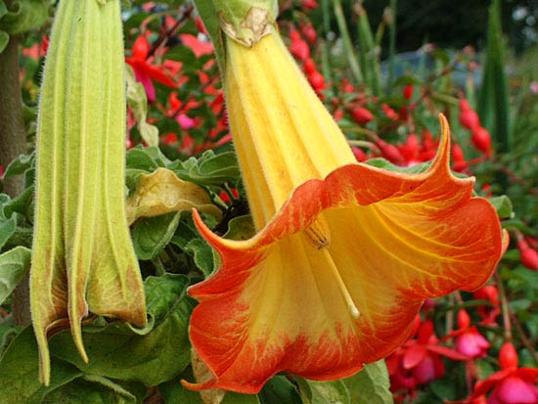
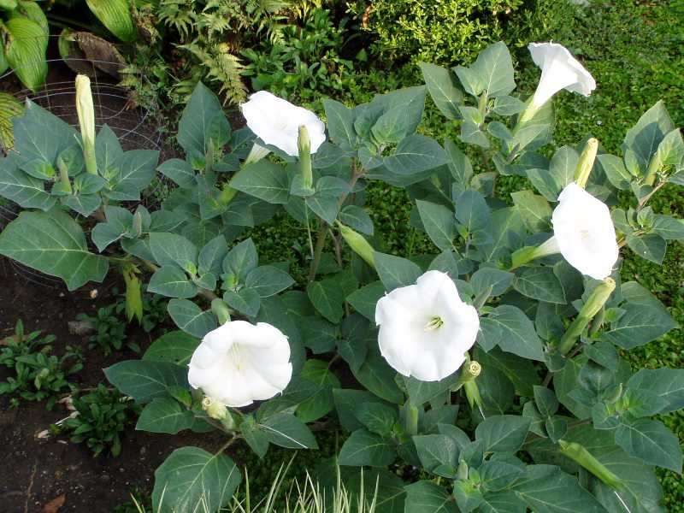
Datura sanguinea
Datura innoxia

Slide 19
Kavakava
Kavakava, Piper methysticumis indigenous to Fiji and other Pacific islands but is now grown throughout the islands of the Pacific.
The thick, knotty, grayish-green roots are the source.
These are dug up and the bark is removed.
After cleaning they are cut up into small pieces.
It is allied with the entire social, political and religious life of the people.
It is used as a beverage that acts as a sedative, a soporific and a hypnotic, bringing about pleasant dreams and sensations.
Excessive use may produce skin diseases and weaken the eyesight.
The active principle is a resinous substance that is stimulating in small amounts.

Slide 20
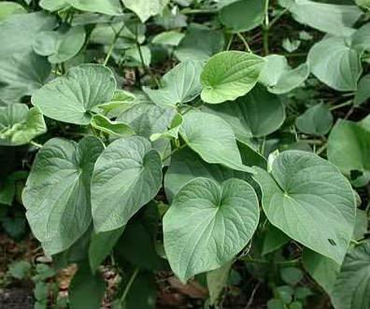
Piper methysticumis

