Slide 1
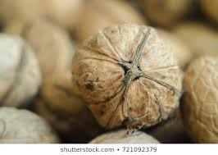
Pecan Nut

Slide 2
Scientific name :
Carya illinoinensis
Family :
juglandaceae
Origin :
Native American
Valleys of Mexico

Slide 3
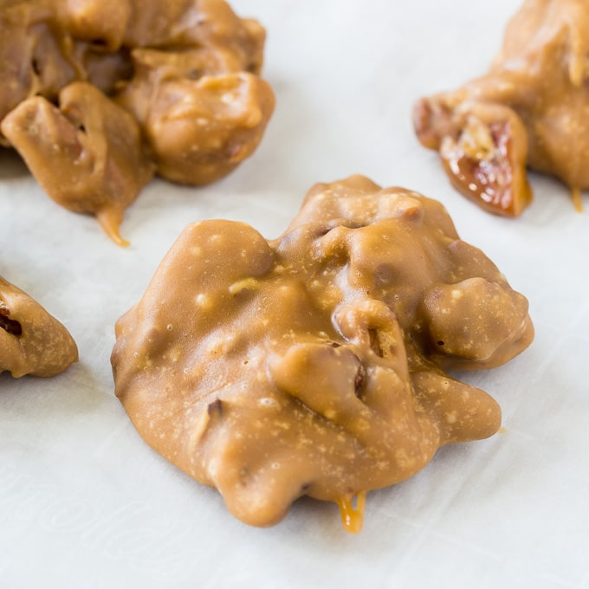
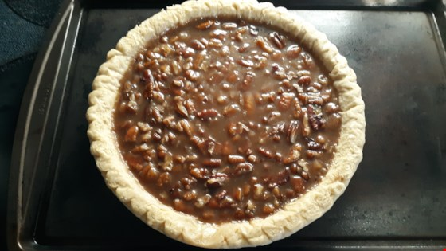
Seed is an edible nut used as a snack
In Praline candy and pecan pie.
Chromosome number 32

Slide 4
Botany
The pecan tree Is a large deciduous tree
Growing to 20–40 m in height, a trunk up to 2 m diameter. A 10-year-old sapling grown in optimal conditions will stand about 5 m tall. The leaves are alternate, 30–45 cm long, and pinnate with 9–17 leaflets, each leaflet 5–12 cm long and 2–6 cm broad.

Slide 5
Propagation
Pecan is conventionally propagated by budding or grafting onto rootstocks obtained by open pollination.

Slide 7
Irrigation
It require Drip irrigation.
Water affect the nuts.

Slide 9
Use
Most commercially grown peanuts are used for the extraction of their oil which is used in cooking.
Also used as animal feed.
Roasted and eaten as a snack food.

Slide 10
Climate
The pecan-nut tree is well adapted to subtropical areas. It also grows well in areas with short, cold winters and long, very hot summers. ... During the summer months (October to April) the tree requires high temperatures for fruit growth.
Pecan trees grow best in a soil pH of 5.5 to 6.5. If the pH is below that, adding lime will raise the number

Slide 11
Harvesting
Harvest pecans in early September through November when they have fallen from the trees. Start your harvest in 3-8 years depending on the variety and growing conditions. Watch for a substantial portion of the husks to have split and opened and the shell to turn brown before gathering.

Slide 12
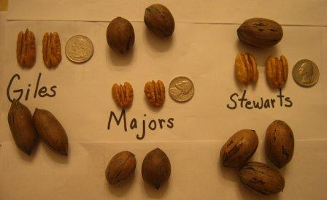
Varites
There are three varites depending upon types is distinctive in size, flavor, and nutritional composition.

