Slide 1
BIOMEMBRANES

Slide 2
DEFINITION
Biological membranes are thin, flexible surfaces separating cells and cell compartments from their environments
Introduction
• Membranes are the borders between different regions of a cell.
• Where membranes exist, differing cell environments can be maintained
• The plasma membrane borders the entire cell separating the internal environment from the external environment

Slide 4
Membrane Structure
Lipids and proteins are the chief ingredients of membrane
Phospholipid is amphipathic, both a hydrophobic and a hydrophilic region
Membrane proteins are also amphipathic
Phospholipid is arranged as a bilayer
Hydrophilic heads exposed, hydrophobic tails protected
Proteins are embedded in the phospholipid bilayer

Slide 5
Not all membranes are identical
Membranes with different functions differ in their chemical composition and structure
Fluid Mosaic Model best describes our current understanding of membrane structure
A mosaic of proteins bobbing in a fluid bilayer of phospholipids
fluid mosaic model
A model that describes the structure of cell membranes. In this model, a flexible layer made of lipid molecules is interspersed with large protein molecules that act as channels through which other molecules enter and leave the cell

Slide 6
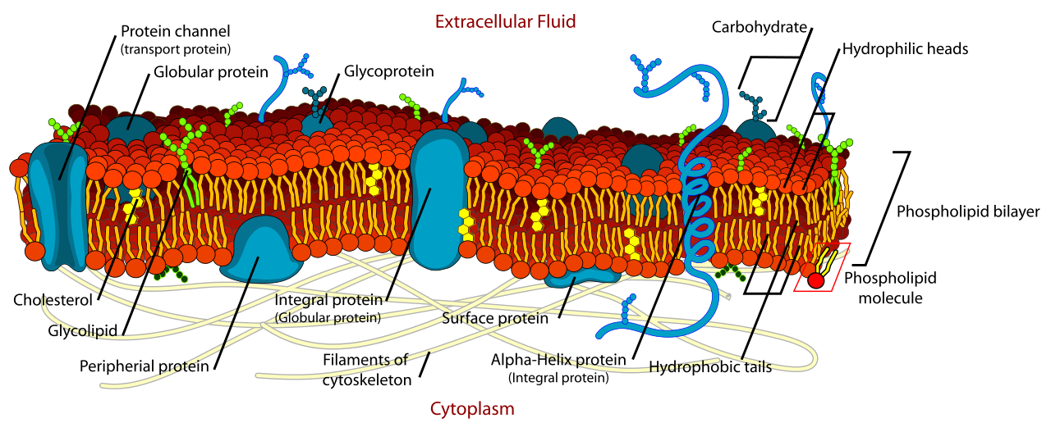

Slide 7
Fluidity
• Membranes are maintained by hydrophobic interactions of the phospholipids resulting in the alignment of the polar phosphate regions toward the aqueous environment and the nonpolar regions’ hydrocarbon chains toward each other.
• Membranes are in motion with fast drifting lipids and slower drifting proteins
• Membrane fluidity may be influenced by presence/absence of unsaturated FA chains and Cholesterol
• Fluidity of membranes is important for proper function

Slide 8
Mosaic
• Combination of proteins makes membrane unique
• Membrane proteins may be fluid or anchored
• Proteins may penetrate the bilayer fully (integral) or reside on the surfaces of membranes (peripheral)
• Integral proteins typically have hydrophobic regions that span the bilayer as a result of nonpolar amino acids arranged as helices
• Anchored proteins strengthen membranes

Slide 9
Membrane Structure
Membranes consist of a phospholipid bilayer combined with a variety of proteins in a fluid mosaic arrangement. The surfaces of cell membranes are hydrophilic (water-loving); the interiors are hydrophobic.
Hydrophilic molecules tend to interact with water and with each other. Hydrophobic molecules avoid interaction with water and tend to interact with other hydrophobic molecules

Slide 10
Membrane lipids
Membrane lipids are a group of compounds (structurally similar to fats and oils) which form the double-layered surface of all cells (lipid bilayer).
The three major classes of membrane lipids are
Phospholipids
Glycolipids, and
Cholesterol.
Lipids are amphiphilic: they have one end that is soluble in water ('polar') and an ending that is soluble in fat ('nonpolar'). By forming a double layer with the polar ends pointing outwards and the nonpolar ends pointing inwards membrane lipids can form a 'lipid bilayer' which keeps the watery interior of the cell separate from the watery exterior

Slide 11
The arrangements of lipids and various proteins, acting as receptors and channel pores in the membrane, control the entry and exit of other molecules and ions as part of the cell's metabolism.
In order to perform physiological functions, membrane proteins are facilitated to rotate and diffuse laterally in two dimensional expanse of lipid bilayer by the presence of a shell of lipids closely attached to protein surface, called annular lipid shell

Slide 12
Cell Membrane Proteins:
Transport Proteins:
Regulate movement of hydrophilic molecules through membrane
Channel Proteins (e.g. Na+ channels)
Carrier Proteins (e.g. glucose transporter)
2) Receptor Proteins:
Trigger cell activity when molecule from outside environment binds to protein
3) Recognition Proteins:
• Allow cells to recognize / attach to one another
• Glycoproteins: Proteins with attached carbohydrate groups

Slide 13
Plasma Membrane
A microscopic membrane of lipids and proteins which forms the external boundary of the cytoplasm of a cell or encloses a vacuole, and regulates the passage of molecules in and out of the cytoplasm.

Slide 14
Selective Permeability of Membranes
Cell membranes are selectively permeable. Some solutes cross the membrane freely, some cross with assistance, and others do not cross at all.
A few lipophilic substances move freely across the cell membrane by passive diffusion.
Most small molecules or ions require the assistance of specific protein carriers to transport them across the membrane.
Large molecules do not cross intact cell membranes, except in certain special cases. Selective Permeability of Membranes

Slide 15
Osmosis Movement of Water Across Membranes
Osmosis (movement of water across membranes) depends on the relative concentration of solute molecules on either side of the membrane.
The presence or absence of cell walls influences how cells respond to osmotic fluctuations in their environment.

Slide 16
Passive and Active Transport
Most biologically important solutes require protein carriers to cross cell membranes, by a process of either passive or active transport
Active transport uses energy to move a solute "uphill" against its gradient, whereas in facilitated diffusion, a solute moves down its concentration gradient and no energy input is required

Slide 17
Mechanisms of Active Transport
Active transport can occur as a direct result of ATP hydrolysis (ATP pump) or by coupling the movement of one substance with that of another (symport or antiport).
Active transport may move solutes into the cell or out of the cell, but energy is always used to move the solute against its concentration gradient.

