Slide 1
BRANCHES OF BIOLOGY
(-OLOGY, -ONOMY = STUDY OF)

Slide 2
ANATOMY
Structure of living things

Slide 3
BACTERIOLOGY
Bacteria

Slide 4
BIOCHEMISTRY
Chemical processes in living organisms

Slide 5
BOTANY
Plant life

Slide 6
CYTOLOGY
Cells function, structure, and chemistry

Slide 7
DERMATOLOGY
Skin

Slide 8
ECOLOGY
Interrelationships between organisms and their environment

Slide 9
EPIDEMIOLOGY
Epidemics, Widespread diseases

Slide 10
ENTOMOLOGY
Insects

Slide 11
ETHOLOGY
Animal behavior

Slide 12
GENETICS
The process by which genetic information is passed from parents to offspring
(Genes and heredity)

Slide 13
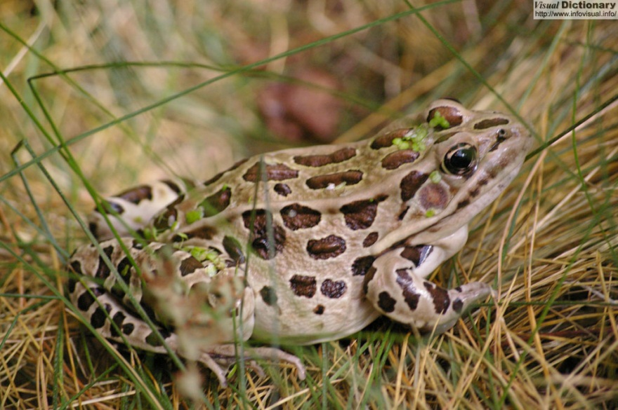
HERPETOLOGY
Reptiles and amphibians
Reptiles Amphibians
Crocodiles Frogs
Alligators Toads
Turtles Salamander
Lizards Anurans

Slide 14
ICHTHYOLOGY
Fish

Slide 15
MARINE BIOLOGY/ OCEANOGRAPHY
Sea creatures and the underwater environment

Slide 16
MAMMALOGY
Mammals
(Warm blooded,
Have hair,
Make milk)

Slide 17
MICROBIOLOGY
Microscopic organisms

Slide 18
MYCOLOGY
Fungi

Slide 19
NUTRITION
Diet and health

Slide 20
ORNITHOLOGY
Birds

Slide 21
PALEONTOLOGY
Prehistoric life

Slide 22
PATHOLOGY
Diseases caused by organisms
(bacteria, fungi, protist, viruses)
Pathos- sickness

Slide 23
SCATOLOGY
Animal droppings

Slide 24
PHYSIOLOGY
How organisms function and carry out physical/
chemical processes

Slide 25
TAXONOMY
The groupings of living things

Slide 26
VIROLOGY
Viruses and virus-like agents (prions)
No consensus on whether they are living

Slide 27
ZOOLOGY
The animal kingdom

