Slide 1
An Overview of Wireless Security

Slide 2
802.11 Security
WAP Security

Slide 3
IEEE 802.11
A set of standards for WLAN computer communication in 5 GHz and 2.4 GHz.
Most popular members: 802.11b, 802.11g.
Originally weak in security, even now.

Slide 4
802.11 Security
Two subsystems:
- A data encapsulation technique called WEP(Wired Equivalent Privacy)
- An authentication algorithm called Shared Key Authentication
Severe security weakness in WEP.
WPA, WPA2, 802.11i

Slide 5
WEP
Stream cipher RC4 for confidentiality
-Standard 64-bit WEP:
40-bit pre-shared key
24-bit initialization vector(IV)
CRC-32 checksum for integrity

Slide 6
WEP’s weakpoints
Pseudo-random number generator
Encryption Key K
Random byte b
Plaintext data byte p
Ciphertext data byte c
⊕
When p1 and p2 are encrypted under the same “random” byte b:
c₁ = p₁ ⊕ b
c₂ = p₂ ⊕ b
c₁ ⊕ c₂ = (p₁ ⊕ b) ⊕ (p₂ ⊕ b) = p₁ ⊕ p₂

Slide 7
WPA, WPA2
WPA
-Partly implements of IEEE 802.11i
-RC4 stream cipher with a 128-bit key and 48-bit IV.
-Temporal Key Integrity Protocol(TKIP)
-Michael Algorithm
WPA2
-Mandatory implements of 802.11i
-CCMP: AES-based algorithm

Slide 8
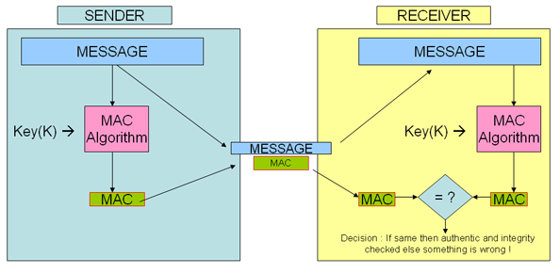
Temporal Key Integrity Protocol(TKIP) & Message Integrity Code(MIC)
TKIP
-per-packet key mixing
-message integrity check
-rekeying mechanism
MIC also named as MAC

Slide 9
CCMP: AES
Counter Mode with Cipher Block Chaining Message Authentication Code Protocol
key management and message integrity is handled by a single component built around AES
Advanced Encryption Standard
-block cipher
-SubBytes, ShiftRows, MixColumns, AddRoundKey
-only successful attacks: side channel attacks

Slide 10
WAP protocols
Wireless Application Protocol
Principal applications: for mobile phone and PDA,
-Devices with low processing power and small memory capacities.
-Wireless networks with low bandwidth.
From transport layer to application layer
Competitor: i-mode

Slide 11
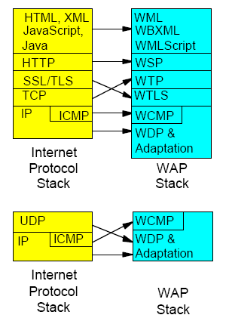
WAP Stacks
WML: Wireless Markup Language
WSP: Wireless Session Protocol
WTP: Wireless Transport Protocol
WTLS: Wireless Transport Layer Security
WCMP: Wireless Control Management Protocol
WDP: Wireless Datagram Protocol

Slide 12
Wireless Transport Layer Security
Derived from TLS
-Compressed data structures
-New certificate format
-Packet based design
Algorithm for public-key cryptography
-RSA
-ECC(Elliptic Curve Cryptography)
Security problems

Slide 13
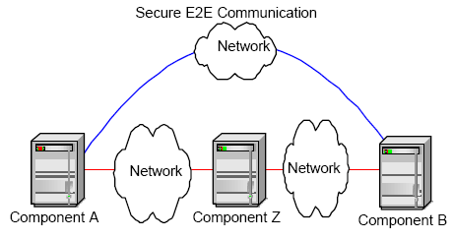
WTLS’s Security Problems
Security GAP
-reason: WTLS session exists only between the WAP device and the Gateway.
-Temporarily in clear text on the Gateway when translating WML to HTML until SSL established.

Slide 14
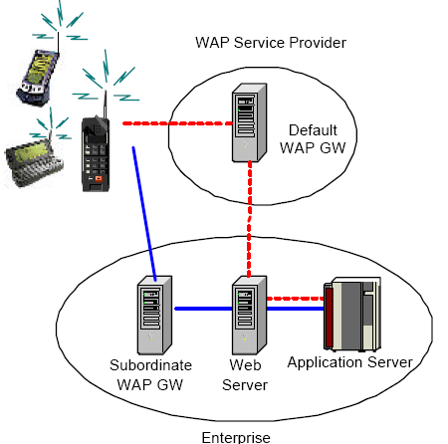
WTLS’s Security Problems
Solutions:
-Place Gateway and the back-end system within a secure environment.
-Provide integrity protection on information(digital signatures).
Other problems:
-Client Implementation

Slide 15
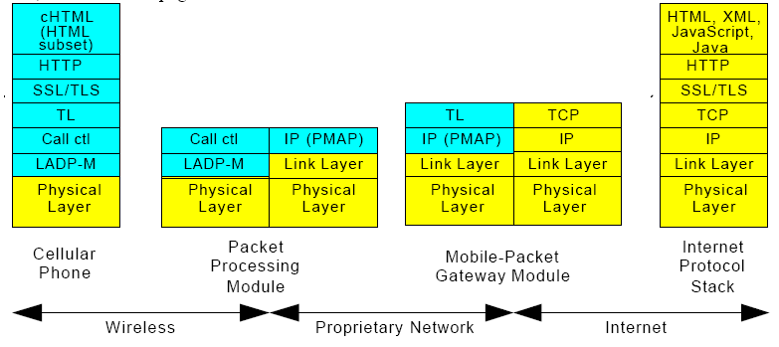
I-mode
Based on Internet protocols
HTTP and SSL/TLS are used end-to-end
Equivalent to security offered in wired networks

Slide 16
Future Topics in Wireless Networks
The next generation networks
Ad-hoc networks
Sensor networks

