Slide 1
Subject: Population Studies
Class: MSc 4th
Lecture: 5th week
Topic: Life Tables

Slide 2
Central Death Rate
mx (central death rate) is defined as the number of deaths during the year divided by the average number alive during the year, i.e.
$${ m}_{x}=\frac{d_{x}}{{\frac{1}{2}(l}_{x}+l_{x+1})} or\frac{q_{x}}{{1−0.5q}_{x}}$$
This differs slightly from qx , which is the number of deaths during the year divided by the number alive at the beginning of the year.
$$q_{x}=\frac{d_{x}}{l_{x}} or{ q}_{x}=\frac{{2∗m}_{x}}{{2+m}_{x}}$$

Slide 3
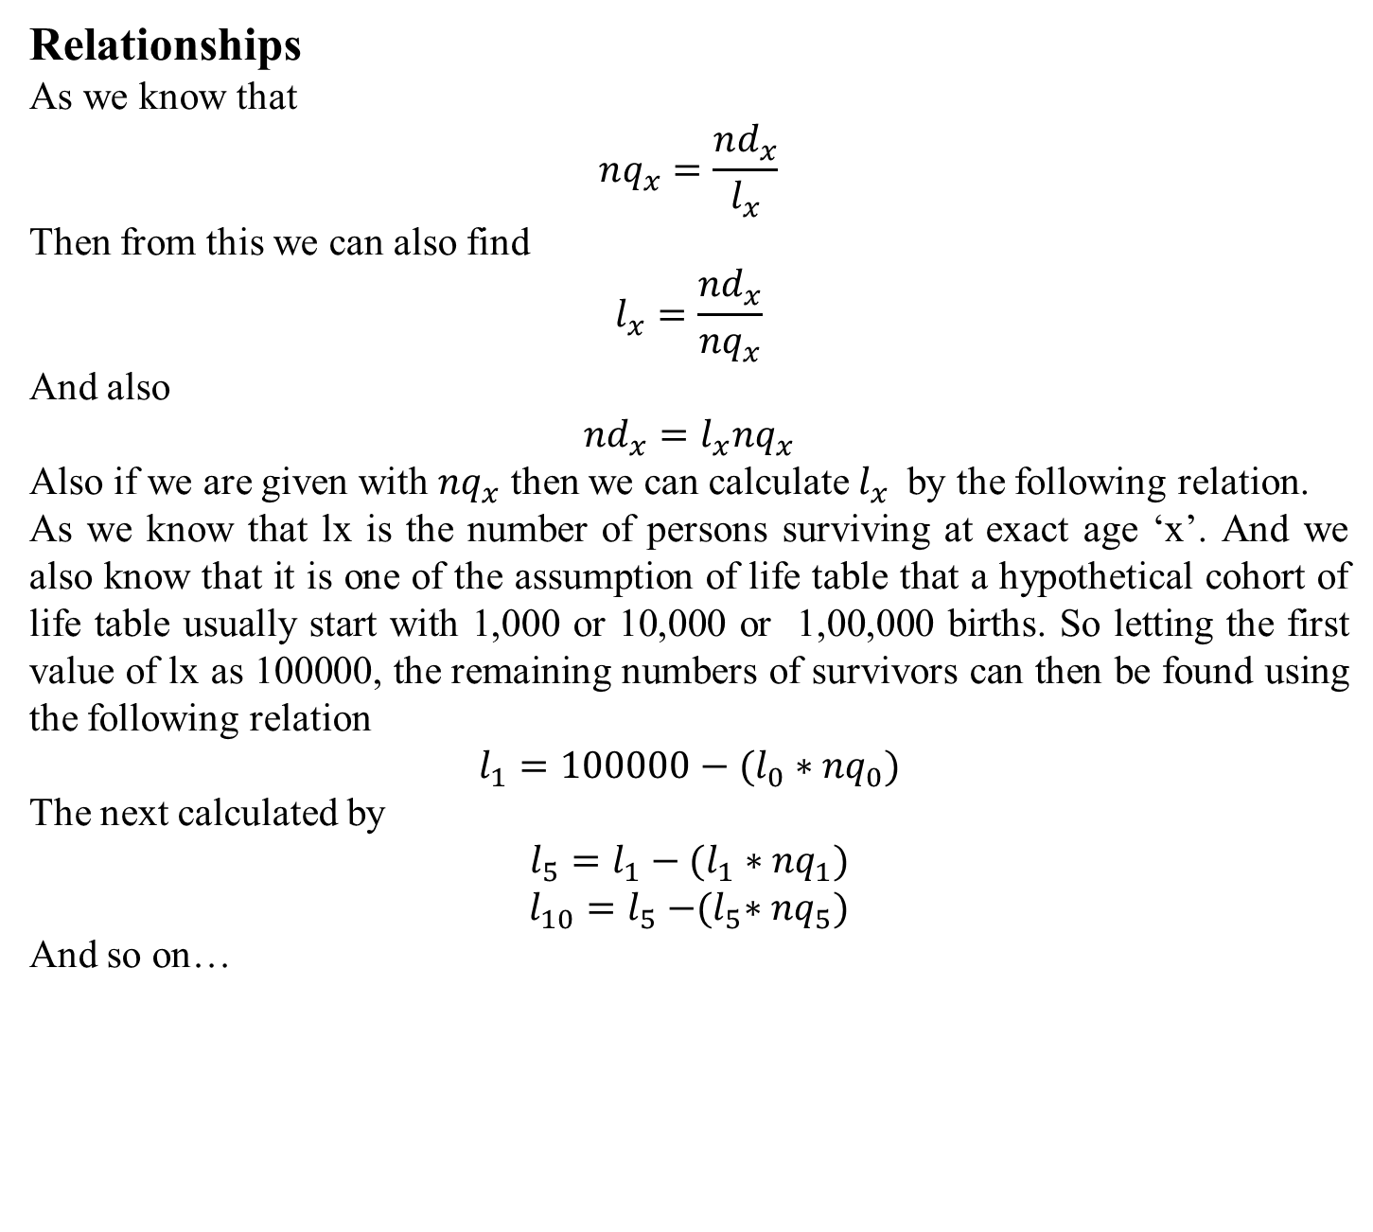
Relationships
As we know that
$$nq_{x}=\frac{nd_{x}}{l_{x}}$$
Then from this we can also find
$$l_{x}=\frac{{nd}_{x}}{{nq}_{x}}$$
And also
$${nd}_{x}=l_{x}{nq}_{x}$$
Also if we are given with ${nq}_{x}$ then we can calculate $l_{x}$by the following relation.
As we know that lx is the number of persons surviving at exact age ‘x’. And we also know that it is one of the assumption of life table that a hypothetical cohort of life table usually start with 1,000 or 10,000 or 1,00,000 births. So letting the first value of lx as 100000, the remaining numbers of survivors can then be found using the following relation
$$l_{1}={100000−(l}_{0}∗{nq}_{0})$$
The next calculated by
$$l_{5}={l_{1}−(l}_{1}∗{nq}_{1})$$
$$l_{10}=l_{5}{−(l}_{5}∗{nq}_{5})$$
And so on…

Slide 4
Q. Given the following information complete the life table and also find the central death rate for this data set.
Age | nqx
0 | 0.18848
1 | 0.102758
5 | 0.016879
10 | 0.016261
15 | 0.033087
20 | 0.043531
25 | 0.045788
30 | 0.047213
35 | 0.050633
40 | 0.055575
45 | 0.062217
50 | 0.078196
55 | 0.104964
60 | 0.141789
65 | 0.205583
70 | 0.285959
75 | 1

Slide 5
As we are given with only ${nq}_{x}$ so first we find the lx for further solution of life table
We know that the first value of lx is always 100000 i.e. our cohort. So to find the next value we simply start multiplying lx with the given probability of death.
For example here in this data the first ${nq}_{x}=0.18848$ so if we multiply this with the first value of lx i.e. 100000 we get
100000*0.18848 = 18848 (it is actually the ndx)
Now simply subtract this from 100000 we get
100000-18848 = 81152
Similarly for next value of lx, now we multiply the next probability of death with the corresponding value of lx i.e. 81152*0.10276 = 8339.19
Again subtract this from the previous value of lx we get
81152-8339.19 = 72813
And so on…

