Slide 1
Post Harvest Technology of Cucumber
Prof .Dr. Sarfraz Hussain
FST-508

Slide 2
INTRODUCTION
Cucumber (Cucumis sativus) is most popular vine salad crop.
fruit within 2 months after transplanting.
Ffruit is produced after a 4-week period.
Cucumbers is highly perishable and looses moisture rapid & decay.
Bruising and compression injury are very common,
Careful harvest and handling practices are needed.
Marketed domestically due to high perishability,

Slide 3
Harvest Maturity Indices…
1. External indices factor;
Fruit size (small, medium, Large, varietal characteristics),
Proper size depend on cultivar
That must be 15 cm (6inch)

Slide 4
Internal indices factor
Seed development (immature seeds),
Locular jelly formation
Flesh texture,
A cross sectional slice from the center of the fruit is used to judge the internal fruit maturity,

Slide 5
Skin color
The peel should be of green color at harvest, or pale yellow,
glossy skin,
Wax on surface (reduces as maturity,
Another widely used index for assessing maturity,

Slide 6
Harvest Maturity Indices…
Noticeable wax deposite at the time of proper maturity
If over mature the layer demaged which results in moisture loss, dull appearance,

Slide 7
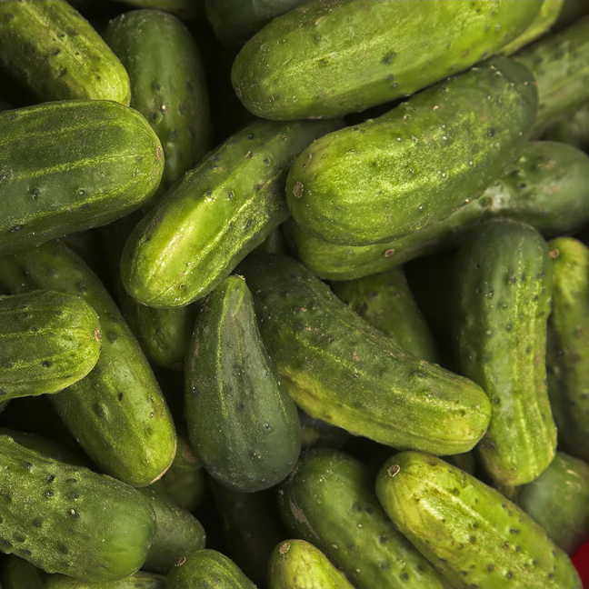

Slide 8
Harvest maturity indices...
Seed development
Should be uniform
White in color
Immature
locular jelly development;
At proper harvest maturity a jelly like material is formed in seed cavity

Slide 9
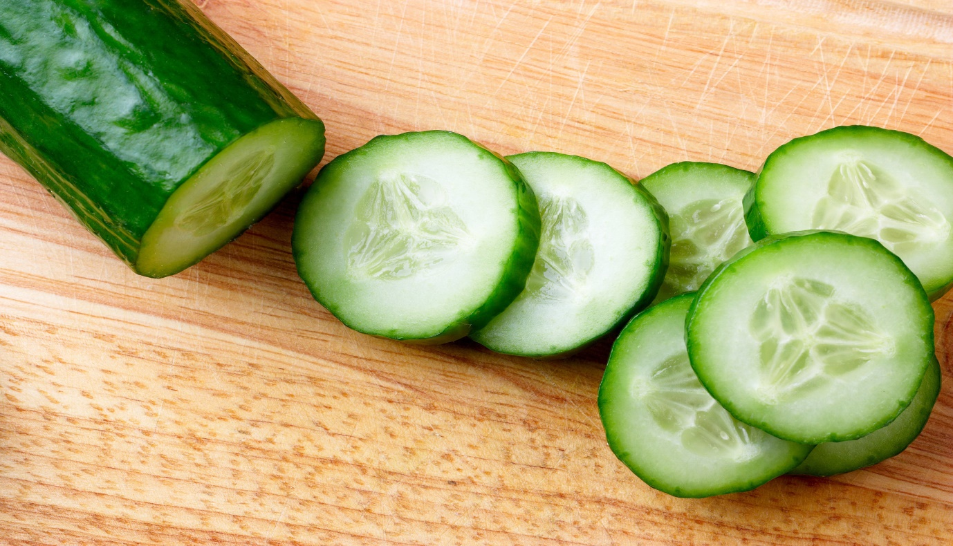
Harvest Maturity Indices…
Flesh texture;
the fruit texture should be firm and crispy,
That should be tender,

Slide 10
Over Mature Indices
Skin color changes from green to yellow
Waxing get removed
Wilting
Loss of tenderness
Seed size become large
Fruit become tough and leathery

Slide 11
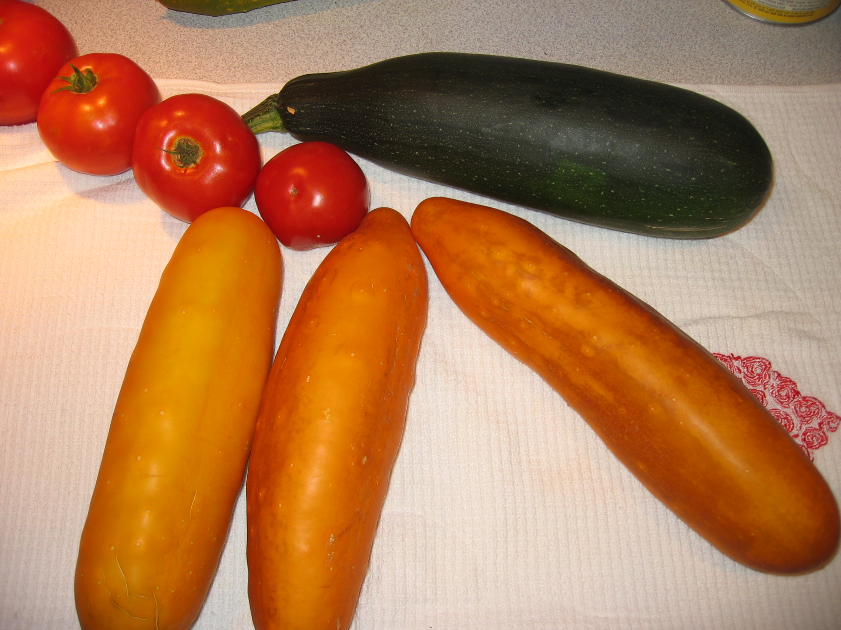

Slide 12
Harvesting Methods
Cucumber is carefully removed from the vine using one of two harvest techniques.
The first technique involves squeezing the stem attached to the vine between the thumbnail and forefinger, followed by pulling off the fruit from the vine.
This will leave a jagged stem section which will require trimming with a pruning shears or knife.

Slide 13
Harvesting Methods
The second technique, which is preferable, is to use a small knife to severe the fruit stem from the vine at a point just above the shoulder of the fruit. Done properly, the stem will not have to be re-cut during packing.

Slide 14
Harvest Methods…
The fruit should never be torn off the vine,
As this will result in damage to the vine & fruit.
Fruit which have been pulled off the vine are often “plugged”,

Slide 15
Vine of Cucumber bearing Fruit

Slide 16
Harvest Methods…
Plugging causes the very end of the fruit tissue to pull loose from the fruit.
This is a quality defect, leaving an exposed crater of internal pulp tissue at the end of the fruit.
The plugged area is an open wound which is highly susceptible to decay.
Never put cucumbers in plastic bags or containers where air will be excluded for any period of time.

Slide 17
Harvesti ng Methods…
Fruit kept in non ventilated containers will lose skin color and firmness due to a buildup of heat inside the container
Avoid leaving the fruit exposed to direct sun for more than 15 minutes.
The cucumbers should be moved to the cleaning and packing area as soon as possible.

Slide 18
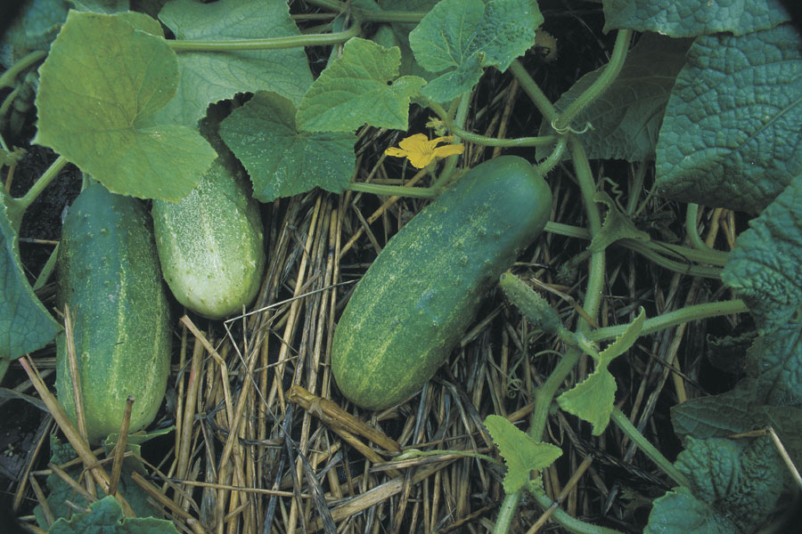

Slide 19
Cleaning as Preparation for Marketing
Remaining soil in the ground spot area or other surface stains should be removed at the time of harvest.
This can be done manually by rubbing the fruit surface with a soft damp cloth or cotton gloves.
Washing the fruit is more efficient if the cucumbers are particularly dirty, or if the quantity of fruit is large.
In this case, the fruit are submerged in a large wash tank and the surface is rubbed clean by hand or with a soft brush

Slide 20
Market Prepation & Cleaning
The wash water should be clean and properly sanitized to reduce the potential for the spread of disease.
Sodium hypochlorite (household bleach) wash water sanitizing agent is commonly used since it is an
(a) inexpensive and readily available

Slide 21
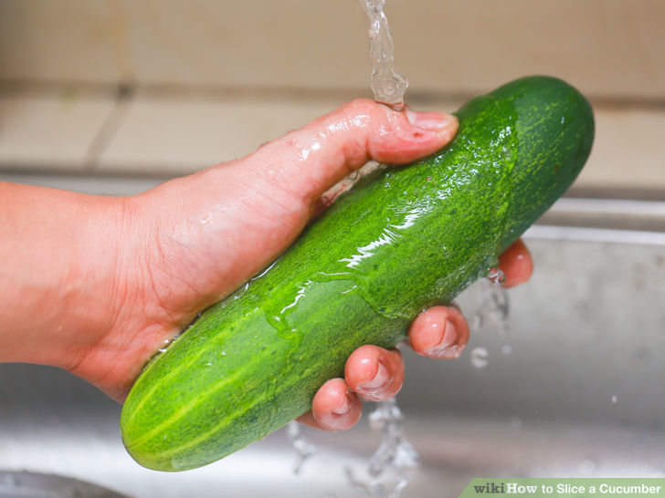

Slide 22
Grading
Table cucumber quality is primarily based on size, uniformity of shape, firmness, and skin color.
Additional quality indices are the amount of surface blemishes and peel injury, and incidence of decay.
High quality cucumber fruit should be straight, uniformly green, and have an appropriate length: diameter ratio. They should also have small seeds and a desirable flavor.

Slide 23
Grading
Marketing size is based on diameter and length:
Diameter; Large size- have a diameter greater than 6 cm (2 in.),
Length; greater than 15 cm (6 in.),
Small size cucumbers have diameters between 1.3- 5 cm (0.5 in. and 2 in.)
Over mature; fruit with poor coloration should not be exported,
These fruit often have a bitter flavor and tough internal texture,

Slide 24
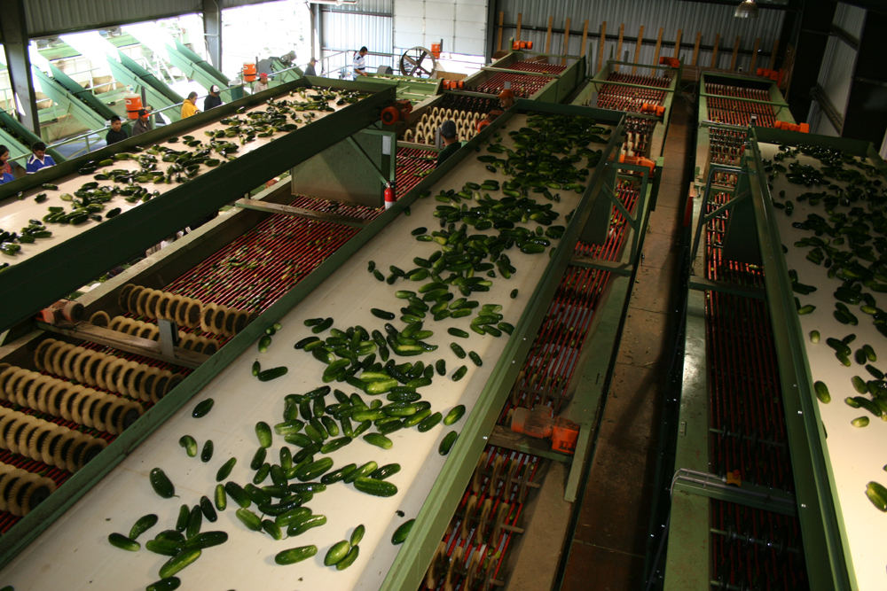

Slide 25
Waxing
Cucumbers treated with a food-grade liquid wax after grading.
The purpose is to replace some of the natural wax removed during washing and cleaning,
To retard water loss, and to improve appearance.
The wax is similar to mineral oil and may be applied by roller brushes.

Slide 26
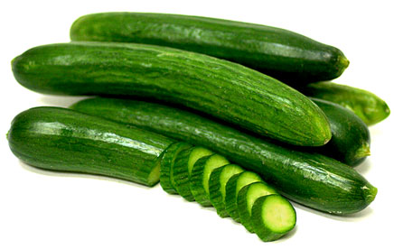

Slide 27
Packaging
Cucumbers should be packed in strong, well-ventilated containers. Wooden containers which allow for stacking without collapsing are appropriate for the domestic market.
Durable plastic crates are also acceptable. Mesh sacks should not be used as they provide little protection to the fruit.

Slide 28
Packaging
Cucumbe packed in strong well ventilated fiberboard cartons with a minimum test strength of 275 psi,
Carton size typically contains 25 kg (55 lb) of fruit.
If cucumbers are packed in smaller cartons they are sold by count, with 24-count being a popular size.

Slide 29
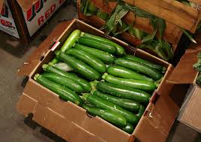

Slide 30
Temperature Management
The optimum temperature for storage and transport of cucumbers is 10°C (50°F).
At this temperature, cucumbers can be expected to have a 2 week market life.
Shriveling, yellowing, and/or decay are likely to be apparent beyond two weeks.

Slide 31
Temperature Management
Peel color will start to change to yellow after about 10 days at 10°C (50°F).
Storage of cucumbers below 10°C (50°F) should be avoided, as this will result in chilling injury.
Holding cucumbers without refrigeration at ambient temperature will result in noticeable shriveling and decay after one week.

Slide 32
Relative Humidity
Cucumbers have waxy skin, they are susceptible to water loss during storage and marketing,
Sunken lesions may appear on the fruit surface within several days at a low relative humidity (RH).
Fruit loses its firm crisp texture.
A small depression at the point of stem attachment may develop.
The ideal RH for holding cucumbers is 95%.

Slide 33
Postharvest Disorders
Chilling Injury
Cucumbers are susceptible to chilling injury (CI) if held below 10°C (50°F) for more than several days.
The amount of CI depends on temperature and the cultivar.
Tissue damage becomes more severe with decreasing temperature. Symptoms of CI include tissue collapse, water-soaked spots, pitting, and accelerated decay

Slide 34
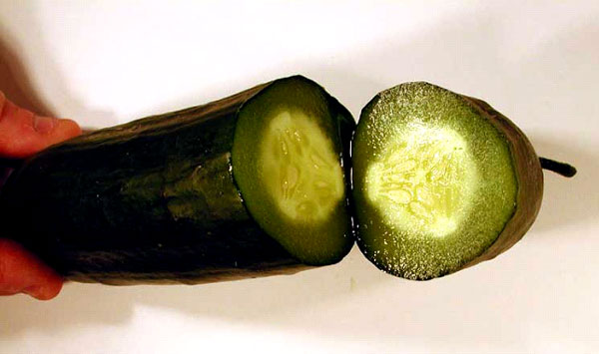

Slide 35
yellowing
Yellowing of the peel is a common postharvest disorder of cucumbers.
This may be due to several factors, including harvesting the fruit at an advanced stage of maturity, storage at ambient temperatures for several days, or exposure of the fruit to ethylene.
Yellowing and decay will result from low levels of ethylene (1 to 5 ppm) exposure during distribution and holding.
Cucumbers should not be stored in the same location as bananas, plantains, or other high ethylene emitting products.

Slide 36
