Slide 1
Engr. Syed Nasir Abbas
MSc Structural Engineering
UNIVERSITY OF SARGODHA

Slide 2
20
sessional
30
Mid term
50
Final term

Slide 3
Materials Testing Repair And Maintenance
Objective:
1. To know about the failure of building structures and their measures
2. To understand the rules and regulations of maintenance.
Basically the subject is divided into two major parts First part is different type of testing (destructive and non-destructive) and 2nd part consist of remedial measure of different defects present in the structure and there possible solution (repair).

Slide 4
Materials Testing Repair And Maintenance
Material Testing: Destructive and Non-destructive test, Mechanical properties, Method of testing of Fatigue test, impact and hardness test, tensile test and mild steel specimen.
Repair and Maintenance of Civil Works: Introduction to different types of failures in building structures and their causes, Assessment of damage by different methods including non- destructive methods, Introduction to Rules and Regulations of Maintenance, Repair and Maintenance Measures.

Slide 5
Non-destructive test
Non- destructive test.
The use of noninvasive techniques to determine the integrity of a material, component or structure
or
quantitatively measure some characteristic of an object.
i.e. Inspect or measure without doing harm.

Slide 6
Introduction:
For inspecting the defects on surface.
Wide group of analysis techniques used in science & industry.
Saves both the time &money.
Use of this N.D.T in specialist high risk areas such as nuclear & sea shore structures , gas & oil pipelines.

Slide 7
Why we are using N.D.T?
It’s an assessment without doing harm, destroying the test.
Plays crucial role in ensuring cost effective operation, safety and reliability of plant.
Cost saving technique in quality assurance process.

Slide 8
N.D.T METHODS
Ultrasonic Testing (UT)
Ultrasonic pulse velocity method
Rebound hammer test
Radiographic Testing (RT)
Liquid penetrate Testing
Magnetic particle Testing
Electromagnetic Testing (ET)

Slide 9
N.D.T TESTS
Ultrasonic Pulse Velocity test.
Rebound Hammer test.

Slide 10
ULTRA SONIC PULSE VELOCITY TEST

Slide 11
Ultrasonic Pulse Velocity Test
It measures the time of travel of an ultrasonic pulse passing through the concrete.
The apparatus for ultrasonic pulse velocity measurement consists of the following:
(a) Electrical pulse generator
(b) Transducer – one pair
(c) Amplifier
(d) Electronic timing device

Slide 12
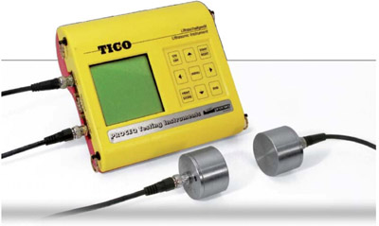
Ultrasonic Pulse Velocity Meter

Slide 13
How it works?
In ultrasonic testing, an ultrasound transducer connected to a diagnostic machine is passed over the object being inspected.
There are two methods of receiving the ultrasound waveform, reflection and attenuation.

Slide 14
Reflection mode:
The transducer performs both the sending and the receiving of the pulsed waves as the "sound" is reflected back to the device.
Attenuation mode:
In attenuation mode, a transmitter sends ultrasound through one surface, and a separate receiver detects the amount that has reached it on another surface after traveling through the medium.

Slide 15
Applications & Limitations
The pulse velocity method is an ideal tool for establishing whether concrete is uniform.
Applied to both existing structures and those under construction.
High pulse velocity readings are generally indicative of good quality concrete.

Slide 16
INTERPRETATION
To determine the quality & homogeneity of the concrete structures.
To determine the existence of the flaws ,cracks & voids in concrete structures.
Table: Velocity Criterion for concrete Quality Grading

Slide 18
Advantages:
Disadvantages:
High penetrating power.
High sensitivity.
Greater accuracy
Some capability in estimating the size , shape , nature of the flaws.
portability
Manual operation requires careful attention by experienced technicians
Difficulty in inspecting the parts which are irregular.
Test objects should be water resistant.

Slide 19
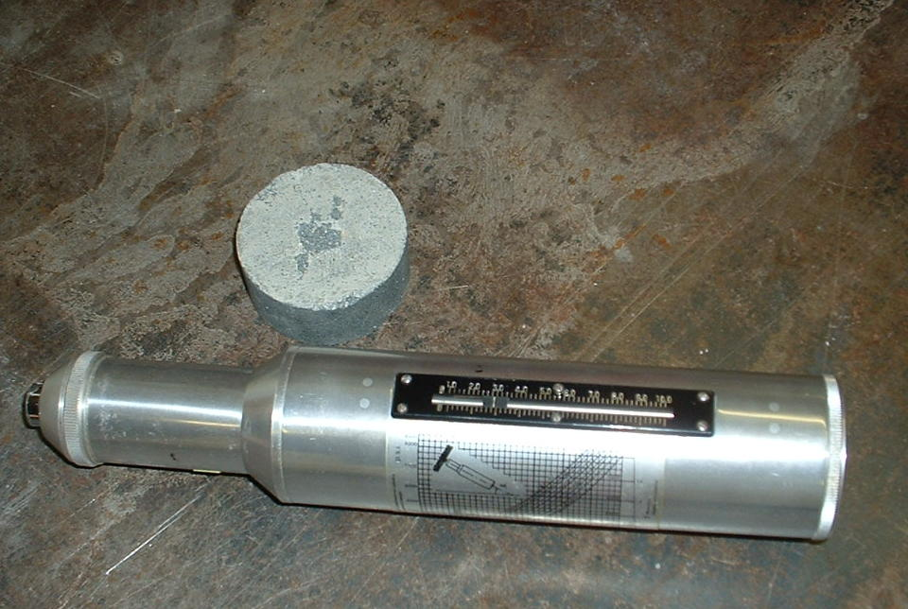
REBOUND HAMMER TEST
This is a simple, handy tool, which can be used to provide a convenient and rapid indication of the compressive strength of concrete.

Slide 20
REBOUND HAMMER TEST
The schematic diagram showing various parts of a rebound hammer were
1.Concrete surface
2.Impact spring
3.Rider on guide rod
4.Window and scale
5.Hammer guide
6. Release catch
7.Compressive spring
8.Locking button
9.Housing
10.Hammer mass

Slide 21
Principle
The elastic mass depends on the hardness of the surface.
It is related to the compressive strength of the concrete.
The rebound value is designated as the rebound number or rebound index.
The results are significantly affected by :
Mix characteristics.
Angle of inclination of direction of hammer.
Member characteristics.

Slide 22
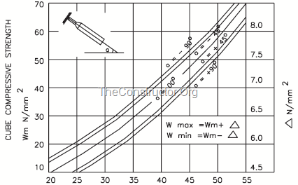
cube compressive strength is N/sq.mm plotted against
rebound number

Slide 23
Procedure
Should be tested against the test anvil.
Apply light pressure on the plunger and allow it to extend to the ready position for the test.
Apply a gradual increase in pressure until the hammer impacts.
Take the average of about 15 readings.

Slide 24
REBOUND HAMMER TEST
Advantages:
Assessing the likely compressive strength of concrete .
Assessing the quality of concrete in relation to standard requirements.

Slide 25
Interpretation of Results:
The rebound reading on the indicator scale has been calibrated by the manufacturer of the rebound hammer for horizontal impact.
Average Rebound Number | Quality of Concrete
>40 | Very good hard layer
30 to 40 | Good layer
20 to 30 | Fair
< 20 | Poor concrete
0 | Delaminated

Slide 26
conclusion
for better maintenance of existing concrete structures, there are still more tests have to be done.

