Slide 1
IUCN Categorized Protected Areas of Pakistan: Red Listing

Slide 2
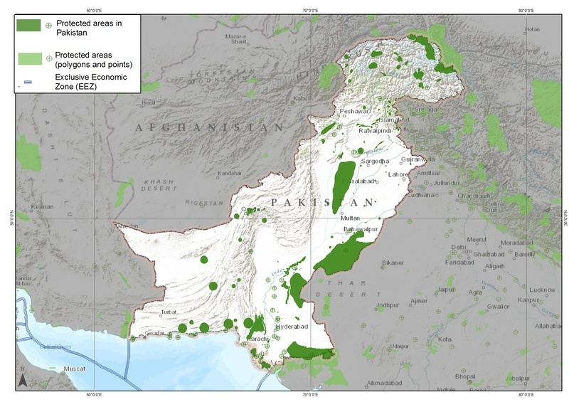

Slide 3
“ Protected areas
A clearly defined geographical space, recognized, dedicated and managed, through legal or other effective means, to achieve the long-term conservation of nature with associated ecosystem services and cultural values.“
As of present, there are around 157 protected areas in Pakistan that are recognized by IUCN.

Slide 4
IUCN protected areas management categories
IUCN Category Total sites
IUCN Category Ia :Strict Nature Reserve o
IUCN Category Ib: Wilderness Area 0
IUCN Category II : National Parks 5
IUCN Category III: Natural Monuments 0
IUCN Category IV:Wildlife Sanctuaries 62
IUCN Category V:Protected Landscape/Seascapes 5
IUCN Category VI: Managed Resouce Protected Area 2
Unclassified areas 83
All IUCN Categories 157

Slide 5
Types of Protected Areas in Pakistan
These are types of protected areas in Pakistan.
National Parks : 29
Wildlife Sanctuaries : 99
Game Reserves :102
Community Controlled Hunting Areas : 76

Slide 6
National Parks
According to modern protected area legislation, a national park is a protected area set aside by the government for the protection and conservation of its outstanding scenary and wildlife.
Pakistan has 29 proteted areas known as National parks , only some of these are under the conservation scope of IUCN.
A national park shall be accesible to public for recreation,education and research subject to such restrictions and fee as government may impose.

Slide 7
Prohibited acts in National Parks
Hunting,trapping,shooting,killing and capturing of wild animals.
Firing of guns.
Burning ,destroying and removal of plants.
Clearing of land for cultivation.
Construction of roads , railway lines etc.
Surface mining.
Polluting water flowing through national parks.

Slide 8
Aims and purposes of establishing national parks
The primary purpose of national park is to protect the natural wonders and the wildlife located within these enviornments.
For variety of living things.
They provide safe home for native plants and animals. We coexist with all these creatures on this planet so we must do our best to protect them.
For our enjoyment and health.
National parks are places of natural beauty. Many people have fun camping or having a picnic,enjoying the view and taking fresh air.

Slide 9
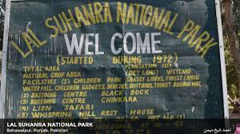
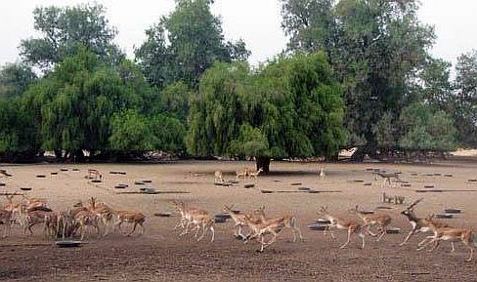
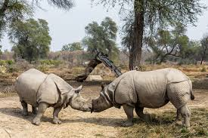
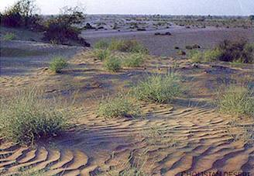

Slide 10
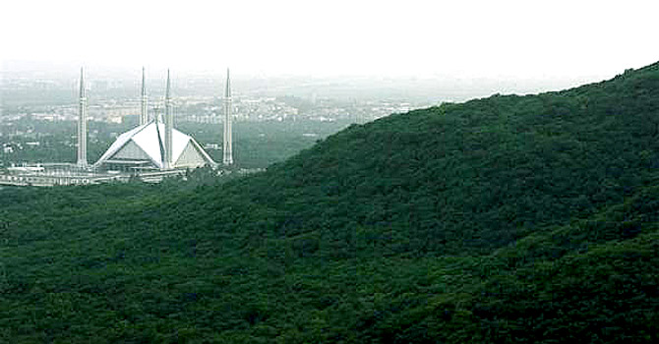
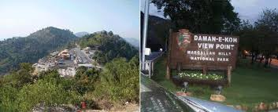
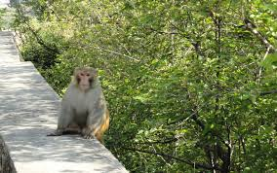

Slide 11
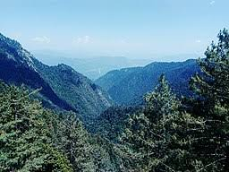
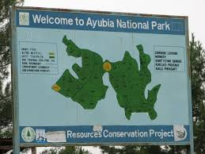
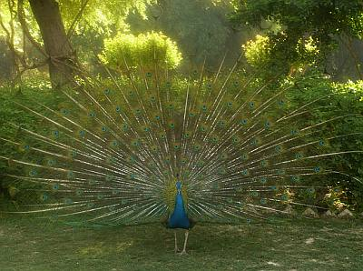
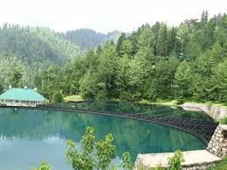
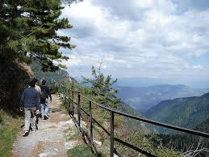
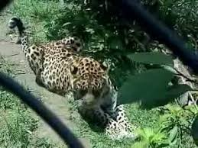

Slide 13
G A M E R E S E R V E
Game reserves are large areas of land where wild animals live safely or are hunted in a controlled way for sport.
Government may declare any area to be a game reserve where hunting of wild animals shall not be allowed , except under special permits.
In pakistan there are 102 game reserves.

Slide 14
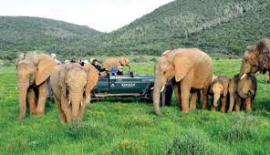
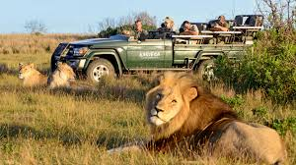
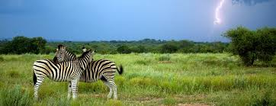
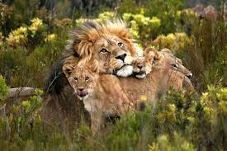
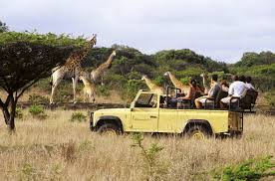
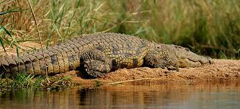

Slide 15
Wi ld life sanctuary
A Wildlife sanctuary is an area set aside as an undisturbed breeding ground where public access restricted or regulated beyond national parks and game reserves.
Public access, settlement , grazing by domestic livestock,such activities are prohibited in wildlife sancturies.
Hunting is strictly prohibited in these areas.
The main objective of wildlife sanctuary is to protect flora and fauna from extinction.
At present there are 99 wildlife sanctuaries in Pakistan, 66 officially recognised by and upto the standards of the Internatonal Union for Conservation of Nature (IUCN).

Slide 16
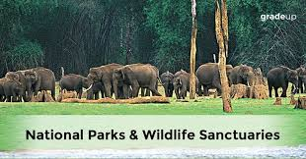
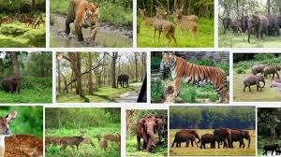
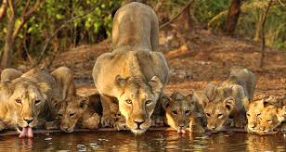
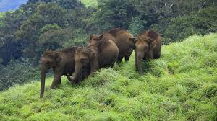
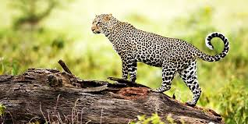

Slide 17
P R O T E C T E D F O R E S T S
The protected areas serve the purpose of conserving the forests and wildlife of Pakistan.
Natural protected forests
Coniferous Forest ( 'Deodar Chilghoza Oak Forest') in Chitral District.
Sulaiman Coniferous Forest (Sulaiman Chilgoza Pine Forest') in Khyber Pukhtunkhwa.
Ziarat Juniper Forest in Ziarat District.
Artificial resource managed forests
Changa Manga Forest in Lahore District
Chichawatni Plantation in Sahiwal District

Slide 18
C I T E S P otected Animals in Pakistan.
Appendix I : Species threatened with extinction
Indian wolf
Black bear
Induns dolphin
Markhor
Snow leopard
Common leopard
Falcon
Green sea turtle
Indian or bengal monitor.

Slide 19
CITES Protected Animals in Pakistan
Appendix II : Not necessarily threatened with extinction.
Fox
Brown bear
White headed duck

Slide 20
