Slide 1
Composition
Andleeb Rana

Slide 3
Elements of Composition
The elements of composition in art are used to arrange or organize the visual components in a way that is pleasing to the artist and, one hopes, the viewer. They help give structure to the layout of the painting and the way the subject is presented. They can also encourage or lead the viewer's eye to wander around the whole painting, taking in everything and ultimately coming back to rest on the focal point. In art the elements of composition are generally considered to be:

Slide 4
Unity:
Do all the parts of the composition feel as if they belong together, or does something feel stuck on, awkwardly out of place?

Slide 5
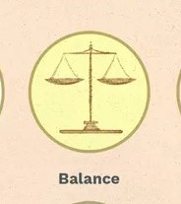
Balance:
Balance is the sense that the painting "feels right" and not heavier on one side. Having a symmetrical arrangement adds a sense of calm, whereas an asymmetrical arrangement creates a more dynamic feeling. A painting that is not balanced creates a sense of unease.

Slide 6
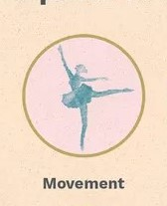
Movement:
There are many ways to give a sense of movement in a painting, such as the arrangement of objects, the position of figures, the flow of a river. You can use leading lines (a photography term applicable to painting) to direct the viewer's eye into and around the painting. Leading lines can be actual lines, such as the lines of a fence or railroad, or they can be implied lines, such as a row of trees or curve of stones or circles.

Slide 7
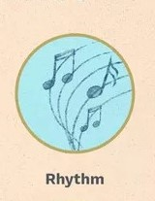
Rhythm:
In much the same way music does, a piece of art can have a rhythm or underlying beat that leads your eye to view the artwork at a certain pace. Look for the large underlying shapes (squares, triangles, etc.) and repeated color.

Slide 8
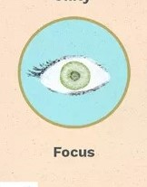
Focus (or Emphasis):
The viewer's eye ultimately wants to rest on the "most important" thing or focal point in the painting, otherwise the eye feels lost, wandering around in space.

Slide 9
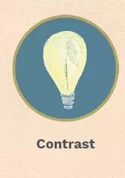
Contrast:
Paintings with high contrast—strong differences between light and dark, for example—have a different feel than paintings with minimal contrast in light and dark, such as in Whistler Nocturne series. In addition to light and dark, contrast can be differences in shape, color, size, texture, type of line, etc.

Slide 10
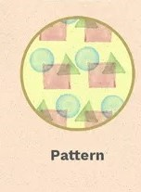
Pattern:
A regular repetition of lines, shapes, colors, or values in a composition.

Slide 11
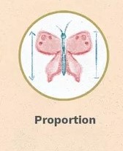
Proportion:
How things fit together and relate to each other in terms of size and scale; whether big or small, nearby or distant.

Slide 12
The elements of composition are not the same as the elements of art, though composition is sometimes included as one of the latter.

Slide 13
Some Examples

Slide 14
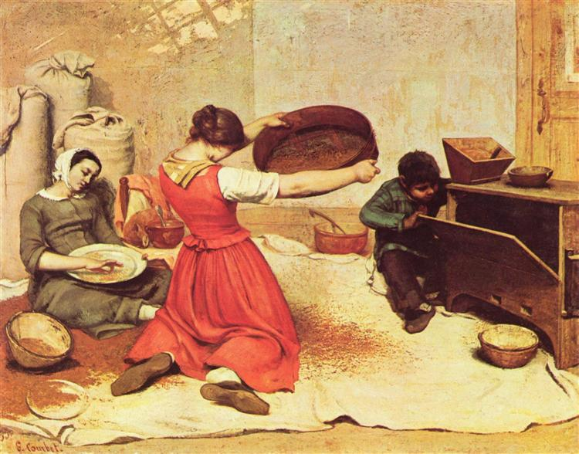
the-winnowers-1855 Gustave Courbet

Slide 15
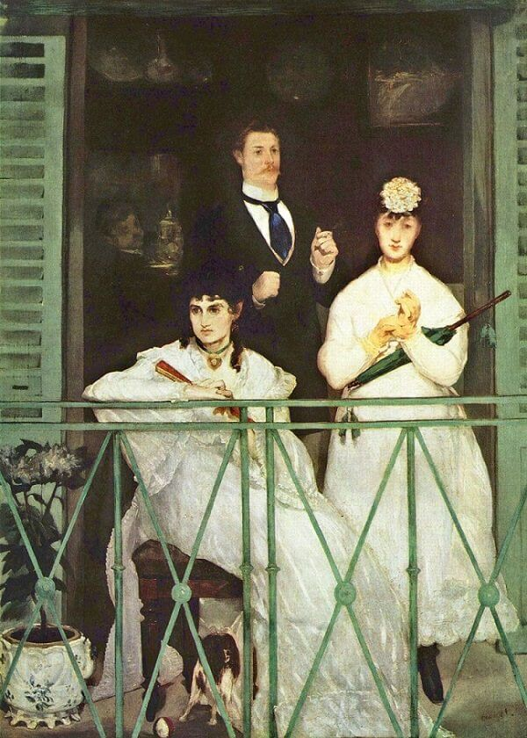
The balcony by Edouard Manet

Slide 16
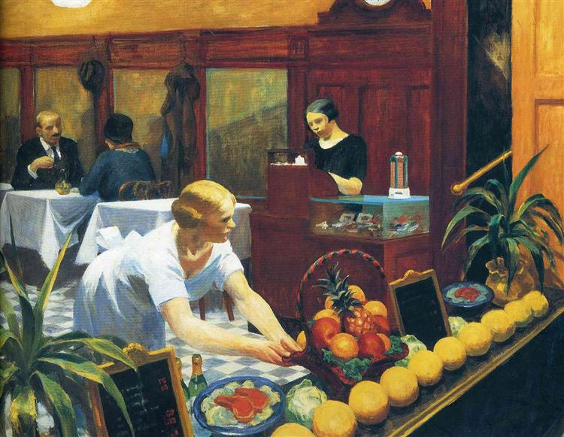
Tables for ladies-1930 Edward Hopper

Slide 17
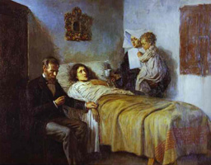
Pablo Picasso 1897

Slide 18
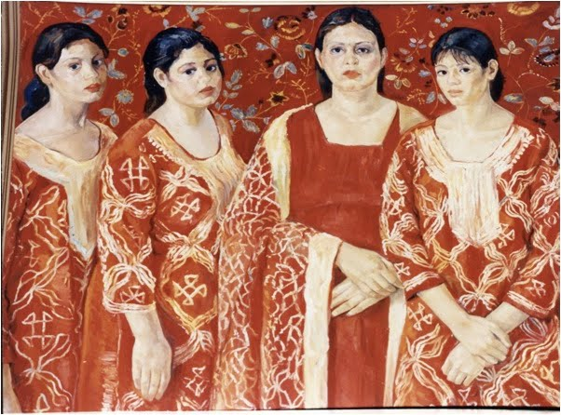
Iqbal Hussain

Slide 19
Thank You

