Slide 1
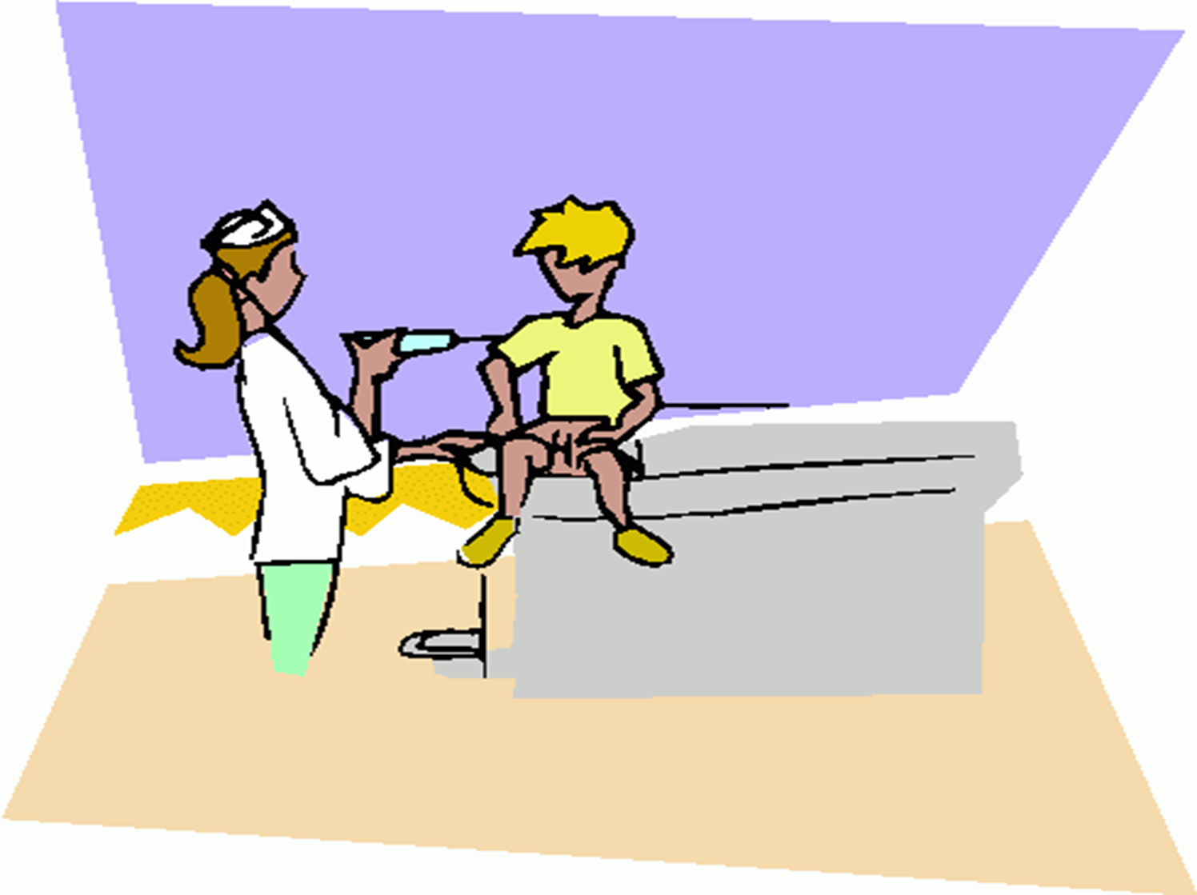
Expended Program of immunization(EPI)

Slide 2
Storage of the vaccine
The vaccine should not kept frozen or exposed to freezing
Store at 2° to 8°C
Shake vial vigorously before withdrawal and use.
Do not use if re suspension does not occur with vigorous shaking.
The vaccine should be administered shortly after withdrawal from the vial.

Slide 3
Give all infants, including premature infants, a primary series of Hib vaccine beginning at 2 months of age.
Do not administer Hib vaccine to infants younger than 6 weeks of age because this may induce immunologic tolerance to further doses of Hib vaccine.

Slide 4
The most common adverse reactions after Hib vaccination are
1-local reactions: swelling, redness, or pain at the injection site. 2-Fever also can occur in as many as 5% of recipients. Fever usually starts within the 1st 24 hours of vaccination and may last for 2 to 3 days. These reactions can be treated with a non-aspirin pain reliever, if needed.

Slide 5
The main contraindication to Hib vaccine :
Severe allergic reaction Do not give Hib-containing vaccine to anyone who has had a prior severe allergic reaction to a dose of Hib vaccine or to a component in the vaccine.
Persons who are severely allergic to diphtheria toxoid, meningococcal vaccine, or tetanus toxoid also may be sensitive to a particular Hib vaccine because of the protein carriers used to create the conjugate vaccines.

Slide 6
Basic Principles to be considered in immunization schedule:
1-All EPI antigens are safe and effective if administered simultaneously.
2-The recommended interval between two doses of
- Live attenuated vaccine .
- Inactivated vaccines.
3-The only live attenuated vaccine given to HIV child is measles

Slide 7
4-Tetanus immunoglobulin (250 IU) must be given to babies :
i) Born outside hospital in unsanitary home conditions
ii) Seen within 10 days after birth.
ii) Whose mothers are not given two documented
doses of TT.
5- Introduction of HB vaccine in 1990.
6-MMR vaccine is given not before the 12months not to be neutralized by maternal antibodies

Slide 8
Contraindications to vaccinations:
Absolute
Temporary

Slide 9
Contraindications to live attenuated vaccines:
Absolute:
1- History of anaphylactic reactions.
2- Subsequent doses of pertussis vaccines are absolutely contraindicated if the child gets (within 48 hours of vaccination )
Fever (40.5º) ,
Collapse or shock .
Persistent crying for 3 hours without apparent cause.
Convulsion with or without fever within 3 hours after
vaccination.
3- HIV infection is an absolute contraindication to administration of live attenuated vaccines ( OPV & BCG).

Slide 10
Temporary:
1- Pregnancy.
2- Severe illness that needs hospitalization.
3- Immunosuppression.
4- Recent receipt of blood.

Slide 11
The strategy for the vaccine delivery:
The static immunization strategy.
The National Immunization Days (NIDs).
Mopping up Immunization.
Outreach immunization.

Slide 12
The static immunization strategy:
Advantages of integration of immunization services through (MCH):
1-Available resources.
2- Cold Chain maintenance.
3- Save ,time, effort and money.

Slide 13
(II) The National Immunization Days (NIDs):
It is periodic immunization of all the eligible targets in a defined group over a large geographic areas within a short period of time. It is one of the strategy for polio eradication and tetanus elimination.

Slide 14
For successful NIDs for polio:
Two doses of OPV are given to all children in the age group
0-59 months within 1-3 days.
It is conducted in two rounds (4-6weeks apart).
The doses of OPV given are extradoses and do not replace the
routine doses given during infancy.
The NIDs are conducted during low season of polio transmission
Most countries conduct NIDs annually for at least three years and until polio is reduced from being an endemic disease to a disease that occurs only in focal areas. Then the Mopping Up Immunization is conducted.

Slide 15
(III) Mopping up Immunization:
It is house-to-house immunization with OPV in high risk districts.
It consists of two to three rounds 4-6 weeks apart .
Each round should be completed within a short period of time (3days).
High risk districts are those:
Where the wild polio virus is still circulating
( polio case in the last 36 months) .
With low immunization coverage.
Transient population, with overcrowding poor sanitary environment and low access to health services.

Slide 16
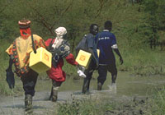
(IV) Outreach immunization:

Slide 17
What is the difference between the NIDs and the out reach Strategy?
The outreach is carried for routine immuniation that is compusory for the targets in certain areas where:
- immunization services are not accessible.
- vaccination coverage is Low.
The outreach is carried during any time without specific duration.
Limitations:
(i) Expensive
(ii) Cold chain failure.
(iii) Difficulty to arrange the immunization schedule.

Slide 18
Missed opportunity :
It occurs when a child or a woman in child bearing period comes to the health facility or outreach site and does not receive any of the vaccine doses for which he or she is eligible.

Slide 19
The reasons for missed opportunity are:
Health workers` practices.
Logistical problems.
Failure to administer simultaneously all the
vaccines for which the child is eligible.
False contraindications to immunization.

Slide 20
False contraindications to immunization:
Conditions that are wrongly considered as contraindications:
Minor illness( respiratory tract infections ,diarrhea, fever < 38.5°C).
Prematurely or small for date infants.
Child being breast-fed.
Family history of convulsion.
History of jaundice at birth
Chronic health problems: Malnutrition ,allergy, asthma, other atopic manifestations, hay fever ,chronic diseases of heart, lungs, kidney or liver, cerebral palsy & Down syndrome ,dermatoses, local skin lesion.
Treatment with antibiotics, low dose corticosteroids( local or inhaled)

