Slide 1
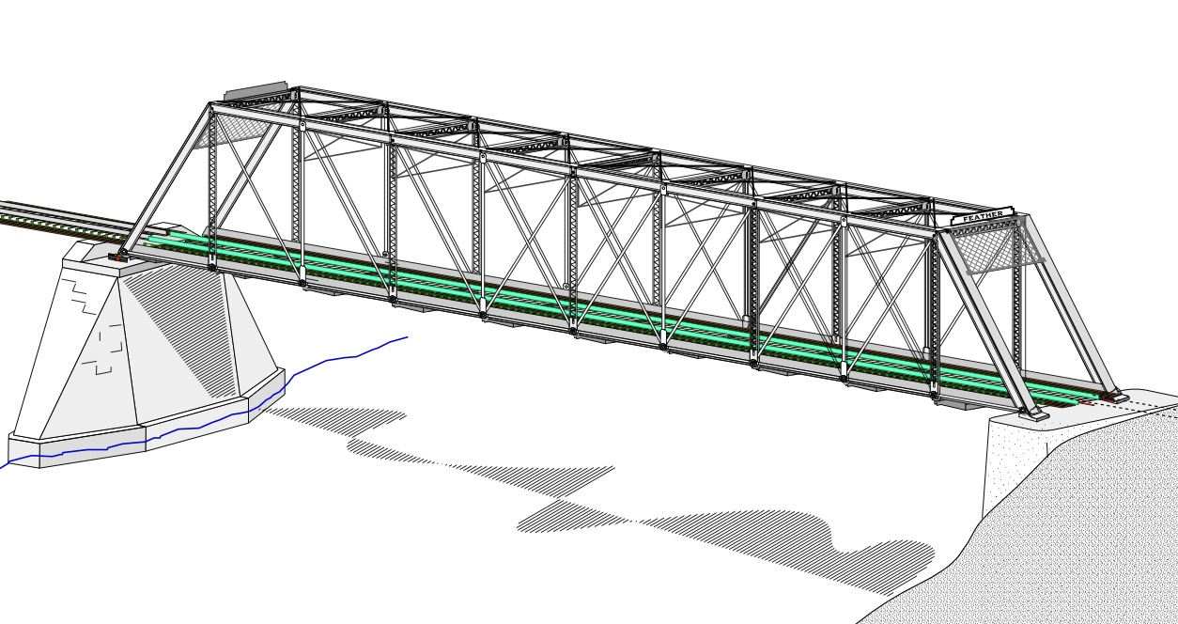
COLLEGE OF ENGINEERING AND TECHNOLOGY UNIVERSITY OF SARGODHA STEEL STRUCTURES (CT-313) (B.S TECHNOLOGY)
LECTURE-34,35 & 36
COMPRESSION MEMBERS
Engineer Aqeel Ahmed
Lecturer, Civil Engineering Department
CET, UOS, Sargodha

Slide 2
Compression Members……….. More on Effective Length
We studied the concept of effective Length in previous lectures , “Column Theory”.
All Compression Members are treated as pin-ended regardless of the actual end conditions but with the effective length of KL that may differ from the actual length.
With this modification the load capacity of Compression Member is a function of only the slenderness ratio and modulus of elasticity.
For the given material, the load capacity is a function of slenderness ratio only, because modulus of elasticity of steel is approximately same.
If a Compression Member is supported differently with respect to each of its principal axes, the effective length will be different for two directions.

Slide 3
Compression Members……….. More on Effective Length……….
In figure 4.10, a W-shape is used as Column and is braced by horizontal members in two perpendicular directions at the top.
These members prevents translation of the column in all directions but the connections, the details of which are not shown permits small rotations to take place.
Under these conditions the member can be treated as pin connected at the top. For some reasons, the connection to the support at bottom may also be treated as a pin connection.
Generally speaking, a rigid or a fixed condition is very difficult to achieve and unless some special provisions are made.
Ordinary connections will usually closely approximate a hinge or pin connection.
At mid height, the column is braced, but only in one direction.

Slide 4
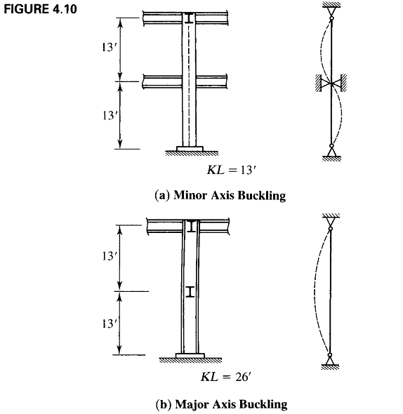

Slide 5
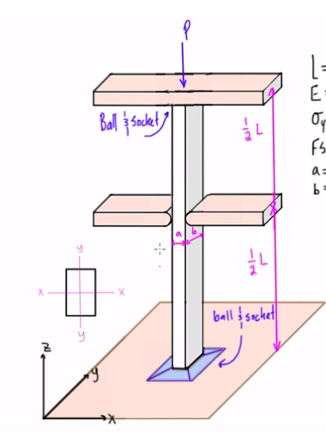

Slide 6
Compression Members……….. More on Effective Length…………..
Again the connection prevents translation but no restraint against rotation is furnished.
This brace prevents perpendicular to the weak axis of the cross section but provides no restraint perpendicular to the strong axis.
As Schematically in Figure 4.10, if the member were to buckle about the major axis the effective length would be 26 feet, where as the buckling about minor axis would have to be in the second buckling mode, corresponding to the effective length of 13 feet.
Because its strength decreases with increasing KL/r , a column will buckle in the direction corresponding to the largest slenderness ratio.
So KxL/r must be compared with KyL/r.
In figure 4.10, the ratio 26(12)/rx must be compared with ratio 13(12)/ry (where rx and ry are in inches) and the larger ratio would be used for the determination of the axial compressive strength.

Slide 7
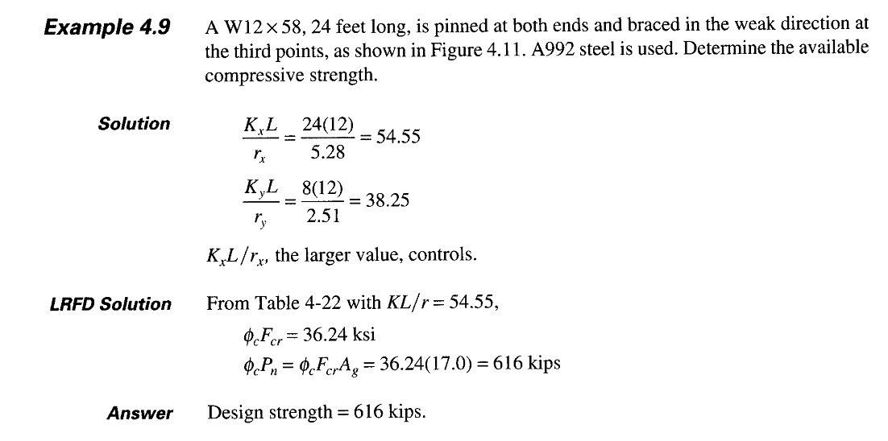

Slide 8
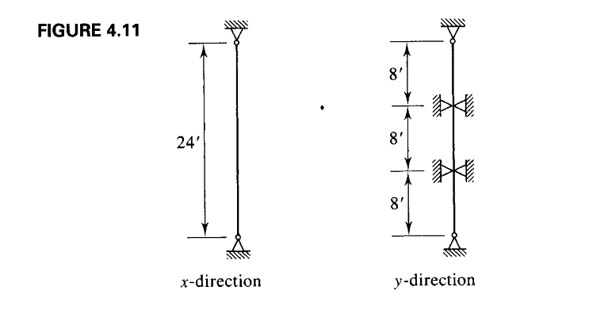

Slide 9
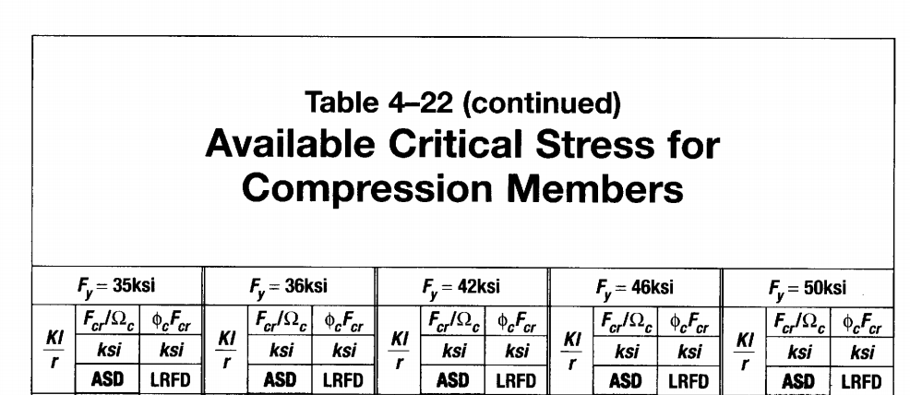

Slide 10
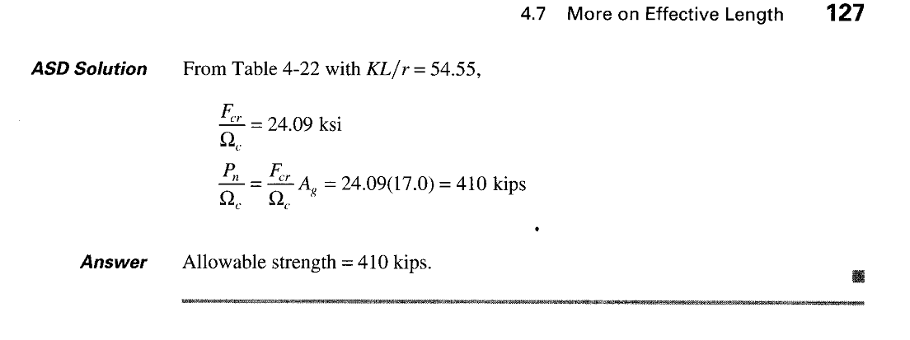

Slide 12
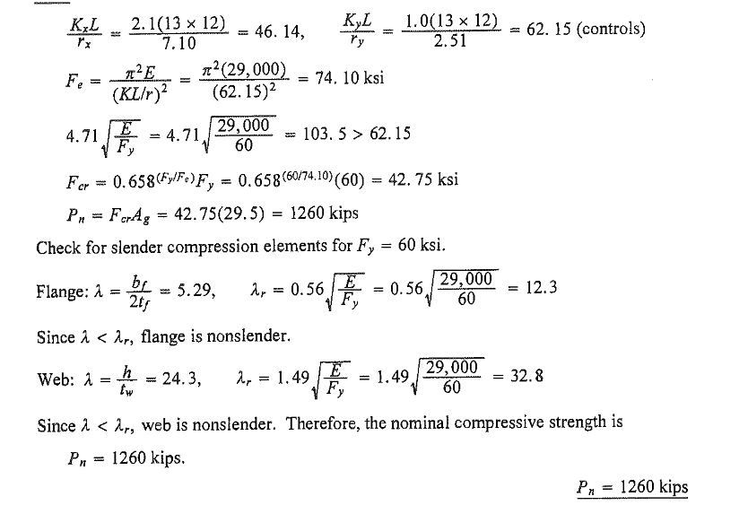

Slide 13
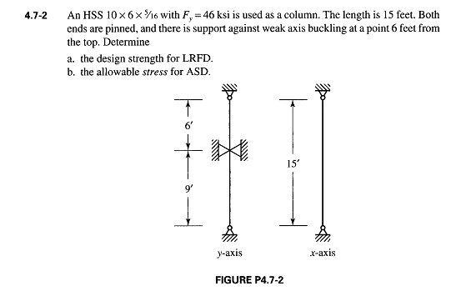

Slide 14
