Slide 1
Presentation Topic: Crop wild relatives and Exploration of genetic Resources DR . IKRAM-UL-HAQ

Slide 2
Contents
Crop wild relatives
Importance
Purpose
Elements
Implementation
Exploration of genetic resources
Types of seed collections
Germplasm activities

Slide 3
Crop Wild Relatives
Crop wild relatives are wild plant species that are genetically related to cultivated crops.

Slide 4
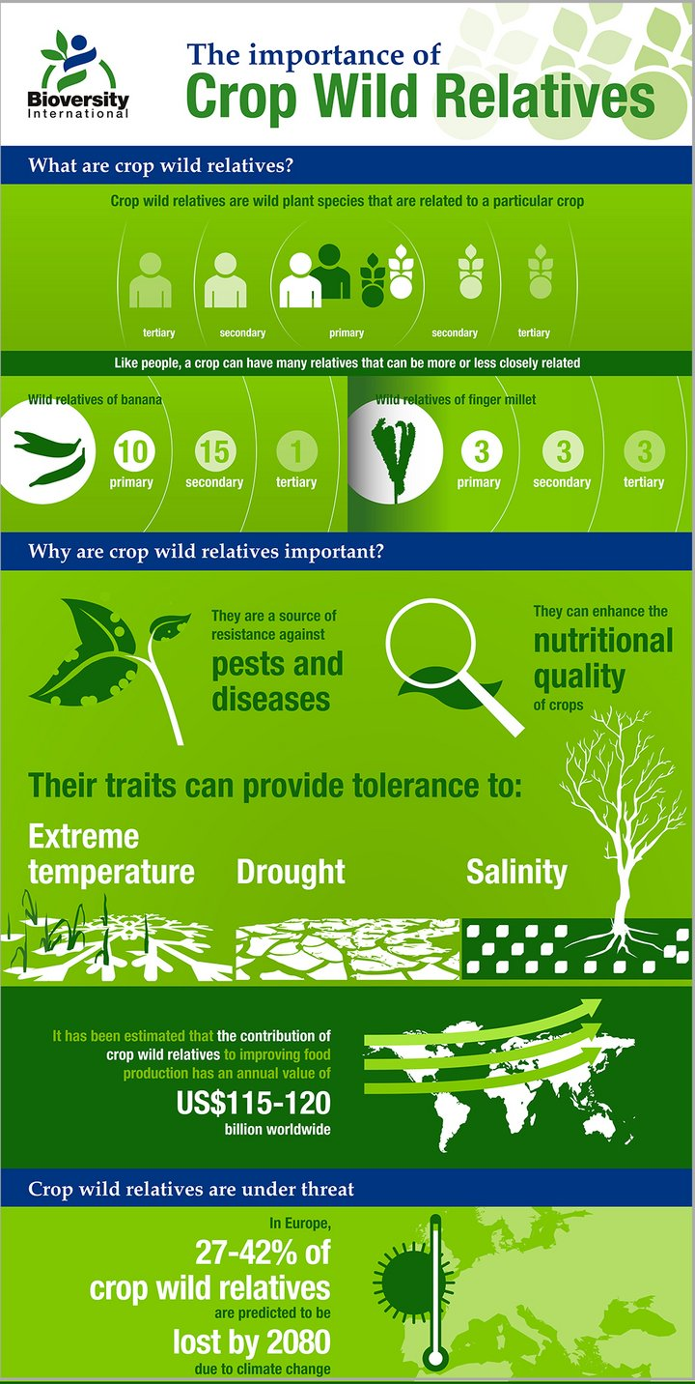

Slide 5
Purpose Of Crop Wild Relatives
Raise awareness of the value of national CWR diversity for food and economic security particularly for adapting crops to the impacts of climate change
Define the specific actions and resources required to effectively conserve and sustainably utilize national CWR diversity
Provide a framework and roadmap for long-term conservation and sustainable use of CWR
Contribute to regional and global efforts in CWR conservation and sustainable use

Slide 6
Elements Of Crop Wild Relatives
National agricultural and floristic diversity
National, regional and global policy framework
National CWR diversity
Utilization potential and conservation status
Concrete actions for conservation &sustainable use of CWR
Strategic actions for conservation &sustainable use of CWR
Stakeholder collaboration
Resource mobilization
Monitoring and review

Slide 7
Elements Of Crop Wild Relatives
Concrete actions for conservation & CWR
Important CWR taxa
Ex situ conservation programme
Pre-breeding local communities, public awareness
Sites for active in situ conservation

Slide 8
Implementation Of Crop Wild Relatives
Strategic actions
Policy interventions to enable concrete actions
Provide the enabling conditions and necessary incentives to achieve NSAP objectives

Slide 9
Implementation Of Crop Wild Relatives
Enabling environment
Review existing policy
Integrate CWR conservation into existing national, regional and global conservation and sustainable use initiatives
Define lead agencies and stakeholder responsibilities
Identify capacity building needs
Develop communication strategy
Sustainability, financial support, stakeholder commitment

Slide 11
Types Of Seed Collections
Based on the use and duration of conservation, seed collections are of three types:
Base collections
Active collections
Working collections

Slide 12
Base Collections
Base collections include maximum number of accessions available in a crop
These are meant for long term conservation upto 50 years or more
They are stored at -18 to -20 0C in hermetically sealed container

Slide 13
Active collections
This category of germplasm is actively utilized in breeding programme are conserved for medium term 8-10 years or more
These collections are stored at zero to two degree celcius with moisture content around 8%

Slide 14
Working collections
These collections are frequently used by breeders in their crop programmes
These are stored for short term 3-5 years
The seed is stored at 5-10 0C with moisture content of 8-10%

Slide 16
Germplasm Activities
There are six important activities related to plant genetic resources
Exploration and collections
Conservation
Evaluation
Documentation
Distribution
Utilization

Slide 17
Exploration And Collections
Exploration refers to collection trips and collection refer to tapping of genetic diversity from various source and assembling the same at one place. This process takes into six important items.
Source of collection
Priority of collection
Agencies of collection
Methods of collection
Methods of sampling
Sample size

Slide 18
1-Source Of Germplasm Collection
There are five important source of germplasm collections:
Centre of diversity
Gene banks
Gene sanctuaries
Seed companies
Farmers fields

Slide 19
2-Priority Of Collections
Some crop species have more risk, of extinction than others. Hence, endangered areas and endangered species should be given priority for germplasm collection.

Slide 20
3-Agencies Of Collections
The risk of germplasm collection is undertaken by crop research institutes and state agriculture universities in collaboration with national bureau of plant genetic resources.
New delhi for indigenous collections.
For global collection the task is undertaken in collaboration with International plant genetic resources, Institute (IPGRI), Italy.

Slide 21
4-Method Of Collection
Germplasm collections are made in three principal ways:
Through the regions of genetic diversity
By personal visit to gene bank centre
Through exchange of material

Slide 22
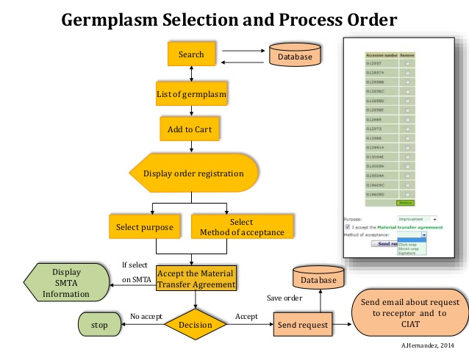

Slide 23
5-Method Of Sampling
There are two sampling methods for collection of germplasm from the regions of diversity.
Random sampling
Biased sampling
Random or biased sampling is useful in collection of morphologically distinct genotypes.

Slide 24
6-Sample Size
The sample size should be such that 95% of the total genetic diversity can be captured from the area of collection. To achieve this goal, 50-100 individuals should be collected per site with seeds per plant.

