Slide 1
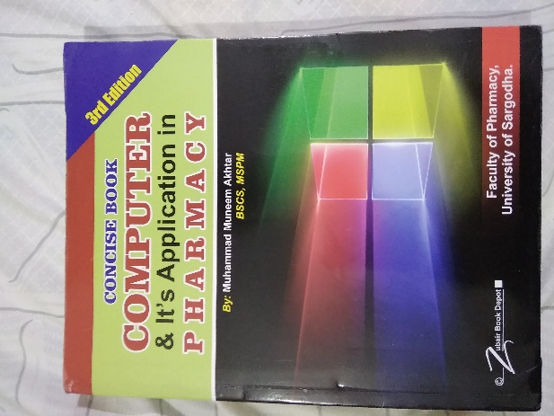
System Analysis & Design
17
Recommended For
Pharmacy Student !
Part
Pharm-D (Doctor of Pharmacy),
DPT (Doctor of Physiotherapy) &
Pharmacy Technician.
Muhammad Munim Akhtar

Slide 2
Welcome to
Computer & its Application in Pharmacy with Munim Akhtar
Free online quality educational tutorials about Computer in Pharmacy

Slide 4
What is system

Slide 5
What is System?
A group of interacting, interrelated, or interdependent elements.
Or parts that function together as a whole to accomplish a goal.
A computer system refers to the hardware & software components that run a computer.
Large systems contain many sub-systems
A system has structure, behavior and has interconnectivity.
e.g.
Earth is a subsystem of solar system,
which is a subsystem of the Galaxy,
which is a subsystem of the universe.

Slide 6
Types of System
A System: A set of components that work together to achieve a common goal.
A Subsystem: A subsystem are units that make up a bigger system so that a system can be able to achieve its goals.
A Closed System/ isolated: Stand-alone system that has no contact with other systems. In the business world closed systems do not exist.
An Open system: System that interact with other systems e.g. living organisms such as food and air. etc.
Note: Being a Muslim and believer of Almighty Allah, could be one example of closed system

Slide 7
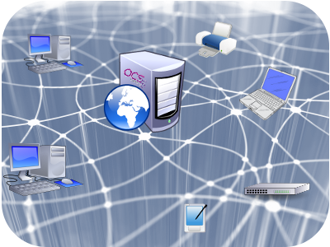
Close and open system
Open system
Close system
Universe system
Computer System

Slide 8
What is Computer system
1- Data: Raw facts such as an employee’s name and number of hours worked in a
week, inventory part numbers or sales orders.
2- Processing: Manipulation of data by a computer
3- Information: A collection of facts organized in such a way that they have
additional value beyond the value of the facts themselves.
Information
Data (Raw data)
Salesperson: J. Jones Sales
Territory: Western Region
Current Sales: 147 Units
Sale = $147,000
$35,000 12 Units $12,000 J. Jones Western Region $100,000 100 Units
Units $147
Processing

Slide 9
Common elements of all systems
Input - Give raw material transformed by the system.
Output - The product of a system’s processing of input.
Processing/ Throughput - Processes used by the system to convert raw materials into information/ products that are usable by either the system itself.

Slide 10
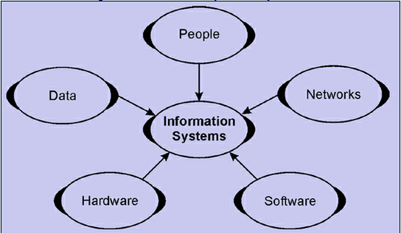
What is information System.
An information system is software that helps you to organize and analyze data.
The purpose of an IS to turn raw data into useful information that can be used for decision making in an organization.

Slide 11
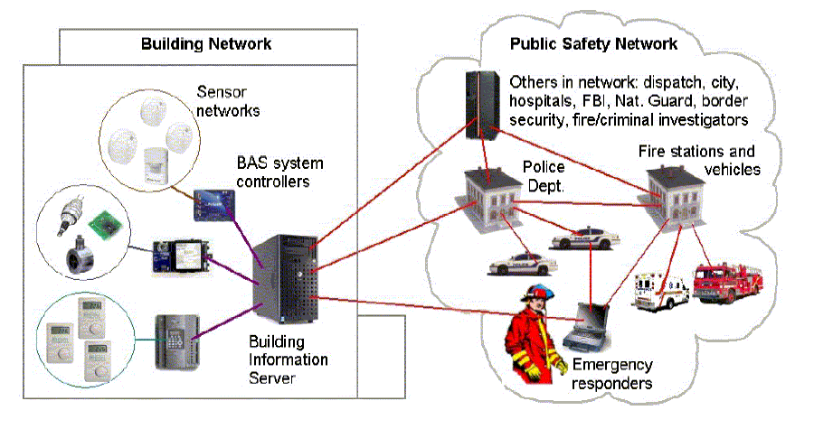
A Building Network System

Slide 12
Main components of IS system
An Information System is an organized combination of people,
Hardware,
Software,
Communication networks
People
IS system collects, transforms, distribute / broadcast information in a organization.

Slide 13
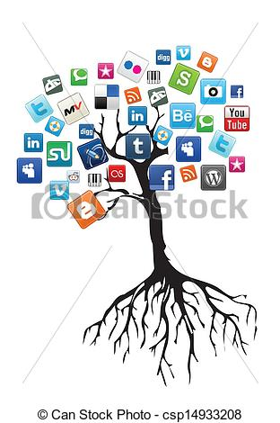
What is IT
Information technology is the application of computers and telecommunications
equipment to
store,
retrieve,
transmit and
manipulate data, often in the context of a business.
IT includes
network administration,
computer engineering,
Web development,
technical support.

Slide 14
Difference b/w IT Vs. IS
Payroll System
IT
IS
Information technology
Hardware
Software
Databases
Networks
Other related components
Inventory System
are used to build
Information Systems
Marketing System
Customer Service System. etc.
Technology: The scientific method and material used to achieve a goal/ objective.

Slide 15
Classification of IS
Information Systems
Management Support System
Operations Support System
TPS
PCS
OAS
MIS
DSS
EIS

Slide 16
Operations Support System
TPS: Transaction processing system can collect, store, modify, and retrieve transactional data about any organization.
e.g.
Systems that manage sales order entry,
Airline reservations,
Payroll,
Employee records,
Manufacturing etc.

Slide 17
Operations Support System…
ii) Process Control Systems:
Monitor and control industrial processes. Or a system that deals with architecture, mechanisms and algorithm for maintaining the output of a specific process within a desired range.
e.g. Heating system in a room etc.

Slide 18
Operations Support System…
iii) Office Automation Systems
OA are office procedures that enhance office communications and productivity. OR
Refers to the varied computer hardware and software used to digitally create, collect, store, manipulate for accomplishing tasks.
e.g. ATM, Payroll system, etc..

Slide 19
2. Management Support Systems
i-Decision Support system: Provide information and support needed for effective decision making by managers.
Or DSS applications are systems that help people make decisions based on data that is collect from a wide range of sources.
e.g. on-line book seller, Chain Pharmacy, Chain stores etc.

Slide 20
2. Management Support Systems…
ii. Management Support Systems:
Provide information and support needed for effective decision making by managers OR
Is a computer-based information system that supports business rganizational for decision making activities.
e.g. Comparative sales figures between one period to the next.

Slide 21
2. Management Support Systems…
iii- Executive information system (EIS):
EIS is a type of management information system that facilitates and supports senior executive for decision making .
EIS may include:
Financial Information
Work in process
Sales figures
Market trends etc.
It may even suggest what need to be done, but differs from DSS, it is targeted at executives.

Slide 22
IS Development Cycle

Slide 23
Challenges
Workforce downsizing
Information overload
Employee mistrust
Difficult to built
Security breaks

Slide 24
Opportunities
Enhanced global competitiveness
Capture market opportunities
Support corporate strategy
Enhance worker productivity
Improve quality of goods and services

Slide 25
Conclusion
Information System is crucial for all area in world business.
Industry,
Academia
any organization to meet the future challenges etc.

Slide 26
Today quote
"Only a life lived for others is a life worthwhile."
-Albert Einstein

Slide 27
?

