Slide 1
Portrait through Ages
Andleeb Rana

Slide 2
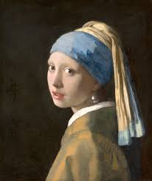
Baroque Period Girl with a Pearl Earring is an oil painting by Dutch Golden Age painter Johannes Vermeer, dated c. 1665

Slide 3
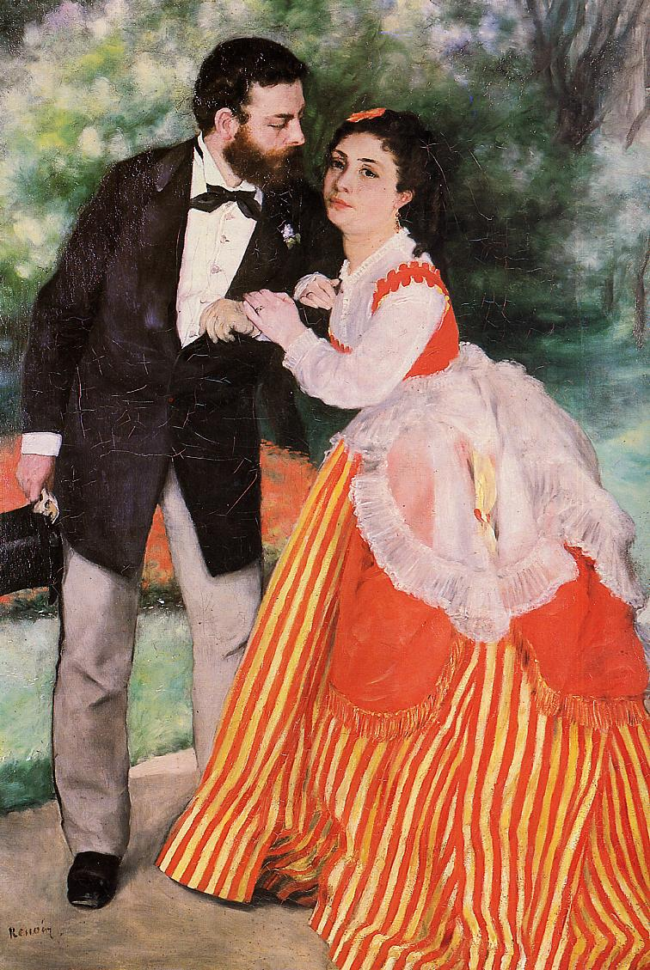
Impressionists Alfred-Sisley-with-His-Wife-1868-Pierre-Auguste-Renoir

Slide 4
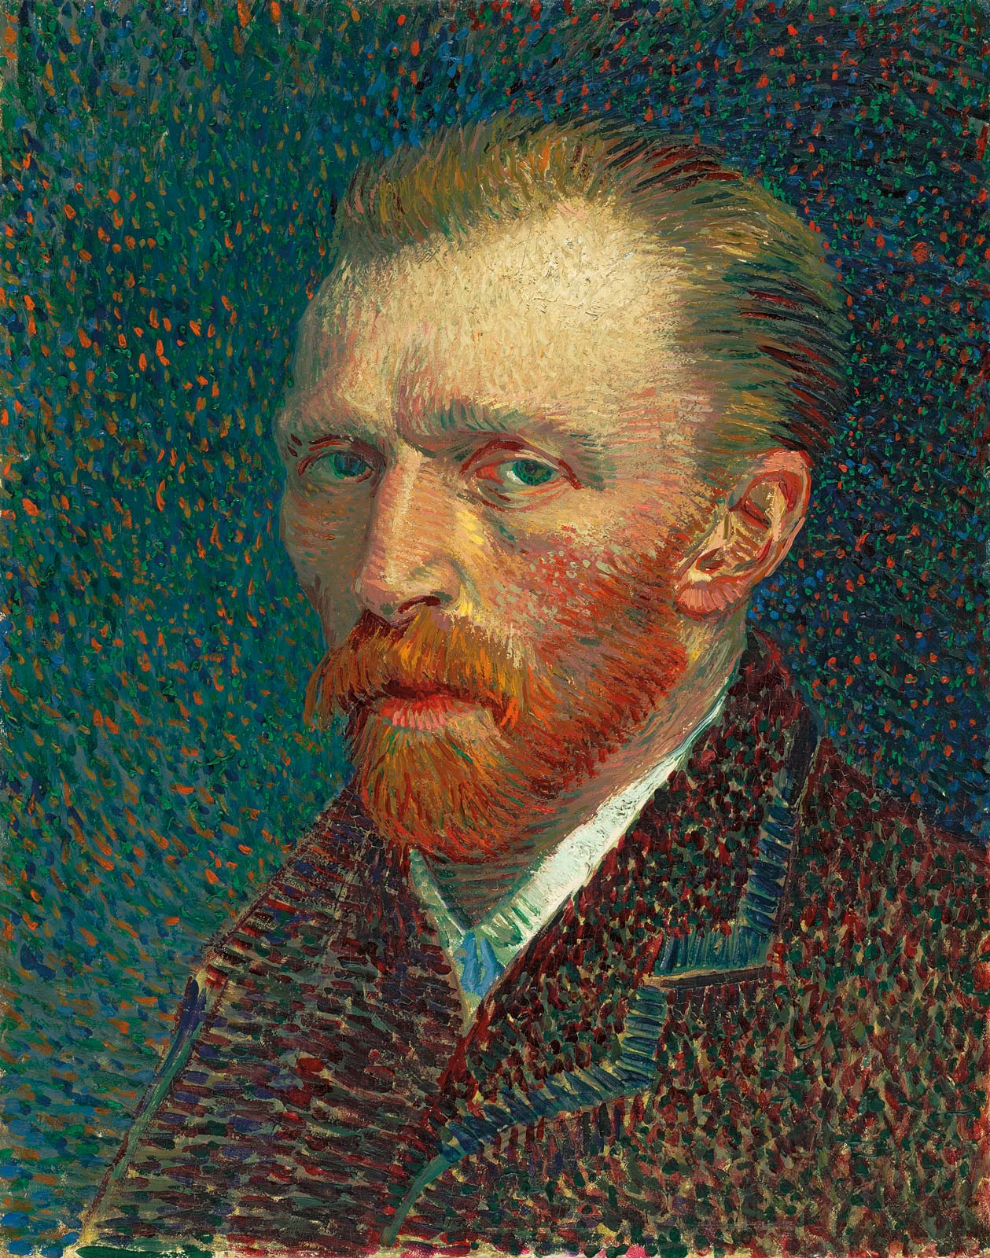
Post Impressionist Self-Portrait-artist-panel-board-Vincent-van-Gogh-1887

Slide 5
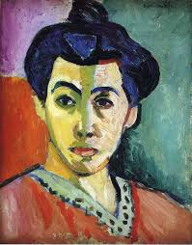
Fauvist The Green Line, is a portrait by Henri Matisse of his wife, Amélie Noellie Matisse-Parayre. It is an oil painting on canvas, completed autumn or winter 1905

Slide 6
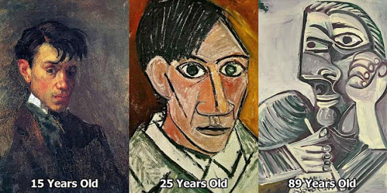
Cubist Pablo Picasso (Expressionism 1907)

Slide 7
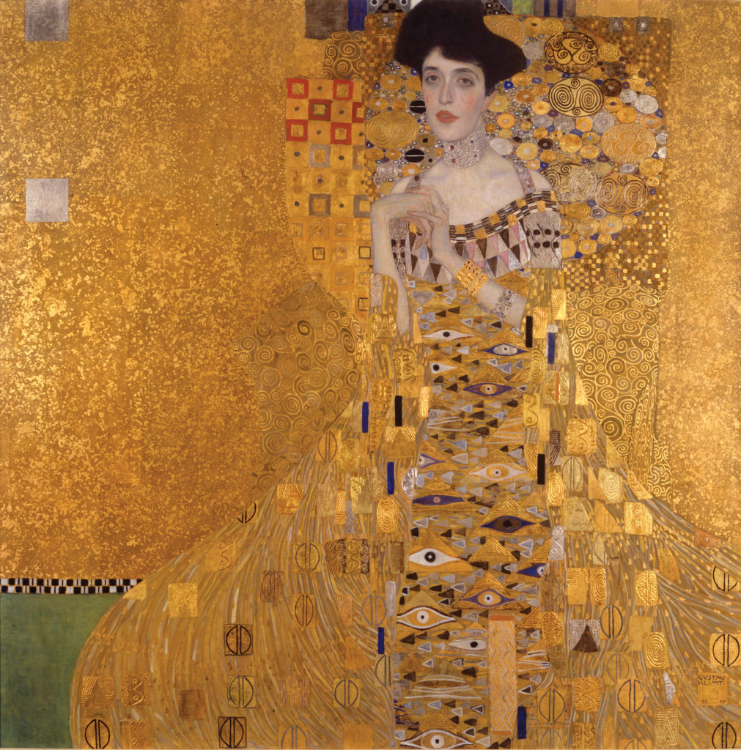
Art Nouveau Portrait of Adele Bloch-Bauer I is a painting by Gustav Klimt, completed between 1903 and 1907.

Slide 8
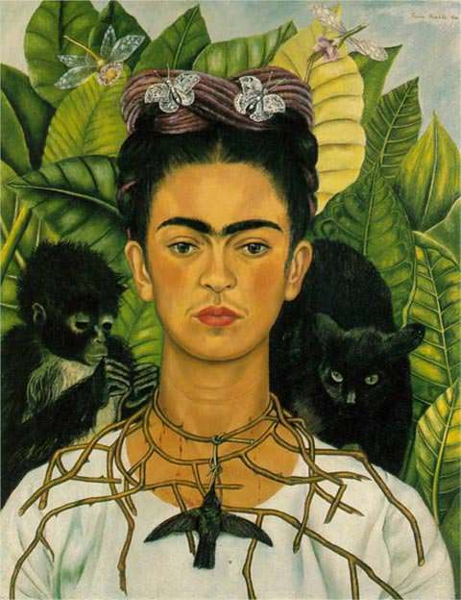
Self-Portrait with Thorn Necklace and Hummingbird is a 1940 painting by Mexican painter Frida Kahlo. Kahlo painted the self-portrait, which includes a black cat and a monkey, after her divorce from Diego Rivera and the end of her affair with photographer Nickolas Muray.

Slide 9
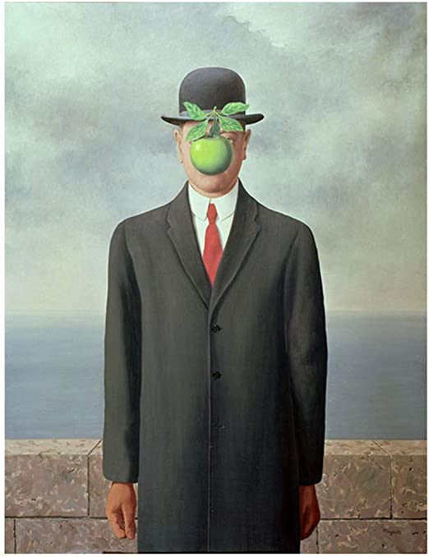
The Son of Man is a 1964 painting by the Belgian surrealist painter René Magritte. It is perhaps his most well-known artwork. Magritte painted it as a self-portrait

Slide 10
Contemporary Portrait Painters of Pakistan 21st c

Slide 11
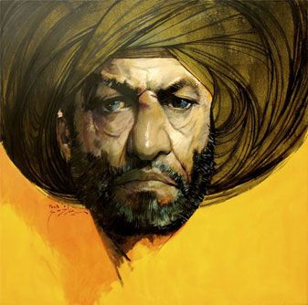
Saeed Akhter

Slide 12
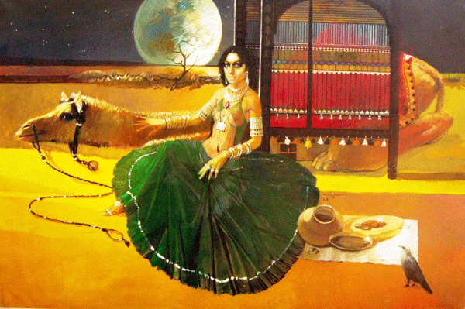

Slide 13
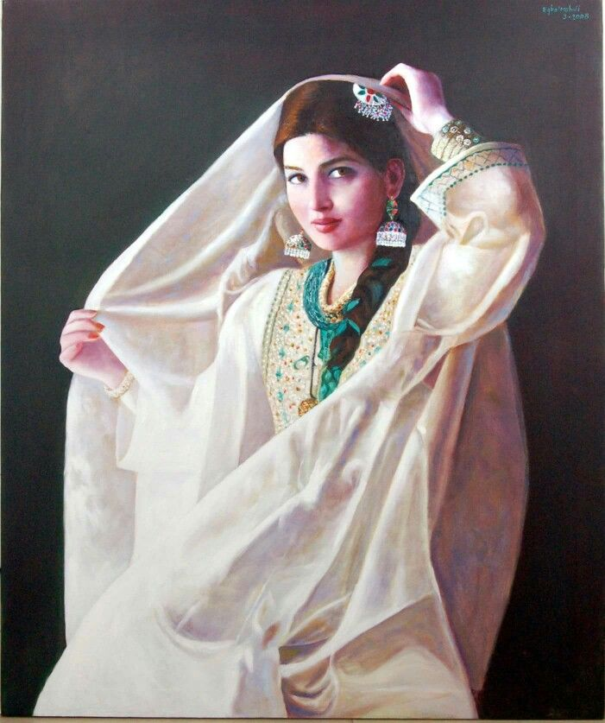
Eqbal Mehdi

Slide 14
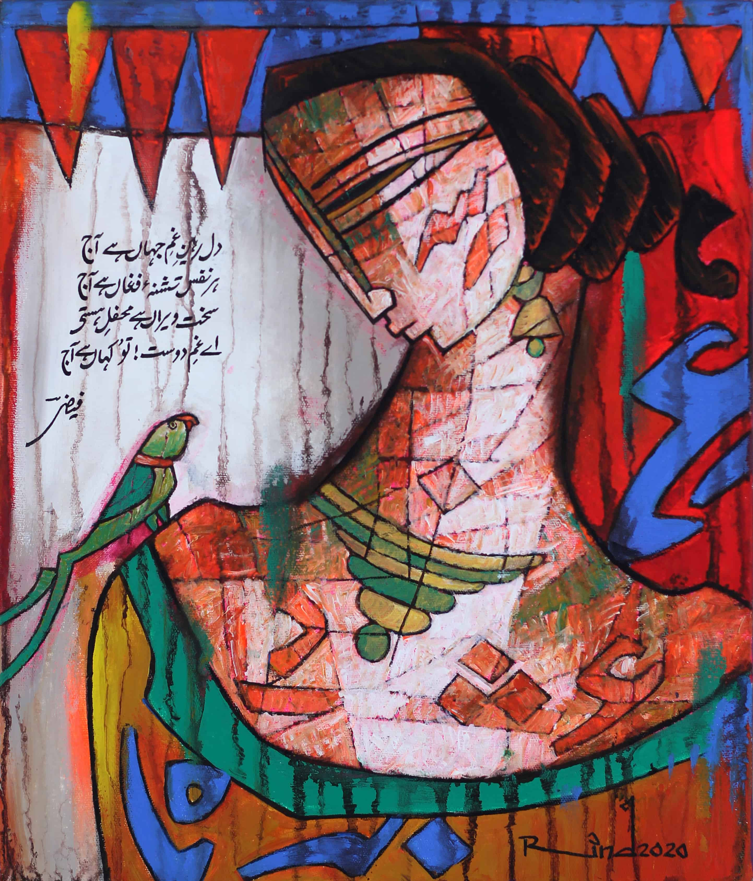
A.S-Rind-12-x-14-Acrylic-on-Canvas

Slide 15
Find more https://paintersofpakistan.wordpress.com/

Slide 16
Explore your style

