Slide 1
How To Do A Literature Review: An Overview

Slide 2
Outline of session
What is a literature review?
Why review the literature?
Plan your search/Keywords/Subjects
Snowballing/Tracking Citations
Choose appropriate Databases/Sources
Sample searches
Read and evaluate
A good literature review…

Slide 3
What is a literature review?
“… a systematic…method for identifying, evaluating and interpreting the …work produced by researchers, scholars and practitioners.”
FINK, A., 1998. Conducting literature research reviews: from paper to the internet. Thousand Oaks, CA: Sage., p.3.

Slide 4
Why review the literature?
“…without it you will not acquire an understanding of your topic, of what has already been done on it, how it has been researched, and what the key issues are.”
HART, E., 1998. Doing a literature review: releasing the social science research imagination, by E. Hart and M. Bond. London: Sage., p.1.

Slide 5
Choose Appropriate Databases
Google is not (usually) the answer
Start with Library Resources for your Subject First
Search a range of databases
Think about the range of sources: books, journal articles, statistics, websites, conference reports…

Slide 6
How does Google Search work?
Notes:
Halpern, Sue. "Mind Control & the Internet." New York Review of Books 58.11 (2011): Web. 17 Jun 2011. <http://www.nybooks.com/articles/archives/2011/jun/23/mind-control-and-internet/>

Slide 7
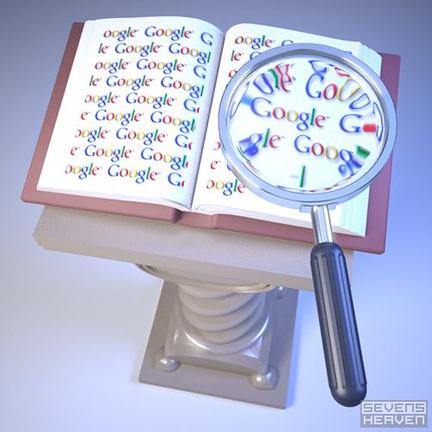
Google Search
PageRank (algorithm)
500 million variables
2 Billion Terms
Bias?
Popularity is a Proxy for Importance

Slide 8
Personalized Search
Google’s algorithm will suggest “what is best for you” – based on past searches.
It’s as if we looked up the same topic in an encyclopedia and each found different entries.

Slide 9
Personalized Search
Find information that is most likely to reinforce your own worldview
We begin to lose dissenting opinion/conflicting points of view
Yet search seems neutral, objective, unbiased.

Slide 10
Personalized Search & the Internet
Google is likely to direct you to material with which you already agree.
“a search for proof about climate change will turn up different results for an environmental activist than it would for an oil company executive.”
“democracy requires citizens to see things from one another’s point of view, but instead we’re more and more enclosed in our own bubbles…offered parallel but separate universes.”

Slide 11
SO WHAT?

Slide 12
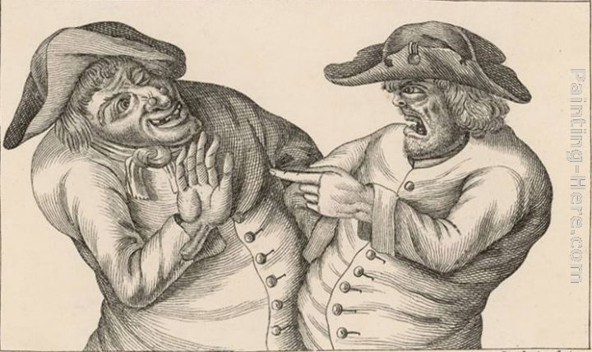
What are the repercussions for research carried out in an environment where Search itself is being compromised?

Slide 13
“when ideology drives the dissemination of information, knowledge is compromised.”
“having our own ideas bounce back at us, we inadvertently indoctrinate ourselves with our own ideas.”
Halpern, Sue. "Mind Control & the Internet." New York Review of Books 58.11
(2011): Web. 17 Jun 2011.

Slide 14
Major Concerns
Right terms to search
Narrowing the search
Using the library effectively

Slide 15
Define what you want to know
“I am looking for literature and data that focus on incarceration as a deterrent for crime. ”
Use this statement to choose keywords and key phrases

Slide 16
Define key words and phrases
incarceration
deterrent
crime

Slide 17
Identifying Keywords
Identify the significant terms and concepts that describe your topic from your thesis statement or research question.
These terms will become the key for searching catalogs, databases and search engines for information about your subject.

Slide 18
Class Exercise
Keyword Building Exercise (Part One)
Topic: Crime and Punishment
Thesaurus.com

Slide 19
Define key words and phrases
incarceration
deterrent
crime

Slide 20
Crime & Punishment
Prisons
Policies
Murder
Incarceration
Deterrent
Crime
Rehabilitation
Solutions
Robbery

Slide 21
Explore Subject Headings
incarceration
deterrent
crime
General topics – Library of Congress
Psychology – Am. Psychological Assn.
Education – U.S. Dept. of Education
Medicine – National Library of Medicine

Slide 22
Class Exercise
Keyword Building Exercise (Part Two)
Topic: Crime and Punishment
Academic Search Complete

Slide 23
Crime & Punishment
Prisons
Policies
Murder
Incarceration
Deterrent
Crime
Subj. head.
Subj. head.
Subj. head.
Rehabilitation
Solutions
Robbery

Slide 24
We think of citation patterns as the flow of information," says Carl Bergstrom, a biologist at the University of Washington. "That's what a citation is — the trace that an idea flowed from one place to another."

Slide 25
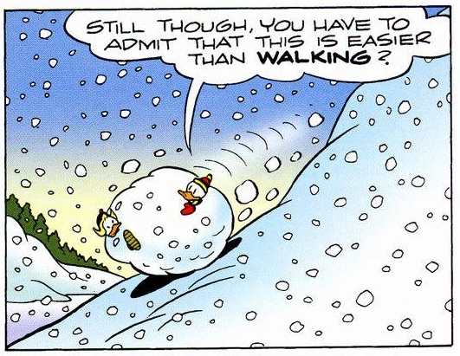
Snowballing
Building on the works of others
A scholarly article will always have References/Bibliography
A bibliography is always ripe for the picking…

Slide 26
Tracking Citations
Wild, D. (2003, March). GOING TO WAR: A LITERATURE REVIEW. Emergency Nurse, 10 (10), 18. Retrieved June 4, 2009, from Academic Search Complete database
Notes:
How to Track Citation: Look for the Specific Journal: show example. If we don’t have the journal we can still get the article through ILL

Slide 27
Tracking Citations
Wild, D. (2003, March). GOING TO WAR: A LITERATURE REVIEW. Emergency Nurse, 10 (10), 18. Retrieved June 4, 2009, from Academic Search Complete database
Notes:
27
How to Track Citation: Look for the Specific Journal: show example. If we don’t have the journal we can still get the article through ILL

Slide 28
The Citation Video

Slide 29
Class Exercise
Citation Worksheet
Periodicals List
Do we have access to the Journal?
If so, do we have access to the specific article?
Notes:
29

Slide 30
Choose Appropriate Databases
Google is not (usually) the answer
Start with Library Resources for your Subject First
Search a range of databases
Think about the range of sources: books, journal articles, statistics, websites, conference reports…

Slide 31
JSTOR
Includes archives of over one thousand leading academic journals across the humanities, social sciences, and sciences.
Search by discipline: Sociology

Slide 32
EBSCOhost Databases:
Academic Search Complete
PsycARTICLES
SocINDEX with Full Text
TOPICsearch

Slide 33
Working with EBSCOhost
Create a Folder
Narrow Your Search
Scholarly (Peer Reviewed) Journals
Filter by Publication Date
Filter by Subject:Thesaurus Term
Filter by Publication
Cited References
Notes:
Run through a Search using the Four Filters/Add

Slide 34
The Citation Video: Advanced

Slide 35
Class Exercise
Academic Search Complete Worksheet
Academic Search Complete
Work with your topic
Work together
Get familiar with narrowing your results
Notes:
35

Slide 36
Google: Improve Your Searches
Site Specific Command
What it does: searches only specific domains
What to type: prison overcrowding site:edu
prison overcrowding site:gov

Slide 37
Google Scholar
Google Scholar provides a simple way to search for scholarly literature. Search across many disciplines and sources: peer-reviewed papers, theses, books, abstracts and articles, from academic publishers, professional societies, preprint repositories, universities and other scholarly organizations.

Slide 38
Google Scholar
Works best for Citations
Restrictions to Content
Fee-based
Often your Library already owns material
We’re working on improving access
Notes:
Find: Tribal Colleges Gaining Digital Access to Worldwide Library Resources. A periodical search will take me to the article

Slide 39
OpenThesis & OAIster
OpenThesis - A free repository of theses, dissertations, and other academic documents.
OAIster - A union catalog of millions of records representing open archive scholarly digital resources.

Slide 40
Evaluate what you read
Think about…
Relevance to your topic
Intended audience
Currency of the information
Coverage of the topic
Accuracy of the information
Authority of the author or information source
Level of objectivity of the author

Slide 41
A good literature review…
Goes beyond simply listing relevant literature
Is a critical essay
Assesses the range of literature available
Is a critical summary of the literature
Examines the background against which your own research is set
Forms a significant section of your dissertation

Slide 42
A good literature review…
Offers opinions and personal response to the different writings
Relates different writings to each other, compares and contrasts
Does not take the literature at face value
Shows an awareness of the theories and values that underpin the research
Uses particular language: authors assert, argue, state, conclude, contend

Slide 43
Questions?
Contact me:
Jason Dupree
774-3031
jason.dupree@swosu.edu

Slide 44
Thanks!
Notes:
Cue: “Too Much Information”

