Slide 1
Choline
Choline is considered essential to the animal organism and is utilized both as a building unit and as an essential component in regulation of certain metabolic processes.
Choline is tentatively classified as one of the B-complex vitamins even though it does not entirely satisfy the strict definition of a vitamin. Choline, unlike B vitamins, can be synthesized in the liver, is required in the body in greater amounts, and apparently functions as a structural constituent rather than as a coenzyme.
existence of choline in essential body constituents was recognized long be- fore the first vitamin was discovered. Regardless of classification, choline is an essential nutrient for all animals and a required dietary supplement for some species (e.g., poultry, swine, and fish).
Choline is likewise an essential nutrient for humans, and studies have investigated the benefits of choline treatment for certain diseases, such as cancer and Alzheimer’s disease.

Slide 2
History
the discovery of insulin in 1922 by Banting and Best. It was observed that fatty degeneration of the liver associated with insulin deprivation in dogs could be corrected by feeding either raw pancreas or lecithin.
In 1932 choline was discovered to be the active component of pure lecithin previously shown to prevent fatty livers (“lipotropic effect”) in rats (Best et al., 1934).
Betaine, considered to be only a methyl donor, was found to have a similar lipotropic effect in rats and dogs.
Various studies in the late 1930s and early 1940s determined that the lipotropic activity of choline related to transfer of methyl groups and interrelationships and sparing effects of choline on dietary methionine, folacin, and vitamin B12.
In 1940, Jukes showed that choline is required for normal growth and the prevention of perosis, a leg disorder in turkeys; he found that the amount required to prevent perosis was greater than that required for normal growth.
Choline was found to prevent a “spraddled-leg” condition in swine in the 1950s and 1960s.

Slide 3
Chemical structure and properties
Choline is a β- hydroxyethyltrimethylammonium hydroxide and is depicted . The prominent feature of choline’s chemical structure is its triplet of methyl groups, which enables it to serve as a methyl donor.
Pure choline is a colorless, viscid, strongly alkaline liquid that is notably hygroscopic. Choline is soluble in water, formaldehyde, and alcohol and has no definite melting or boiling point.
The chloride salt of this compound, choline chloride, is produced by chemical synthesis for use in the feed industry, although other forms exist.
Choline chloride exists as deliquescent white crystals that are very soluble in water and alcohols. Aqueous solutions are almost pH neutral.
Choline is ubiquitously distributed in all plant and animal cells, mostly in the form of the phospholipids phosphatidylcholine .
lysophosphatidylcholine, choline plasmalogens, and sphingomyelin-essential components of all membranes (Zeisel, 1990). Lecithin is the predominant phospholipid (> 50%) in most mammalian membranes. In the lung, disaturated lecithin is the major active component of surfactant (Brown 1964), lack of which results in a respiratory distress syndrome in premature infants. Choline is a precursor for the biosynthesis of the neurotransmitter acetylcholine (Fig. 14.1). Glyc-
erophosphocholine and phosphocholine are storage forms for choline within the cytosol and principal forms found in milk (Rohlfs et al., 1993).

Slide 4
Function
Choline functions in four broad categories in the animal body:
Transmitter in the nervous system. Apparently, brain tissue lacks the ability to synthesize sufficient choline (Ansell and Spanner, 1971) for neural function. However, apparently circulating choline is the major source of choline for acetylcholine synthesis. 4. A fourth function of choline is as a source of labile methyl groups for formation of methionine from homocystine and of creatine from guanidoacetic acid. However, praccal significance of the cholinhomocystine interrelationship is of no real importance to feeding animals since natural proteins contain very little of the metabolic intermediate homocystine (Ruiz et al., 1983). Methyl groups also function in the synthesis of purine and pyrimidine, which are used in the production of DNA. Methionine is converted to S- adenosylmethionine in a reaction catalyzed by methionine adenosyl transferase. adenosylmethionine is the active methylating agent for many enzymatic methylations. A disturbance in folacin or methionine metabolism results in changes in choline metabolism and visa versa (Zeisel, 1990).

Slide 5
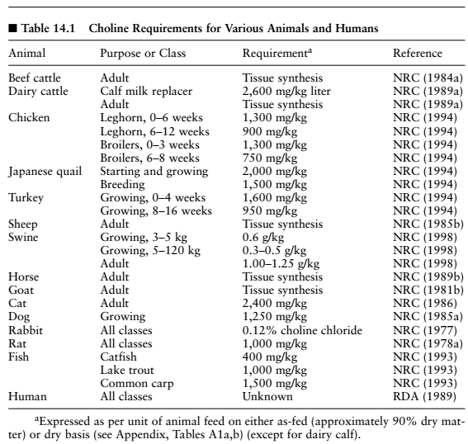

Slide 6
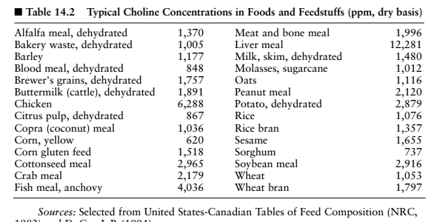
DEFICIENCY

Slide 7
Effects of Deficiency
Ruminants The ability of ruminants to synthesize the B vitamins including choline is well known. In cattle and sheep, orally ingested choline is rap- idly degraded in the rumen, but rumen microbes synthesize choline.
It has been found that ruminal synthesis and/or the unsupplemented diet do not always supply enough choline to meet feedlot cattle demands. Improved performance of feedlot cattle has been related to use of dietary choline, although not consistently in all experiments
. Reports from Washington (Swingle and Dyer, 1970) and Maryland (Rumsey, 1975) showed increased gains by as much as 6 to 7% and improved feed efficiency by 2.5 to 8% for finishing cattle when supplemented with 500 to 750 ppm dietary choline
. In other experiments with growing cattle, no response occurred after addition of dietary choline (Wise et al., 1964; Harris et al., 1966). Thus, choline, under certain conditions of high-concentrate feeding, may be limiting in the diet. Researchers have shown interest in choline in view of its possible lipotropic effect in high-producing dairy cows.
Atkins et al. (1983) and Erdman et al. (1984) studied the effects of supplementing choline on roughage adequate diets for dairy cattle and concluded that added choline had little effect on milk production, although slight increases were seen in feed intake and milk fat percentage. Limited research indicates that supplemental choline may be needed to obtain optimum milk fat, possibly through its effect on hepatic lipid metabolism.

Slide 8
Deficiency of choline in poultry
Growth retardation and perosis result from choline deficiency in young poultry. Perosis is the primary clinical sign of choline deficiency in chicks and turkey poults, whereas bobwhite quail develop enlarged hocks and bowed legs (NRC, 1994)
Progressively, the Achilles tendon slips from its condyles, thus rendering the bird relatively immobile. Some studies indicated that in prevention of perosis, choline is required for the phospholipids needed for normal maturation of the cartilage matrix of bone. Adult chickens probably synthesize sufficient choline to meet requirements for egg production.
Minimal dietary choline does not affect hatchability with either chickens or turkeys, but Japanese quail and their developing embryos readily express general.
Supplementary choline may be necessary for maintenance of egg size in quail (NRC, 1994). Contrary to some reports, 500 ppm supplemental choline to Leghorn hens increased egg weight while reducing specific gravity (Tapia Romero et al., 1985). Also, the choline growth requirement for quail is apparently higher than that
for chicks or poults. Choline requirement of growing chicks decreases with age, and it is generally not possible to produce a deficiency at an age over 8 weeks. It was observed that methylation of aminoethanol

Slide 9
Deficiency of choline in other animal species
DOGS AND CATS In growing cats, choline deficiency results in per lobular infiltration of the liver, hypoalbuminemia, and decreased growth (NRC, 1986). In young puppies, choline deficiency results in reduced appetite and growth rate, fatty metamorphosis of the liver, and atrophic changes of the thy- mus. Choline-deficient dogs with fatty livers show an increased rate of hepatic phospholipid synthesis following choline supplementation (NRC, 1985a).
Severity and nature of choline deficiency signs, as well as the time required for them to appear, seem to be highly variable and may depend on species or diet or both (Ketola, 1976). Channel catfish fed casein-gelatin diets containing excess methionine did not develop signs of choline deficiency; however, catfish fed diets adequate but not excessive in methionine did develop deficiency signs (Wilson and Poe, 1988).
Rainbow trout fed a choline-deficient diet developed light yellow- colored livers, protruded eyes, anemia, and extended abdomens (Kitamura et al., 1967), while lake trout fed a choline-deficient diet for 12 weeks had depressed growth rate and increased liver fat content (Ketola, 1976.
LABORATORY ANIMALS Guinea pigs, like young poultry, easily develop choline deficiency even with adequate dietary methionine. Clinical signs of choline deficiency in young guinea pigs include poor growth, anemia, muscular weakness, and some adrenal subcutaneous hemorrhages .

Slide 10
Toxicity
Experimental animal toxicity data on clinical signs of choline over- dosage include salivation, trembling, jerking, cyanosis, convulsions, and respiratory paralysis. Estimates of the oral LD50 of choline chloride in rats varied from 3.4 to 6.7 g/kg (Chan 1991).
Bell (1985) reported that when rats were exposed prenatally to 22 mg of soy lecithin preparation daily, sensorimotor development and brain cell maturation were altered.
Choline levels somewhat above the requirement (868 to 2,000 ppm) were shown to reduce rate and efficiency of gain in swine (Neumann et al., 1949; Southern et al., 1986). Derilo and Balnave (1980) reported reduced gain and efficiency in young broiler chicks fed a level of choline only slightly in excess of the requirement.
Studies with chickens suggest that dietary choline double the requirement is safe, with swine having a higher tolerance for choline (NRC, 1987). Work by Southern et al. (1986) showed that excess choline, up to 2,000 mg/kg above the recommended level, had no adverse effect on swine performance.

