Slide 1
Chapter 8: Resource Allocation

Slide 2
What is Resource Allocation
Up till now, the activities have been identified using various
techniques.
1.Using activity network analysis, we were able to identify
when the activities should take place: Activity span (LF ‐ ES).
2.Using PERT technique, we were able to forecast a range of
expected dates by which activities would be completed.
• In both cases, the availability of resources was not taken
into consideration.
• When we allocate resources to the identified activities .
This process is considered resource allocation.

Slide 3
What is Resource Allocation
The allocation of resources to activities will
lead to:
– the review and
– modification of the ideal activity plan.
• Resource allocation may lead to:
– Revising project completion dates.
– Narrowing activity time spans.

Slide 4
Resource Allocation Schedules
An activity schedule (revised):
– Start and completion dates.
• A resource schedule:
– When each resource will be required.
– Level of its requirement.
• A cost schedule:
– Showing the planned cumulative expenditure
incurred by the use of resources over time.
These schedules will be used on daily basis for
the control and management of the project.

Slide 5
Resource Nature
Resources can be:
– Item required for the execution of the project.
– Person required for the execution of the project.
Some resources will be required for a specific period and
some will be required for the whole duration of the project.
Which type of resources need to be the concern of the
project manager?
stationary and other office supplies (paper clips….)
office Manager should be concerned.
system analysts, software developers.
project manager should be concerned.

Slide 6
Resource Nature
Resources will fall into one of seven categories:
Labour (the project manager, system analysts, software developers……).
Equipment: used items (workstations, office equipment, desks, chairs…).
Materials (Consumed items – floppy disks, paper, printer ink…..).
Space : for additional staff recruited or contracted (Rooms, Cubicles).
Services (Telecommunication services, Cleaning services………..).
Time (The most rigid item of all).
• Extended if other resources are reduced and
• Reduced if other resources are increased.
Money (Secondary resource).
• Used to buy other resources,
• Is consumed while other resources are being used.

Slide 7
Identifying Resource Requirements
• Resource allocation plan:
– The first step is to prepare the resource requirement list:
• A list of the resources that will be required.
• Along with the expected level of demand.
– Normally this will be done by considering each activity in
turn.
– But there could be resources that are not activity specific.
• Resources that are part of the project infrastructure:
– Project manager.
• Resources required to support other resources.
– Office space required to house contract software developers.

Slide 8
Example

Slide 9
Precedence Network

Slide 10
Resource Scheduling
• After all the required resources have been
identified, they need to be scheduled
effectively.
• So we need to map the resources to the
activity plan to asses the distribution of the
resources over the duration of the project.
• This mapping is best done by representing the
activity plan as a bar chart and using a
resource histogram for each resource.

Slide 11
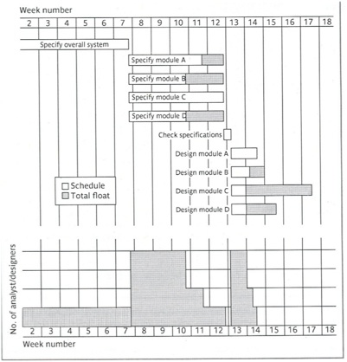
Bar chart and resource histogram for analyst/designers

Slide 12
From the previous histogram is there any ideal time foe an analyst/designer between the specification and design time?
You can also look at the precedence network in slide 9
Two of the analyst/designers stay idle for 12 days.
– From 49 to 61.
one stays idle for 7 days.
– 54 to 61.
One stays idle for 2 days.
– 59 to 61.

Slide 13
Resource Scheduling
• Allocating a recourse (a member of the project
team) to an activity limits the flexibility for
resource allocation and scheduling of other
activities.
– Since each activity has a start and an end date this
team member will not be available for the other
activities for that period.
• Due to the above it is a good idea to prioritize the
activities so that resources can be allocated to
competing activities in a rational order.

Slide 14
Prioritizing Activities
• Total Float Priority
– Activities with the smallest total float are given
highest priority.
– Thus Activities are allocated resources in
ascending order of total float.
– It is desirable to recalculate floats as the
scheduling proceeds. Why?

Slide 15
Critical Paths
• Resource scheduling will almost always change
the activity network.
• The changes oYen result in changes to the
critical path.
– Delaying an activity due to lack of resources
will cause that activity to become critical aYer
it uses up all its float.

Slide 16
Staff Allocation Issues
• Availability
– Whether a particular individual will be available when needed.
– Investigate the risks that can prevent that from happening.
• Criticality
– Allocating more experienced personnel to critical activities often:
• Shortens the project duration
• Or at least reduces the risk of overrun.
• Risk
– Allocating the most experienced staff to the highest‐risk activities is
likely to have the greatest effect in reducing overall project uncertainties.

Slide 17
Staff Allocation Issues
• Training
Allocate junior staff to appropriate non
critical activities, so there will be enough slack
for them to train and develop skills.
• Team Building
The selection of individuals in the project
team must take account of :
– the final shape of the project team,
– the way they will work together.

Slide 18
Cost Scheduling
• A detailed cost schedule will be created:
– Showing weekly or monthly costs over the life of the
project.
• Broad Categories
– Staff.
– Overheads (Office Space, Interest charges, Travel Costs,
Insurance and so on).
– Usage charges (for external resources or contractors,
leased/rental equipment).

Slide 20
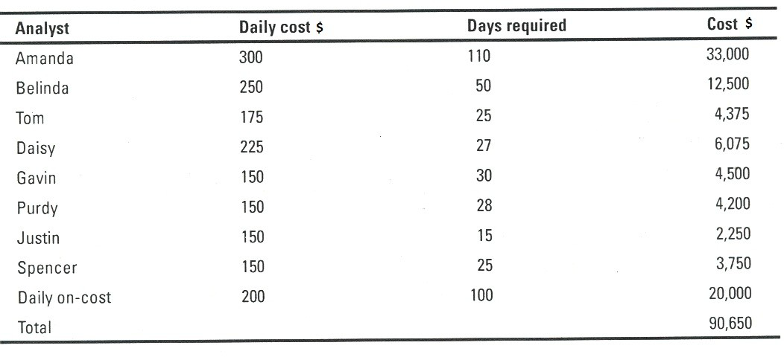
Project Cost Table

Slide 21
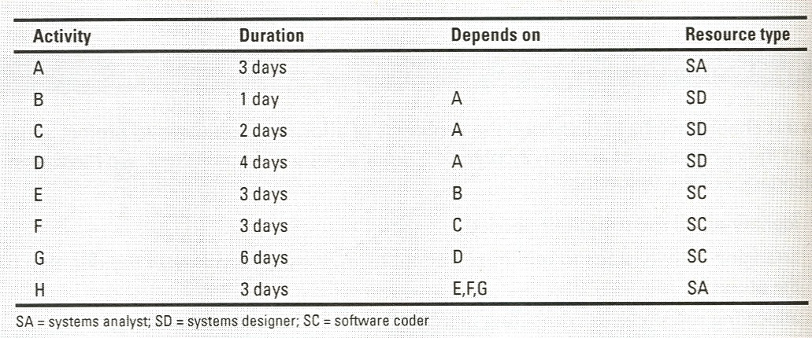
Exercise

Slide 22
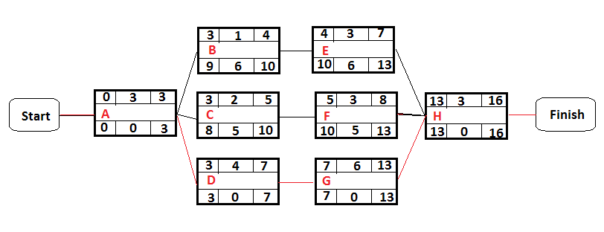
Precedence Network

Slide 23
Exercise (cont’d)
(1)How many of each type of resource
(minimum) will need to be recruited for the
project as a whole if the earliest finish date is
to be preserved? (1 SA, 3 SD, 2 SC)

Slide 24
Exercise (cont’d)
(2)What impact would there be on the project if there were only two system
designers?

Slide 25
Solution
• So if there were only two system designers,
the completion date of the project still will be
16 weeks and the critical path is still the
same.
• But now we have 5 staff members (1 SA, 2 SD,
2 SC) instead of 6 as before (1 SA, 3 SD, 2 SC) ,
which could result in reducing the project
expenditure (cost).

Slide 26
Exercise (cont’d)
(3)What impact would there be on the projec if there were only one system designer but you had three software coders?

Slide 27
Solution
• So if there were only one system designer but you
had three software coders, the compltion date
of the project still will be 16 weeks.
• But now we have 5 staff members (1 SA, 1 SD, 3
SC) instead of 6 as before (1 SA, 3 SD, 2 SC) ,
which could result in reducing the project
expenditure (cost).
• Also now we have 2 critical paths “start A‐ D‐ G‐H-finish”
and “start A‐ C‐ F‐H‐finish”, instead of only
one critical path as before “start A‐ D‐ G‐H‐finish”.

