Slide 1
HORT 308
MEDICINAL AND AROMATIC PLANTS

Slide 2
Turmeric

Slide 3
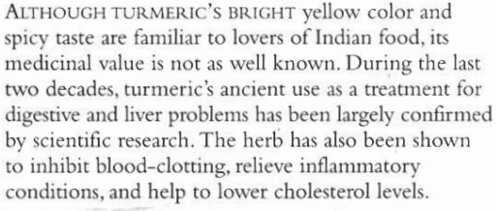
B.N Curcuma longa Family: Zingiberaceae

Slide 4
Habitat & Cultivation
Native to India & Southern Asia
Cultivated in Southern & Eastern Asia

Slide 5
Key Constituents
Volatile Oil (3-5%)
Curcumin
Bitter principles
Resin

Slide 6
Key Actions
Stimulate secretions of bile
Anti-inflammatory
Ease stomach pain
Antioxidant
Antibacterial

Slide 7
Traditional & Current Uses
Traditional remedy: (Liver) Jaundice, Digestive problems
Arthritis & Allergies
Circulatory disorders
Skin condition

Slide 8
Parts Used
Fresh & Dried rhizomes

Slide 9
Key Preparations
Powder
Decoction
Tincture
Poultice

Slide 10
Cardamom

Slide 11
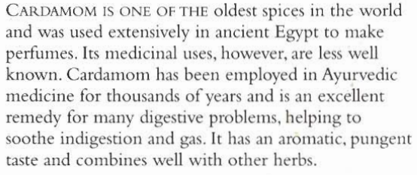
B.N Eletteria cardamomum Family: Zingiberaceae

Slide 12
Habitat & Cultivation
Native to Southern India and Sri Lanka
Grown 2500-5000 ft. above sea level
Now cultivated in India, Southern Asia, Indonesia and Guatemala

Slide 13
Key Constituents
Volatile Oil (borneol, camphor, pinene, humulene, caryophyllene, carvone, eucalyptole, terpinene and sabinene)

Slide 14
Key Actions
Ease stomach pain
Carminative
Aromatic
Warming digestive stimulant
Antispasmodic

Slide 15
Research
Proved in 1960 that volatile oil is strong antispasmodic, helpful in gas, colic and cramps

Slide 16
Traditional & Current Uses
Digestive problems
Asthma
Bronchitis
Kidney stone
Anorexia (Loss of appetite)
Urinary incontinence
Bad breath
Aphrodisiac

Slide 17
Parts Used
Seeds
Pods
Crushed seeds

Slide 18
Key Preparations
Infusion
Tincture

