Slide 1
CALLUS CULTURE

Slide 2
CONTENTS
History
Callus culture
Physical appearance of a callus
Culture establishment :media preparation, surface sterilization , inoculation and incubation conditions
Subculturing
Growth measurement of callus
Techniques to develop callus culture
References

Slide 3
HISTORY
1924 - Callus culture of carrots (Daucus carota)- R.Blumenthat
and P.Meyer - Pathological implications ,compared callus
tumour growth.
1927 - L.Rehwald - Cultivation of callus from carrot slices.
P.Boysen- Jensen – growth promoting substances found in
plant shoot tip would diffuse across a wound covered with
gelatin.
1928 – Frits Went collected this growth substance form coleptile
tips in tiny blocks of Agar.

Slide 4
1934 – F.Kogl , A. J. Hagen Smith and H.Erxleben – isolation and chemical analyses of the substance -plant hormone or auxin- indole -3-acetic acid (IAA)
1937- R.Gautheret – undifferentiated carrot tissues
1939 –R.J.Gautheret and Nobecourt, France, growth of callus from carrot cambium when using auxin in the nutrient medium.
P.R.White (USA) –Excised root tips of tomatoes(Lycopersicon)in continuous culture.
1939 – White reported successful culture of tobbaco (Nicotiana) callus.

Slide 5
1941 – J.van Overbeek, M.E. Conklin and Albert
F.Blakeslee- Coconut milk stimulated
callus formation in cultures of excised
embryos of jimson weed
(Daturastramonium).
1943 – White – A Handbook of Plant Tissue
Culture, accumulated knowledge of PTC.

Slide 6
CALLUS CULTURE
Callus : An unorganised mass of loosely arranged
parenchymatous cells which develop from parent
tissues due to proliferation of cells.
Angiosperms , gymnosperms , pteridophytes and
bryophytes.
Has the potentiality to produce normal roots and
embryoids-plantlets.
Callus culture: development of an unorganised mass of cells from an explant on an artificial medium supplemented with suitable PGR when provided with appropriate environment (i.e. Proper incubation conditions)

Slide 7
Physical Appearance Of A Callus
HARDNESS : Hard (due to lignification of cell walls), brittle or sometimes soft
COLOUR : Dirty or off white , creamish to brown or light green to dark green.
Degree of darker pattern varies from plant to plant and mainly depends upon the quantity of polyphenols present in the plant species.
Higher the polyphenol content darker the callus appear, i.e. Brown coloration on the culture.

Slide 8
Development Of Aseptic Callus Cultures
EXPLANTS : Juvenile tissues, seedlings , young shoots , buds , root tips, developing embryos: fruits, floral parts, tubers and bulbs.
CULTURE MEDIUM :
Media: MS
Hormonal balance: Auxin : Cytokinin = 1
Carbon source :sucrose (3% w/v )
ph = 5.6 -6.0, optimum 5.8
Gelling agent

Slide 9
Surface Sterilization
Wash throughly tween-20
under running tap -----→ Antifungal (Bavistin; 0.04% )
water Antibacterial agents
(Streptomycin sulfate;0.0 4 % )
__UNDER_ROOM_ENV____________________
↓ 15-20 min
Double Distilled Water
↓washing
70 % Ethanol treatment
↓ 1 min / dip
UNDER LAMINAR AIR FLOW HgCl2 treatment
(0.04 or 0.02 %)
↓4-5 min
Washing with Autoclaved Water

Slide 10
Inoculation and Incubation
Leaf segments, buds, root tips etc.
Nodal explant
Cutting of the nodal ends that comes in contact with the surface sterilant with the sterile surgical blade
Place the explant in vertical position on medium supplemented with appropriate PGR with the help of forceps.
Segmentation of the explant into2-3 parts i.e. Basal medium and tip with sterile surgical blade
Place the explant with their abaxial surface in contact with the medium with the help of sterile inoculating forceps.

Slide 11
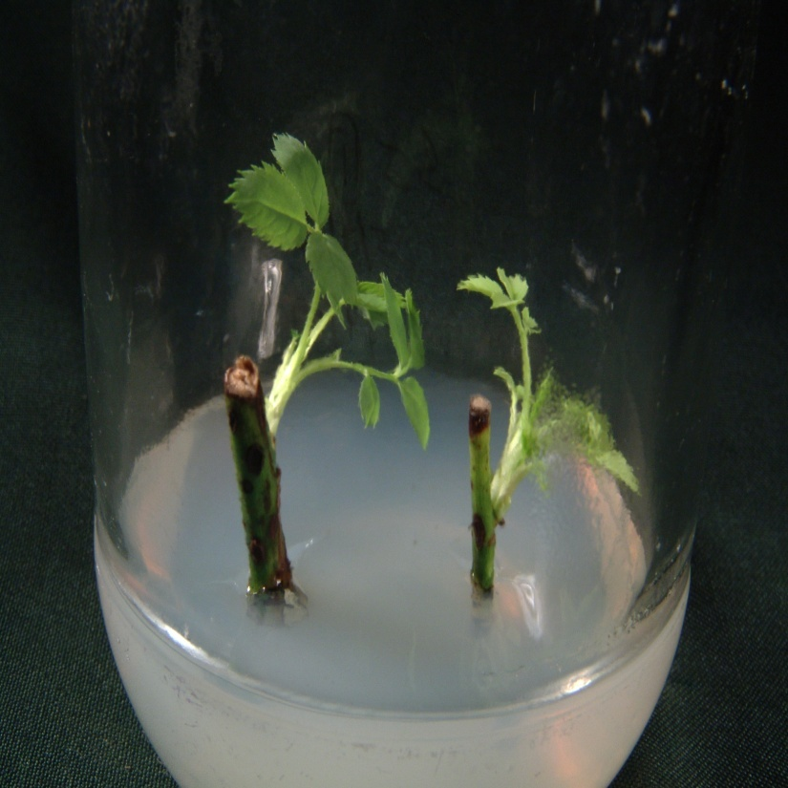
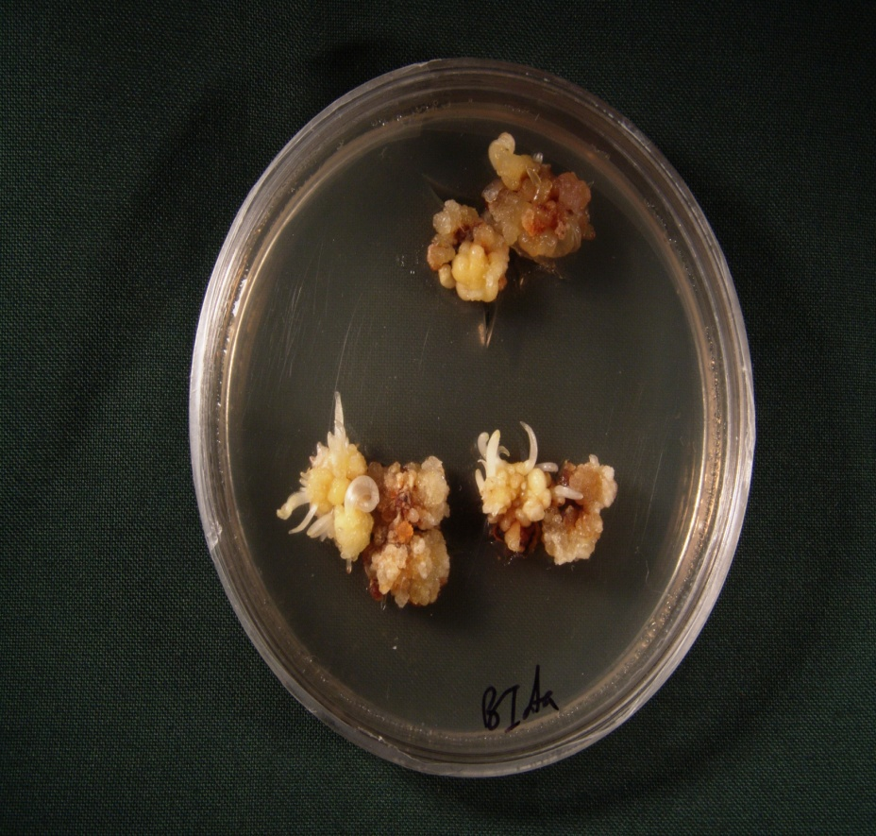
Further development -Organogenesis
Nodal explant
Bud segments
Rose (shoot proliferation)
Lilly (shooting)

Slide 12
Incubation :
Incubation conditions : The Environment
Temperature :25 ± 2⁰C
Light : 5000-10,000 lux m
Duration of incubation: 16 hr light
08 hr dark

Slide 13
How a piece of explant gets converted into the callus ?
Produced from the outer layers of cortical cells
in a stem explant by repetitive division of cells
These deviding cells create pressure on the epidermis --- rupturing of the epidermis exposing newly formed callus
Separation of callus and then subculturing it.
2-3 weeks to grow (10-15 days) but sometimes 4 weeks.

Slide 14
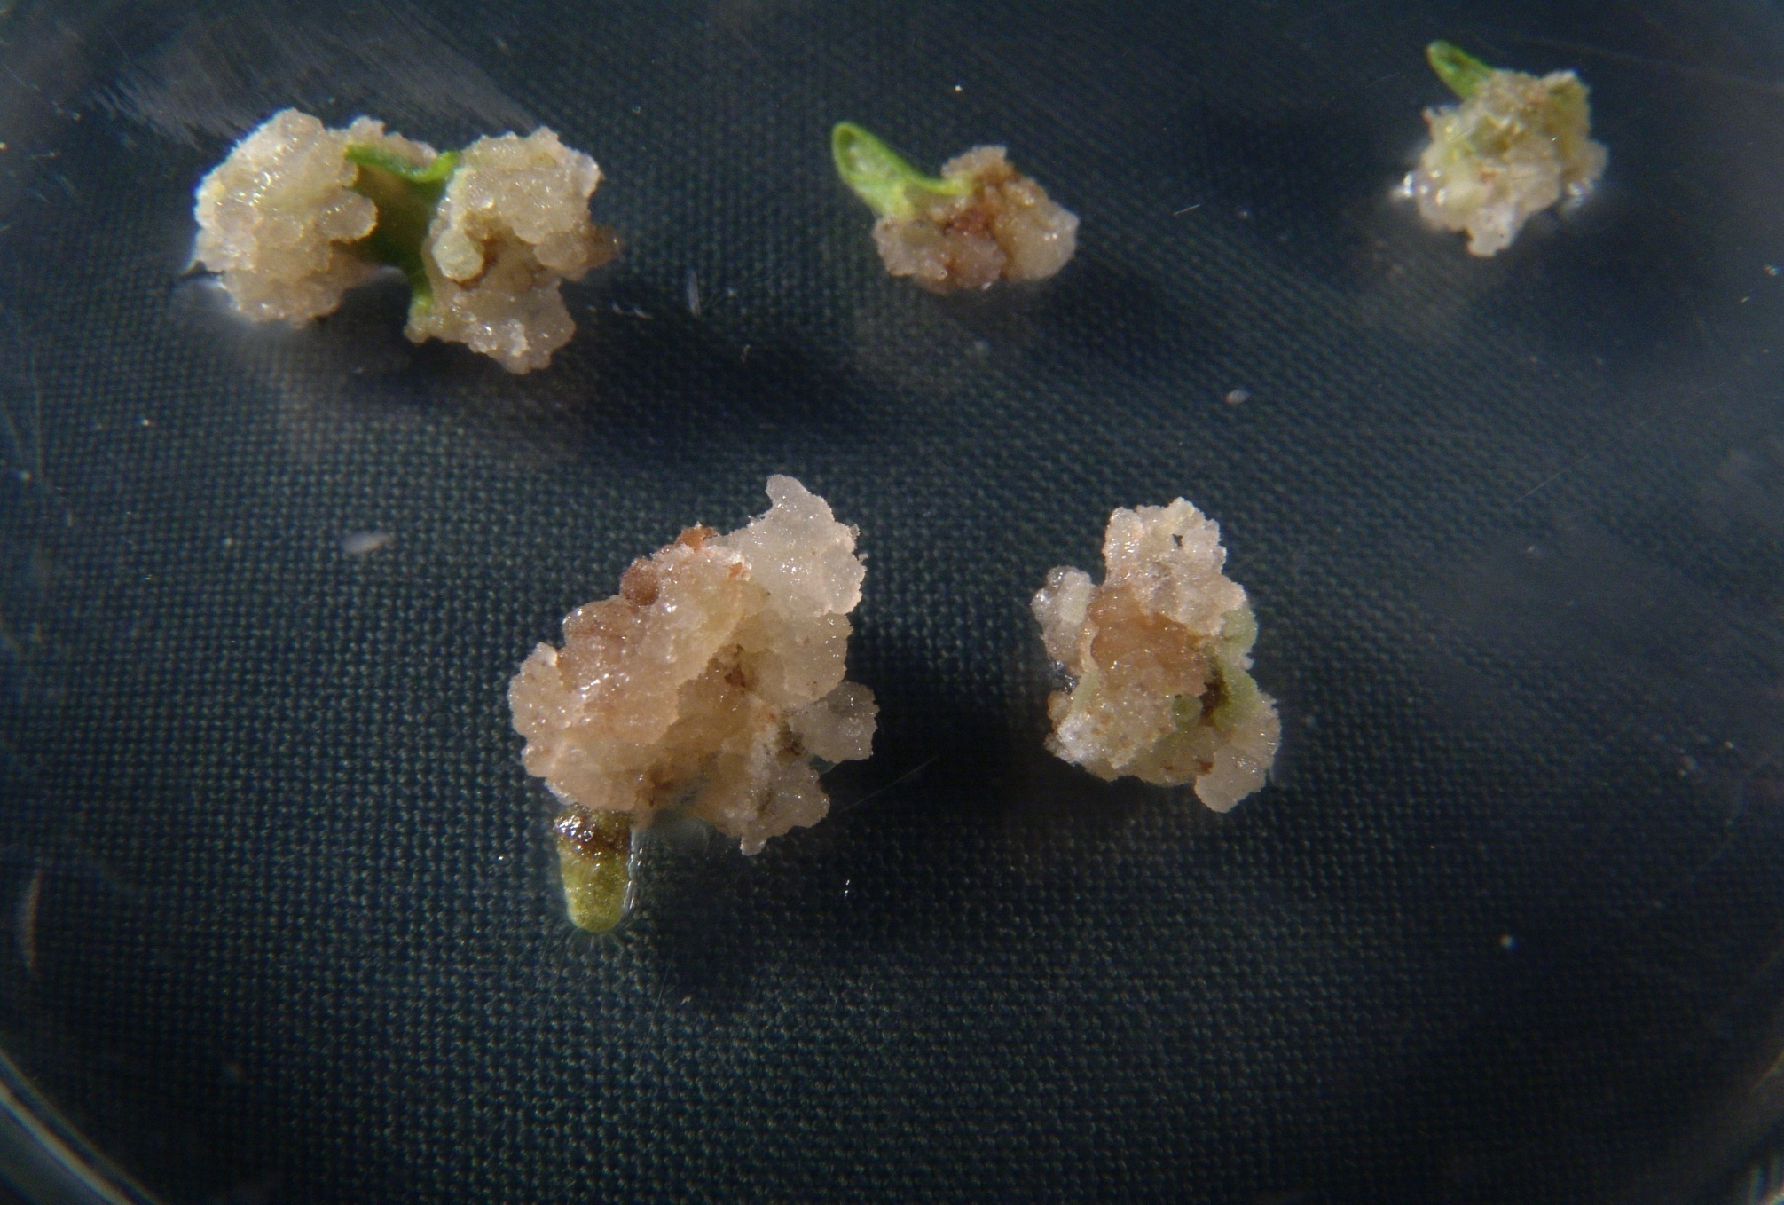
Callus culture of Lavandula officinalis
Lavandula Officinalis

Slide 15
SUBCULTURING OF THE CALLUS CULTURE
3-4 weeks
250-500mg approx. pieces -------- transferred to the fresh media.
NEED:
Nutrition depletion
Accumulation of toxic substances
Drying of media
ADVANTAGES :
1)Maintains the state of viability of cells
2)Provides fresh instalment of media for further growth

Slide 16
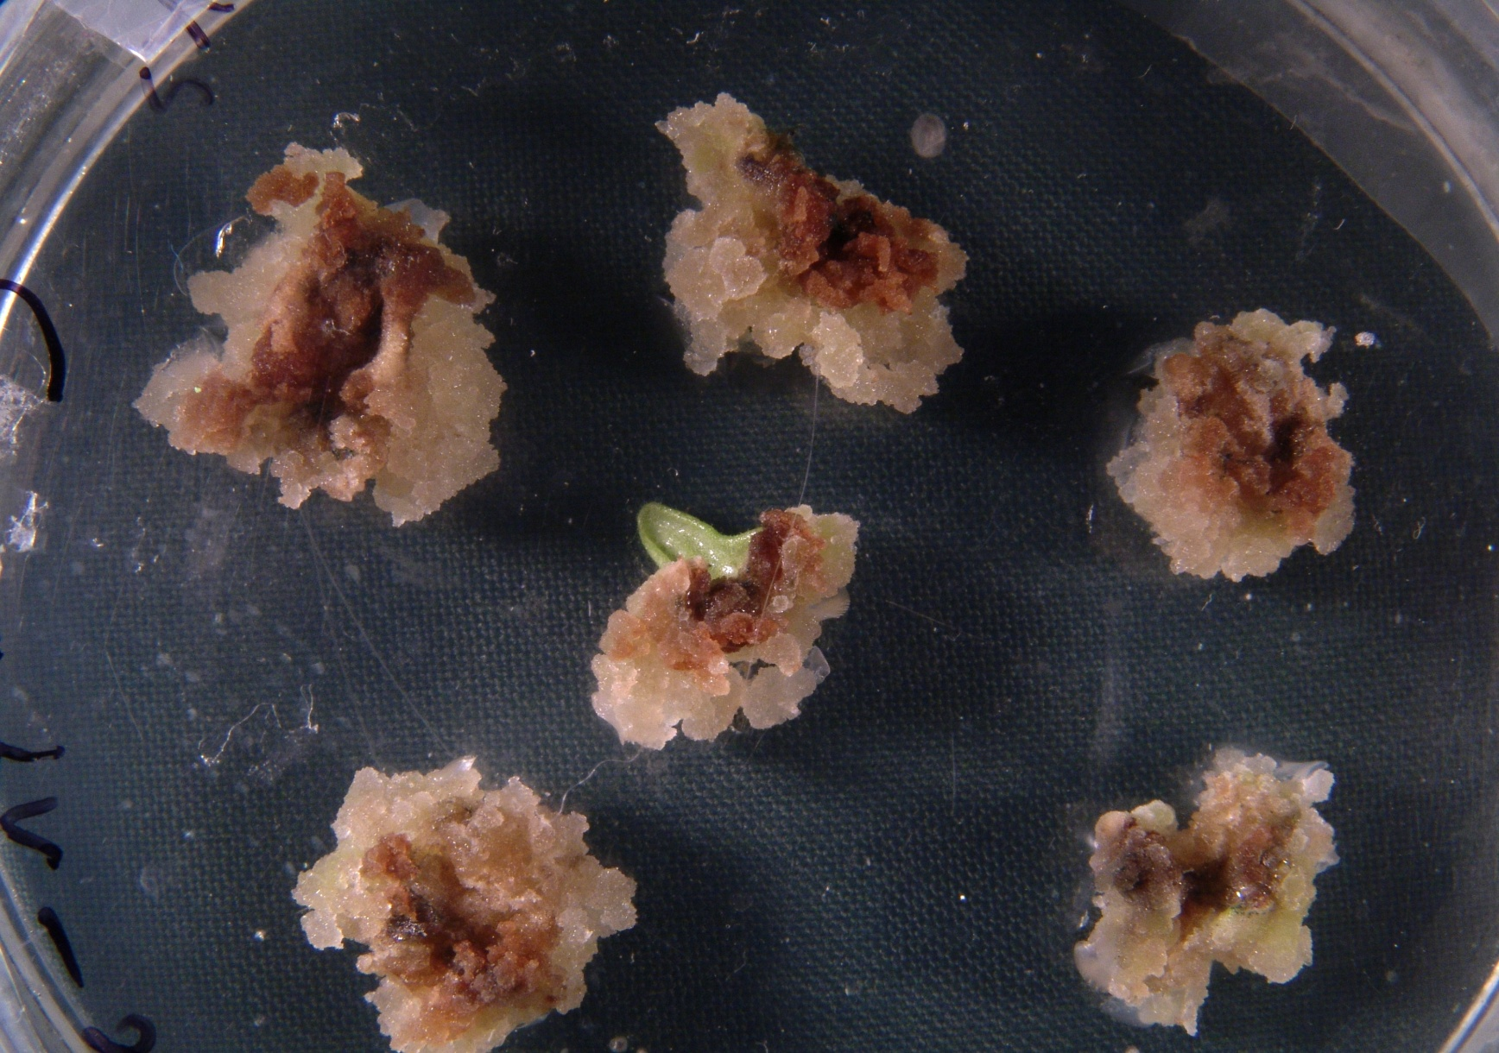

Slide 17
DISADVANTAGES
Cells lose the power to regenerate to a plantlet.
2)Chromosomal abbrations : polyploidy and aneuploidy. Polyploid cells appear to originate through endoreduplication( additional rounds of DNA replication without intervening cell division) ;
aneuploid cells-anaphase irregularities
3)Non chromosomal changes : changes in metabolic pathways and alteration in composition of media.
4)Selection of explant size highly dependent upon the type of glassware is being used for culture purpose.

Slide 18
Flow sheet (subculturing process)
Callus work station(glass plate , sterile)
cutting of the callus into small
pieces (250-500 mg approx)
fresh media having appropriate composition
and hormonal balance
OR
Agitation can be done (25-150 rpm)-------fresh media

Slide 19
Growth measurement of callus culture
Fresh weight or wet weight method:
Pre weighed (in wet condition) circular filter of nylon fabric supported in a Hartley funnel
Cell washing to remove the medium
Draining under vacuum, reweighing .

Slide 20
Dry weight method
Collection of cells on pre weighed dry nylon filter paper
Drying of cells for 12 hours at 60⁰C
Reweighing
Cell weight is expressed as per culture or as per 10⁶ cells

Slide 21
Calculating the Mitotic index
MI-ratio of nuclei undergoing mitosis(including prophase) to total nuclei.
MI =>
No. Of nuclei in mitosis × 100
Total No. Of nuclei examined in the sample
A MI of 0.3 means that 30% of cells in the population are observed in mitosis.

Slide 22
calculating the respiration rate
Utilization of carbon source and oxygen are related to metabolic activity of cells.
More is the consumption of sugar and oxygen more active are the cells.

Slide 23
Techniques/routes to culture callus
THE FILTER PAPER RAFT NURSE TECHNIQUE:
Muir et.al (1954)--- to culture single cells and friable calli of tobacco marigold.
Cultivating individual cells on top of an actively growing callus(of related sp) .
Use of micropipette or microspatula.
Placing 8×8mm squares of filter paper on the nurse tissue(callus), wetted with nutrients and liquid from the nurse tissue
Colony dev-transferred to agar medium.

Slide 24
A number of recalcitrant species , such as avocado, coconut, and lychee.
THE MICROCHAMBER THECHNIQUE :
Jones et. Al (1960)
Replacement of nurse tissue with conditioned media(spent media ; already supported the growth of a tissue, have certain growth factors that promote/boast the growth of another plant tissue)

Slide 25
Process
A drop of the medium carrying the cells of interest is isolated from suspension
Placing on a sterile microscope slide and ringed with sterile mineral oil (a drop on either side of the culture drop and coverglass placed on each drop
Placing of third coverglass----- formation of microchamber slide placed in petri plate and incubated
development of cell colonies-------fres media

Slide 26
PLATING TECHNIQUES
POUR PLATE : Each dilution is mixed with 15 ml of molten agar medium. Temp-48-50 ⁰C
Pouring in sterile petri plate
Incubation and the colonies develops

Slide 27
SPREAD PLATE TECHNIQUE:
Agar plate should be dried for 15 min at 55⁰C
for 45 min at 37⁰C.
Add 0.2 ml of portions from each dilution and spread evenly on surface of media
Disadvantage: some cells are taken up by the glass rod so this will decrease the count.

Slide 28
DIALYSIS TUBING TECHNIQUE:
Street and Steward (1969)
Mainly involved in cell suspension cultures
Used when cell concentration is less than the critical cell density=> 9 -15 × 10³ cells/ml
Carried out in dialysis tube
A high cell density of nursing tissues of closly related species which is more responsive is selected
Use of conditioned media, high conc of growth factors
Nurse cell grows well and the growth factors diffuses out and provide nutrition for growth of cells of interested callus of low density.

Slide 29
References
Plant Biotechnology by Purohit
Plant tissue culture by S.S.Bhojwani and M.K.Razdan
Introduction to Biotechnology by A.K.Panday and K.S. Bilgrami.
Biotechnology by B.D.Singh
Plant Biotechnology by K.G.Ramawat
Methods in Plant tissue culture by U.Kumar
Intenet:http://google.com

