Slide 1
Managing data resources
Management Information System
BCMP-302

Slide 2
Objectives
Why do businesses have trouble finding the information they need in their information systems?
How does a database management system help businesses improve the organization of their information?

Slide 3
The database approach
The database approach is an improvement on the shared file solution as the use of a database management system (DBMS) provides facilities for querying, data security and integrity, and allows simultaneous access to data by a number of different users.
At this point we should explain some important terminology:
Database: A database is a collection of related data.
Database management system: The term 'database management system', often abbreviated to DBMS, refers to a software system used to create and manage databases. The software of such systems is
complex,
consisting of a number of different components
System catalogue/Data dictionary: The description of the data in the database management system.
Database application: Database application refers to a program, or related set of programs, which use the database management system to perform the computer-related tasks of a particular business function, such as order processing.

Slide 4
Traditional File Processing System
Before the use of computer, a manual file system was used to maintain the records and files.
All the data was stored in files and it makes it easy to find any information.
But this system was good only for small organizations having small number of items.
It has many disadvantages given below:
It was time consuming.
Inefficient to maintain the record of big firm having large number of items.
It requires a lots of labor work to do.
It becomes more complex when anyone requires changing the information.

Slide 5
Traditional File Processing System
It was totally computer based system where all the information is store in different computer files.
Also traditional files system stores data in a manner that all the departments of an organization have their own set of files that creates data redundancy.
For example:
lets us take an example of: College where student record for examination is stored & their library record is stored in different file that creates many duplicate values like roll Number, Name and Father Name.

Slide 6
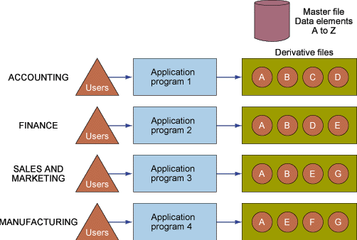
Traditional File Processing System
Figure 1-7
Traditional File Processing

Slide 7
Purpose of Database
A database should be a repository of data needed for an organization's data processing. That data should be
accurate,
private, and
protected from damage.
Advantages of Using Databases
Database minimizes data redundancy to a great extent.
The database can control the inconsistency of data to a large extent.
Sharing of data is also possible using the database.

Slide 8
Purpose of Database
Advantages of Using Databases
Database enforce standards.
The use of Databases can ensure data security.
Integrity can be managed using the database
Risks of the database approach
New specialized personnel: Need to hire or train new personnel e.g. database administrators and application programmers.
Need for explicit backup
Organizational conflict: Different departments have different information needs and data representation.
Large size: Often needs alarmingly large amounts of processing power.
Expensive: Software and hardware expenses.
High impact of failure: Concentration of processing and resources makes an organization vulnerable if the system fails for any length of time.

Slide 9
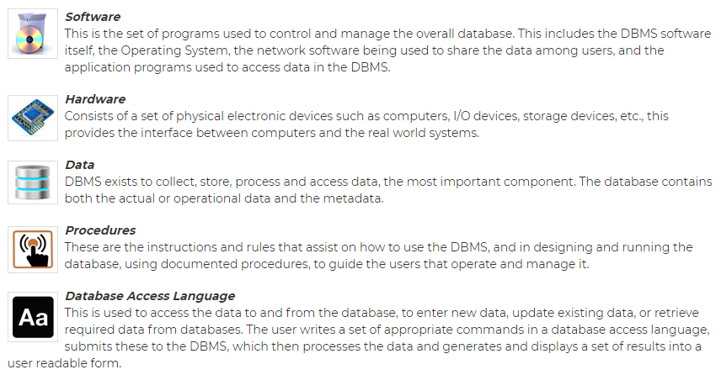
Components of DBMS
DBMS have several components, each performing very
significant tasks in the database management system environment.
Below is a list of
components within the database and its environment.

Slide 10
Basic Terminologies Related to Database
Relation: In general, a relation is a table, i.e., data is arranged in rows and columns. A relation has the following properties:
In any given column of a table, all the items are of the same kind, whereas items in different columns may not be of the same kind.
For a row, each column must have an atomic value, and also for a row, a column cannot have more than one value.
All rows of a relation are distinct.
The ordering of rows in a relationship is irrelevant.
The column of a relation are assigned distinct names, and the ordering of these columns is irrelevant.

Slide 11
Basic Terminologies Related to Database
Tuple: The rows of tables in a relationship are generally termed as Tuples.
Attributes: The columns or fields of a table is termed as Attributes.
Degree: The number of attributes in a relation determines the degree of relation. A relation having three attributes is said to have a relation of degree 3.
Cardinality: The number of tuples or rows in a relation is termed as cardinality.

Slide 12
Types of databases
A database is a collection of data or records. Database management systems are designed to manage databases.
There are several types of database management systems. Here is a list of some common database management systems:
Relational DBMS
Hierarchical and Network DBMS
Object-Oriented Databases

Slide 13
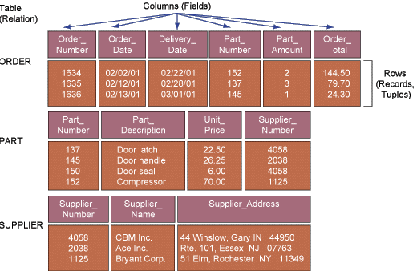
Relational DBMS
Represents data as two-dimensional tables called relations
Relates data across tables based on common data element
Examples: DB2, Oracle, MS SQL Server
Figure 2-7

Slide 14
Hierarchical DBMS
Organizes data in a tree-like structure
Supports one-to-many parent-child relationships
Prevalent in large legacy systems
Figure 3-7

Slide 15
Network DBMS
Depicts data logically as many-to-many relationships
A network database looks more like a cobweb or interconnected network of records.
In network databases, children are called members and parents are called occupiers. The difference between each child or member is that it can have more than one parent.
Network DBMS

Slide 16
Object Oriented Database
It takes more than the storage of programming language objects. Object DBMS's increase the semantics of C++ and Java.
Object-oriented DBMS: Stores data and procedures as objects that can be retrieved and shared automatically

Slide 17
Relation

