Slide 1
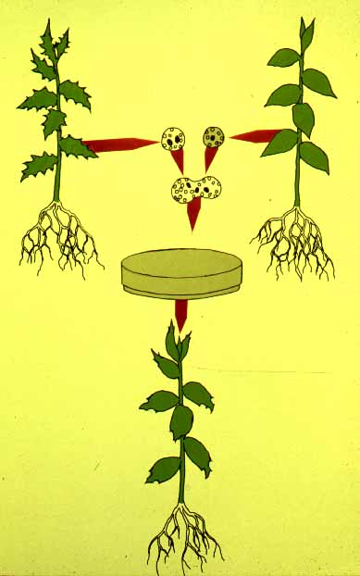
SOMATIC HYBRIDIZATION

Slide 2
Development of hybrid plants through the fusion of somatic protoplasts of two different plant species/varieties is called somatic hybridization

Slide 3
Somatic hybridization technique
1. isolation of protoplast
2. Fusion of the protoplasts of desired species/varieties
3. Identification and Selection of somatic hybrid cells
4. Culture of the hybrid cells
5. Regeneration of hybrid plants

Slide 4
Isolation of Protoplast
(Separartion of protoplasts from plant tissue)
1. Mechanical Method
2. Enzymatic Method

Slide 5
1. Mechanical Method
Plant Tissue
Cells Plasmolysis
Microscope Observation of cells
Release of protoplasm
Removing cell wall
Collection of protoplasm

Slide 6
1. Mechanical Method
Used for vacuolated cells like onion bulb scale, radish and beet root tissues
Low yield of protoplast
Laborious and tedious process
Low protoplast viability

Slide 7
Enzymatic Method
Leaf sterlization, removal of
epidermis
Plasmolysed
cells
Plasmolysed
cells
Pectinase +cellulase
Pectinase
Release of
isolated cells
Protoplasm
released
Protoplasm released
cellulase
Isolated
Protoplasm

Slide 8
Enzymatic Method
Used for variety of tissues and organs including leaves, petioles, fruits, roots, coleoptiles, hypocotyls, stem, shoot apices, embryo microspores
Mesophyll tissue - most suitable source
High yield of protoplast
Easy to perform
More protoplast viability

Slide 9
Protoplast Fusion
(Fusion of protoplasts of two different genomes)
1. Spontaneous Fusion
2. Induced Fusion
Intraspecific
Intergeneric
Chemofusion
Mechanical
Fusion
Electrofusion

Slide 10
Spontaneous Fusion
Protoplast fuse spontaneously during isolation process mainly due to physical contact
Intraspecific produce homokaryones
Intergeneric have no importance

Slide 11
Induced Fusion
Chemofusion- fusion induced by chemicals
Types of fusogens
PEG
NaNo₃
Ca ²⁺ ions
Polyvinyl alcohal

Slide 12
Induced Fusion
Mechanical Fusion- Physical fusion of protoplasts under microscope by using micromanipulator and perfusion micropipette
Electrofusion- Fusion induced by electrical stimulation
Pearl chain of protoplasts is formed by low strength electric field (10kv m⁻¹)
Fusion of protoplasts of pearl chain is induced by the application of high strength electric field (100kv m⁻¹) for few microseco

Slide 13
Identification and Selection of somatic hybrid cells
Hybrid identification- Based on difference between the parental cells and hybrid cell with respect to
Pigmentation
Cytoplasmic markers
Fluorochromes like FITC (fluoroscein isothiocyanate) and RITC (Rhodamine isothiocyanate) are used for labelling of hybrid cells
Presence of chloroplast
Nuclear staining
Heterokaryon is stained by carbol-fuschin, aceto-carmine or aceto-orcein stain

Slide 14
Hybrid Selection
(Several markers are used )
Genetic complementation
Phytotoxins
Specific amino acid
Auxin autotrophy
Antibiotics
Auxotrophic and metabolic mutants
Chromosomal analysis
Herbicides

Slide 15
Culture of the hybrid cells
Hybrid cells are cultured on suitable medium provided with the appropriate culture conditions.

Slide 16
Regeneration of hybrid plants
Plants are induced to regenerate from hybrid calli
These hybrid plants must be at least partially fertile, in addition to having some useful property, to be of any use in breeding schemes.

Slide 17
Advantages of somatic hybridization
Production of novel interspecific and intergenic hybrid
Pomato (Hybrid of potato and tomato)
Production of fertile diploids and polypoids from sexually sterile haploids, triploids and aneuploids
Transfer gene for disease resistance, abiotic stress resistance, herbicide resistance and many other quality characters

Slide 18
Advantages of somatic hybridization
Production of heterozygous lines in the single species which cannot be propagated by vegetative means
Studies on the fate of plasma genes
Production of unique hybrids of nucleus and cytoplasm

Slide 19
Limitations of Somatic hybridization
Poor regeneration of hybrid plants
Non-viability of fused products
Not successful in all plants.
Production of unfavorable hybrids
Lack of an efficient method for selection of hybrids
No confirmation of expression of particular trait in somatic hybrids

Slide 20
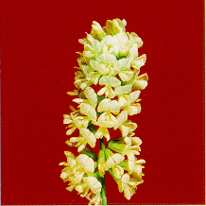
Thank
You

