Slide 1
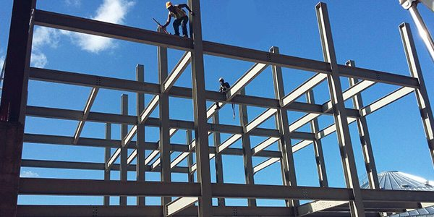
COLLEGE OF ENGINEERING AND TECHNOLOGY UNIVERSITY OF SARGODHA DESIGN OF STRUCTURES (CE-409) 01-Credit Hour
LECTURE-3
STRUCTURAL FORMS

Slide 2
STRUCTURAL FORMS
Trusses
Cables and Arhces
Surface Structures
Frames

Slide 3
STRUCTURAL FORMS
Trusses:
When the span of a structure is required to be large and its depth is not an important criterion for design, a truss may be selected.
Trusses consist of slender elements usually arranged in triangular fashion.
Planar trusses are composed of members that lie in the same plane and are frequently used for bridge and roof support.
whereas space trusses have members extending in three dimensions and are suitable for derricks and towers.
Due to the geometric arrangement of its members, loads that cause the entire truss to bend are converted into tensile or compressive forces in the members.
Because of the above advantages of a truss compared to beam is that it uses less material to support a given load.

Slide 4
STRUCTURAL FORMS
Trusses:
A truss is also constructed from long and slender elements, which can be arranged in various ways to support a load.
Most often, it is economically feasible to use a truss to cover spans ranging from 30 ft (9m) to 400 ft (122 m), although trusses have been used on occasion for spans of greater length.

Slide 5
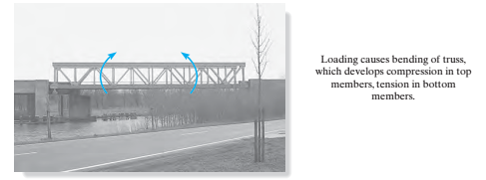
STRUCTURAL FORMS
Trusses:

Slide 6
STRUCTURAL FORMS
Cables and Arches:
Two other forms of structures used to span long distances are the cable and arch.
Cables are usually flexible and carry their loads in tension.
They are commonly used to support bridges and building roofs, when used for these purposes, the cable has an advantage over the beam and the truss, especially for spans that are greater than 150 ft (46 m).
Because they are always in tension, cables will not become unstable and suddenly collapse, as may happen with beams or trusses.
Furthermore, the truss will require added costs for construction and increased depth as the span increases.
Use of cables, on the other hand, is limited only by their sag, weight and methods of anchorage.

Slide 7
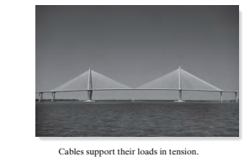
STRUCTURAL FORMS

Slide 8
STRUCTURAL FORMS
Cables and Arches:
The arch achieves its strength in compression, since it has a reverse curvature to that of the cable.
The arch must be rigid, however, in order to maintain its shape and this results in secondary loadings involving shear and moment, which must be considered in its design.
Arhces are frequently used in bridge structures, dome roofs and for openings in masonry walls

Slide 9
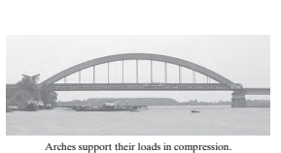
STRUCTURAL FORMS

Slide 10
STRUCTURAL FORMS
Frames:
Frames are often used in buildings and are composed of beams and columns that are either pin or fixed connected.
Like trusses, frames extend in two or three dimensions.
The loading on a frame causes bending of its members and if it has rigid joint connections, this structure is generally “indeterminate” from a standpoint of analysis.
The strength of such a frame is derived from the moment interactions between the beams and the columns at the rigid joints.

Slide 11
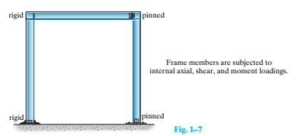
STRUCTURAL FORMS

Slide 12
REINFORCED CONCRETE MEMBERS
Reinforced concrete structures consist of a series of “members” that interact to support the loads placed on the structure.
The second floor of the building in figure. 1-6 is built of concrete joist-slab construction.
Here, a series of parallel ribs or joists support the load from the top slab.
The reactions supporting the joists apply loads to the beams, which in turn are supported by columns. In such a floor, the top slab have two functions:
it transfers load laterally to the joists
It serves as the top flange of the joists, which act as T-shaped beams that transmit the load to the beams running at right angles to the joists.

Slide 13
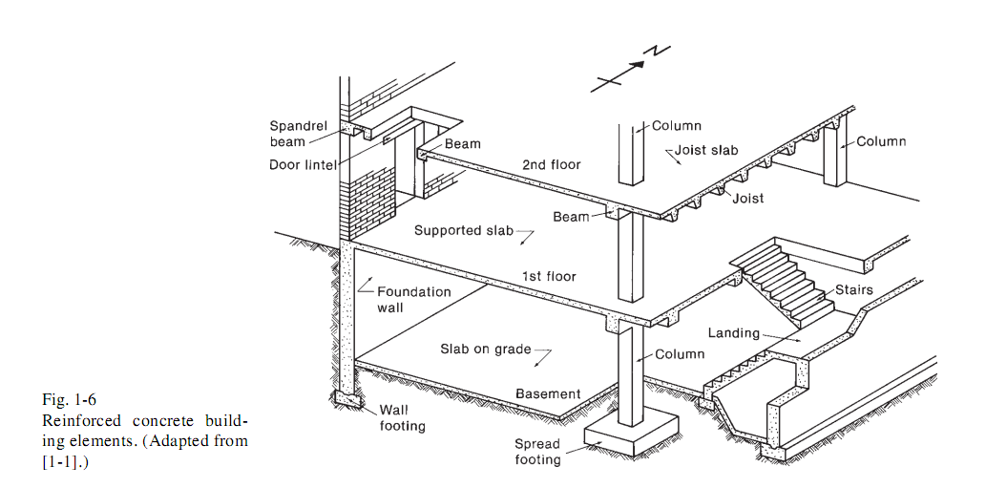

Slide 14
REINFORCED CONCRETE MEMBERS
The first floor of the building in figure 1.6 has a slab-and-beam design in which the slab spans between beams, which in turn apply loads to the columns.
The column loads are applied to spread footings, which distribute the load over an area of soil sufficient to prevent overloading of the soil.
Some soil conditions require the use of pile foundations or other deep foundations.
At the perimeter of the building, the floor loads are supported either directly on the walls as shown in figure 1.6 or on exterior columns as shown in figure 1.7.
The walls or columns in turn are supported by a basement wall and wall footings.
The first and second floor slabs in figure 1.6 are assumed to carry the loads in a north-south direction (see direction arrow) to the joists or beams, which carry the loads in an east-west direction to other beams, girders, columns or walls

Slide 15
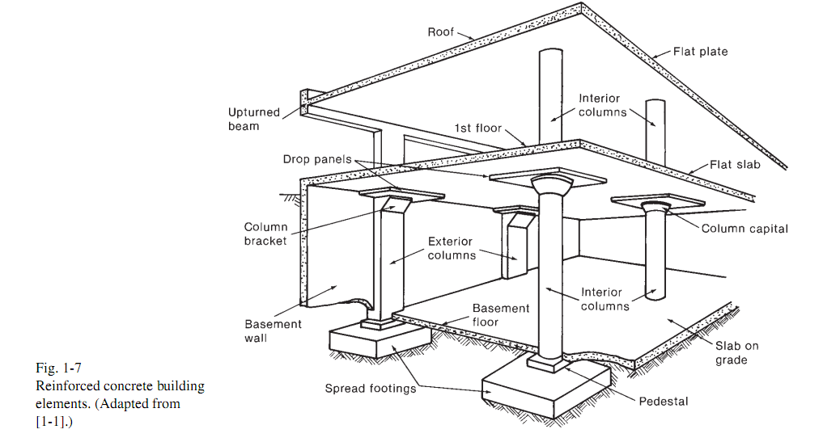

Slide 16
REINFORCED CONCRETE MEMBERS
This is referred to as one-way slab action and is analogous to a wooden floor in a house, in which the floor decking transmits loads to perpendicular floor joists, which carry the loads to supporting beams and so on.
The ability to form and construct concrete slabs makes possible the slab or plate type of structure shown in figure 1.7.
Here the loads applied to the roof and the floor are transmitted in two directions to the columns by plate action.
Such slabs are referred to as two-way slabs.

Slide 17
STRUCTURAL FORMS
The figures that follow show some of the principal structural forms of reinforced concrete.
Floor systems for buildings include the monolithic slab-and-beam floor shown in figure 1.1, the one way-joist system of figure. 1.2 and the flat plate floor without beams or girders, shown in figure. 1.3.
The flat slab floor of figure. 1.4, frequently used for more heavily loaded buildings such as warehouses, is similar to the flat plate floor, but makes use of increase slab thickness in the vicinity of the columns as well as flared columns tops to reduce stresses and increase strength in the support region.
The choice among these and other systems for floor and roofs depends upon functional requirements, loads, spans and permissible member depth as well as on cost and esthetic factors.

Slide 18
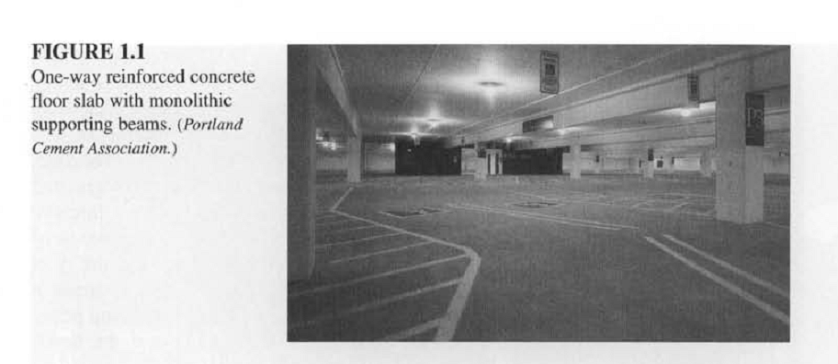

Slide 19
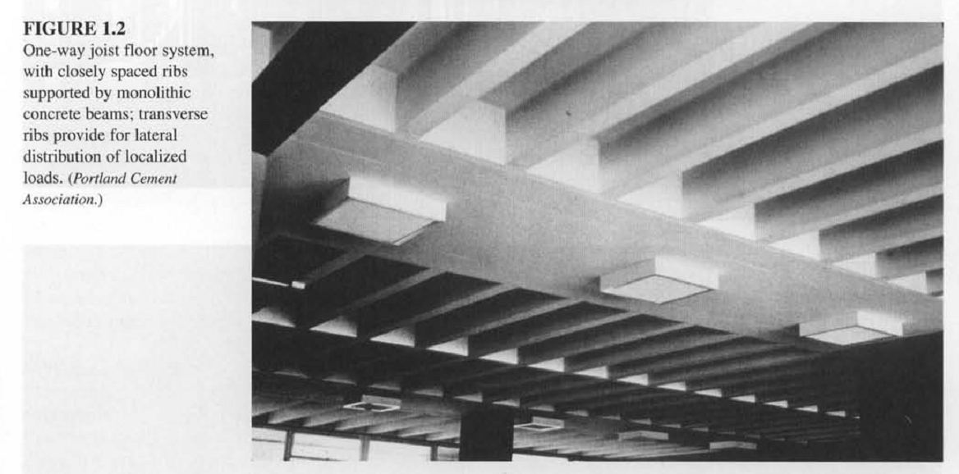

Slide 20
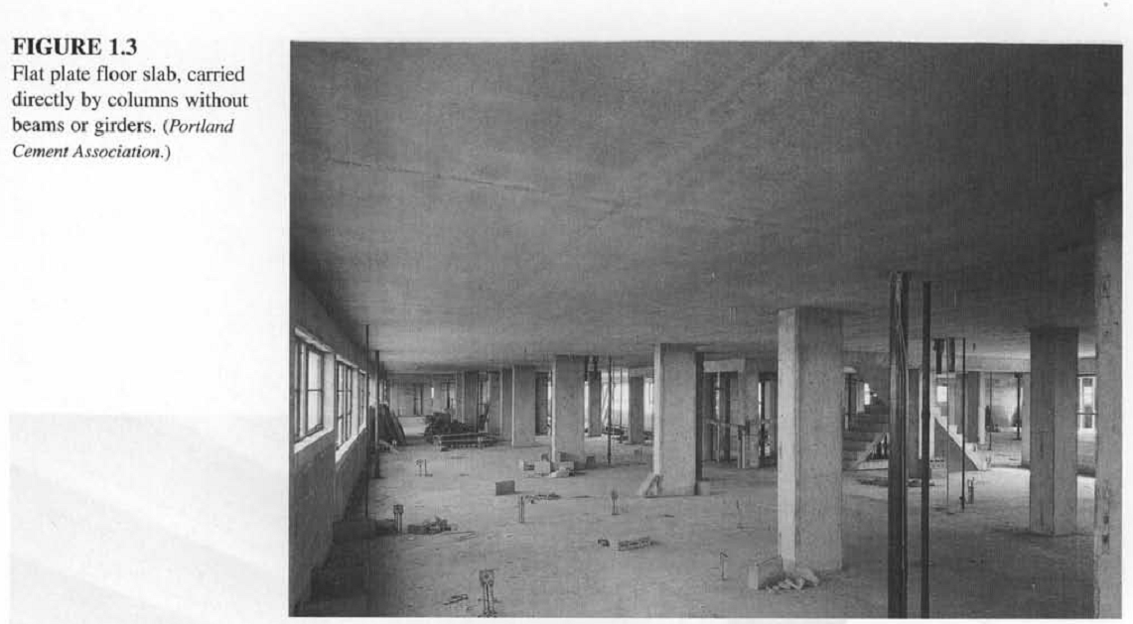

Slide 21
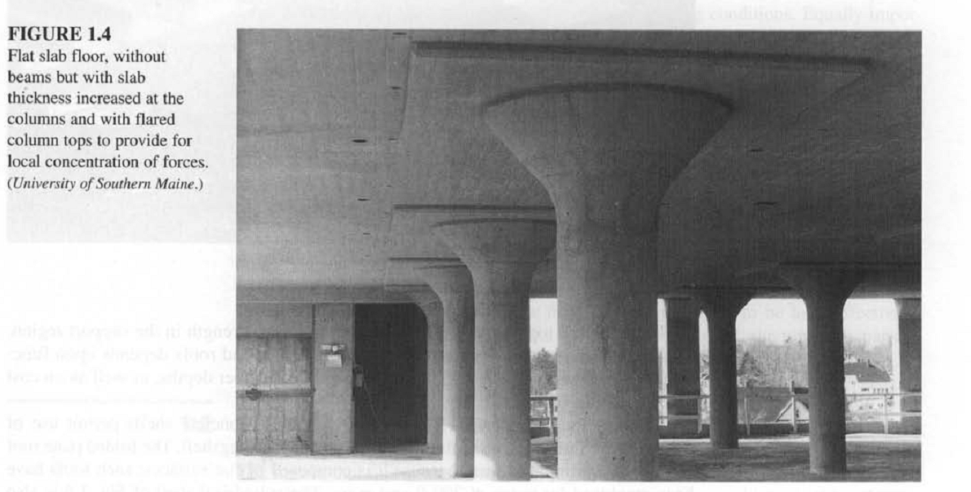

Slide 22
STRUCTURAL FORMS
Where long clear spans are required for roofs, concrete shell permit use of extremely thin surfaces, often thinner, relatively than an eggshell.
The folded plate roof of figure 1.5 is simple to form because it is composed of flat surfaces, such roofs have been employed for spans of 200 ft and more.
The cylindrical shell of figure 1.6 is also relatively easy to form because it has only a single curvature, it is similar to the folded plate in its structural behavior and range of spans and loads.
Shells of this type once quite popular in the united states and remain popular in other parts of the world.
Doubly curved shell surfaces may be generated by simple mathematical curves such as circular arcs, parabolas and hyperbolas or they may be composed of complex combinations of shapes.

Slide 23
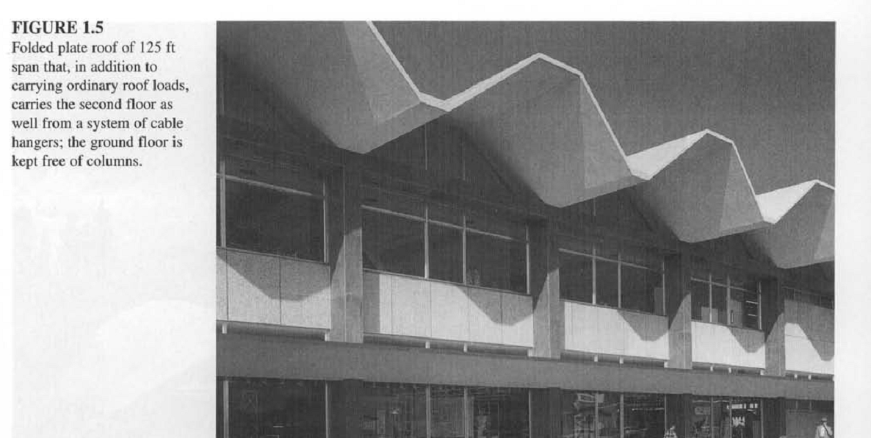

Slide 24
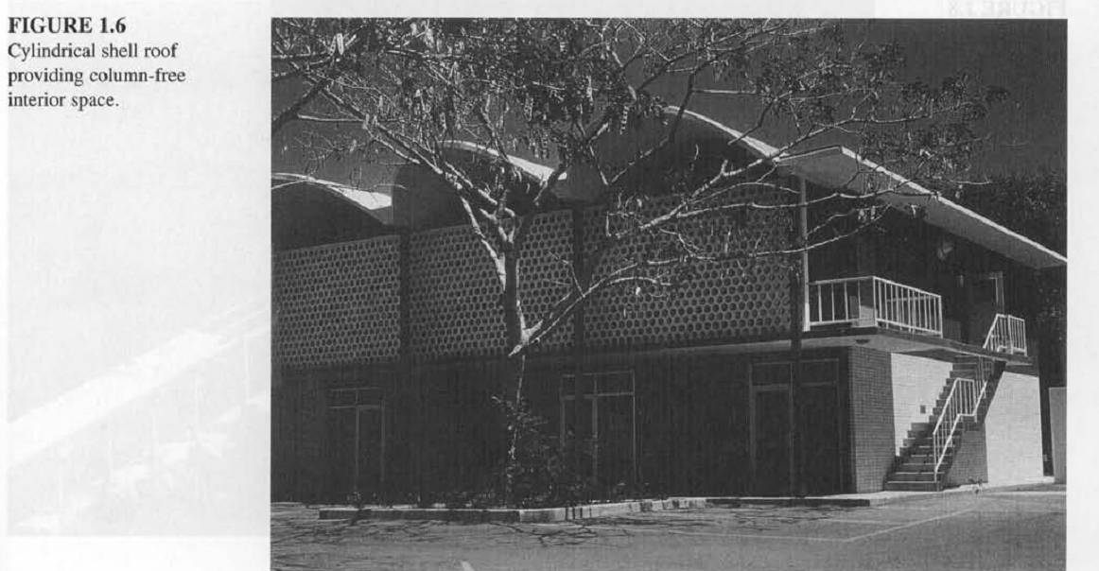

Slide 25
STRUCTURAL FORMS
The hyperbolic paraboloid shape, defined by a concave downward parabola path, has been widely used.
It has the interesting property that the doubly curved surface contains two systems of straight-line generators, permitting straight-form lumber to be used.
The complex dome of figure 1.7, which provides shelter for performing arts events consists essentially of a circular dome but includes monolithic upwardly curved edged surfaces to provide stiffening and strengthening in that critical region.
Bridge design has provided the opportunity for some of the most challenging and creative applications of structural engineering.
The award-winning Napoleon Bonaparte Broward Bridge, show in figure 1.8 is a six-lane cable-stayed structure that spans St. johns River at Dame point, Jacksonville, florida.

Slide 26
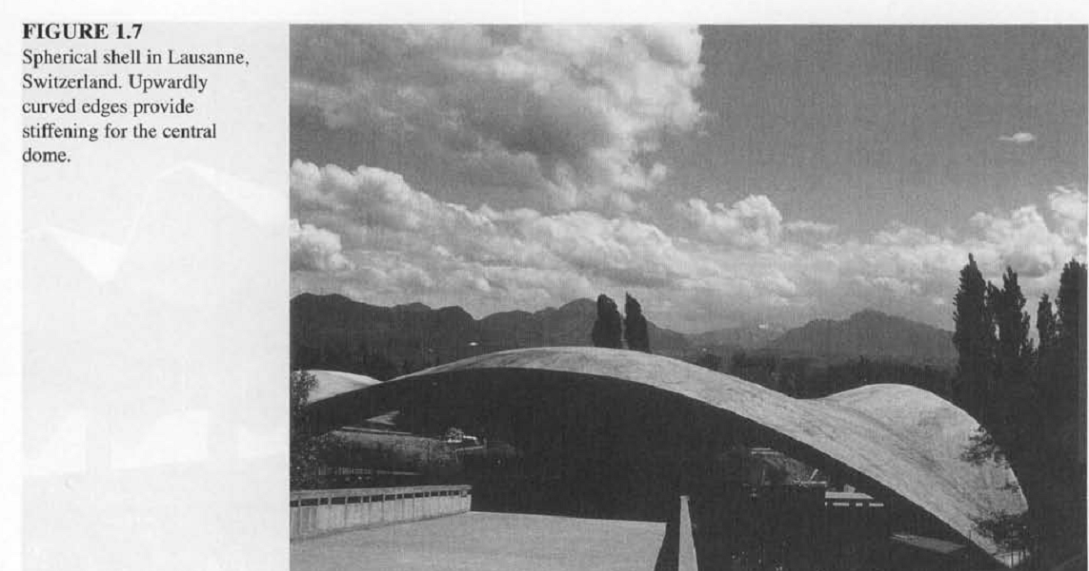

Slide 27
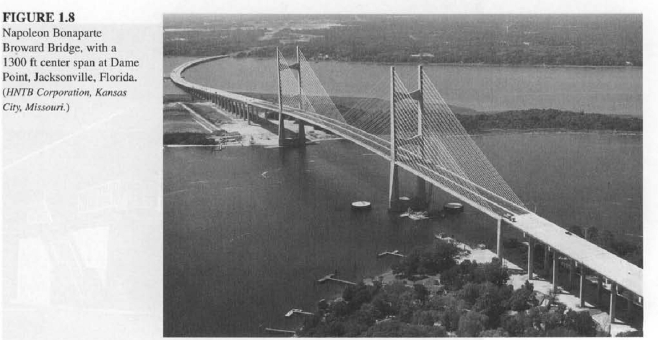

Slide 28
STRUCTURAL FORMS
Its 1300 ft span is the second longest of its type in the western hemisphere.
Figure 1.9 shows the Bennett Bay centennial bridge, a four span continuous, segmentally cast-in-place box girder structure.
Special attention was given to esthetic in this award winning design.
The spectacular Natchez trace parkway Bridge in Figure 1.10, a two-span arch structure using hollow precast elements, carries a two-lane highway 155 ft above the valley floor.
This structure has won many honors.
Cylindrical concrete tanks are widely used for storage of water or in waste purification plants.
The design shown in figure 1.11 is proof that a sanitary engineering facility can be esthetically pleasing as well as functional.

Slide 30
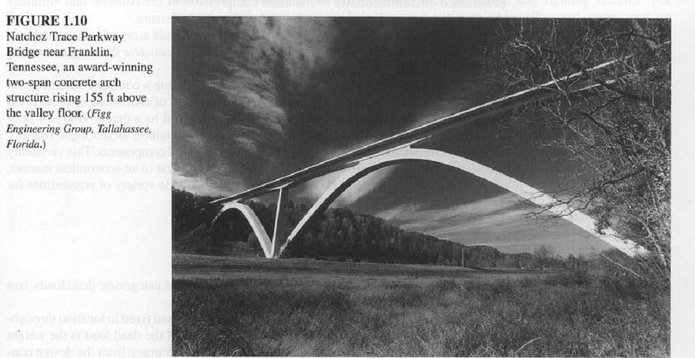

Slide 31
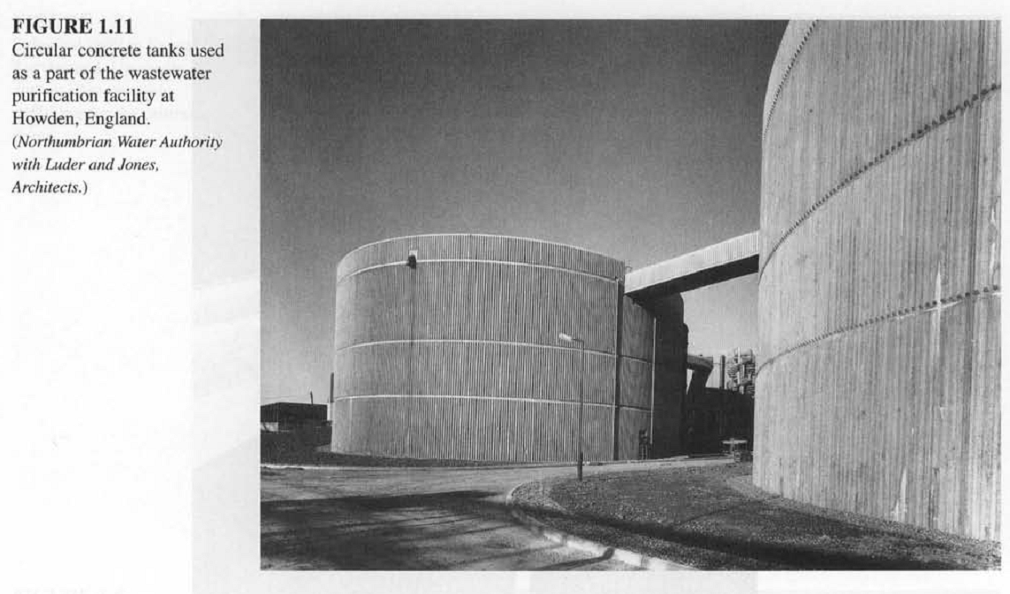

Slide 32
STRUCTURAL FORMS
Cylindrical tanks are often pre-stressed circumferentially to maintain compression in the concrete and eliminate the cracking that would otherwise result from internal pressure.
Concrete structures may be designed to provide a wide array of surface textures, colors and structural forms.
Figure 1.12 shows a precast concrete building containing both color changes and architectural finishes
The forms shown in figure 1.1 to 1.12 hardly constitute a complete inventory but are illustrative of the shapes appropriate to the properties of reinforced or pre-stressed concrete.
They illustrate the adaptability of the material to a great variety of one-dimensional (beams, girders, columns), two dimensional (slabs, arches, rigid frames) and three dimensional (shells, tanks) structures and structural components.

Slide 33
STRUCTURAL FORMS
This variability allows the shape of the structure to be adapted to its functions in an economical manner and furnishes the architect and design engineer with a wide variety of possibilities for esthetically satisfying structural solutions.

