Slide 1
IN THE NAME OF ALLAH ALMIGHTY, THE MOST BENEFICIENT, THE MOST MERCIFUL.

Slide 2
Topic CONVERSION FROM CONVENTIONAL TO ORGANIC FARMING

Slide 3
Outlines
What is conventional farming?
What is organic farming?
Conversion from conventional to organic farming
Recommendations for conversion
Considerations for conversion to organic farming
Step-by-step conversion to organic agriculture
Certification process
Conclusion

Slide 4
Conventional Farming
Conventional farming is also known as industrial agriculture.
It refers to farming system which include the use of
Synthetic chemical fertilizers
Pesticides
Herbicides
genetically modified organisms
Conventional animal feeding operations etc

Slide 5
.

Slide 6
Organic Farming
It’s a method of crop and livestock production that involves mush more than choosing not to use
Pesticides
Fertilizers
Genetically modified organisms
Antibiotics
Growth hormones.

Slide 8
Conversion from conventional to organic farming
Conversion refers to the physical and biological processes the farmer and the farming system must undergo to comply with organic standards.
The period required to develop an organic agriculture system is called the conversion period.
The approach is to fit an organic system into any given local situation.
It will thus clear that organic farming cannot be introduced in one day.

Slide 9
Conversion Requirements
When traditional agriculture methods fulfill the principles of these standards no conversion period is required.
When claiming virgin land for organic agriculture , no conversion period is required.
The whole farm, including livestock should be converted according to the standards over a period of time.
If a farm is not converted all at once, it should be done on a field by field basis whereby,

Slide 10
Conti..
The full standards are followed from the start of conversion on the relevant fields.
The composition of a farm unit can very widely according to
Geographical conditions
Ownership structure
Time span etc.

Slide 11
Recommendations for Conversion
Avoid burning of crop residues after harvest as this is, in most cases, not a viable solution.
Establish a well organized diversification system
Accumulate knowledge and practices regarding
Compost production to Manage and improve soil fertility.

Slide 12
Conti..
Indiscriminate tree cutting for firewood and charcoal burning.
Establish a system to collect the animal manure for composting.
Apply measures to prevent loss of soil
Pay special attention to satisfy feed and health requirement of the farm animals.
Avoid infection of seeds with diseases.
Avoid harvest and storage losses.

Slide 13
Considerations for Conversion to Organic Farming
A. Analysis of the location
Farm characteristics
Soil Analysis
Climate
Organic matter sources and management (manures).
Presence of animal housing systems
Limiting factors
This information will help one to have clear picture of his farm and to take decision.

Slide 14
.

Slide 15
B. Farm-Related Challenges to Conversion
1. Farms with High External Input Use
The majority of intensively managed farms in Africa, Latin America and Asia that strongly rely on external inputs are larger farms.

Slide 16
Minimizing External Inputs

Slide 17
.

Slide 18
Recycling Valuable Farm By-Products

Slide 19
2. Farm with Low External Input Use

Slide 20
.

Slide 21
3. Mixed Farming
Implement organic practices to mange the soil and to control weeds instead of using herbicides.
E.g. in fruit orchards grow a leguminous cover crops to cover the soil.
Use seeds without pesticide-treatment, if available.

Slide 22
Conversion of Mixed Farming

Slide 23
4. Degraded Land
Land may be degraded due to shifting cultivation, overgrazing, over-cultivation or deforestation.
In case of bare and eroded soil organic farming calls for digging of terraces.
Terraces are made by digging trenches along the contours and throwing the soil uphill to form embankments.
saline soils contain large amount of water soluble salts that inhibit seed germination and plant growth. These can be reduced

Slide 24
Conti..
Slowly by ensuring proper irrigation and building up the structure of the soils with
Compost to allow natural drainage of the excess salts.
Acid soils can be reclaimed by adding lime and well-made compost.
Flooded soils can be improved by creating drainage channels to drain off the excess water.

Slide 25
Conversion of Degraded Land

Slide 26
C. Climate Related Challenges to Conversion
In very warm and dry climate, losses of water through transpiration from plants and evaporation from soils are high.
Under such conditions, the key to increasing crop productivity lies in
Protecting the soil from strong sun and wind
And increasing the supply of organic matter to the soil.

Slide 27
Conversion in dry climate

Slide 28
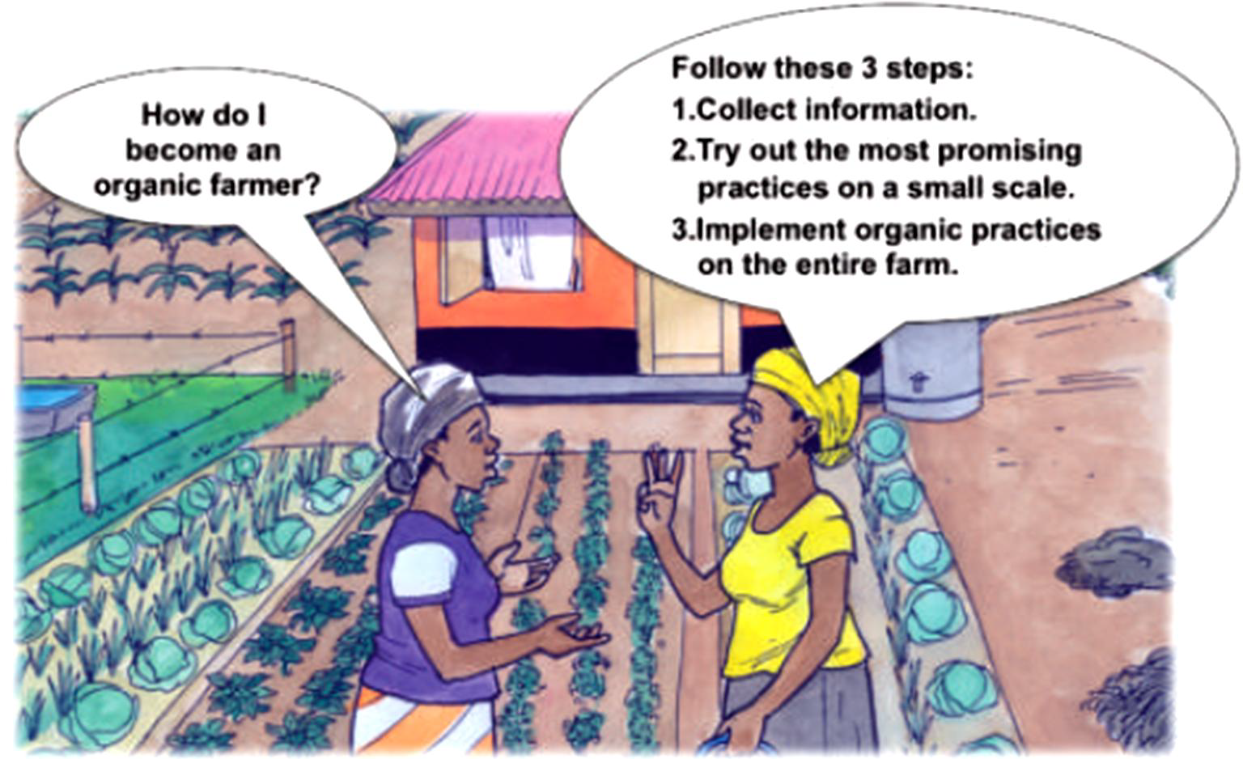
Step by Step Conversion to Organic Farming

Slide 29
1. Good Information First
Interested farmer need to know following points for conversion:
How to improve soil fertility?
How to keep crops healthy?
How to best increase diversity in the farm?
How to keep livestock healthy?
How to give value to organic products?
How to successfully sell them?

Slide 30
How to get information on organic agriculture?

Slide 31
2. Getting Familiar with Organic Practices
Mulching
It involves covering the soil with dead plant material or plastic sheets.

Slide 33
Intercropping
Growing two annual crops together.
Special attention must be paid to avoid competition between the crops for
Light, nutrient and water.

Slide 34
.

Slide 35
Composting
Application of compost to the field can have major impact on crop growth and yields.
Enough plant material and animal manure is required.

Slide 36
.

Slide 38
Green Manuring
The practice of growing a leguminous plant species for biomass production and incorporation into the soils.

Slide 39
.

Slide 40
Organic Pest Management
Initially, bio-control agents may be applied but organic pest management is best achieved through ecological approaches e.g.
Establish a pest/predator balance.
While the choice of resistant varieties of crops is paramount.
Other prevention methods include :
Choosing sowing time
Improving soil health to resist soil pathogens.
Rotating crops
Trapping pests in pheromone attractants etc

Slide 42
Appropriate Seeds and Planting Material
Use of healthy seeds and planting material and robust cultivars.
Generally, locally-adapted seeds are preferred.

Slide 43
.

Slide 44
Planting of Leguminous Trees
Some leguminous trees provide good fodder for livestock.
In perennial crop plantation such as banana, coffee, planting of leguminous trees such as
gliricidia,
calliandra
sesbania

Slide 45
.

Slide 46
.

Slide 47
Growing Farm-Own Animal Feeds
Grow grasses and leguminous fodder crops between the other crops or in rotation.
As animal feed must be of organic origin.

Slide 48
.

Slide 49
Terraces and Soil Embankments
Construction of terraces and soil bunds along the curves of hills is a key measure for soil conservation.

Slide 50
.

Slide 51
How to start implementation of organic practices?

Slide 52
Which crop should farmer grow?

Slide 53
3. Full Conversion to Organic Farming
In this step, implementation of organic practices throughout the entire farm should be considered.
Improve Soil Fertility
Encouraging Positive Interactions

Slide 54
Optimizing the Balance Between Feed Production and Livestock
Farming organically also means continuously learning from personal observation, from outside experiences.
Sharing experiences with other organic farmers and implementing new information on your farm.

Slide 55
Mitigating Contamination Risks
Pesticides
Planting of natural hedges on the boundary to neighboring fields can avoid the risk of pesticides spray drift through wind or run-off.
To avoid run-off from upstream fields, organic farmer should divert the water way or
Talk to the farmer upstream about how to work together to minimize the risk of contamination.
A farmer should use organic pesticide( neem oil etc) instead of chemically prepared pesticides.

Slide 56
.

Slide 57
How to protect crops from pesticide drift?

Slide 58
Genetically Modified Organism (GMO)
Genetically modified products should not be used in organic farming.
Organic farmer should protect their production against any GMO contamination.
Use either personally selected seeds or get organic or untreated seeds.
If one use seeds from a trader, make sure its pure.
Check for the breeding habits of the specific crops.

Slide 59
How to reduce the GMO contamination?

Slide 60
Certification of Organic Field

Slide 61
Conclusion
Organic farming develops harmony with the nature.
Organic products are more pure than conventional products.
Organic products are more nutritious and health loving.
These products have more shelf life.
Although yield is low but more profitable than conventional products.

