Slide 1
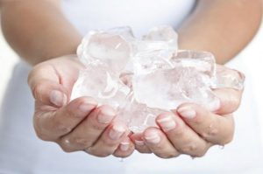
cryotherapy

Slide 2
“The application of cold for various therapeutic purposes is called Cryotherapy”
Condition: acute trauma and sub-acute injury
The temperature of the body tissue is reduced and heat is transferred from the body tissue to the cold medium

Slide 3
Basic principles
When cold therapy is applied to the tissues, the heat is absorbed from the tissue by the cooling agent
Ice changes its state from solid to liquid by absorbing heat
“A specific amount of energy is required to change the solid form of ice into water which is called latent HEAT OF FUSION”
one gram of ice at 0C requires 336 Jouls of energy to convert it into 1 gram of water at 0C, whereas 1 gram of water at 0C requires 155 Jouls of energy to convert it into 1 gram of water at 37C.
Thus for cooling body tissue it is better to use ice for treatment rather than water

Slide 4
For a constant source of cooling the temperature drop in the tissues will depend upon
The temp. difference b/t the coolant and the tissue
Thermal conductivity of the tissue, msl higher thermal conductivity than fat or skin
Length of time for which the cold applied
The size of area, being cooled

Slide 5
TECHNIQUES
Ice massage: (10_20 min)
Ice towel: (30sec- 2 min for each towel, 15 – 20 min, 10 towels)
Immersion in cold or cold whirlpool: ( 0-10C, 10 min)
Ice packs or cold packs:
Evaporative cooling or vapocoolant sprays: (fluoromethane or ethyl chloride, 1 feet distance, gentle stretch)
Excitatory cold: (myotomes, dermatomes, ice strokes)

Slide 6
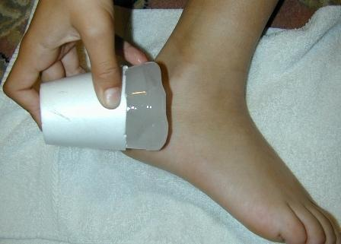
Ice massage

Slide 7
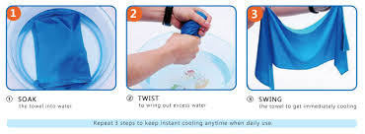
Ice towels

Slide 8
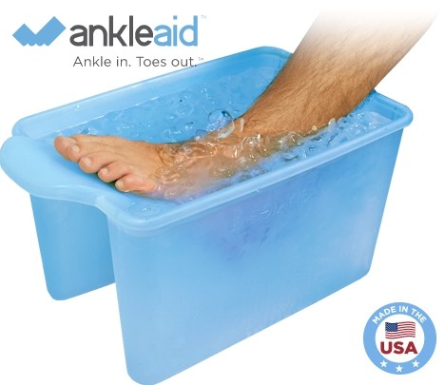
Immersion in cold or cool whirlpool

Slide 9
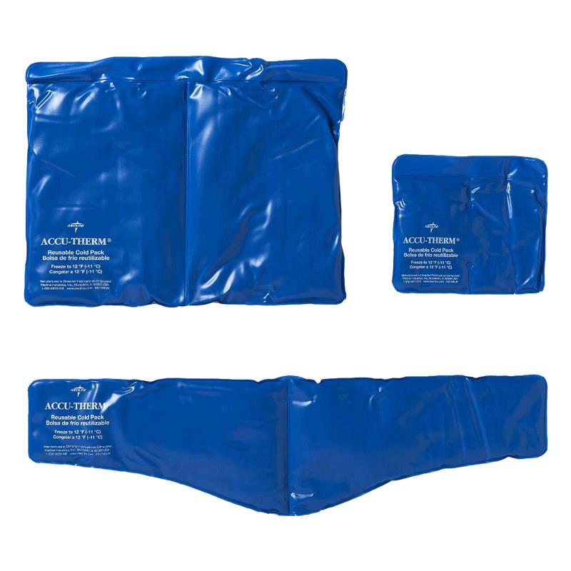
Ice packs / cold packs

Slide 10
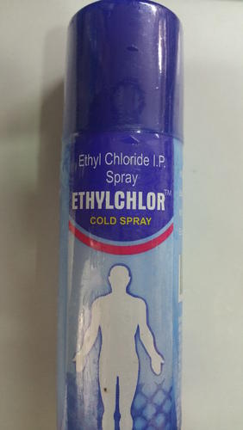
Vapocoolant sprays

Slide 11
Physiological effects and therapeutic uses of cryotherapy

Slide 12
Effects on circulatory system and uses
The initial response_ preserve heat
Local vasoconstriction
Homeostasis is reached
Phase of vasodilatation
vasoconstriction:- reduce blood flow(recent injury, limit swelling and extent of tissue damage)
Alternate vasoconstriction and vasodilatation:- removes waste product of metabolism like lactic acid, so delays fatigue

Slide 13
Effects on nervous system and neural tissue
Rate of conduction of the nerve fiber is reduced by cold
A fibers effect first then B n C
Major effect is relive pain
Pain gate is closed
Cold noxious stimulus to mid brain: release endorphin or enkephalin(body’s own opiod like substances)
Increased circulation may carry out the nociceptor stimulating substances
Short brisk application of ice_ enhance the muscle tone
Prolonged use of cold_ the muscle tone greatly

Slide 14
Dangers and contraindications
Cardiac condition
Peripheral nerves
Peripheral vascular disease or vasospastic disease
Psychological or cold sensitive

Slide 15
Thanks!!!!!!!!!!!!!!!!!!!!!

