Slide 1
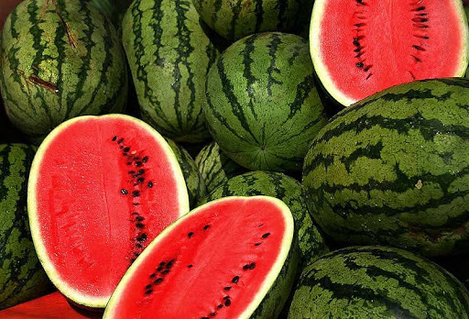
WATERMELON
Prof. Dr. Sarfraz Hussain
FST 508

Slide 2
Introduction
It is an annual plant of the Cucurbitaceae family.
The edible fruit is produced on trailing vines that may reach 15 ft. (4.6 m) or more in length.
Fruit vary in shape from globular to oblong.
The color of the hairless skin varies in shades of green from pale yellowish to almost black and may be solid, striped, or marbled

Slide 3
Varieties

Slide 4
Quality Characteristics and Criteria
High-quality watermelons are well formed, symmetrical, and uniform in shape and have a waxy, bright appearance.
The rind should be free of scars, sunburn, and abrasions with no bruising or other physical injury; free from anthracnose or other decay; and not overripe

Slide 5
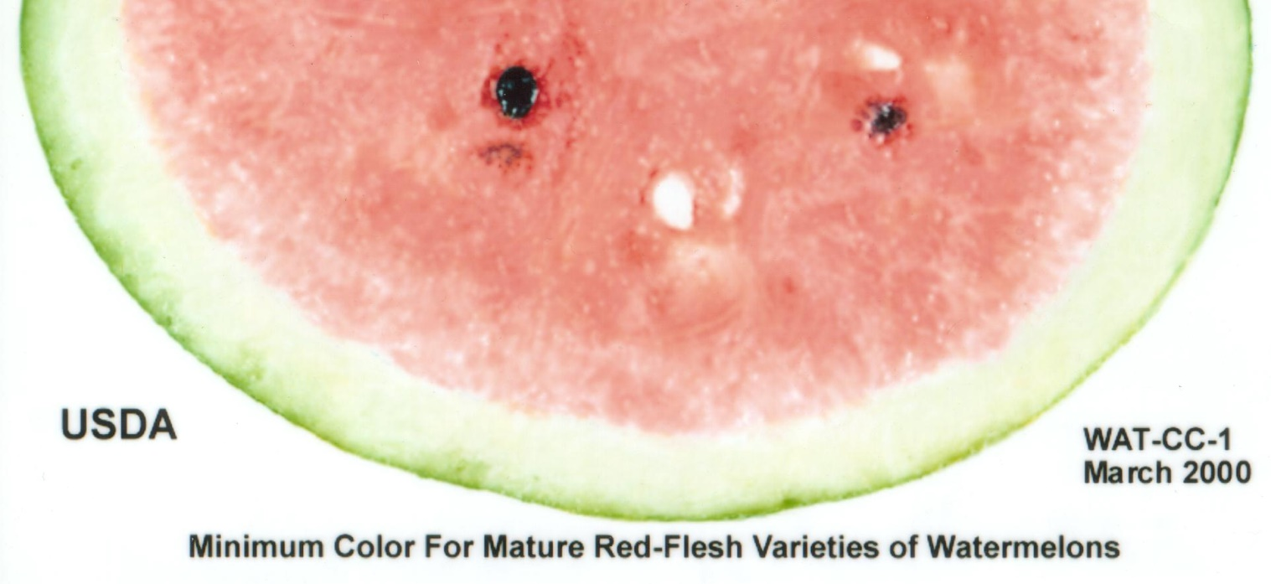
Maturity Indices
The ground spot (the portion of the melon resting on the soil) changes from pale white to a creamy yellow at proper harvest maturity. Another indicator used at harvest include a wilted but not fully desiccated vine tendril proximal to the stem-end attachment

Slide 6
Water melon are considered optimum for eating when their flesh mature to produce a sweet flavor
A crisp texture
Deep red color
External rind appearance does not always predict good internal flesh quality and full maturity.
reliable method of determining maturity within a given feld is to visually examine the fruit for the changes described above, then cut some fruit in random sectors of the feld to check ﬂavor and internal color development.

Slide 8
Health Benefits

Slide 9
Precooling Conditions
Watermelons generally are not precooled and some are shipped in unrefrigerated trucks
If precooling is implemented, forced air cooling would be the method of choice
In common room-cooling, good air circulation between palletized boxes is essential
Fruit that are placed in bulk fiberboard bins will cool slowly because of poor air circulation within the bin.

Slide 10
Optimum Storage Conditions
Some variability is noted in watermelon varieties and types, such as seeded vs. seedless;
But in general none are suited to very-long-term storage.
The ideal storage temperature is in the range of 10 to 15 °C (50 to 59 °F) with approximately 90% RH
Fruit should be consumed within 2 to 3 weeks following harvest

Slide 11
Controlled Atmosphere (CA) Conditions
Watermelons generally do not respond well to CA or to MAP
Studies with shrink-wrap packaging of individual fruits, a form of MAP, was not beneficial, and in some cases decay in MAP was higher

Slide 12
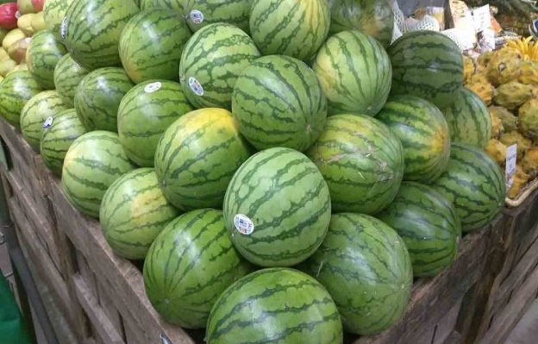
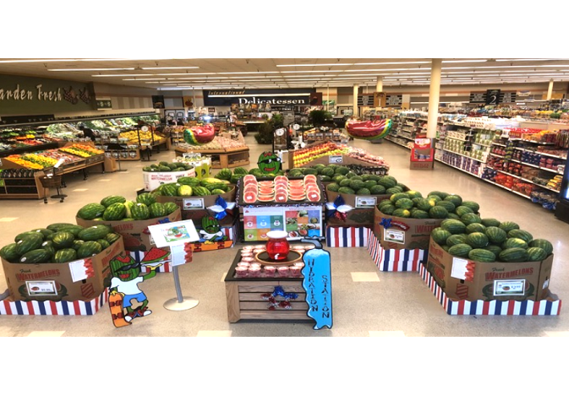
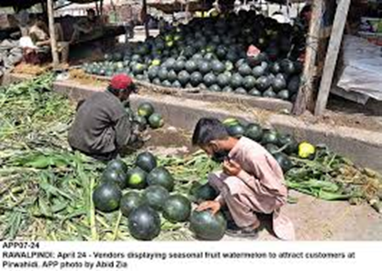
Retail Outlet Display Considerations
Watermelons are usually sold from unrefrigerated displays
Bulk fiberboard bins with colorful graphics have been a popular method of displaying watermelons for retail sale

Slide 13
Chilling Sensitivity
Watermelons develop chilling injury when stored below about 10 °C for more than a few days, these lower temperatures will hasten the onset of injury
Symptoms appear as brown-staining of the rind, surface pitting, deterioration of ﬂavor, fading of ﬂesh color, and increased incidence of decay after being returned to room temperatures

Slide 14
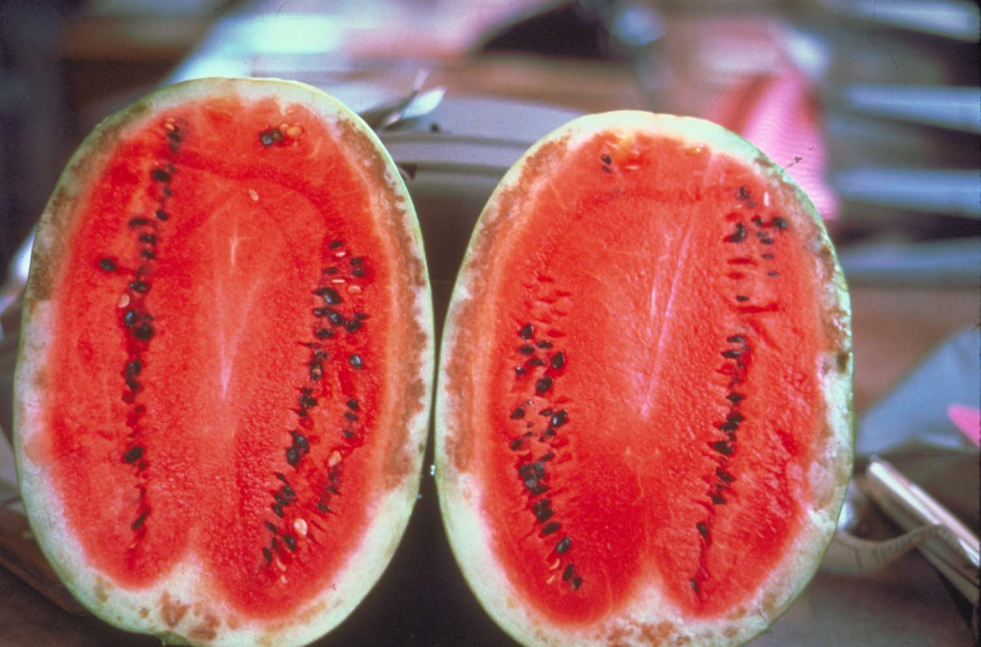
Continued . . .
Conditioning fruit at 30 °C (86 °F) for about 4 days prior to cooling has been shown to induce some tolerance to chilling, but it does not completely alleviate the problem

Slide 15
Ethylene Production and Sensitivity
Watermelons are classified as low-ethylene producers, with production rates in the range of 0.1 to 1.0 µL kg-1 h-1 at 20 °C.
Though production rates are low, fruit are extremely sensitive to ethylene. Exposure to as little as 5 µL L-1 ethylene causes softening, rind thinning, fading of ﬂesh color, and over-ripeness
Interactions between ethylene concentration, temperature, and duration of exposure are not well defined.
The recommended management protocol is to avoid any exposure to ethylene in storage.

Slide 16
Postharvest Pathology
A variety of pathogens may cause postharvest decay of watermelon
The primary defense against decay is the exclusion of diseased fruit from the marketing chain through careful selection at harvest and appropriate grading before shipment.
Postharvest rot caused by Fusarium spp. and Phytophthora capsici are of concern because control measures for these fungi in the feld often are inadequate.
With good disease control in the field, anthracnose (Colletotrichum orbiculare) and black rot (Didymella bryoniae) rarely develop on watermelon

Slide 17
Special Considerations
Special care should be given to avoid rough handling injury of watermelon fruit during harvesting and handling
Fruit that are inadvertently dropped during harvest or handling should not be shipped
Injury that may not be obvious at the moment it occurs can develop into bruised areas and damage to the ﬂesh in transit

