Slide 1
Positive psychology (psy-426)
Marriage and happiness
Marriage
the legally or formally recognized union of two people as partners in a personal relationship (historically and in some jurisdictions (official power to make dcison or judgment ,specifically a union between a man and a woman).
BS 8 (R and SS)
Anam Yousaf

Slide 2
Does marriage make you happier?
The cautious answer to this question is Yes. Married people do appear to be happier than people who are not married including people who are never married. Gilbert said married people are happier than unmarried ones perhaps because the single best predictor of human happiness. The quality of social relationship.
Biggest fact of happiness and marriage take place when people are middle aged.That gap in happiness between married and unmarried is narrower when people are younger and start to disappear after the age of 60.

Slide 3
Two reasons: why marriage contributes to well-being:
First, marriage provides additional sources of self-esteem, for instance by providing an escape from stress in other parts of one’s life, in particular one’s job. It is advantageous for one’s personal identity to have more than one leg to stand on.
Second, married people have a better chance of benefiting from a lasting and supportive intimate relationship, and suffer less from loneliness. Among the not married, persons who cohabit with a partner are significantly happier than those who live alone. But this effect is dependent on the culture one lives in. The difference in happiness between married people and people who were never married has fallen in recent years. The “happiness gap” has decreased both because those who have never married have experienced increasing happiness, and those married have experienced decreasing happiness.

Slide 4
Impact of marriage on happines
Make you happy or not?
Your

Slide 5
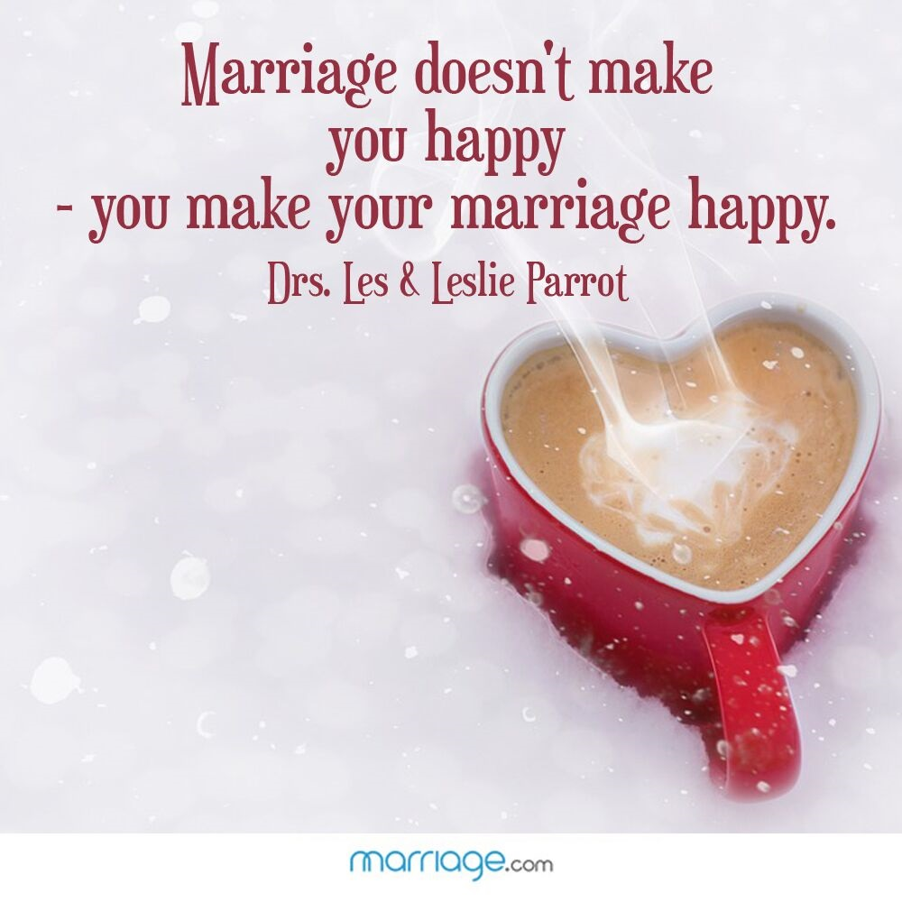
Researches concludes that its not a marriage that makes you happy, its happy marriage that makes you happy. John Helliwell in the journal of happiness studies find that marriage make people happier and that they continue to be satisfied years into the marriage.
“marriage make people happier but it is not guarantee of happiness’
Biggest boost to marriage is among people who consider their partner their best friend.

Slide 6
Historically large studies show that on average married people report greater happiness later in life than unmarried.
Married people tend to be happier more satisfied with their lives and less depressed.
An award-winning study of more than 24,000 German adults found that people who got married tended to be a bit happier in the year of the wedding but eventually their happiness return to where it was prior.

Slide 7
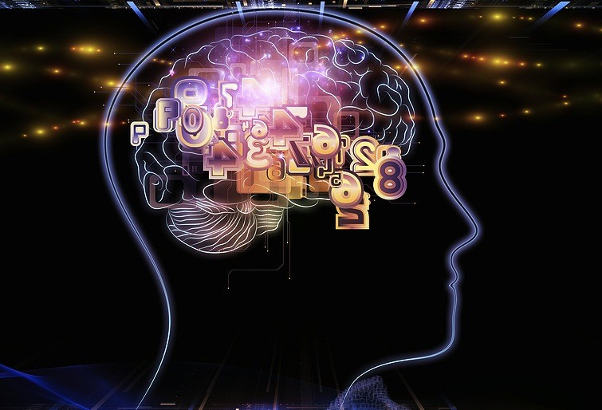
The positive effect of marriage on happiness are there for both women and men. Marriage cause happiness and brain respond to a pleasure stimulus by activating a reward system. When the brain receive a positive sensory stimulus(something that feels good)it send a signal to the ventral tegmental area(VTA)in the mid brain. The VTA release dopamine into nucleus accubens(the pleasure center)into the septum the amygdala (part of our emotional system) and the prefrontal cortex.

Slide 8
Reward system
The term reward system refers to a group of structures that are activated by rewarding or reinforcing stimuli (e.g. addictive drugs or tangible (measurable, concrete and visible characteristics like money, vacations, materialistic things/intangible (praise, acknowledgemnet, thank you). When exposed to a rewarding stimulus, the brain responds by increasing release of the neurotransmitter dopamine and thus the structures associated with the reward system are found along the major dopamine pathways in the brain.

Slide 9
Dopaminergic neurons are located in the midbrain structures substantia nigra (SNc) and the ventral tegmental area (VTA).
No doubt in vta there are a lot of neuron but the large population is of dopaminergic neurons,

Slide 11
Basal ganglia: group of structures, including in cerebrum (Cerebrum is the largest and the most prominent part of the brain, whereas the cerebral cortex is the outer layer of the cerebrum. Cerebral cortex is actually a part of the cerebrum. ... The cerebrum has both gray and white matter, whereas the gray matter is considered to be the cerebral cortex; (caudet, putamen, globus pallidus) and substantia nigra in mid brain
Nucleus accumbens: There is a nucleus accumbens in each hemisphere; it is situated between the caudate and putamen. The nucleus accumbens is considered part of the basal ganglia and also is the main component of the ventral striatum.
Striatum: the striatum is divided into a ventral striatum, and a dorsal striatum, subdivisions that are based upon function and connections. The ventral striatum consists of the nucleus accumbens. The dorsal striatum consists of the caudate nucleus and the putamen

Slide 12
continue
The mesolimbic dopamine pathway is thought to play a primary role in the reward system. It connects the ventral tegmental area (VTA), one of the principal dopamine-producing areas in the brain, with the nucleus accumbens, an area found in the ventral striatum that is strongly associated with motivation and reward. Another major dopamine pathway, the mesocortical pathway, travels from the VTA to the cerebral cortex and is also considered part of the reward system. So, the reward system is generally considered to be made up of the main dopamine pathways of the brain (especially the mesolimbic pathway) and structures like the VTA and nucleus accumbens, which are connected by these dopamine pathways.

Slide 13
Personality traits and married life OCEAN
Neuroticism—anxiety and volatility (unpredictable) versus emotional stability and confidence;
Conscientiousness—persistence and responsibility versus sloppiness (lack of care and organization) and laziness;
Agreeableness—friendliness and empathy versus hostility and insolence (disrespectful);
Openness to experience—creativity and curiosity versus intolerance and rigidity;
Extroversion—assertiveness and social, outgoing versus introversion and shyness.

Slide 14
neuroticism
1987 University of Michigan researchers Lowell Kelly and James Connelly published a study that followed 300 married couples over 30 years. The neuroticism of one spouse predicted dissatisfaction in marriage and divorce. Adding insult to injury, research has also shown that high neuroticism predicts low resilience post divorce.

Slide 15
Conscientiousness, extroversion and agreeable
predict relationship satisfaction, in part because these traits signify low impulsivity and high interpersonal trust, respectively.
Personality psychologist Portia Dyrenforth and colleagues (2010) published a study of 20,000 couples in three countries—Australia, England, and Germany—finding that high agreeableness and conscientiousness (as well as low neuroticism) in self or spouse were associated with marital satisfaction.

Slide 16
Openness to Experience
Openness appears to play a rather minor role in the romantic context. In 2010, the Australian researcher John and his colleagues analyzed the results of 19 studies involving more than 3,800 participants. Four traits—low neuroticism, high conscientiousness, high agreeableness, and high extraversion—predicted higher levels of relationship satisfaction with intimate partners.

Slide 17
Characteristics of happy single people:
Happy single people are more social.
Give more time to themselves.
Give more time to leisure.
They report experiencing more personal growth.
They have better health habits and sleep patterns.
Tend to have more control on their life.
Remains focused and enjoy doing stuff out of their comfort zones.

Slide 18
Do Happy People Get Married?
Research analyzes the causal relationships between marriage and subjective well-being in a longitudinal data set spanning 17 years. We find evidence that happier singles opt more likely for marriage and that there are large differences in the benefits from marriage between couples. Potential, as well as actual, division of labor seems to contribute to spouses’ wellbeing, especially for women and when there is a young family to raise.
http://ftp.iza.org/dp1811.pdf

Slide 19
Moreover, people who enjoy happiness tend to have good interpersonal relationships. They focus on their needs, try to achieve their goals while keeping a balance in their life.
Marriage is a fundamental institution of society and happier people tend to opt for successful marriages more often mostly because of the stable mindset they experience.

Slide 20
What is it exactly about marriage that leads to happiness?

Slide 21
A good marriage is one of the life-factors most strongly associated and consistently associated with happiness. Good relationships make people happy because a dependable companionship is a basic human need. Improving social relationships will bring our happiness score up. There is strong consensus in the field of positive psychology that the number and depth of personal relationships has the greatest effect of all on happiness. And the relationship where vast numbers of people derive that greatest boost to their well-being is in their marriage.
Tal Ben-Shahar states that
“Having people about whom we care and who care about us to share our lives with, to share events and thought and feelings in our lives, intensifies our experience of meaning, consoles in our pain, deepens our sense of delight in the world. While relationships in general are important for the ultimate currency, romantic relationships.

Slide 22
“The well-being benefits of marriage are much greater for those who also regard their spouse as their best friend. These benefits are on average about twice as large for people whose spouse is also their best friend.” John Helliwell
Good marriage entails love, support, and personal fulfillment.

Slide 23
Married people earn more money and accumulate greater assets than those who are single or divorced, regardless of race or ethnic background 1.)Married men may work harder knowing they are supporting others 2.) Employers may discriminate in favor of "family men" whom they see as stable and good workers 3.) Wives still have the most of the responsibility for housework and childcare, freeing men to focus on paid work.

Slide 24
Impact of children on married life
According to Western culture:
Married vs unmarried vs married with and without children
Indigenous culture of Pakistan
Strong Bonding after babies
Without children men move toward second marriges

Slide 25
Are women more labile, while men are stony?
We can explain this through gender role of men and women in our society. Gender roles are determined by the sociocultural norms of society. Nowadays, family systems are based on gender roles, which already have certain requirements and customs that help each family member fulfill their responsibilities.
In our society, the gender roles of men have traditionally been designated with the words “breadwinner,” “master,” “defender.” While traditional female gender roles are about “homemaker,” “mother,” “wife.
The society expects that a woman will be kind, patient, modest, soft, caring, understanding, and “homely.” One of the examples of traditional gender roles is a family in which a husband earns money, providing his family completely while a wife looks after the house, cooks and brings up children and in general, does everything to please her man.

Slide 26
Marriage and divorce
Disclosing personal (marrital )information with others
Non-religious practices (hypocracy, just decision)
Media exposure
Gratitude
Unforgiving
Greed
In laws
Psychological problems
Joint family system
Young ages
Unrealistic expectations
Status diffrences
Sects diffrences or religion different
Culture

