Slide 1
Economic actvities
mic activities are basicall
Basically economic activities are involving in making, Providing ,purchasing or selling
Of goods or services.
Additionally, ecnomic activity involved in money or the exchange of products or services.
Economic activities can be discussed in five sectors which are all related to the
Extraction of resources
Manufacturing or production
Services
Knowledged based services
Intellectual services or macro level executives services

Slide 2
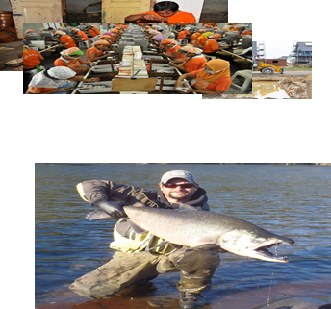
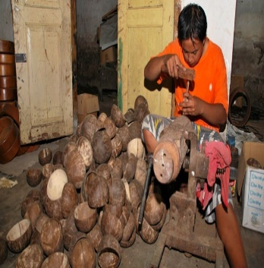
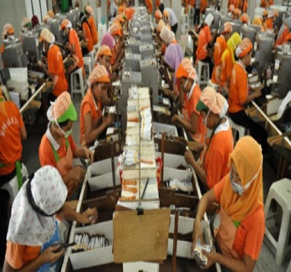
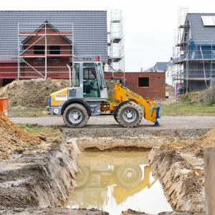
Economic activitiy; Every human effort or activity for livelihood purpose.
Economic activities;
These are related to production, distribution, exchange and consumption of goods and services

Slide 3
Sectors of economic activities.
SECTOR OF ECONOMY.
There are five sectors in economic activities.
Primary Sector
Secondary Sector
Tertiary Sector
Quaternary Sector
Quinery Sector

Slide 4
Sectors of economic actvites.
Primary sector is Resources based and extractive activities.
Secondary sector is Manufacturing based activities.
Tertiary sector is Services based activities.
Quaternary sector is knowledge based activities.
Quinary sector is intellectually based macro level activities.

Slide 5
Primary activities.
Primary sector of economy is the sector of economy making direct use of natural resources.
These activities are those that harvest or extract something from earth
These includes hunting and gathering, raw material, agriculture ,forestry ,fishing,mining .
Primary sector is usually most important in less develop countries and typically less important in industrial country.
Primary producers are “ RED COLLAR” worker.

Slide 6
Primary activities.
Agriculture
The primary sector also called agriculture sector because the main activity of these sector is agriculture
Also because more people concentrated in the agriculture field and dependent on environment.
In agriculture include crops and live stock such as food etc
Only 3%and 10% labour force engaged in this activity.

Slide 7
Primary activities.
Fishing
It also include in primary activity.
10 to12 % of annual fish supply comer from inland water , river,lakes,pounds farm.
And the other 88 to 90% comes from the world ocean.
Fish provie 6% of total daily protein intake of the developing world population and 7% of total protein supply worldwide

Slide 8
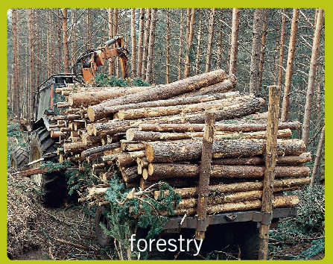
Primary activity.
Forstry
it is valuable primary activity , after retreat of continental glacier 1100 years ago bfore the rise of agiculture.
The world forest and woodland probably covered 45% of earth land area.it is productive environment for earlier society that gatherd fruits,nuts, leaves ,roots,fiber collected from trees and woody plants.
Forest still coverd 30 % of land area.
Forest coverage area

Slide 9
Primary activity.
Mining
It is the extraction of valueable minerals from the earth.
Mining started with the advent of industrial revolution in England about one half century ago.
With the pessage of time extraction of minerals has become commercial activity.

Slide 10
Secondary activities.
Secondary economic activity in which people use raw material to produce or manufacture new products of greater value.
Example; manufacturing steel into car or textile into clothing.
Also include handicraft production , electronic goods production and chemical industries etc.
The total population or labour force directly engaged to secondary sector.
Secondary producers are “BLUE COLLAR” workers.

Slide 11
Tertiary activities.
The tertiary sector of economy is the service industry.
This sector provides services to the general population and to business and personal services.
These activities are associated wirth the sectors including retail,wholesale, distribution, transportation ,entertainment, heathcare etc
Mostly concerned with retailing and wholesaling of goods.
Tertiary activities are “ PINK COLLAR” worker.

Slide 12
Quaternary activities.
Quaternary services represent special type of service work.
the quaternary activity economy is the way to decscribe the knowledge based part of economy.
Which include services such as information technology,information generation and sharing,media and research, and development.
Also focus on administrative and professional services and government and menagment.
Quaternary sector include “ WHITE COLLAR” work force.

Slide 13
Quinery activities.
Quinery activity is the branch of a country’s economy where high level decisions are made by top level executives in the government, industary, business, education ,media.
It is a top economic sector.
Top executives includes chief executive officer ,chief financial officer, president etc
An appropriate label for this group is the “GOLD COLLAR” workers.

