Slide 1
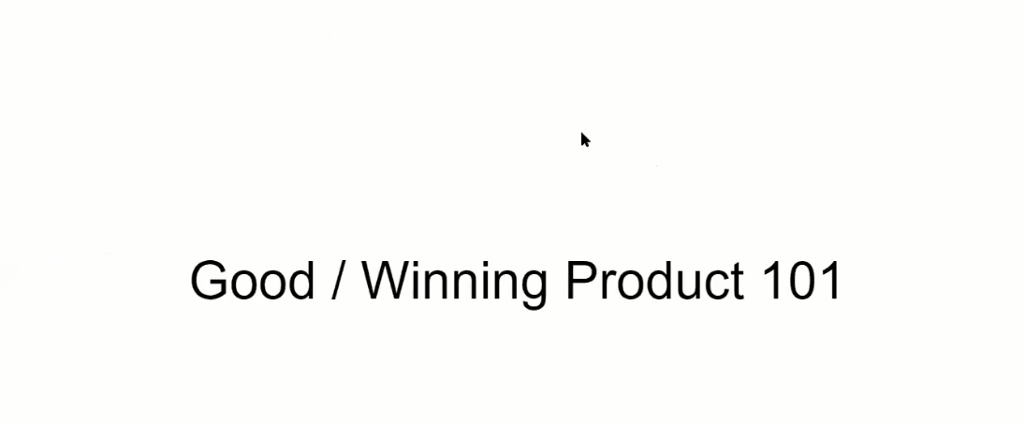

Slide 8
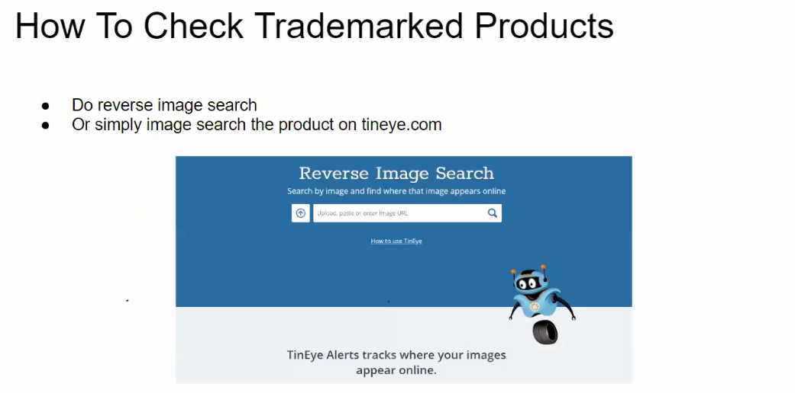

Slide 10
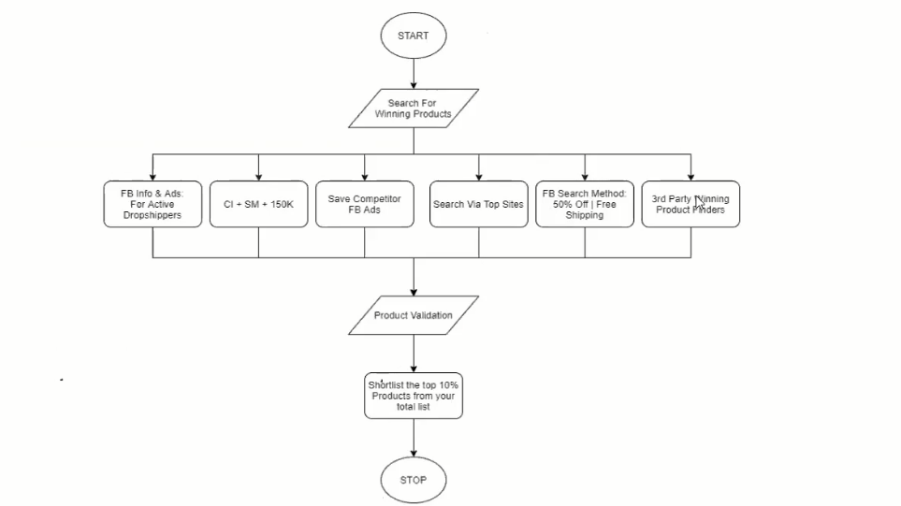
Notes:
Common inspector
Similar web 150 traffic

Slide 14
Notes:
The Great Hack
fbq('track', 'Purchase', {content_type: 'product_group', content_ids: '[4283952300172] ', value: 14.99,num_items:1, currency: 'USD', });

