Slide 1
“ASSIGNMENT OF SPORTS BIO-MECHANICS”
Submitted to: Sir Qasid Naveed
Submitted by: Syeda Sabeeka Fatima
Roll No: 13 (R)
Class: MSC-Physical Education
Topic:
“Definition, Significance & function of Bio-mechanics”
“Department of Sports Sciences”

Slide 2
Table Of Content
Definitions of Sports Bio-Mechanics
Significance of Sports Bio-Mechanics
Major Function of Sports Bio-Mechanics
Conclusion

Slide 3
SPORTS BIO-MECHANICS

Slide 4
DEFINITIONS:
Bio-Mechanics:
The study of forces and their effects on living organism / system.
Sports Bio-Mechanics:
The study of forces and their effects on living organsim / system in the area of sports and exercise.

Slide 5
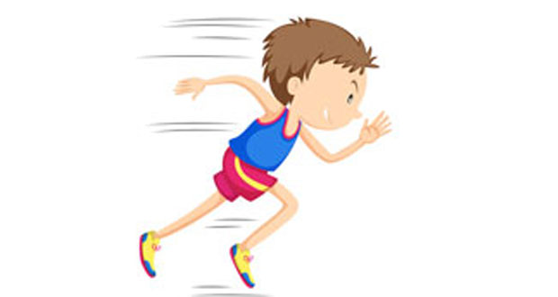
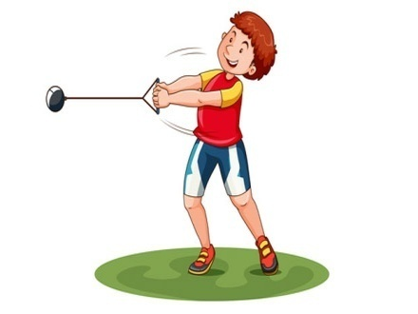
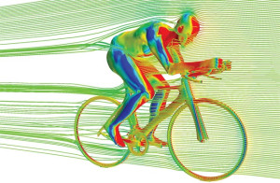
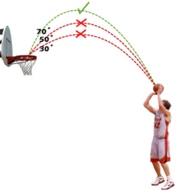
Examples:
Football: the physics of collisions.
Athletics: physics of running in lane one and the High Jump.
Baseball: ball throwing physics.
Basketball: physics of basketball.
Bowling: biomechanics applied to Tenpin bowling.
Cycling: wheel design and aerodynamics.

Slide 6
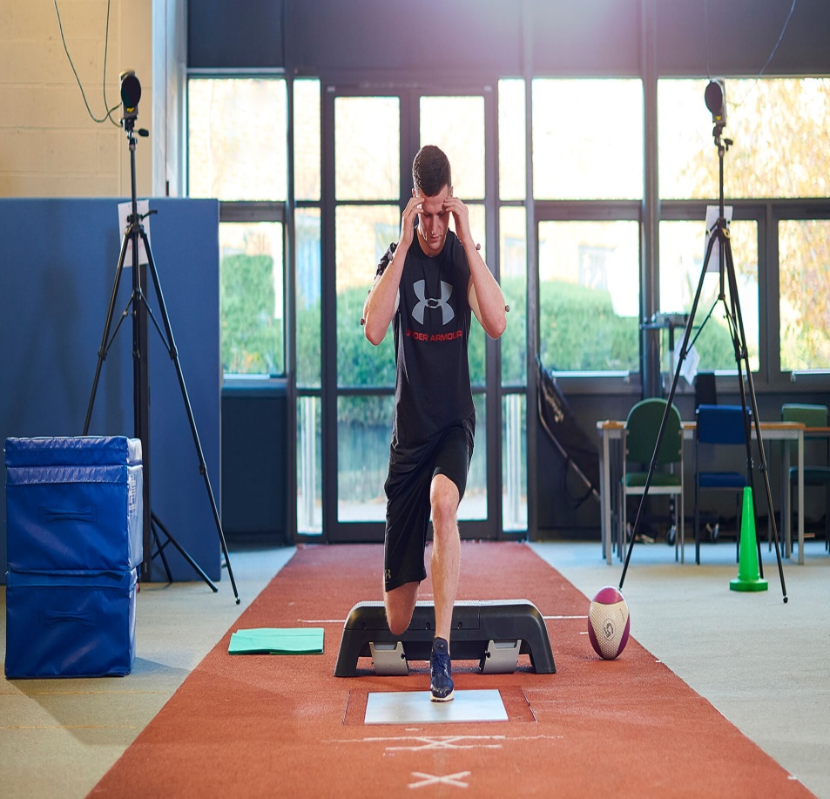
Significance
Improves performance in sports.
Development of improved sports performance.
Helps in understand human body.
Create confidence in sportsperson.
Prevents sports injuries.
Improves in training techniques.
Increases the popularity of sports

Slide 7
Functions:
There are four major functions of sports bio-mechanics :
Technique Improvement
Equipment Improvement
Training Improvement
Injury Prevention

Slide 8
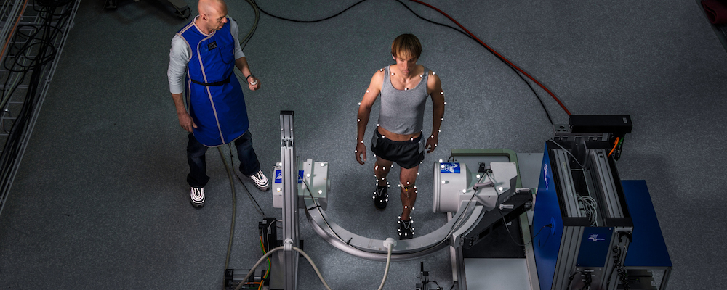
Technique Improvement
Teachers and coaches may use their knowledge of mechanics to correct actions of a student or athlete in order to improve the execution of a skill, or a biomechanics researcher may discover a new and more effective technique for performing a sport skill.

Slide 9
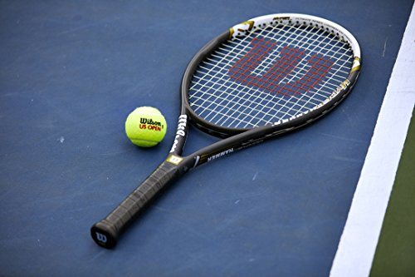
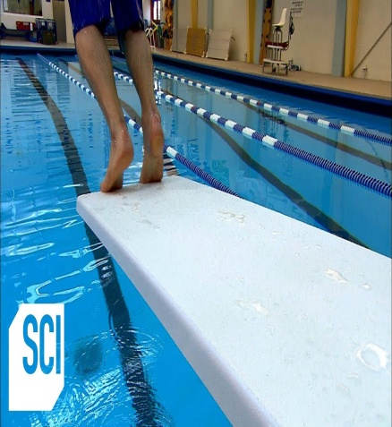
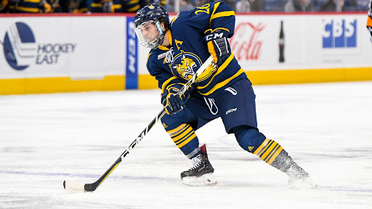
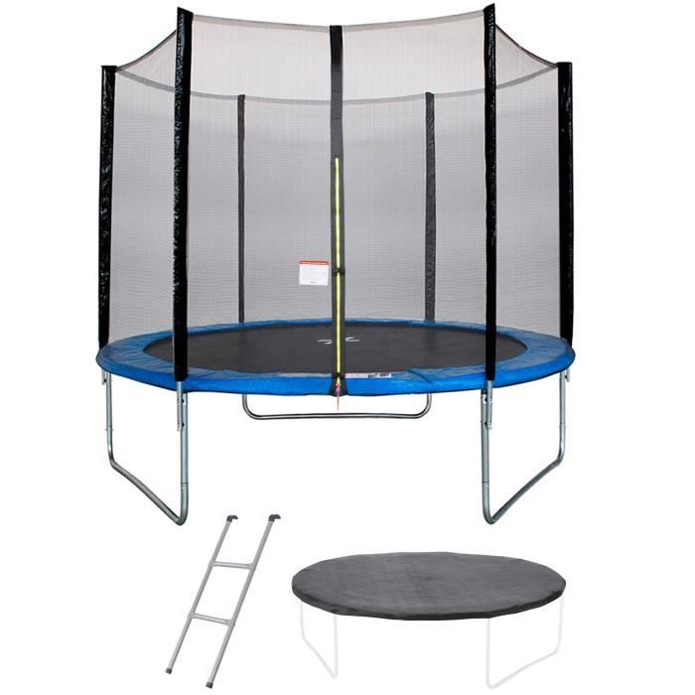
Equipment Improvement
There are many example of energy storage in sports equipments. Vaulting poles, diving boards, trampolines, ice-hockey sticks, tennis racquets and other pieces of equipment are successful example of energy storage. In all of these performance in the sports is heighly depending on the equipments.

Slide 10
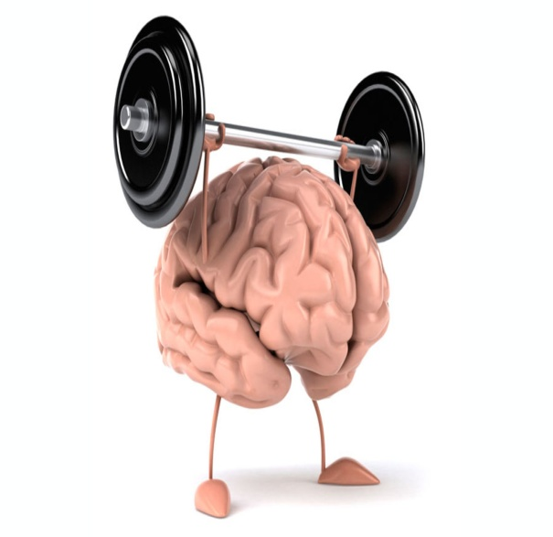
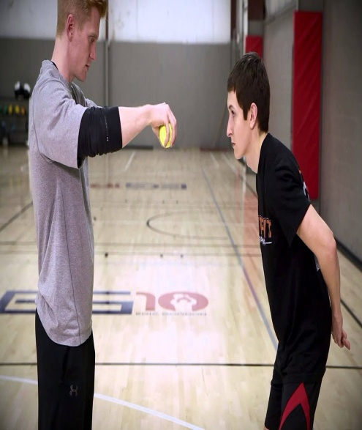
Training Improvement
Analyze sport movements.
Select the best training exercises.
Reduce or prevent injuries.
Design or choose the sport equipment that best matches athletes' personal needs.
Maximize economy and efficiency of movements.

Slide 11
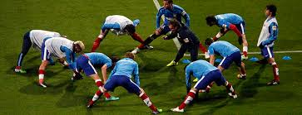
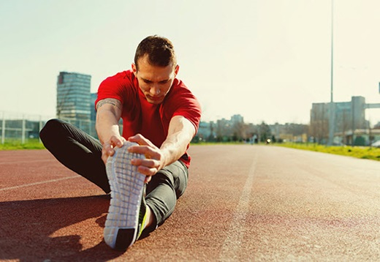
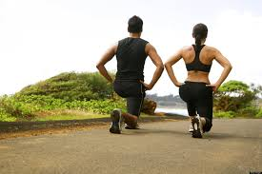
Injury Prevention
Experiencing an injury in any sport is impossible to avoid, but it has been found new ways that may be able to reduce the amount of occurrences. The studies are led by analyzing biomechanics, which is designed to simplify the way we understand the motion of the human body.

Slide 12
Conclusion
This study concludes that role of biomechanics in physical education and sports play a crucial role in this field. Physical educators teach a wide variety of human movements, and biomechanics provides a rationale critical for evaluating technique and prescribing intervention to help young people improve.

Slide 13
REferences
Apply biomechanics to improve techniques. (n.d.). Retrieved April 24, 2020, from https://us.humankinetics.com/blogs/excerpt/apply-biomechanics-to-improve-techniques
Fukuzumi, S. I., Hirasawa, N., & Azuma, M. (2019). 2F3-7 Usability and Quality in Use. The Japanese Journal of Ergonomics, 55(Supplement). doi: 10.5100/jje.55.2f3-7
http://www.asbweb.org/conferences/2010/abstracts/525.pdf
Knudson, D. (1970, January 1). Applying Biomechanics in Physical Education. Retrieved April 24, 2020, from https://link.springer.com/chapter/10.1007/978-1-4757-5298-4_9
McBain, K., Shrier, I., Shultz, R., Meeuwisse, W. H., Klügl, M., Garza, D., & Matheson, G. O. (2012, March 1). Prevention of sports injury I: a systematic review of applied biomechanics and physiology outcomes research. Retrieved April 24, 2020, from https://bjsm.bmj.com/content/46/3/169
Rogers, P. (2019, September 22). Biomechanics Studies the Interplay of Mechanics and Bodies. Retrieved April 24, 2020, from https://www.verywellfit.com/understanding-biomechanics-3498389
Sports biomechanics. (2019, October 2). Retrieved April 24, 2020, from https://en.wikipedia.org/wiki/Sports_biomechanics
Sport Biomechanics: The Rules of Sport Technique. (n.d.). Retrieved April 24, 2020, from https://www.sports-training-adviser.com/sportbiomechanics.html

