Slide 1
3D Fabric Rendering

Slide 2
3D fabrics are the focus of rapid development due to their versatile physical, structural attributes and application scopes. 3D fabrics have wide methods in terms of manufacturing. This paper will discuss about various manufacturing techniques for 3D fabric and their potential end uses in the market.

Slide 3
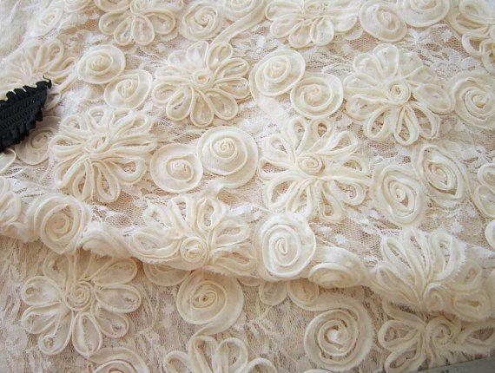

Slide 4
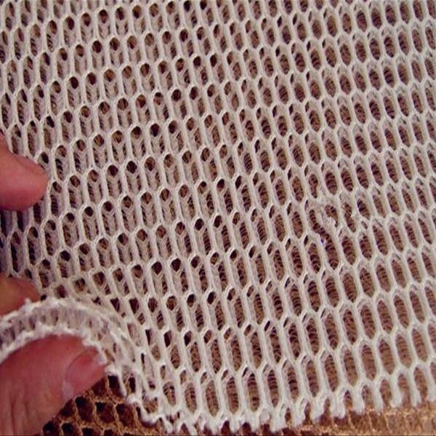

Slide 5
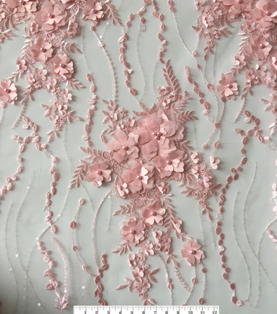

Slide 6
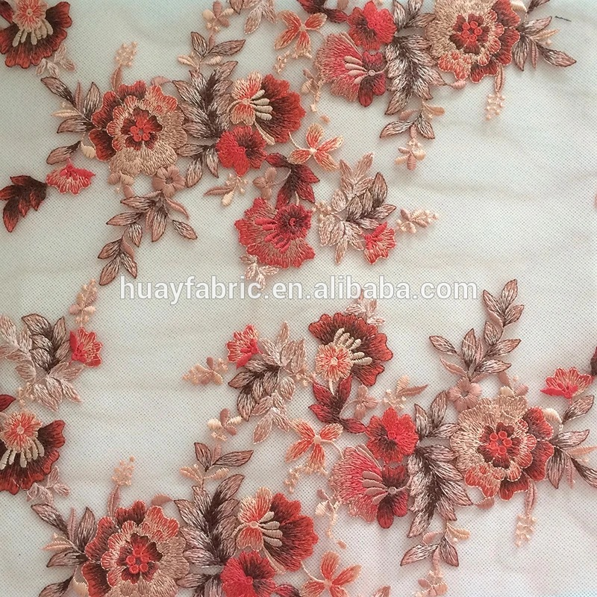

Slide 7
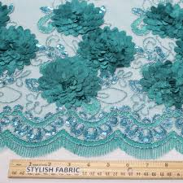

Slide 8
