Slide 1
Immunogenetics

Slide 2
immunogenetics
The study of the genetics of the immune system, known as immunogenetics

Slide 3
THE IMMUNE RESPONSE
The Innate Immune System
The Adaptive Immune System

Slide 4
The Innate Immune System
The innate immune system, which includes some phagocytes, natural killer cells, and the complement system, is an early part of the immune response and recognizes general features of invading microorganisms.

Slide 5
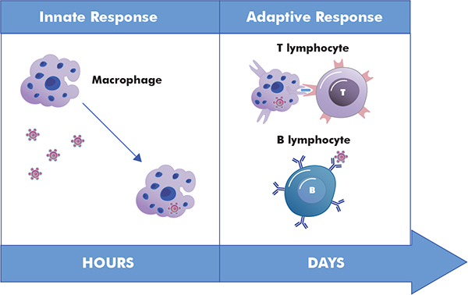

Slide 6
Phagocytes
Complement system
Natural killer cells

Slide 7
The Adaptive Immune System
B lymphocytes are a component of the adaptive immune system; they produce circulating antibodies in response to infection.
T lymphocytes, another component of the adaptive immune system, interact directly with infected cells to kill these cells, and they aid in the B-cell response.

Slide 8
Humoral Immune System
The Cellular Immune System

Slide 9
The B-Cell Response: Humoral Immune System
The humoral immune response involving the transformation of B cells into plasma cells that produce and secrete antibodies to a specific antigen.

Slide 10
Humoral Immune System way to work
The foreign peptide is transported to the surface of the APC by a class II major histocompatibility complex (MHC) molecule
somatic hypermutation
memory B cells

Slide 11
In the humoral immune response, foreign particles are displayed in conjunction with class II MHC molecules by antigen-presenting cells. These displayed molecules are recognized by helper T cells, which then stimulate proliferation of B cells whose receptors (immunoglobulins) can bind to the foreign pathogen.

Slide 12
The Cellular Immune System
Cellular immunity is a protective immune process that involves the activation of phagocytes, antigen-sensitized cytotoxic T cells and the release of cytokines and chemokines in response to antigen.

Slide 13
The immune system is capable of destroying the body’s cells once they are infected. Peptides from the pathogen are displayed on cell surfaces by class I MHC molecules. These are recognized by cytotoxic (killer) T lymphocytes, which destroy the infected cell.

Slide 14
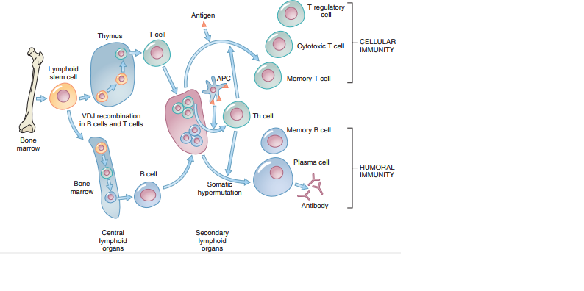

Slide 15
The Innate, Humoral, and Cellular Immune Systems: A Comparison

Slide 16
IMMUNE RESPONSE PROTEINS:
Immunoglobulin molecules & genes:
Each immunoglobulin or antibody molecule is composed of 4 chains:
An identical pair of longer heavy chains
An identical pair of shorter light chains which are linked together by disulphide bond.
there are 5 different types of heavy chains also present:
gamma, meu, alpha, sigma and eeta.

Slide 17
Two types of light chains are also present:
Krypta and lammda.
The five types of heavy chains determine the major class to which an immunoglobulin molecule belongs:( gamma, meu, alpha, delta, eeta) corresponds to the immunoglobulin isotypes IgG, IgM, IgA, IgD,IgE respectively.
Immature B lymphocytes produces only IgM , but as they mature a rearrangement of heavy chains genes called class switching occurs.

Slide 18
This produces the other four major group of immunoglobulin , each of which differs in amino acid composition , charge, size, and carbohydrate content.
Each class tend to be localized in certain parts of the body and try to respond to different type of infection.
The 2 type of the light chains can be found in acossiation with 5 types of the heavy chains.

Slide 19
The heavy and light both chains contains a constant and a variable region, which are located at carboxyl and amino terminal end of the chains respectively,
The arrangement of genes determines the major class of the Ig molecule.
The variable region is responsible for antigen recognition and binding and thus varies with immuglobulin classes.

Slide 20
Three distinct gene segments encode the light chains:
C for constant region,
V for variable region,
J for region that joins the constant and variable region.
1 more gene is also present called as diversity D region located between the joinning and variable region.

Slide 21
The genetic basis of antibody diversity:
Because the immune system can not know in advance which type of microbes it will encounter, the system must contain a huge reservior of structurally diverse immune cells so that at least a few cells can respond or bind to any invading microbe.

Slide 22
Indeed , the hormonal immune system is capable of generating approximately 100 billion structurally distinct antibodies.
At one time, it was tought that because each antibody has a unique sequence of A.A,each must be encoded by a different gene.However, this 1 gene 1 hypothesis was not possibly be correct, because the human genome has only 20,000 to 25,000 protein coding genes.

Slide 23
Further study has shown that several mechanisms are responsible for generating antibody diversity in somatic cells:
Multiple germline immunoglobulin genes:
Molecular genetic studies have shown that for each heavy and light chain, an individual has more then 80 different V segments located contigiously in his or her germline and 6 different J segments.
There are at least 30D segments in heavy chain region.

Slide 24
Somatic recombination (VDJ recombination)
As immunoglobulin molecules are formed during B lymphocytes maturation, a specific combination of single V and J segments is selected for the heavy chain.
This is accomplished by deleting the DNA sequence seperating the single V,J and D segments before they transcribed into mRNA.

Slide 25
The deletion process is carried out in parts by recombinases(encoded by the RAG1 and RAG2 genes) which initiate the double-strand DNA breaks at specific DNA sequences that flank the the V and D gene segments.
After the deletion of all but one V,D and J segments, the nondeleted segments are joined by ligases.

Slide 26
This cutting-and-passing process is known as somatic recombination.
Somatic recombination produces a distictive result: unlike most other cells of a body,whose DNA sequence are identical to one another, mature B lymphocytes are vary in terms of their arranged immunoglobulin DNA sequence.

Slide 28
Because there are many possible combinations of single V,J and D segments,somatic recombination can generate approximately 100,000 to 1,000,000 different types of antibody molecules.
Junctional diversity:
As the V,D and J regions are assembled, slight variations occuer in the position at which they are joined, and small numbers of nucleotides may be deleted or inserted at the junctions.

Slide 29
This creates even more variations in antibody A.A sequence.
Somatic hypermutation:
Typically, only a small subset of B cells has cell-surface receptors that bind specifically and has low affinity in binding.
Once these B cells are stimulated by a foreign antigen, they undergo affinity maturation process.

Slide 30
An enzyme termed activation-induced deaminase causes cytosine bases to be replaced by uracil.
Error-prone DNA polymerases are recruited, and DNA repair process are modified so that mutations can persist in the DNA sequence.
Consequently, mutation rate of these gene segments is approximately 10 raise to power -3 per base per generation.
This causes much variation.

Slide 31
Multiple combination of light and heavy chain:
Random combination of light and heavy chains create a further diversity.
These mechanisms contributes to antibody diversity.

Slide 32
Mechanisms that produce antibody diversity include multiple germ line immunoglobulin gene segments, somatic recombination of the immunoglobulin gene segments, junctional diversity, somatic hypermatutation and the potential for multiple combinations of heavy and light chains.

Slide 33
T-CELL RECEPTORS:
T-cell receptors are similar in function to B-cells receptors. However, they can bind to a foreign peptide only when it is presented by an MHC molecule. Their diversity is created by the same mechanisms that produce immunoglobulin diversity, with the exception of somatic hypermutation.

Slide 34
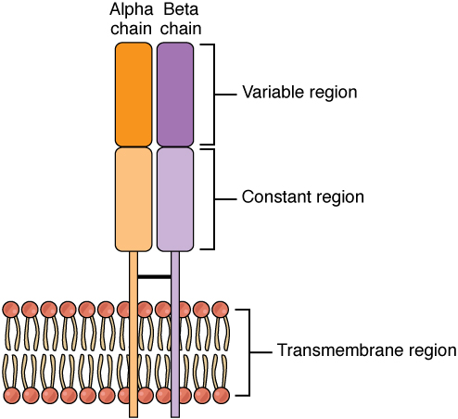
90% of the T-cells are hetrodimers composed of alpha and betta chain and approximately 100% of cells are composed of a gamma and a delta chain.

Slide 35
Lecture Outlines
Define immunodeficiency
Classification
Specific non specific
Primary and secondary
B cell deficiency & Examples
T Cell deficiency & Examples
SCID
Drug induced immunodeficiency

Slide 37
IMMUNODEFICIENCY
It is the absence or failure of normal function of one or more elements of the immune system
Results in immunodeficiency disease
Can be specific or non specific
Specific = Abnormalities of B & T cells
Non specefic = Abnormalities of non specific components
PRIMARY OR SECONDARY

Slide 38
PRIMARY IMMUNODEFICIENCIES
Primary immunodeficiencies are inherited defects of the immune system
These defects may be in the specific or nonspecific immune mechanisms
They are classified on the basis of the site of lesion in the developmental or differentiation pathway of the immune system

Slide 39
B CELL DEFICIENCY
X liked agammaglobuinemia
IgA deficiency
IgG subclass deficiency
Immunodeficiency with increased Igm
Common variable immundeficiency
Transient hypogammaglobulinaemia of infancy

Slide 40
1- X-linked agammaglobulinemia
In X-LA early maturation of B cells fails
Affect males
Few or no B cells in blood
Very small lymph nodes and tonsils
No Ig(Immunoglobulin)
Small amount of Ig G in early age
Recurrent pyogenic infection

Slide 41
2- IgA and IgG subclass deficiency
IgA deficiency is most common
Patients tend to develop immune complex disease
About 20% lack IgG2and IgG4
Susceptible to pyogenic infection
Result from failure in terminal differentiation of B cells

Slide 42
3- Immunodeficiency with increased IgM (HIgM)
Results in patients with IgA and IgG deficiency
Production of large amount of IgM >200mg/dl of polyclonal IgM
Susceptible to pyogenic infection
Treatment by iv gamma globulin
Formation of IgM to neutrophils, platelets and other blood components
Due to inability of B cells to isotype switching

Slide 43
4- Common Variable Immunodeficiency (CVID)
There are defect in T cell signaling to B cells
Acquired a gammaglobulinemia in the 2nd or 3rd decade of life
May follow viral infection
Pyogenic infection
80% of patients have B cells that are not functioning
B cells are not defective. They fail to receive signaling from T lymphocytes

Slide 44
5- Hypogamaglobulinemia of infancy
Due to delay in in IgG synthesis approximately up to 36 months
In normal infants synthesis begins at 3 months
Normal B lymphocytes
Probably lack help of T lymphocytes

Slide 45
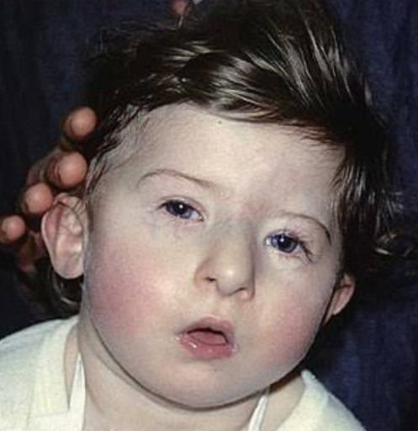
DISORDERS of T CELLS
DiGeorge's syndrome:
It the most understood T-cell immunodeficienc
Also known as congenital thymic aplasia/hypoplasia
Associated with hypoparathyroidism, congenital heart disease, fish shaped mouth.
Defects results from abnormal development of fetus during 6th-10th week of gestation when parathyroid, thymus, lips, ears and aortic arch are being formed

Slide 46
T cell deficiencies with variable degrees of B cell deficiency
1- Ataxia-telangiectasia:
Associated with a lack of coordination of movement (ataxis) and dilation of small blood vessels of the facial area (telangiectasis).
T-cells and their functions are reduced to various degrees.

Slide 47
B cell numbers and IgM concentrations are normal to low.
IgG is often reduced
IgA is considerably reduced (in 70% of the cases).
There is a high incidence of malignancy, particularly leukemia in these patients.
The defects arise from a breakage in chromosome 14 at the site of TCR and Ig heavy chain genes

Slide 48
2- Wiskott-Aldrich syndrome:
Associated with normal T cell numbers with reduced functions, which get progressively worse.
IgM concentrations are reduced but IgG levels are normal
Both IgA and IgE levels are elevated.
Boys with this syndrome develop severe eczema.
They respond poorly to polysaccharide antigens and are prone to pyogenic infection.

Slide 49
MHC DEFICIENCY (Bare leukocyte syndrome):
Due to defect in the MHC class II transactivator (CIITA) protein gene, which results in a lack of class-II MHC molecule on APC.
Patients have fewer CD4 cells and are infection prone !.
There are also individuals who have a defect in their transport associated protein (TAP) gene and hence do not express the class-I MHC molecules and consequently are deficient in CD8+ T cells.

Slide 50
SEVERE COMBINED IMMUNODEFICENCY (SCID)
In about 50% of SCID patients the immunodeficiency is x-linked whereas in the other half the deficiency is autosomal.
They are both characterized by an absence of T cell and B cell immunity and absence (or very low numbers) of circulating T and B lymphocytes.
Patients with SCID are susceptible to a variety of bacterial, viral, mycotic and protozoan infections.

Slide 51
The x-linked SCID is due to a defect in gamma-chain of IL-2 also shared by IL-4, -7, -11 and 15, all involved in lymphocyte proliferation and/or differentiation.
The autosomal SCIDs arise primarily from defects in adenosine deaminase (ADA) or purine nucleoside phosphorylase (PNP) genes which results is accumulation of dATP or dGTP, respectively, and cause toxicity to lymphoid stem cells

Slide 52
Diagnosis
Is based on enumeration of T and B cells and immunoglobulin measurement.
Severe combined immunodeficiency can be treated with bone marrow transplant

Slide 53
IMMUNODEGECIENCY CAUSED BY DRUGS
CORTICOSTEROIDS
Cause changes in circulating leukocytes
Depletion of CD4 cells
Monocytopenia
Decreased in circulating eosinophils and basophils
Inhibition of T cell activation and B cell maturation
Inhibit cytokine synthesis

Slide 54
METHOTREXATE
Structural analogue of folic acid
Blocks folic acid dependent synthetic pathways essential for DNA synthesis
Prolonged use for treatment reduces immunoglobulin synthesis

Slide 55
CYCOLOSPORIN
Have severe effects on T cell signaling and functions
It binds to immunophilins which are believed to have a critical role in signal transduction
Also inhibit IL 2 dependent signal transduction

Slide 56
OTHER CAUSES
Malnutrition
Minerals
Vitamins
Obesity

Slide 57
THANK YOU!

