Slide 1
Forensic Serology and DNA Analysis
SFS1. Students will recognize and classify various types of evidence in relation to the definition and scope of Forensic Science.
SFS2. Students will use various scientific techniques to analyze physical and trace evidence.
SFS3. Students will analyze the use of … serology and DNA technology in forensic investigations.
d. Differentiate the forensic techniques used to distinguish human and animal blood
e. Analyze the physics of blood stain patterns.
f. Compare short tandem repeat patterns (STR) and relate to identifying the DNA of an individual.
g. Explain the use of the DNA database for DNA profiling.

Slide 2
Essential Questions
What is the nature of blood?
How does blood typing work? How can you identify a person using blood type?
What should be considered when examining blood evidence at a crime scene?

Slide 3
Essential Questions
What information can be learned when examining blood spatter evidence?
What are some similarities and differences between RFLP and STR?
What information can be gained with DNA analysis? Why would it be done?

Slide 4
What is forensic serology?
Forensic serology is the detection, classification and study of various bodily fluids such as blood, semen, fecal matter and perspiration, and their relationship to a crime scene.
A forensic serologist may also be involved in DNA analysis and bloodstain pattern analysis.

Slide 5
The Nature of Blood
Blood is a specialized bodily fluid that is composed of two substances – cells and plasma
It is responsible for delivering nutrients and oxygen to and transporting wastes and carbon dioxide from cells, tissues, and organs.

Slide 6
The Nature of Blood
The average human body has about 5 liters of blood (less for females, more for males).
Blood accounts for 8% of your weight
Oxygenated blood is bright red, while deoxygenated blood is darker red due to the nature of hemoglobin

Slide 7
The Nature of Blood
Erythrocytes (red blood cells)
Contain hemoglobin and distribute oxygen
Account for ~93% of all blood cells
Represent ~25% of all cells in the body
Over 2 million made every second
Live for about 120 days before recycled
Hematocrit is a measure of RBC volume (45% of whole blood)

Slide 8
The Nature of Blood
Leukocytes (white blood cells)
Function in the immune system
Five types categorized by immune target and function
Account for ~0.1% of all blood cells
Live for 3-4 days before recycled
Main component of pus

Slide 9
The Nature of Blood
Thrombocytes (platelets)
Responsible for blood clotting
Produced by fragmentation of larger stem cells
Account for ~7% of all blood cells
“Live” for 5-9 days before recycled
Form long fibers to trap RBCs and form scab

Slide 10
THROMBOCYTE
(platelet)
ERYTHROCYTE
(red blood cell)
LEUKOCYTE
(white blood cell)

Slide 11
The Nature of Blood
Plasma is the fluid portion of blood and accounts for 55% of the blood content.
It is mostly water, and it contains the clotting factors, other proteins, hormones, and various chemicals.
Serum is the liquid that separates from the blood when a clot is formed (serum = plasma – clotting factors)

Slide 12
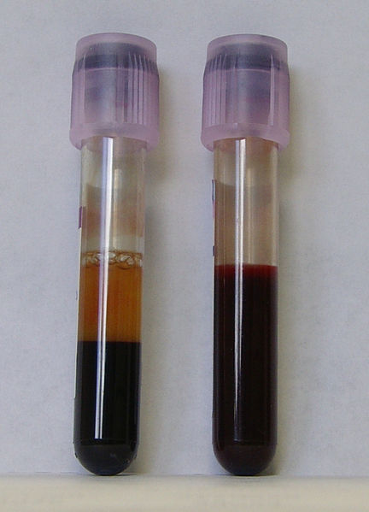
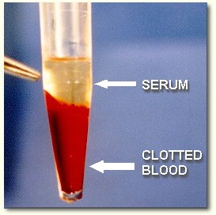
The Nature of Blood:

Slide 13
Basic Immunology
An antigen is any substance that causes your immune system to produce antibodies against it.
The substance may be from the environment or formed within the body.
The immune system will kill or neutralize any antigen that is recognized as a foreign and potentially harmful invader.

Slide 14
Blood typing is…
the classification of blood based on the presence or absence of inherited (chromosome #9, specifically) antigenic substances on the surface of RBCs (although some people secrete them)
More than 30 blood antigen systems have been identified (over 600 individual antigens!), but the ABO and Rh systems are the most important.
ABO system was discovered by Landsteiner in 1901 (Nobel Prize in 1930)

Slide 15
Blood Typing
Type A RBCs have A antigens, and the blood plasma has anti-B antibodies
Type B RBCs have B antigens, and the blood plasma has anti-A antibodies
Type AB RBCs have both A and B antigens, and the blood plasma has no antibodies
Type O RBCs have no antigens, but the blood plasma has both anti-A and anti-B antibodies

Slide 16
Blood Typing
Rh factor is determined primarily by the presence of the D antigen.
RBCs with the D antigen are Rh +
RBCs without the D antigen are Rh -

Slide 17
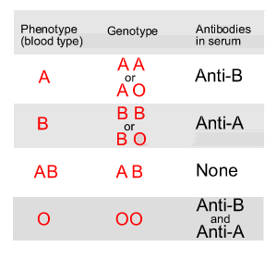
Blood Typing
Because you have pairs of chromosomes, your genotype is composed of two alleles for the ABO blood group gene.
Your phenotype results from your specific genotype.

Slide 18
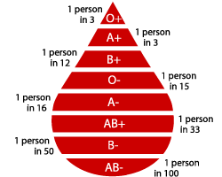
How common are the blood types?
In the US
In general…
African Americans and Hispanics are more likely to have Type O blood.
Caucasians are more likely to have Type A
Asians are more likely to have Type B and AB blood

Slide 19
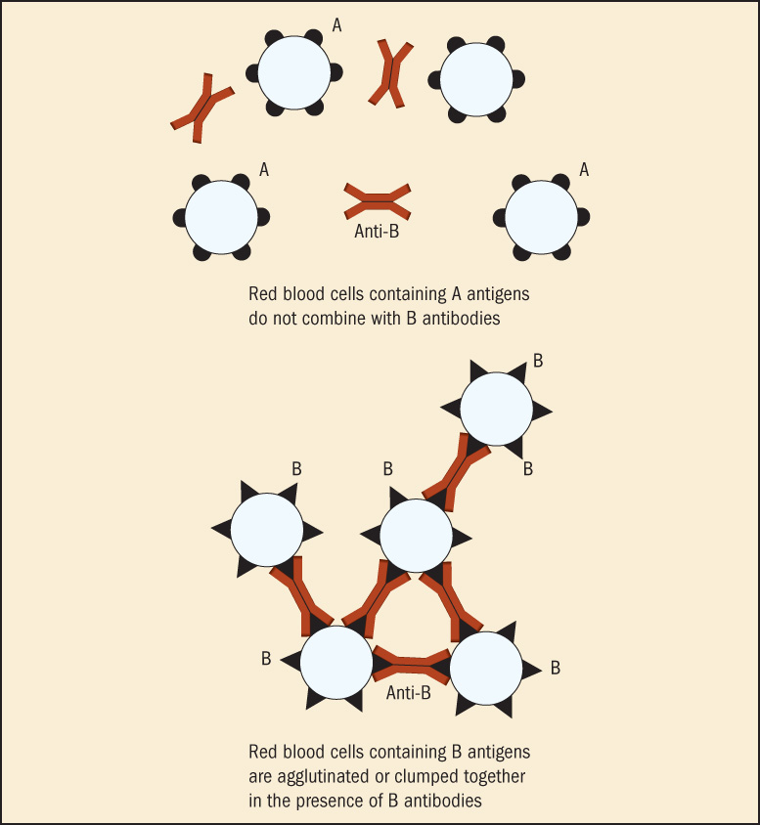
Blood Typing
When an antibody comes into contact with its target antigen, clumping, called agglutination, occurs.

Slide 21
Blood Donation and Transfusion
Because of the immune response in blood, donation and transfusion is dependent on donor and recipient blood type.
Recipient blood should have NO antibodies that could react to the donor antigens, otherwise the blood would agglutinate in the recipient’s vessels, leading to rejection and death.

Slide 22
Blood Donation and Transfusion
So, which blood type is BEST for donation?
Which type recipient would have the easiest transfusions?

Slide 23
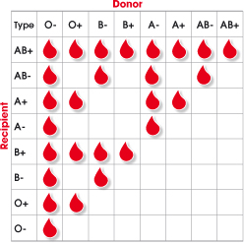

Slide 24
Immunoassay Techniques
An immunoassay is a biochemical test that measures the presence or concentration of a substance in solutions that frequently contain a complex mixture of substances.
A number of immunological assay techniques are commercially available for detecting drugs through antigen-antibody reaction.

Slide 25
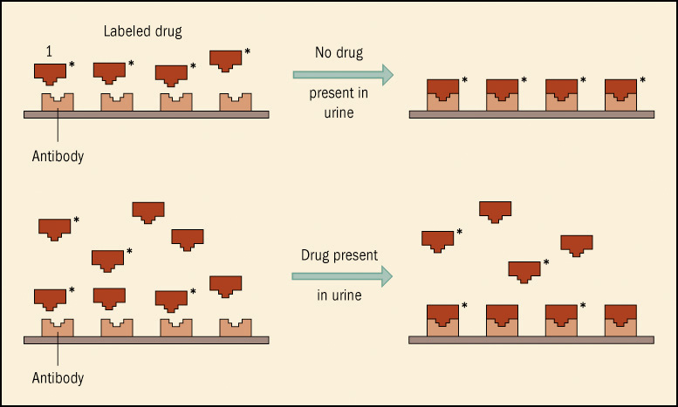
Example of Immunoassay

Slide 26
Bloodstains at the Crime Scene
When blood is found there are four questions to ask:
Is it really blood?
Is the blood human?
From whom did the blood come?
How did the blood get there?

Slide 27
Is it really blood?
Kastle-Meyer Color Test
Stain is mixed with phenolphthalein reagent and then hydrogen peroxide.
If it is blood, the sample will turn a bright pink color due to hemoglobin’s oxidative effects.
Can be a false positive since some substances have the same oxidative effects, so a confirmatory test would be needed.

Slide 28
Is it really blood?
Hemastix Strips
Strip is moistened with distilled water and placed on blood stain.
If blood is present, the strip will turn green.

Slide 29
Is it really blood?
Luminol Test
Luminol reagent is sprayed onto a surface, in as dark of a room as possible.
If blood is present a luminescent glow will show in the area of the blood, as it reacts with the iron in the hemoglobin.
The Luminol test is very sensitive and can detect bloodstains diluted up to 10,000 times!
Can be false positive with feces, urine, or some bleaches

Slide 30
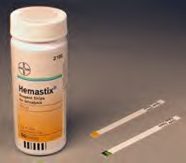
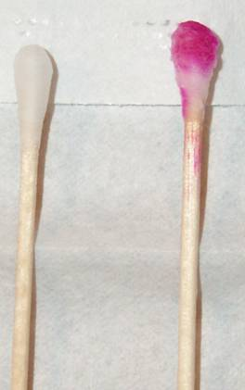
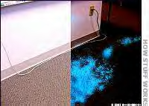

Slide 31
Is the blood human?
To determine whether a blood sample is from a human or animal source, samples are tested with anti-human serum.
The forensic test consists of collecting the blood sample in a test tube containing an animal-derived serum containing antibodies against human blood.
If an insoluble complex of precipitin (this would be visible as agglutination) occurs, the test is positive for human blood.

Slide 32
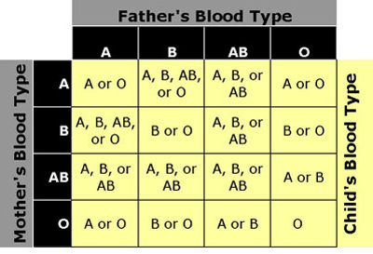
From whom did the blood come?
Blood typing and/or DNA testing (discussed later) can determine this.

Slide 33
How did the blood get there?
Dr. Herbert MacDonell, founder of the Bloodstain Evidence Institute in Corning, New York, is acknowledged as the foremost pioneer in analyzing blood patterns and has been internationally acclaimed for over five decades for his forensic expertise.

Slide 34
MacDonell’s Observations for Blood:
Surface texture is of paramount importance in the interpretation of bloodstain patterns, and correlations between standards and unknowns are valid only if identical surfaces are used.
In general, the harder and less porous the surface, the less spatter results.

Slide 35
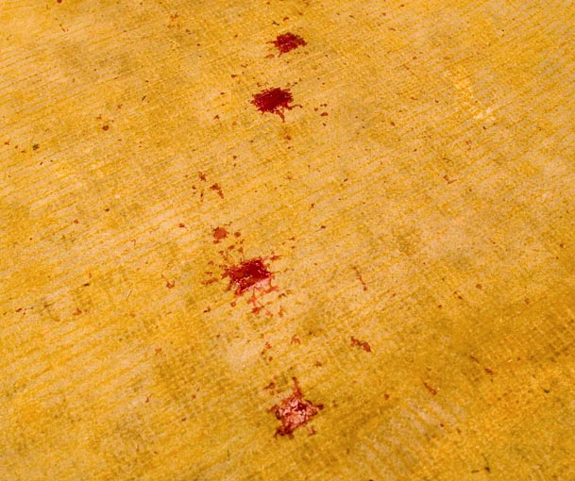

Slide 36
MacDonell’s Observations for Blood:
The direction of travel of blood striking an object may be discerned by the stain’s shape.
The pointed end of a bloodstain always faces its direction of travel.

Slide 37
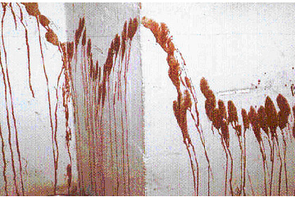
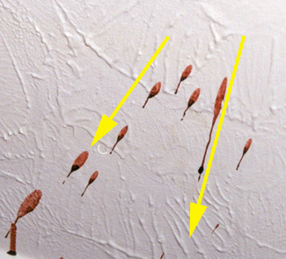
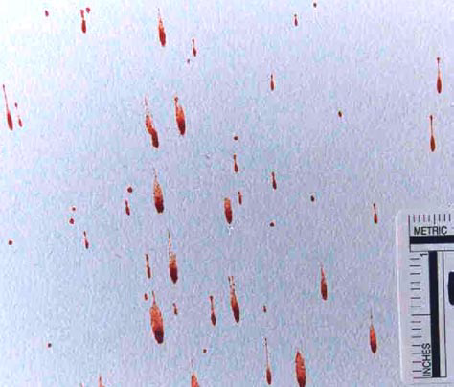

Slide 38
MacDonell’s Observations for Blood:
It is possible to determine the impact angle of blood on a flat surface by measuring the degree of circular distortion of the stain.
A drop of blood striking a surface at right angles gives rise to a nearly circular stain; as the angle decreases, the stain becomes elongated in shape.

Slide 39
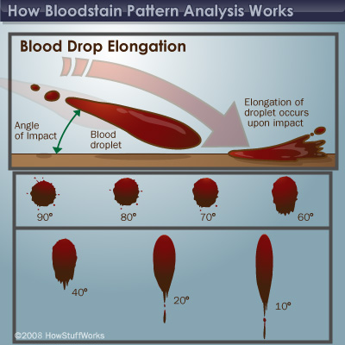

Slide 40
MacDonell’s Observations for Blood:
The origin of a blood spatter in a two-dimensional configuration can be established by drawing straight lines through the long axis of several individual bloodstains.
The intersection or point of convergence of the lines represents the point from which the blood emanated.

Slide 41
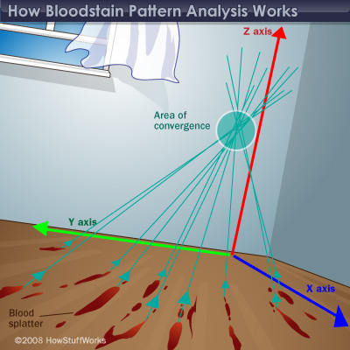

Slide 42
Other issues…
Wet blood has more value than dried blood because more tests can be run.
For example, alcohol and drug content can be determined from wet blood only.
Blood begins to dry after 3-5 minutes of exposure to air.
As it dries, it changes color towards brown and black.

Slide 43
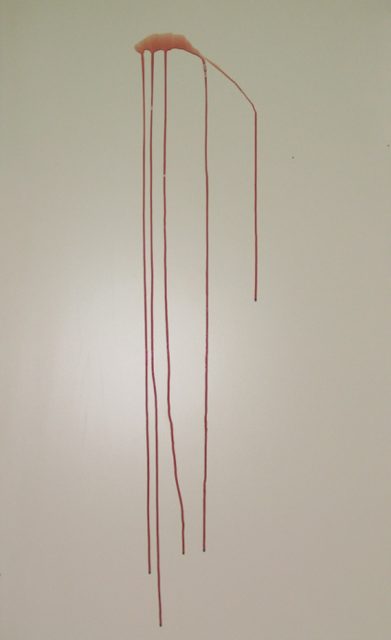
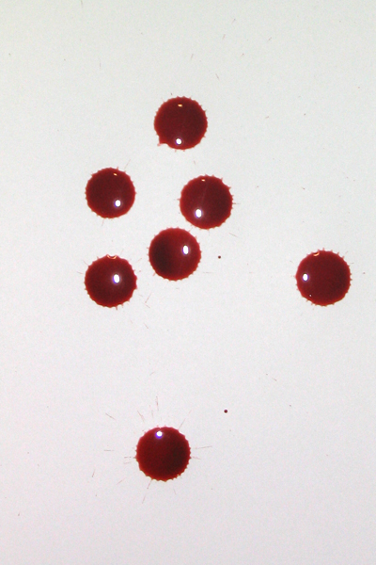
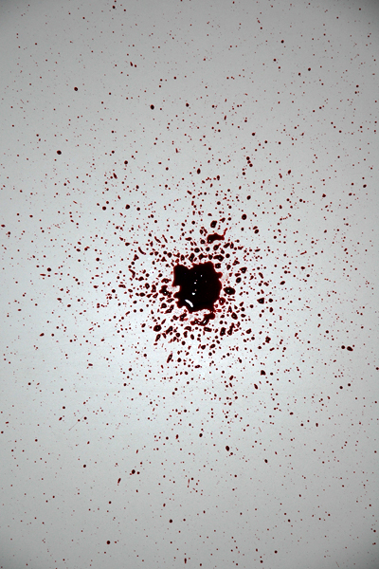
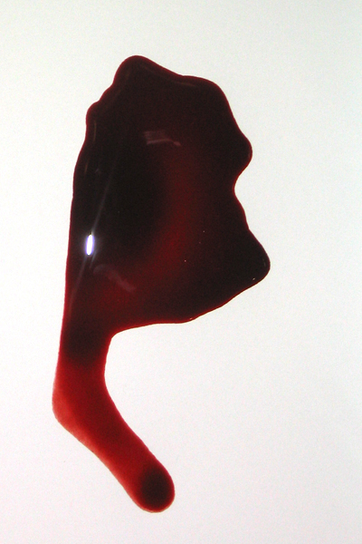
Blood Spatter Types
saturation
Passive
Created by the force of gravity
drops drip flow pool

Slide 44
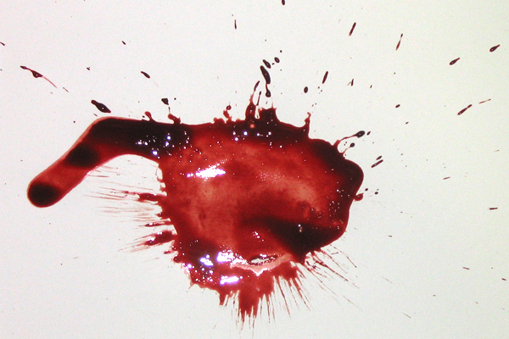
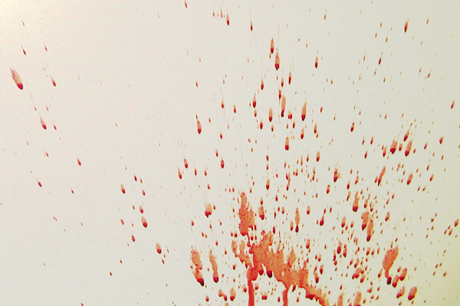
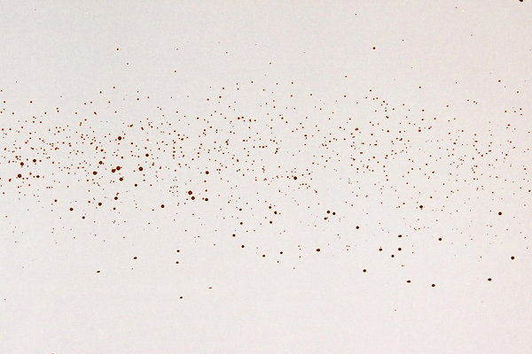
Blood Spatter Types
Projected
Occurs when some form of energy is transferred to the blood source
Low velocity impact
Medium velocity impact
High velocity impact

Slide 45
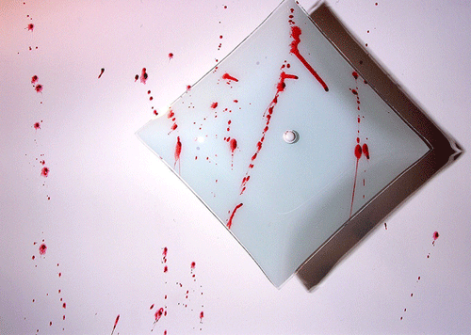
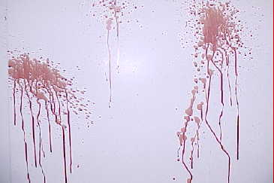
Blood Spatter Types
Projected
cast-off arterial spurting

Slide 46
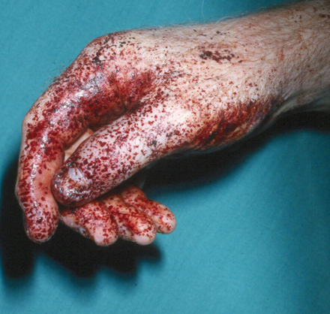
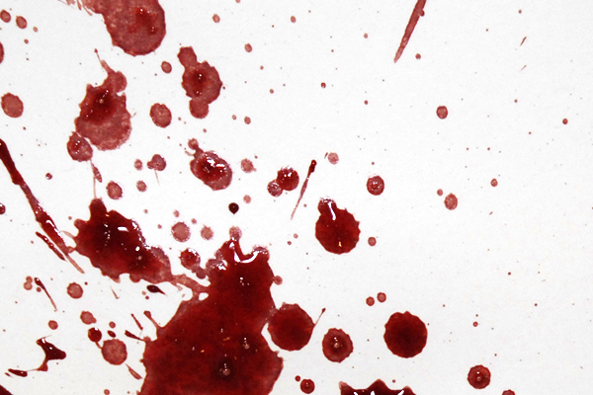
Blood Spatter Types
Projected
back spatter expiratory

Slide 47
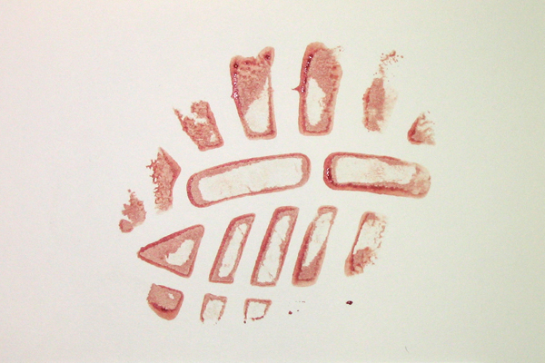
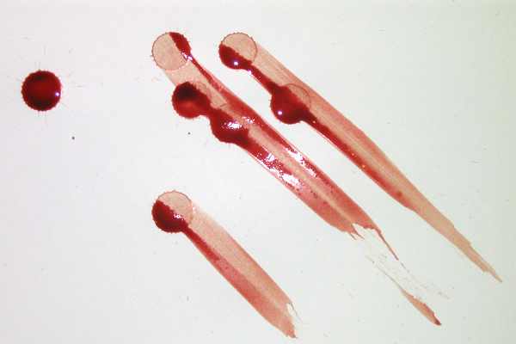
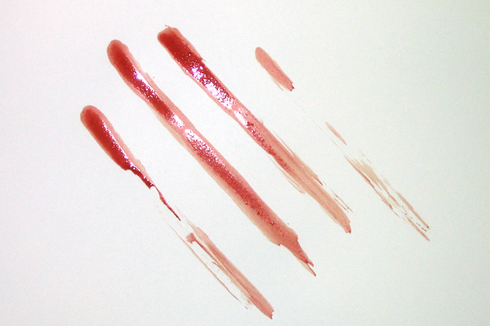
Blood Spatter Types
Transfer
Produced when an object with blood comes in contact with an object or surface that does not have blood
contact wipe swipe

Slide 48
DNA Collection & Analysis
Investigators gather samples from the crime scene and from suspects and then analyze it for a set of specific DNA regions or markers.
A match of one marker is not usually unique, but if a sample matches four or five markers, there is a very good chance it is a match.

Slide 49
DNA Collection
DNA is collected at crime scenes in a variety of ways:
Sterile swabs (for moist substance)
Scalpels (for scraping dried substance)
Collection kits (samples from suspects or living victims)

Slide 50
DNA Collection
DNA samples can be from:
Saliva
Blood
Hair
Skin
Finger or toe nails
Tooth with root material
DNA Extraction

Slide 51
DNA Analysis
Several DNA technologies are used in DNA analysis:
RFLP
PCR
STR
mtDNA Analysis

Slide 52
RFLP: Restriction Fragment Length Polymorphism
Analyzes variable lengths of DNA fragments
Used in the development of DNA fingerprinting (Dr. Alec Jeffreys, 1985)
Not used as much anymore because…
it requires a large DNA sample
the processing is slow and tedious
samples degraded by the environment do not work well with RFLP

Slide 53
The basic RFLP technique:
A sample of DNA is combined with restriction enzymes that break apart the strands at specific locations
The resulting fragments are sorted according to their lengths by gel electrophoresis
Gel Electrophoresis Simulation

Slide 54
PCR: Polymerase Chain Reaction
Used to make millions of exact copies of DNA from a biological sample
Allows very small samples to be analyzed, such as a sample of a few skin cells
Must be very careful about contamination in this process

Slide 55
The basic PCR technique:
DNA strand is heated; two pieces separate
Each half is used as a template to build a new complementary strand
PCR Simulation

Slide 56
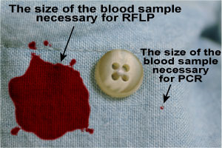

Slide 58
STR: Short Tandem Repeat
Evaluates specific regions (loci) within nuclear DNA
FBI uses 13 standard specific STR regions for CODIS
The purpose of establishing a core set of STR loci is to ensure that all forensic laboratories can establish uniform DNA databases and, more importantly, share valuable forensic information.

Slide 59
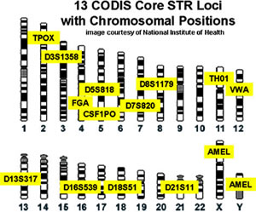
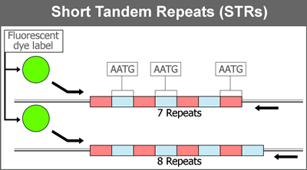

Slide 60
Mitochondrial DNA Analysis
Used for samples that cannot be analyzed using RFLP or STR
Uses DNA extracted from mitochondrion rather than nuclear DNA
Especially useful in old cases and old samples

Slide 61
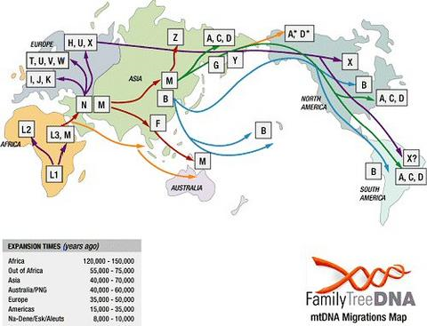

Slide 62
DNA Collection & Comparison
What happens after the samples are collected?
A DNA profile is created….how??
Markers are found by designing small pieces of DNA (probes) that will seek out and bind to complementary DNA sequences. This creates a distinct pattern. Again, one marker is not usually unique, but with four or five regions the match is likely
The DNA profiles are compared with samples from suspects to find possible matches.
If there are no suspects, a national database called CODIS may be used to find potential suspects.

Slide 63
DNA Collection & Comparison
More on CODIS:
Stands for Combined DNA Index System
National network that helps identify leads for crimes with no suspects
Three tiers: Local (LDIS), State (SDIS), National (NDIS)
Uses 13 DNA regions that vary from person to person
Looks for matches at more than one location on a genome for more accurate results

Slide 64
Sources of DNA at Crime Scenes
Cool table at:
http://www.dna.gov/basics/evidence_collection/identifying

Slide 65
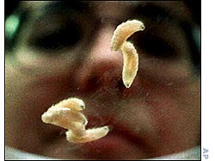
Sources of DNA at Crime Scenes
Examples of sources from real cases:
Saliva on the stamp of a stalker’s threatening letter
Skin cells shed on a ligature of a strangled victim
Perspiration on a baseball cap discarded by a rapist was compared with the saliva swabbed from a bite mark on a different rape victim
A single hair (without the root) found deep in a victim’s throat
Maggot digestive contents

Slide 66
How can DNA evidence be planted?
Sneezing or coughing over evidence
Person touches their mouth, nose or other part of the face and then touches the area that may contain the DNA to be tested.
Scene personnel can deposit hairs, fibers, or trace material from their clothing
Wind can carry in contaminants

Slide 67
Other Uses of DNA
Paternity Testing and Proving Family Relations
Identification of John or Jane Does
Study of evolution and ancestry
Studying Inherited Disorders

