Slide 1
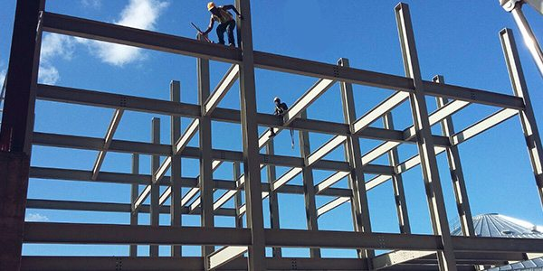
COLLEGE OF ENGINEERING AND TECHNOLOGY UNIVERSITY OF SARGODHA DESIGN OF STRUCTURES (CE-409) 01-Credit Hour
LECTURE-7
SERVICEABILITY………

Slide 2
DEFLECTIONS OF STRUCTURAL CONCRETE MEMBERS
Flexural concrete member must be designed for safety and serviceability.
The members will be safe if they are designed accordingly i.e. may be according to ACI code equations and limitations.
Consequently as studied earlier, size of each member is determined as well as the reinforcing required to maintain an internal moment capacity equal to or greater than that of the external moment.
Once that final dimensions are determined, the beam must be checked for serviceability : Cracks ad Deflections.
Adequate Stiffness of the member is necessary to prevent excessive cracks and deflection.

Slide 3
DEFLECTIONS OF STRUCTURAL CONCRETE MEMBERS…
The use of the ACI Code provisions, taking into consideration the nonlinear relationship between stress and strain has resulted in smaller sections than those designed by the elastic theory.
The ACI Code, Section 9.4, recognizes the use of steel up to a yield strength of 80 Ksi (560 MPa) and the use of high-strength concrete.
The use of high-strength steel and concrete results in smaller sections and a reduction in the stiffness of the flexure member and consequently increases its deflection.
The permissible deflection is governed by many factors, such as the type of the building, the appearance of the structure, the presence of plastered ceilings and partitions, the damage expected due to excessive defection and the type and magnitude of live load.

Slide 4
DEFLECTIONS OF STRUCTURAL CONCRETE MEMBERS…
The ACI Code, Section 9.5, specifies minimum thickness for one-way flexural members and one-way slabs, as shown in Table 6.1.
The values are for members not supporting or attached to partitions or other constructions likely to be damaged by large deflections.

Slide 5
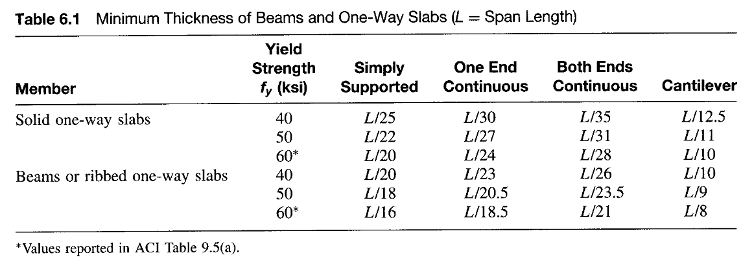

Slide 6
INSTANTANEOUS DEFLECTION
The Deflection of structural members is due mainly to the dead load plus a fraction of or all the live load.
The deflection that occurs immediately upon the application of the load is called the immediate, or instantaneous, deflection.
Under sustained loads, the deflection increases appreciably with time.
Various methods are available for computing deflections in statically determinate and indeterminate structures.
The instantaneous deflection calculations are based on the elastic behavior of the flexural members.
The elastic deflection, Δ, is a function of the load, W, span, L, moment of inertia I and the modulus of elasticity, E.

Slide 7
INSTANTANEOUS DEFLECTION

Slide 8
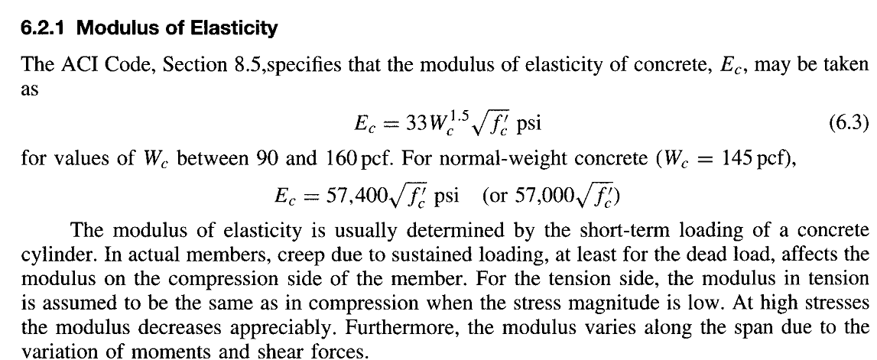
INSTANTANEOUS DEFLECTION

Slide 9
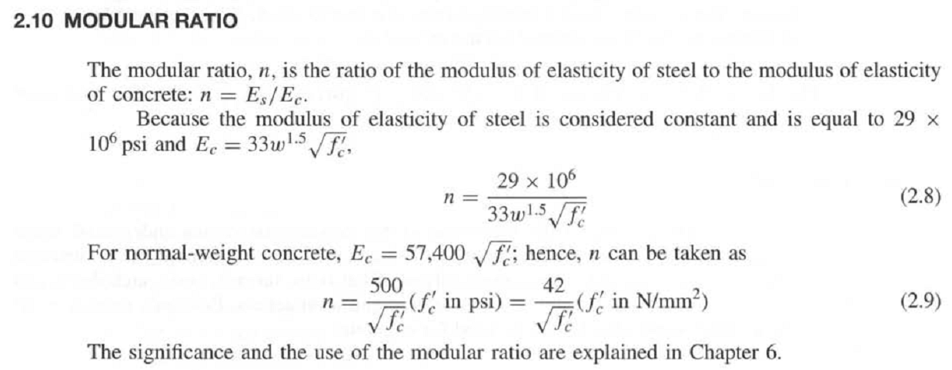
INSTANTANEOUS DEFLECTION

Slide 10
INSTANTANEOUS DEFLECTION

Slide 11
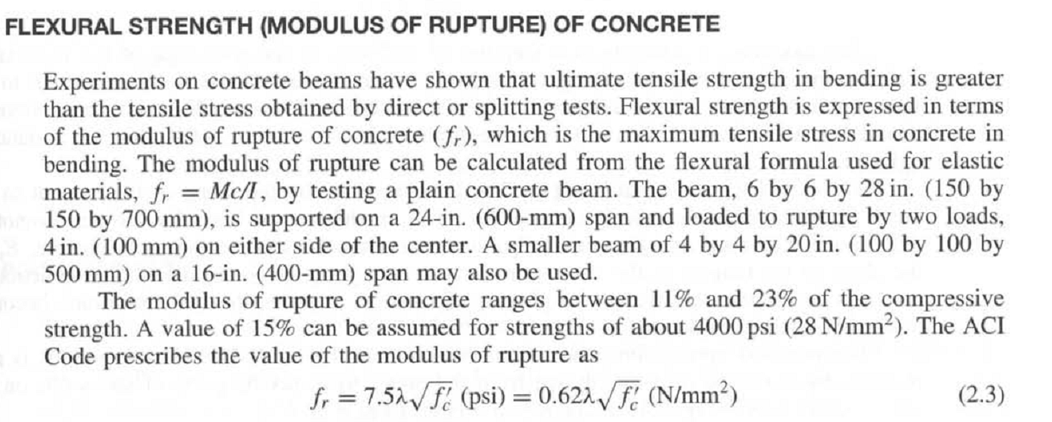
INSTANTANEOUS DEFLECTION

Slide 12
INSTANTANEOUS DEFLECTION

Slide 13
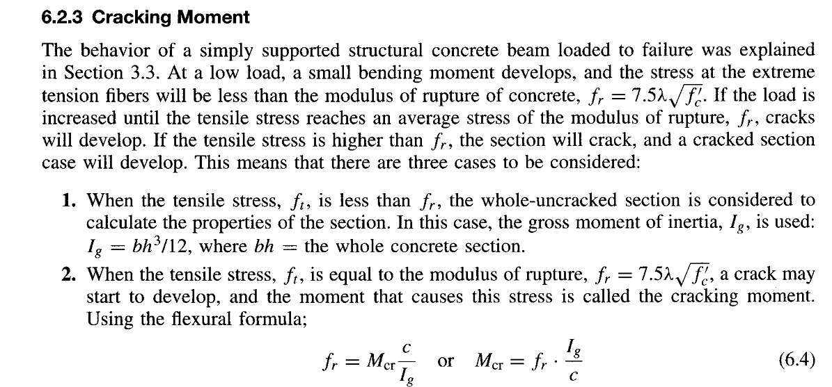
INSTANTANEOUS DEFLECTION

Slide 14
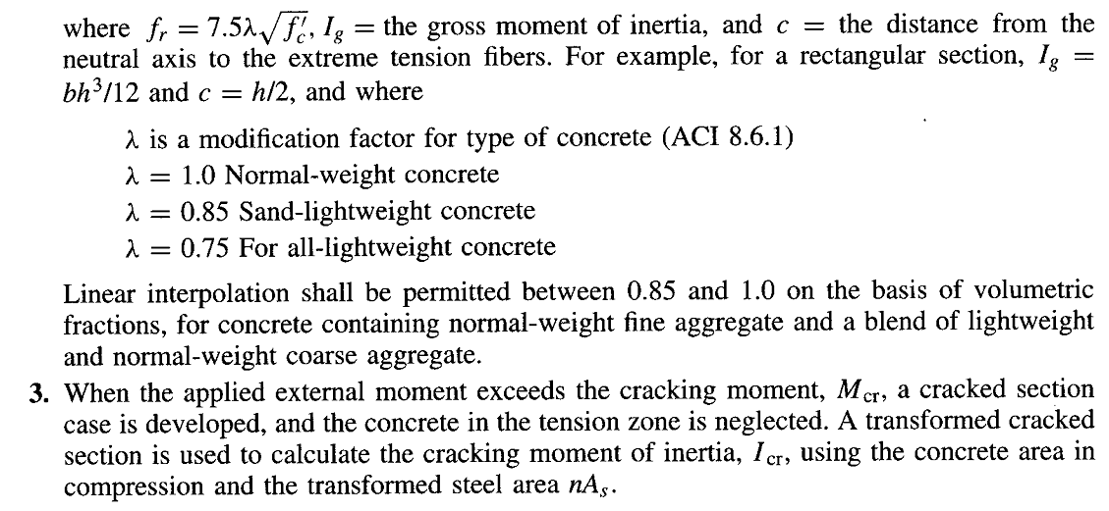
INSTANTANEOUS DEFLECTION

Slide 15
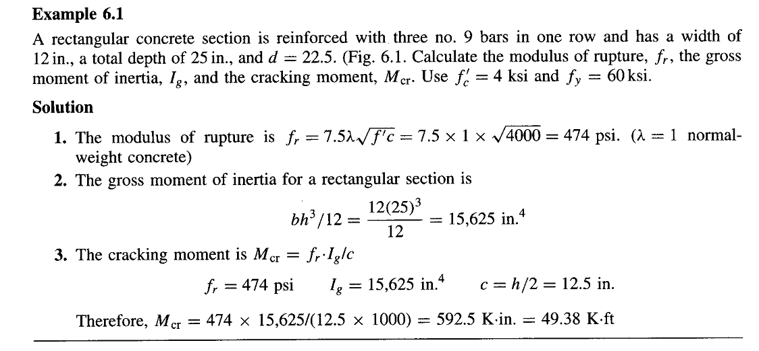
INSTANTANEOUS DEFLECTION

Slide 16
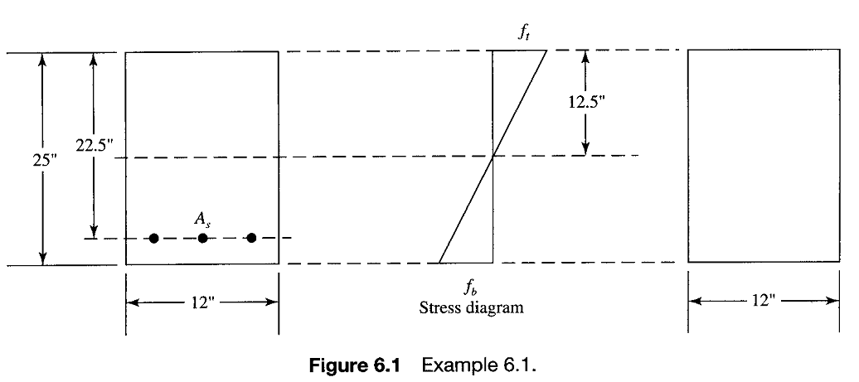
INSTANTANEOUS DEFLECTION

Slide 17
INSTANTANEOUS DEFLECTION

Slide 18
INSTANTANEOUS DEFLECTION
Moment of Inertia
The moment of inertia, in addition to the modulus of elasticity, determines the stiffness of the flexural member.
Under small loads, the produced maximum moment will be small and the tension stresses at the extreme tension fibers will be less than the modulus of rupture of concrete, the gross transformed cracked section will be effective in providing the rigidity.
At the working loads or higher, flexural tension cracks are formed.
At the cracked section, the position of the neutral axis is high, whereas at sections midway between cracks along the beam, the position of the neutral axis is lower (nearer to the tension steel).
In both locations, only the transformed cracked sections are effective in determining the stiffness of the member, therefore, the moment of inertia varies considerably along the span.

Slide 19
INSTANTANEOUS DEFLECTION
Moment of Inertia
At maximum bending moment, the concrete is cracked and its portion in the tension zone is neglected in the calculations of moment of inertia.

Slide 20
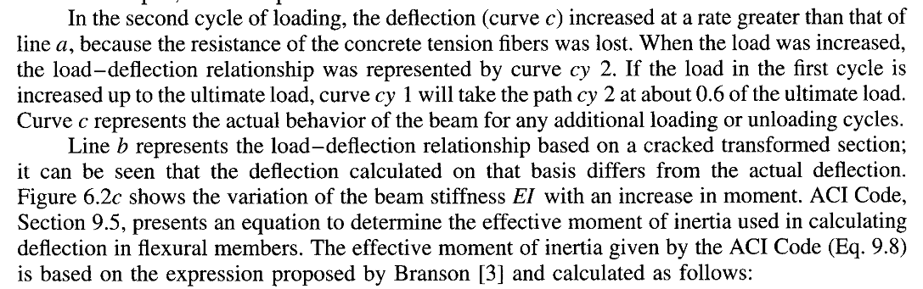
INSTANTANEOUS DEFLECTION
Moment of Inertia

Slide 21
INSTANTANEOUS DEFLECTION
Moment of Inertia

Slide 22
INSTANTANEOUS DEFLECTION
Moment of Inertia

Slide 23
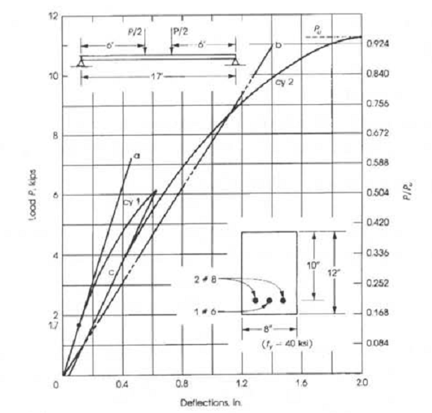
INSTANTANEOUS DEFLECTION
Moment of Inertia
Figure-6.2 (a)

Slide 24
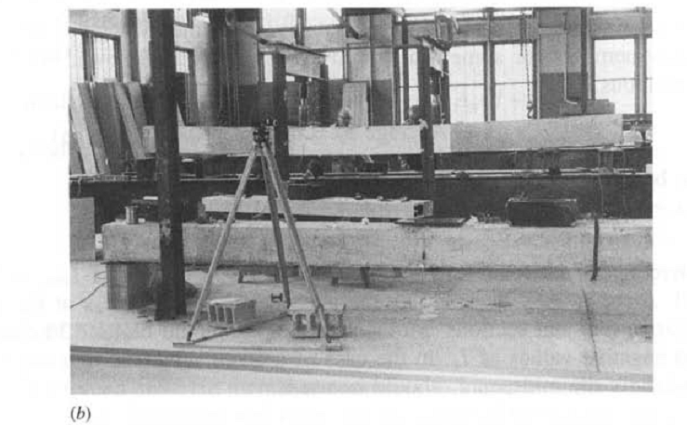
INSTANTANEOUS DEFLECTION
Moment of Inertia
Figure-6.2 (b)

Slide 25
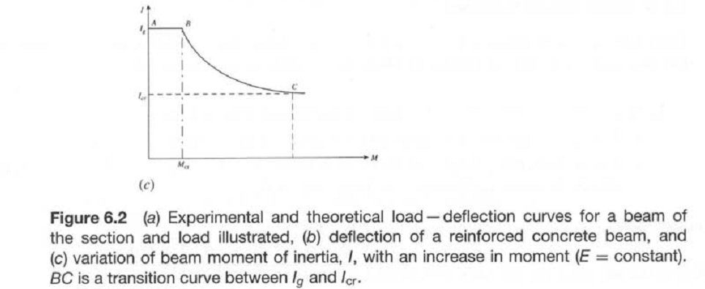
INSTANTANEOUS DEFLECTION
Moment of Inertia
Figure-6.2 (c)

Slide 26
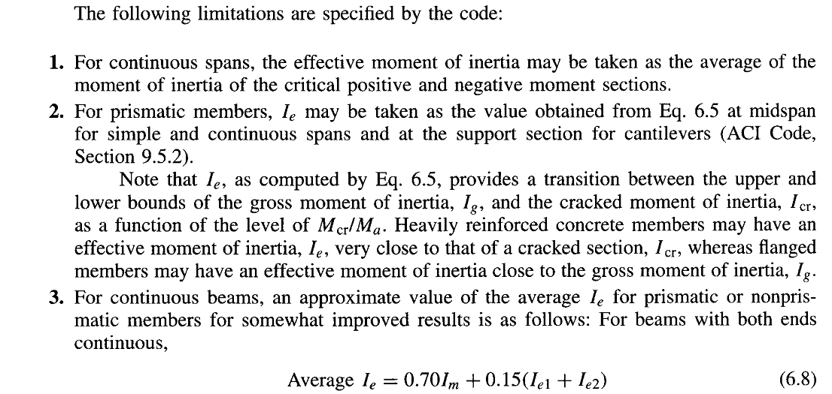
INSTANTANEOUS DEFLECTION
Moment of Inertia

Slide 27
INSTANTANEOUS DEFLECTION
Moment of Inertia

Slide 28
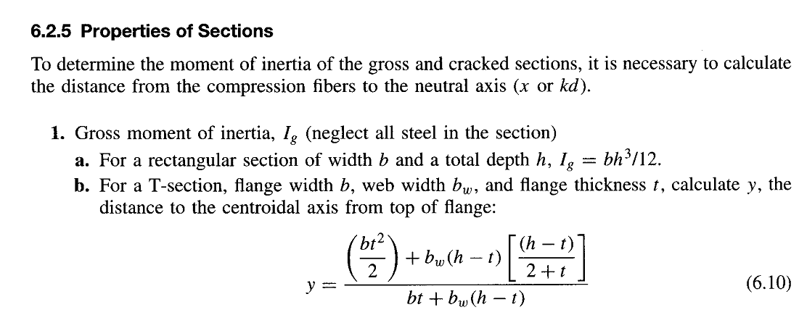
INSTANTANEOUS DEFLECTION
Moment of Inertia

Slide 29
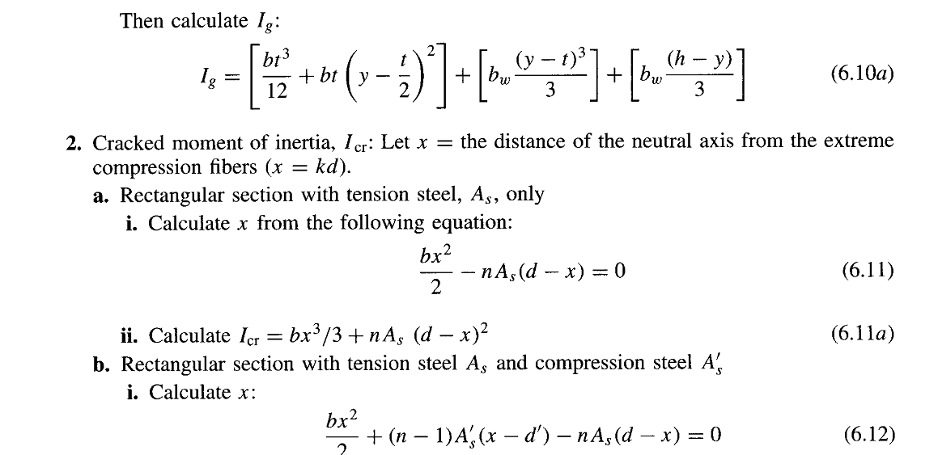
INSTANTANEOUS DEFLECTION
Moment of Inertia

Slide 30
INSTANTANEOUS DEFLECTION
Moment of Inertia

Slide 31
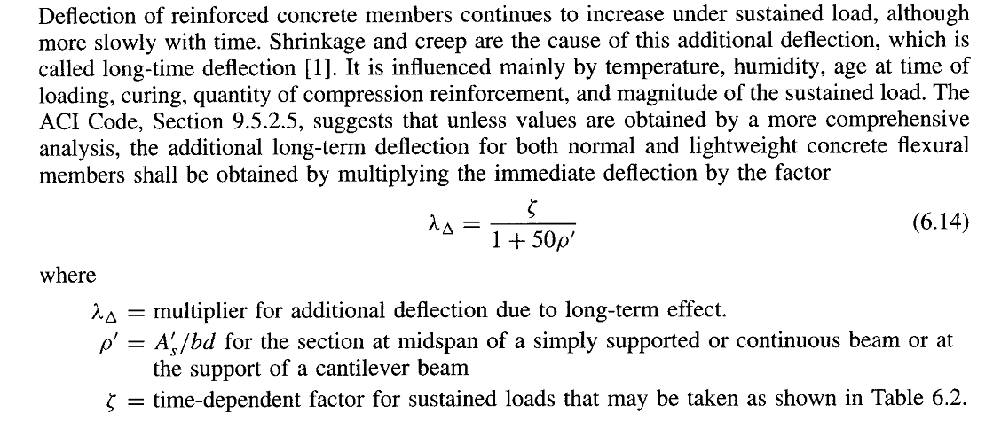
LONG TERM DEFLECTION

Slide 32
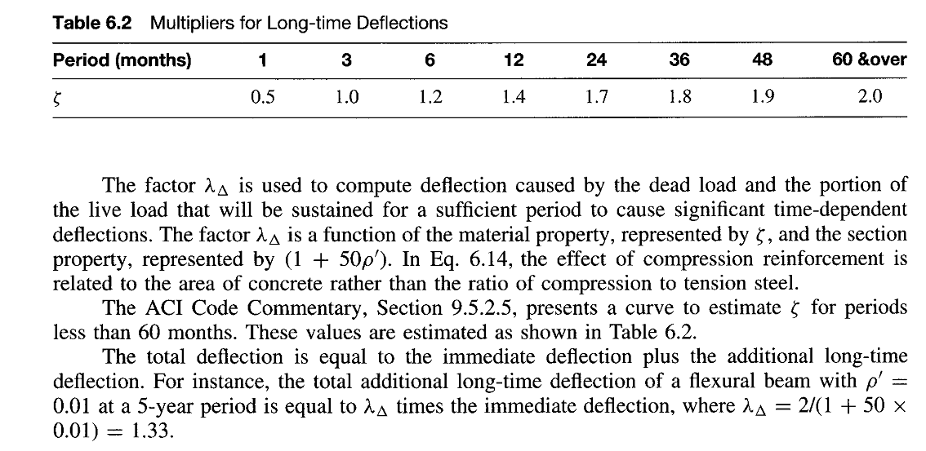
LONG TERM DEFLECTION

Slide 33
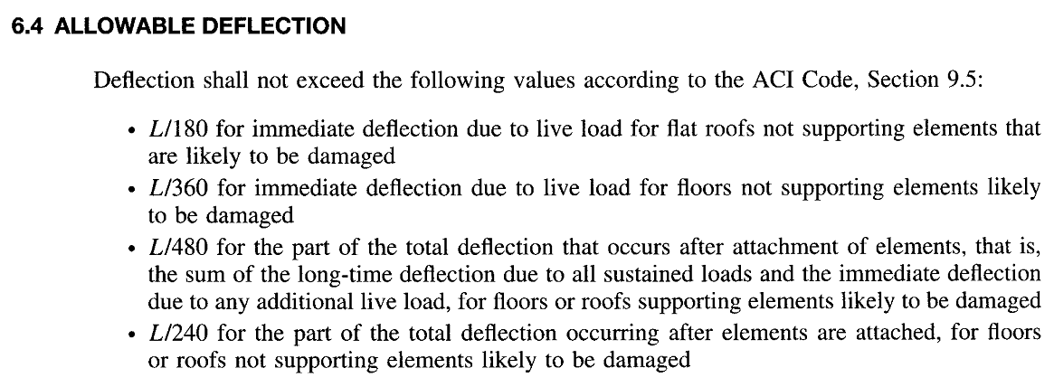
LONG TERM DEFLECTION

Slide 34
LONG TERM DEFLECTION

Slide 35
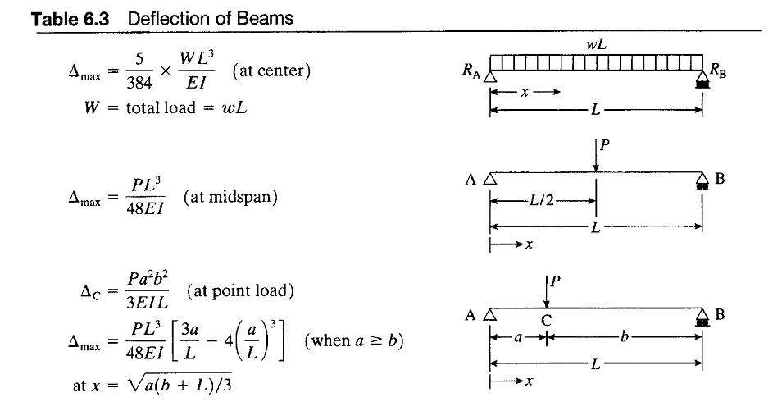
LONG TERM DEFLECTION

Slide 36
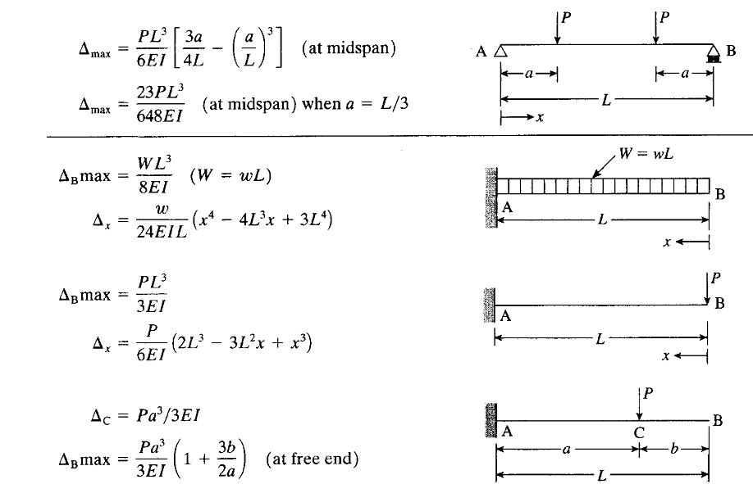
LONG TERM DEFLECTION

Slide 37
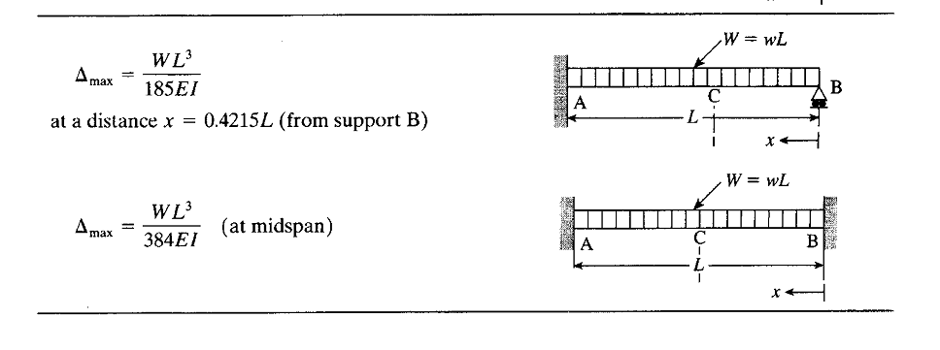
LONG TERM DEFLECTION

Slide 38
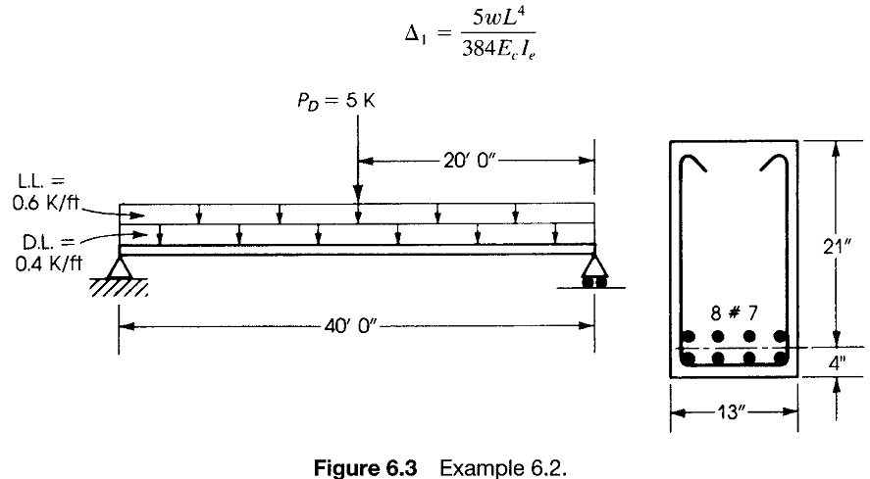
LONG TERM DEFLECTION

Slide 39
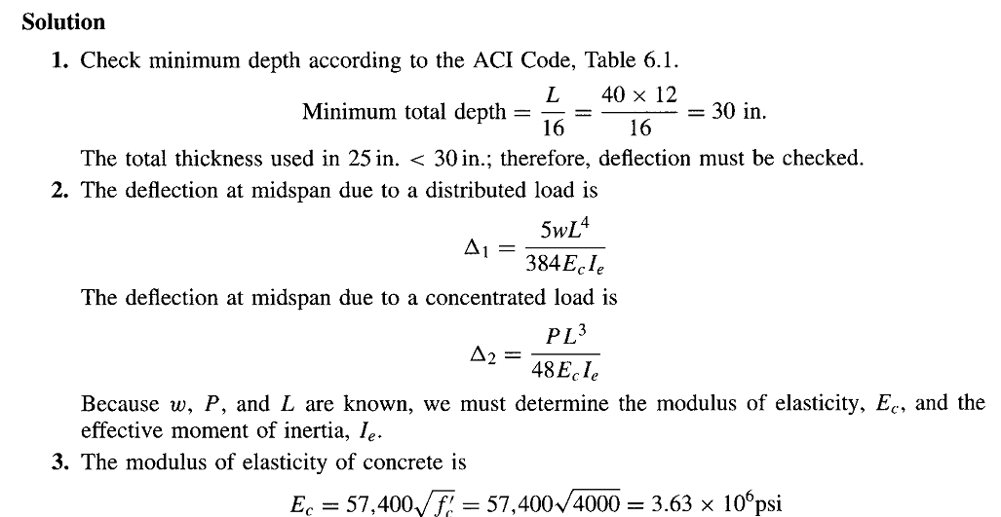
LONG TERM DEFLECTION

Slide 40
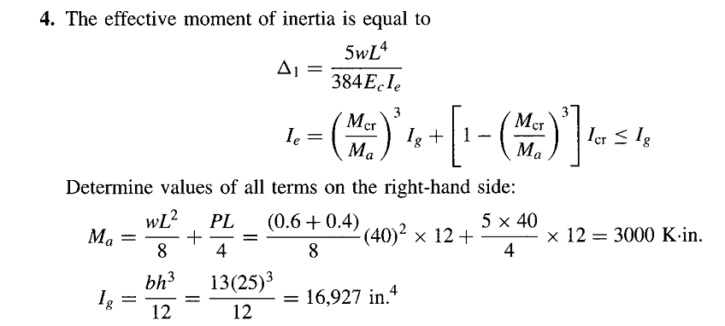
LONG TERM DEFLECTION

Slide 41
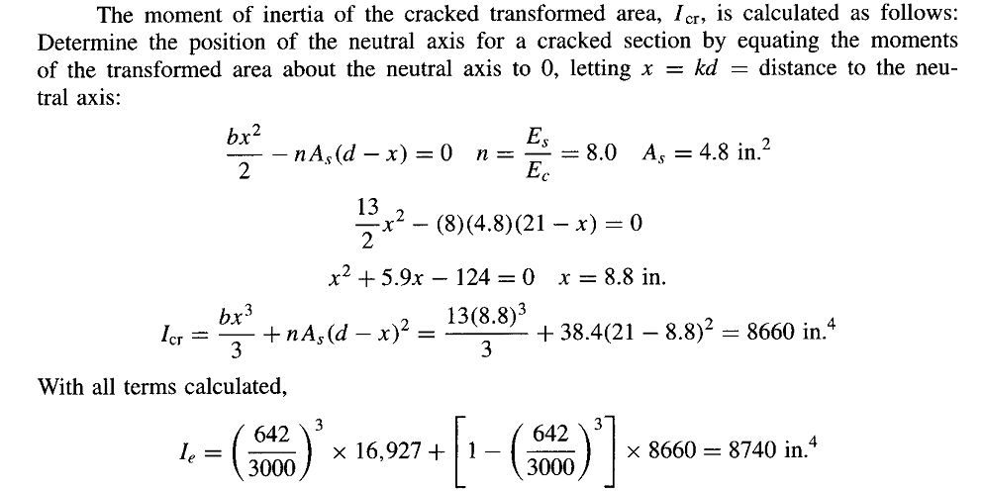
LONG TERM DEFLECTION

Slide 42
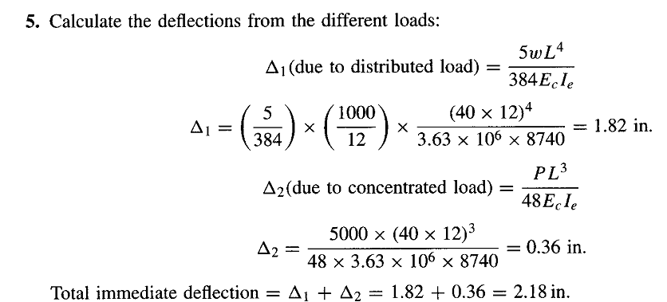
LONG TERM DEFLECTION

Slide 43
LONG TERM DEFLECTION

Slide 44
LONG TERM DEFLECTION

Slide 45
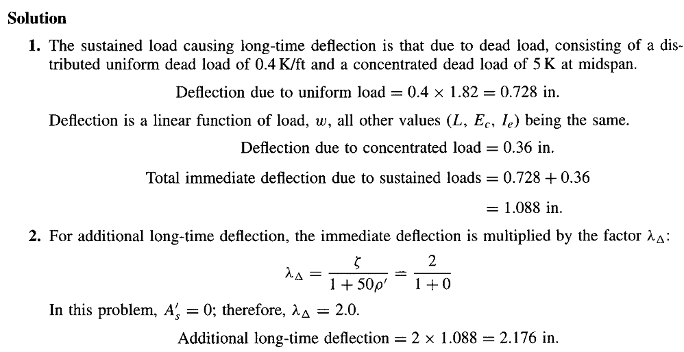
LONG TERM DEFLECTION

Slide 46
LONG TERM DEFLECTION

Slide 47
LONG TERM DEFLECTION

