Slide 2
Objectives Overview
Discuss the purpose of the components required for successful communications and identify various sending and receiving devices
Differentiate between client/server and peer-to-peer networks
Describe the various network communications standards and protocols
Differentiate among LANs, MANs, WANs, and PANs
Explain the purpose of communications software
See Page 450
for Detailed Objectives

Slide 3
Objectives Overview
Describe various types of communications lines
Differentiate among wireless transmission media
Describe commonly used communications devices
Discuss different ways to set up and configure a home network
Differentiate among physical transmission media
See Page 450
for Detailed Objectives

Slide 4
Communications
Digital communications describes a process in which two or more computers or devices transfer data, instructions, and information
Sending device
Transmission media
Receiving device
Page 450

Slide 5
Communications
Page 451
Figure 10-1

Slide 6
Networks
A network is a collection of computers and devices connected together via communications devices and transmission media
Advantages of a network include:
Facilitating communications
Sharing hardware
Sharing data and information
Sharing software
Transferring funds
Pages 452 - 453

Slide 7
Networks
Page 452
Figure 10-2

Slide 8
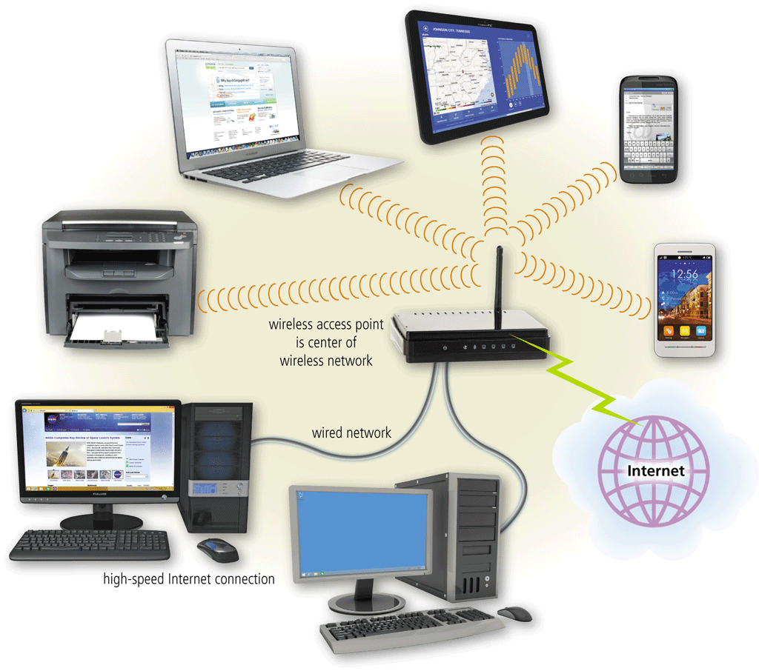
Networks
A local area network (LAN) is a network that connects computers and devices in a limited geographical area
A wireless LAN (WLAN) is a LAN that uses no physical wires
Pages 453 - 454
Figures 10-3 – 10-4

Slide 9
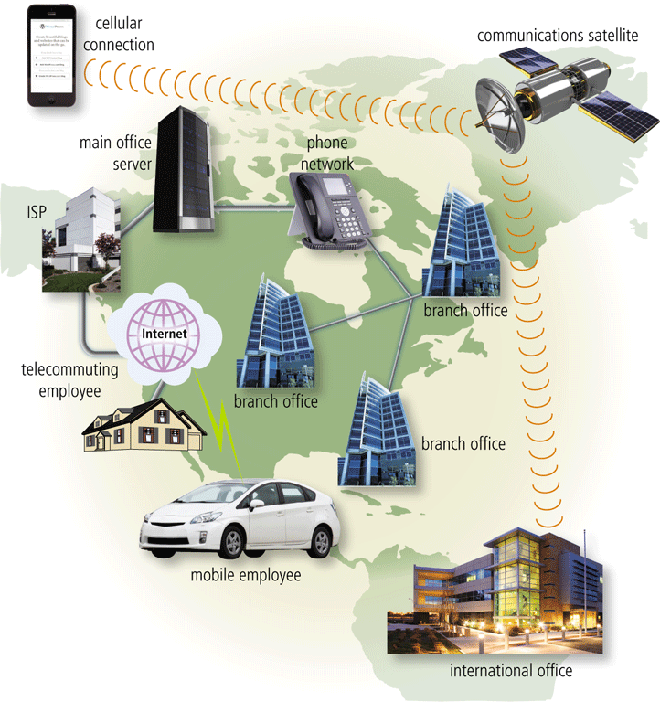
Networks
A metropolitan area network (MAN) connects LANs in a metropolitan area
A wide area network (WAN) is a network that covers a large geographic area
A personal area network (PAN) is a network that connects computers and devices in an individual’s workspace with wired and wireless technology
Page 455
Figure 10-5

Slide 10
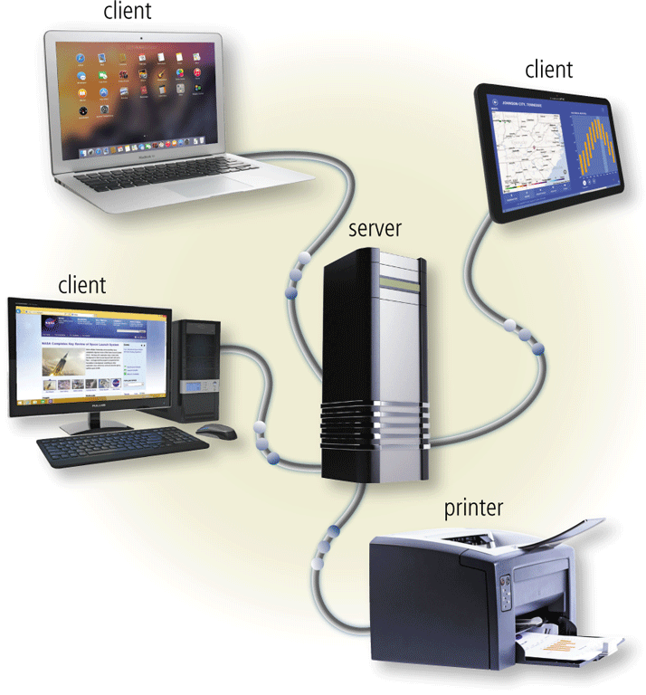
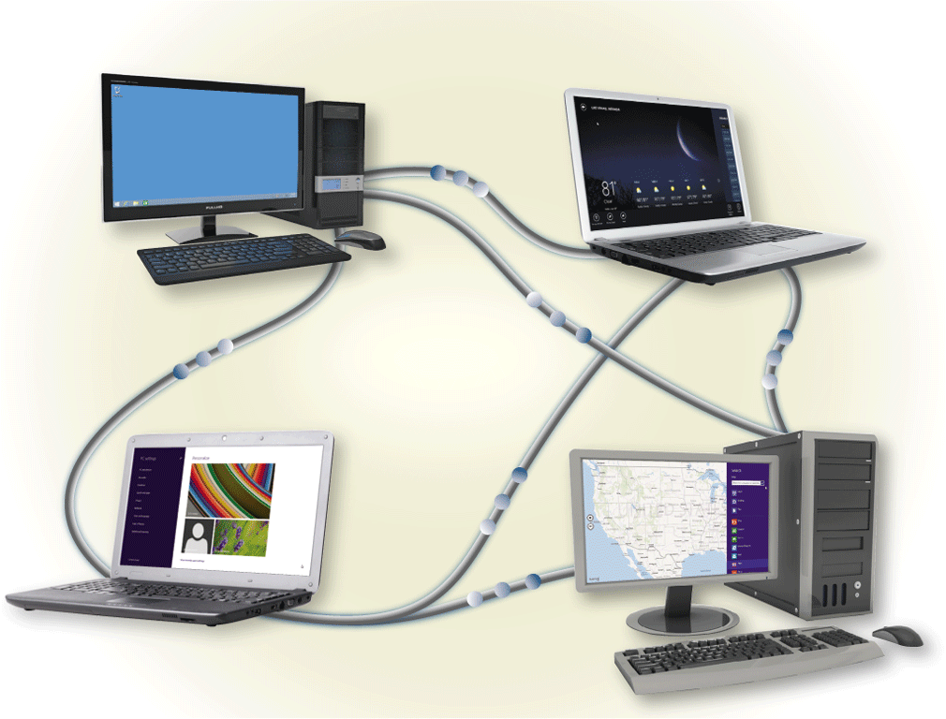
Networks
The configuration of computers, devices, and media on a network is sometimes called the network architecture
Client/server network
Peer-to-peer network
Pages 456 - 457
Figures 10-6 – 10-7

Slide 11
Communications Software
Communications software consists of programs and apps that:
Help users establish a connection to another computer, mobile device, or network
Manage the transmission of data, instructions, and information
Provide an interface for users to communicate with one another
Page 457

Slide 12
Network Communications Standards and Protocols
Ethernet
Token ring
TCP/IP
Wi-Fi
Bluetooth
UWB
IrDA
RFID
LTE
NFC
Page 460

Slide 13
Network Communications Standards and Protocols
Ethernet is a network standard that specifies no central computer or device on the network (nodes) should control when data can be transmitted
The token ring standard specifies that computers and devices on the network share or pass a special signal (token)
TCP/IP is a network protocol that defines how messages (data) are routed from one end of a network to another
Pages 460 - 461

Slide 14
Network Communications Standards and Protocols
Page 461
Figure 10-8

Slide 15
Network Communications Standards and Protocols
Wi-Fi identifies any network based on the 802.11 standard that specifies how two wireless devices communicate over the air with each other
LTE is a network standard that defines how high-speed cellular transmissions use broadcast radio to transmit data for mobile communications
Bluetooth is a network protocol that defines how two Bluetooth devices use short-range radio waves to transmit data
UWB (ultra-wideband) is a network standard that specifies how two UWB devices use short-range radio waves to communicate at high speeds with each other
IrDA transmits data wirelessly via infrared (IR) light waves
RFID is a protocol that defines how a network uses radio signals to communicate with a tag placed in or attached to an object, an animal, or a person
Pages 462 - 465

Slide 16
Network Communications Standards and Protocols
Page 465
Figure 10-9

Slide 17
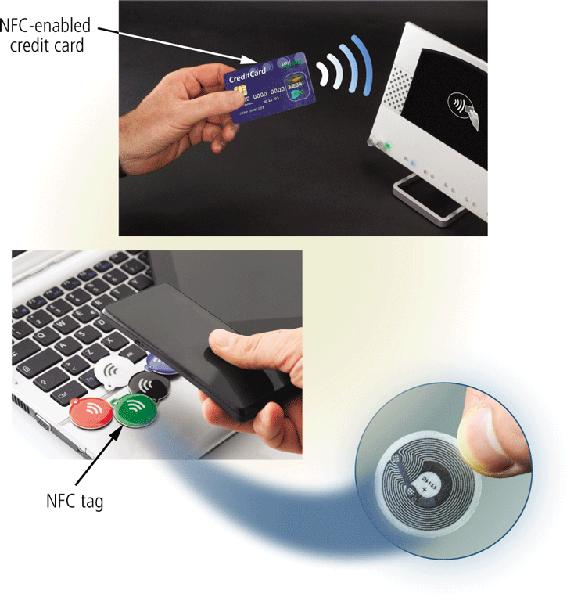
Network Communications Standards and Protocols
NFC (near field communication) is a protocol, based on RFID, that defines how a network uses close-range radio signals to communicate between two devices or objects equipped with NFC technology
Page 466
Figure 10-10

Slide 18
Communications Lines
Dedicated line
Cable
DSL
ISDN
FTTP
T-Carrier
ATM
Pages 466 - 468

Slide 19
Communications Lines
Page 466
Table 10-2

Slide 20
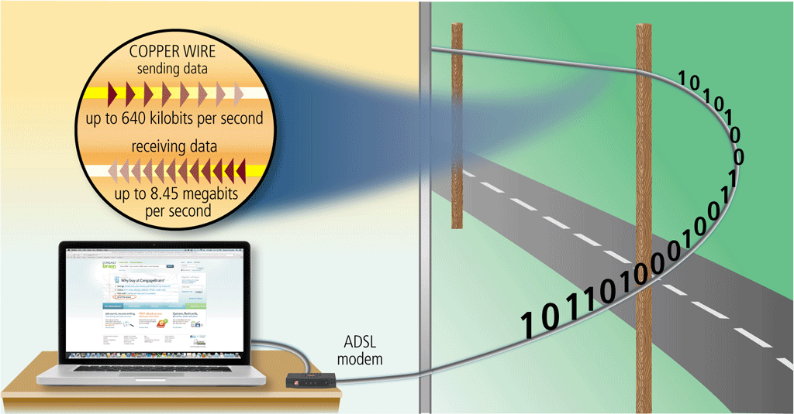
Communications Lines
ADSL is a type of DSL that supports faster downstream rates than upstream rates
Page 467
Figure 10-11

Slide 21
Communications Devices
A communications device is any type of hardware capable of transmitting data, instructions, and information between a sending device and a receiving device
Page 468

Slide 22
Communications Devices
A broadband modem sends and receives data and information to and from a digital line
DSL modem
Cable modem
Pages 468 - 469

Slide 23
Communications Devices
Page 469
Figure 10-12

Slide 24
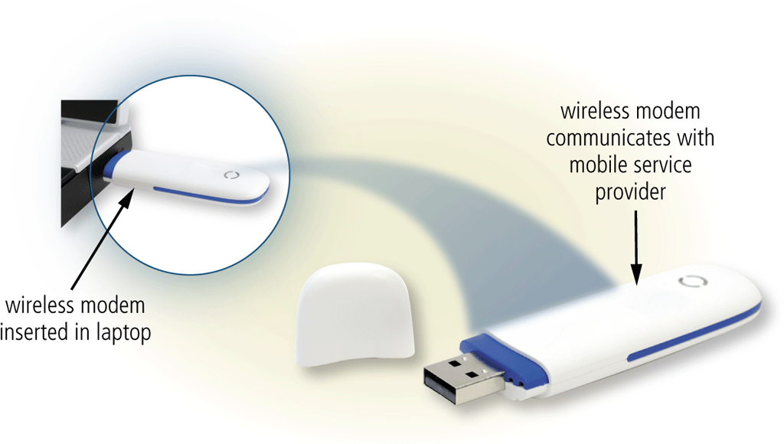
Communications Devices
A wireless modem uses a mobile phone provider’s network to connect to the Internet wirelessly from a computer or mobile device
Page 469
Figure 10-13

Slide 25
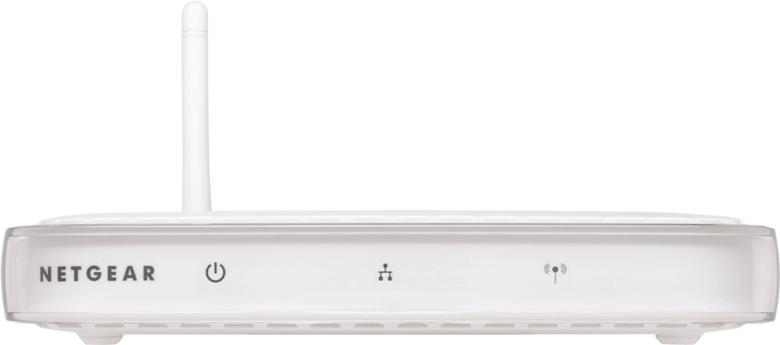
Communications Devices
A wireless access point (WAP) is a central communications device that allows computers and devices to transfer data wirelessly among themselves or to a wired network
Page 470
Figure 10-14

Slide 26
Communications Devices
A router connects multiple computers or other routers together and transmits data to its correct destination on a network
Page 471
Figure 10-15

Slide 27
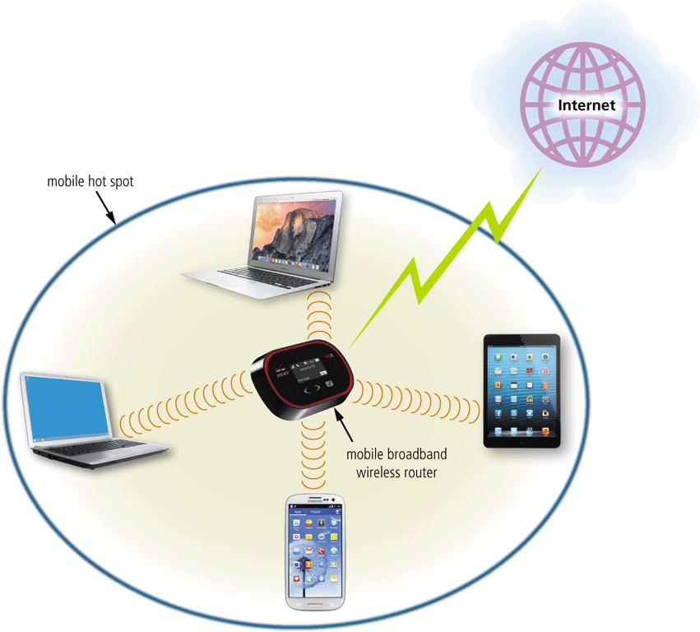
Communications Devices
Some routers provide additional functionality:
Wireless router
Broadband router
Broadband wireless router
Mobile broadband wireless router
Pages 471 – 472
Figure 10-16

Slide 28
Communications Devices
A network card enables a computer or device that does not have built-in networking capability to access a network
Available in a variety of styles
Pages 472 - 473
Figure 10-17

Slide 29
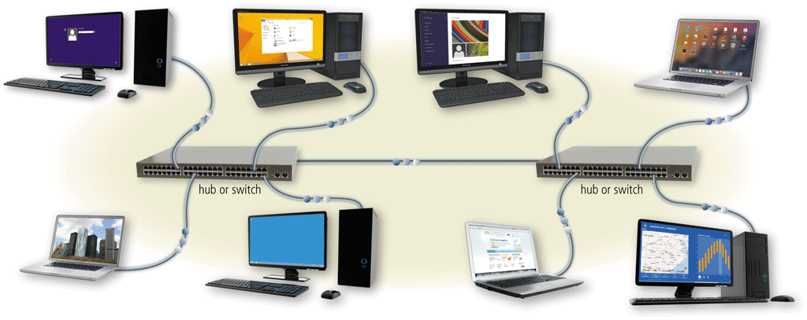
Communications Devices
A hub or switch is a device that provides a central point for cables in a network
Page 473
Figure 10-18

Slide 30
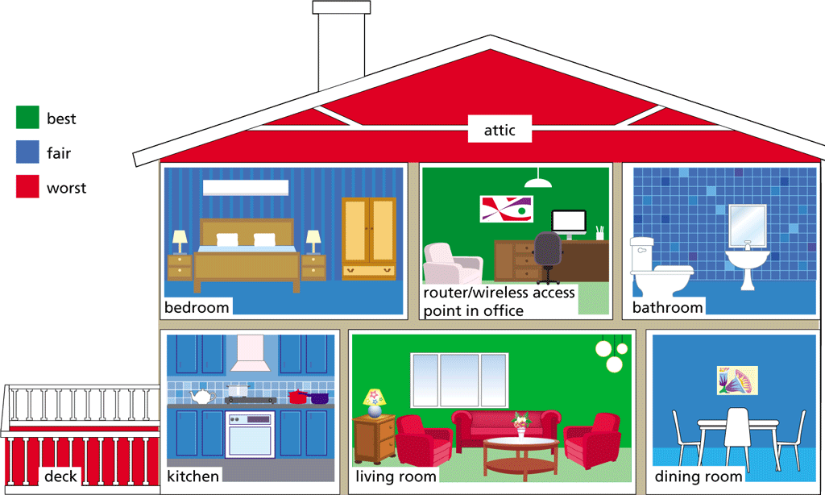
Home Networks
Many home users connect multiple computers and devices together in a home network
Pages 474 – 475

Slide 31
Transmission Media
Transmission media carries one or more communications signals
Broadband media transmit multiple signals simultaneously
The amount of data, instructions, and information that can travel over transmission media sometimes is called the bandwidth
Latency is the time it takes a signal to travel from one location to another on a network
Page 476
Figure 10-19

Slide 32
Physical Transmission Media
Page 477
Table 10-3

Slide 33
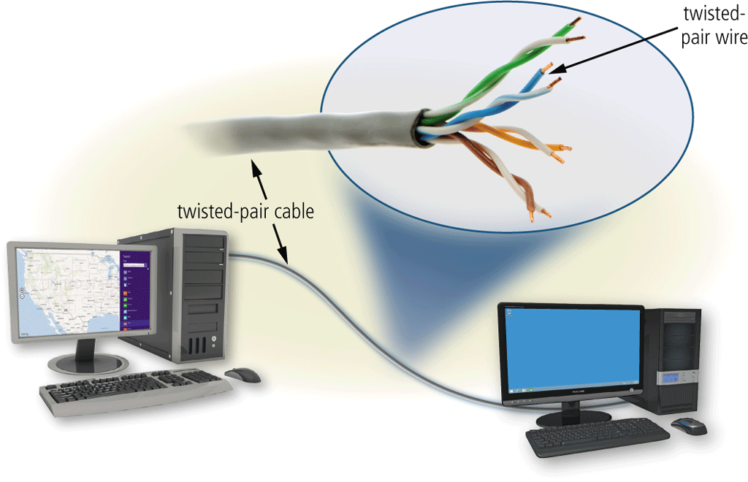
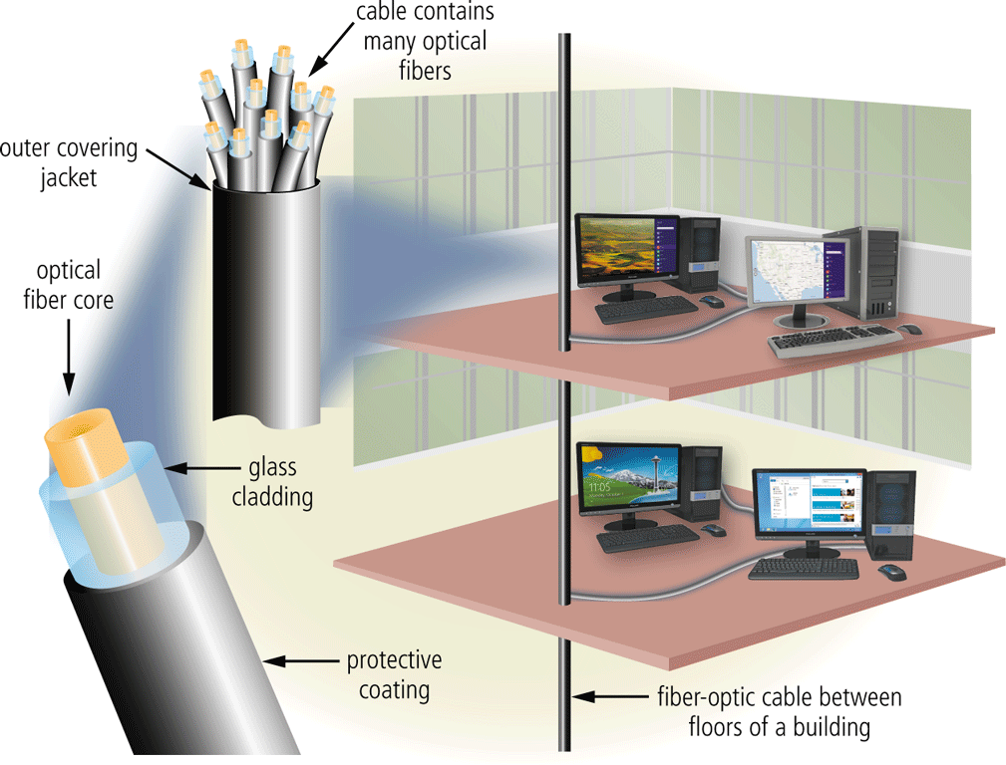
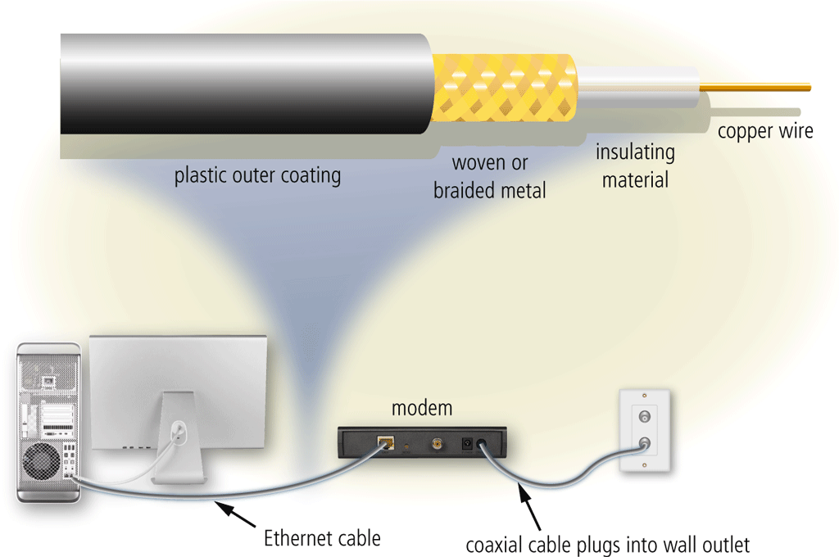
Physical Transmission Media
Twisted-pair cable
Fiber-optic cable
Coaxial cable
Pages 477 - 478
Figures 10-20 – 10-22

Slide 34
Wireless Transmission Media
Page 479
Table 10-4

Slide 35
Wireless Transmission Media
Broadcast radio is a wireless transmission medium that distributes radio signals through the air over long distances
Cellular radio is a form of broadcast radio that is in wide use for mobile communications
Pages 479 - 480
Figure 10-23

Slide 36
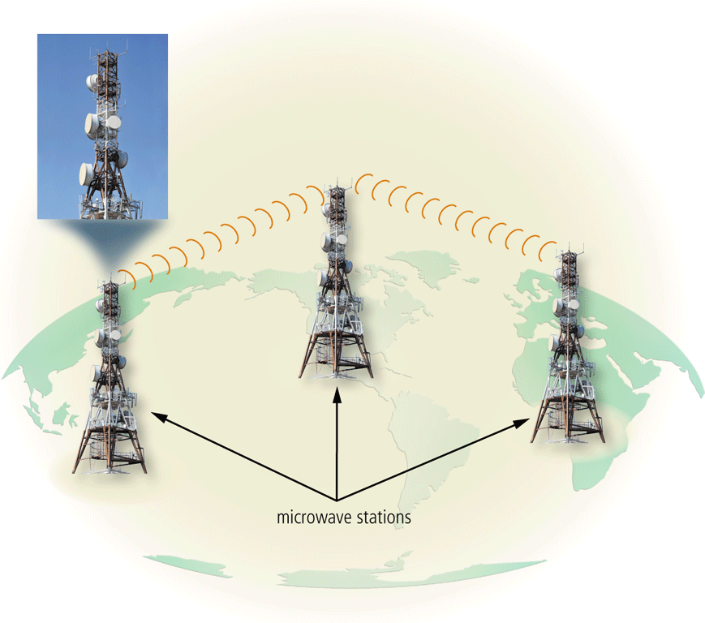
Wireless Transmission Media
Microwaves are radio waves that provide a high-speed signal transmission
Page 482
Figure 10-24

Slide 37
Wireless Transmission Media
A communications satellite is a space station that receives microwave signals from an earth-based station, amplifies it, and broadcasts the signal over a wide area to any number of earth-based stations
Pages 482 - 483
Figure 10-25

Slide 38
Wireless Transmission Media
A GPS (global positioning system) is a navigation system that consists of one or more earth-based receivers that accept and analyze signals sent by satellites in order to determine the receiver’s geographical location
Page 483

Slide 39
Wireless Transmission Media
Page 484
Figure 10-26

Slide 40
Summary
Networks and communications technologies
Various types of network architectures and standards and protocols
Communications software
Several types of communications lines and communications devices
How to create a home network
Variety of physical transmission media and wireless transmission media
Page 485

Slide 41
Chapter 10 Complete

