Slide 1
NOVEL GIT DRUG DELIVERY SYSTEM

Slide 2
Oral Osmotic Pumps
Bio/mucoadhesive DDS
Ion-Exchange Controlled DDS
pH-Controlled DDS
Floating DDS

Slide 3
Oral Osmotic Pumps
Considering the advantages of drug delivery systems, a great number of advancements have been made in the development of new techniques and strategies.
The main aims are;
to regulate the rate of delivery of the active agent,
sustaining the duration of therapeutic action
targeting its delivery to a specific tissue
These advances conduced to the development of osmotic pumps,
which are a form of a membrane-controlled release drug delivery system that uses osmotic pressure as the energy source
The fundamental aspect of the system is that the water of the medium permeates through a semipermeable membrane that allows penetration of water (but not the active agent) to dissolve its content, which is pushed off

Slide 4
INTRODUCTION
The delivery of an active agent based on osmotic pressure is one of the most promising drug delivery technologies of Osmotic pumps are utilized from the drug development stage (e.g., determination of pharmacokinetic parameters in animals) to modern drug delivery technologies (e.g., oral controlled-release and implantable systems)
Rose and Nelson (1955) Inventor of the Osmotic Pump
Two Australian physiologists, developed a system for use in pharmacological research aiming to deliver drugs to the gut of sheep and cattle. Their osmotic pump was never patented, and consisted of three chambers:
A drug chamber (a reservoir containing the delivery orifice)
A salt chamber (containing excess solid salt)
A water chamber
The drug and water chambers were separated by a rigid, semipermeable membrane.
The difference in osmotic pressure across the membrane induces water to move from the water chamber into the salt chamber.
This phenomenon results in an increase in the volume of the salt chamber, which distends the latex diaphragm separating the salt and drug chambers, thereby pumping the drug out of the system

Slide 5
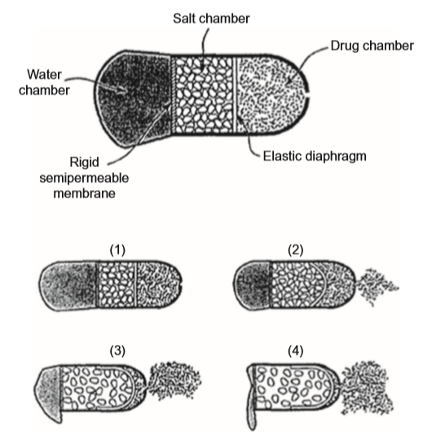

Slide 6
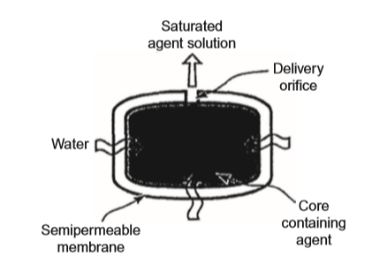
It was the first oral osmotic pump (elementary osmotic pump, EOP), in which both the drug and osmotic agent compartment were combined into one, with the possibility of achieving zero-order delivery.
Macroscopically analysing it, the pump is really a tablet with an orifice, representing a simplification of the original.
However, the system is composed of a compressed drug, with suitable osmotic pressure into a tablet using a tableting machine. A semipermeable (usually cellulose acetate) membrane coats this tablet, and a small orifice is drilled through the membrane coating. When the device is administered, the aqueous environment and the osmotic pressure of the soluble active agent inside the tablet draw water through the semipermeable coating, forming a saturated aqueous solution inside the device.
Theeuwes elementary osmotic pump

Slide 7
The imbibition of water by the system, increase the internal volume. The membrane is non-extensible and the hydrostatic pressure inside the tablet rises slightly.
The way to relieve the pressure is to flow the saturated drug solution out of the system through the small hole.
The process continues until the entire solid active inside the system has been dissolved and only a solution-filled shell remains.
This residual dissolved active agent continues to be released, but at a declining rate, until the osmotic pressures (inside and outside the tablet) equal.
It is important to note that the osmotic pressure produced by the dissolved active agent solution has to be relatively high to overcome the osmotic pressure of the body. However, for active agents displaying solubility greater than 5–10% (w/w), the system works very well.

Slide 8
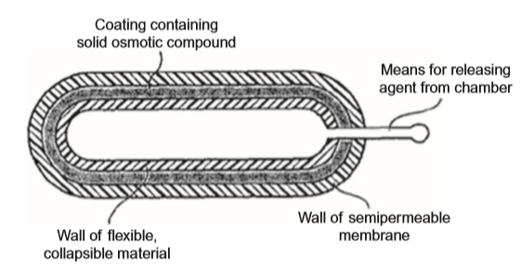
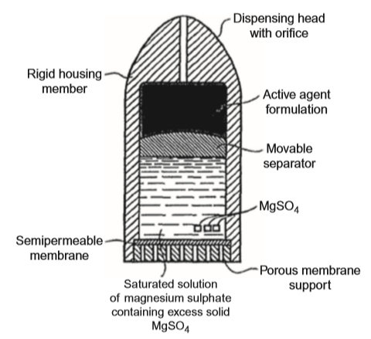
Theeuwes and Higuchi (1974)
developed osmotic pumps without a separate water chamber, activated by the aqueous media from the site of administration
Higuchi and Leeper (1973)
Proposed osmotic pumps activated by the aqueous media from the site of administration or surrounding environment. Their device was composed of two chambers. When the sealed foil was removed from the pouch and the system was placed in an aqueous environment, the pumping action began and the drug was delivered at a constant rate.

Slide 9
Composition
Osmotic pumps possess a core and coatings that are composed of similar components as for matrix controlled systems.
The core constitutes the inner structure of the pump and is composed of
therapeutic agent
filler or substrate
viscosity modifier
solubilizer
lubricant/glidant.
The coatings are composed of
membrane polymer(s),
plasticizer(s),
a membrane modifier
a color/opacifier.

Slide 10
Considering that water is the only diffusing species, an agent must be included in the core that is water-soluble enough to generate osmotic pressure and enable the pumping out of the therapeutic agent.
In addition, the coating must act as a semipermeable membrane that should be fully coalesced and be free from unintentional pinholes
The active agent plus diluents are included in a water-soluble tablet core, which will solubilize (or suspend) the active in the presence of water.
The core coating constitutes a semipermeable membrane that will allow water to pass through into the core, establishing an osmotic pressure and forcing drug dispersion to be pumped out of a small hole in the system coating.
Therefore, the rate of this pumping of the active agent can be controlled by characteristics of the system like delivery orifice, coating material, and composition. Together, the active agent, a water-soluble polymer or an inert salt constitute the core.
Sometimes, the drug itself constitutes the osmotic component, such as the metoprolol fumarate, whose saturated solution has an osmotic pressure of 32.5 atm.

Slide 11
Advantages
Osmotic pumps are well-characterized drug delivery systems to be administered by different routes (e.g., peroral and subcutaneous). They are well-characterized and understood systems, and have some advantages in relationship to other systems:
The coating technology is straightforward, in which controlled drug delivery is due to the water (diffusion species), and the modification of the rate of water diffusion is more uncomplicated than for many active agents.
These systems are suitable for a wide range of therapeutic agents, and they typically give a zero-order release profile after an initial lag.
The delivery rate of active(s) is highly predictable and programmable.
The release mechanism is not dependent on the active agent.
Higher release rates can be achieved than with conventional diffusion-based drug delivery systems.
A high degree of in vitro/in vivo correlation can be obtained.
Drug release from the oral osmotic pumps is minimally affected by food presence.

Slide 12
Disadvantages
On the other hand, osmotic pumps have some disadvantages
First, the orifice size is critical and the laser drilling is very important
The membrane must be fully controlled and therefore the coating process must be well controlled, avoiding the risk of film defects, which could result in dose dumping
Thus, the film droplets or particles must be induced to coalesce into a film with consistent properties
One advantage of this strategy is that the delivery of the active agent is not affected by pH (e.g., gastrointestinal acidity or alkalinity) nor stirring rate (e.g., fed conditions or gastrointestinal motility)
On the other hand, the delay in active delivery is affected by a slowly solubilized coated layer between the active drug core and the outer semipermeable membrane
Changing the surface area, thickness, or composition of the membrane and/or diameter of the drug release hole can lead to alterations in drug delivery
Moreover, the components of the system are biologically inert and remain intact during the time of action (inside the subcutaneous tissue or in the gastrointestinal tract)
In the case of subcutaneous administration, the system needs to be removed after therapy
However, when the system is administered through peroral route, it is eliminated in the feces as an insoluble shell

Slide 13
Drug Delivery Rate
The drug delivery of the active agent from osmotic pumps across the semipermeable membrane is controlled by water movement.
Therefore, for one solution-type osmotic pressure-activated system, the intrinsic rate of active agent delivery is defined by Equation:
Where;
Q/t is the intrinsic rate of drug delivery,
Pw is the water permeability in the semipermeable membrane,
Am is the effective surface area of the semipermeable membrane,
hm is the thickness of the semipermeable membrane, and
ps − pe is the differential osmotic pressure between the system (with an osmotic pressure ps) and the environment (with an osmotic pressure pe)

Slide 14
For a solid-type osmotic pump system, the intrinsic rate of delivery is defined considering the drug concentration (aqueous solubility of the active agent) in the solid reservoir (Sd), according to Equation;
Considering that the system possesses constant internal volume, it will deliver in any time interval a volume of saturated solution equal to the volume of solvent uptake.
Moreover, the drug delivery rate will be constant during the presence of an excess of active agent inside the device.
When the concentration falls below saturation, the delivery rate will decline parabolically toward zero

Slide 15
The size of the orifice is a key factor in order to produce a proper drug delivery.
In this sense, the orifice size must be optimized in order to minimize the contribution to the delivery rate made by solute diffusion through the orifice and the hydrostatic pressure inside the system, which would affect the zero-order release rate.
When the orifice is too small, it will depress the delivery rate below that of the desired constant delivery.
Depending on the administration route, some problems may occur.
This is the case when the pump is administered by peroral route, in which control of the transit of the system down the gastrointestinal tract may vary considerably with time (e.g., when the system is designed to release the therapeutic agent over a period of 10 h, but the total transit time in the gut is 5 h). In this case, the drug bioavailability is reduced

Slide 16
Classification
During the last 30 years, the osmotic patent field has been dominated by Alza Corporation, and several oral osmotic pumps systems have been successfully marketed for therapeutic uses.
Therefore, osmotic pumps can be classified in to two types, depending upon their use
Osmotic pumps for experimental research
Osmotic pumps for drug delivery

Slide 17
Alzet® osmotic pump
Developed by alza corporation for experimental research.
The osmotic delivery device is based on Higuchi–Theeuwes pump design
It became available for investigational use in the mid-1970s
It is a type of implantable or insertable system in which the active agent is a solution or suspension contained in a cylindrical reservoir formed from a synthetic, collapsible, impermeable elastomer wall (e.g., polyester) that is open to the external environment via a single orifice.
In cross section, they are composed of
a drug core (reservoir),
the osmotic agent, and
the semipermeable membrane (rate controller).
In addition,
a flow moderator is inserted into the body of the osmotic pump after filling

Slide 18
Many active agents have been delivered by the Alzet® system including;
Amino acids,
Anesthetics,
Antibiotics,
Antibodies,
Anticancer agents,
Anticoagulants,
Anti-epileptics,
Antigens,
Antihypertensives,
Anti-parasitic agents,
Anti-parkinson agents,
Ascitic fluid,
Catecholamines,
Chelators,
Cholinergics,
Central nervous system acting agents,
Enzyme inhibitors,
Gastrointestinal modulators

Slide 19
The wall of the active agent compartment (semipermeable membrane) is chemically inert to the most active-vehicle combinations:
Purified water or any aqueous solution,
Isotonic NaCl or other salt solution,
Aqueous solution of dextrose (5%),
Ethanol (up to 10% in water),
Polyethylene glycol 300 (neat or in water),
Aqueous solution of tween (2%),
Dimethyl sulfoxide (50% in water or 50% in ethanol 10%),
Propylene glycol (neat or in water),
Glycerine,
Dilute acids (with ph greater than 1.8),
Dilute bases (with ph less than 14) etc.
In addition, it needs to be impermeable, avoiding the crossing of any material between the reservoir and the surrounding osmotic agent.
This last one is located outside the reservoir’s semipermeable membrane, forming a thin cylinder.

Slide 20
Alzet® mini-osmotic pumps have demonstrated that the delivery profile is maintained at different temperatures.
Only the magnitude and the duration of delivery change.
By varying the concentration of the active agent in the dispersion, the amounts delivered can be varied at a constant temperature
They have capsular shape and are available in a variety of sizes, and it is possible to relate the delivery rates with the reservoir capacities.
Strict specifications are used in the manufacture of these pumps, and studies have shown that the rates of volume delivery in vitro and in vivo (as an implant) are within 5% of each other.
The Osmet® modules use the Alzet® technology and are used as research tools in human pharmacological studies.
They can be developed for rectal, vaginal, or oral administration. They can be utilized in clinical studies to deliver a variety of active agents. The definition of the relationship among rate, extent, and time of absorption to the design and efficient development of rate-controlled, duration-specified oral systems of a particular therapeutic agent can be accomplished by use of Osmet® osmotic pumps.

Slide 21
(OSMET®-CT): It is also possible to design osmotic systems for colon-targeted drug delivery (OSMET®-CT).
The enteric coating present in this type of osmotic pump enables the delay of the start of drug delivery for 2–4 h after passing from the stomach.
Actually, the Osmet® pumps are designed to be relevant to standard gastrointestinal transit times. The drug delivery rates are independent of pH, and the delivery rate profiles are similar to those from the Alzet®.
Other examples of osmotic pumps are the elementary and push-pull OROS® delivery system.

Slide 22
Considering the route of administration in humans, osmotic pumps can be classified into two categories:
Oral osmotic pumps
Implantable pumps
The OROS® system is characterized to possess a;
Solid core,
containing an active agent or in the absence of an osmotic agent,
Coated with a semipermeable membrane
The simplest oral osmotic system is the single-compartment EOP, which is suitable for active agents that demonstrate an intermediate solubility range.

Slide 23
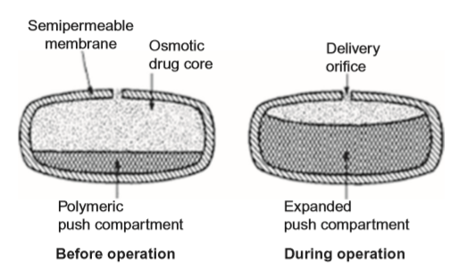
The push-pull OROS® system
For extremely soluble or insoluble active agents, this system is the most useful.
In this type of osmotic pump, the water enters the two layers at essentially the same rate.
Dispersion of the active agent is formed in the reservoir by
the controlled entry of water, which is pushed out through a hole (0.4 mm diameter) present in the semipermeable membrane.
Only a small amount of water is drawn into the system each hour and is dependent on the osmotic gradient between the contents of the two-layer core and dissolution medium

Slide 24
The technology of the OROS® system began to be used with the first product, Osmosin® (controlled-release indomethacin), which was withdrawn a year after launching because of side effects.
After that, a great number of other products launched to delivery:
Vitamin C (acu system® C by alza),
Phenylpropanolamine (acutrim® by alza),
Fexofenadine hydrochloride and
Pseudoephedrine hydrochloride (allegra D by aventis/osmotica),
Lovastatin (altoprev® by andrx; cardura® XL by alza/pfizer/andrx),
Nifedipine (procardia XL® by ALZA/pfizer in the united states and adalat CR® by bayer in europe).
The osmotic tablet of nifedipine contains the semipermeable cellulose acetate coating, the swellable hydrogel layer of polyoxyethylene glycol and hydroxypropylmethylcellulose, and the drug chamber containing nifedipine in hydroxypropylmethylcellulose and polyethylene glycol.

Slide 25
Implants
When the osmotic pump is designed to be subcutaneously implanted at the desired site of the body, the water content in the tissue fluid will penetrate through the semipermeable membrane at a controlled rate and dissolve the osmotically active agent.
Osmotic pressure is produced in the narrow spacing between the flexible reservoir wall and the rigid semipermeable compartment.
The reservoir is gradually increase in volume and the solution of the active agent is forced to exit through the flow moderator at a controlled rate.
Therefore, by varying the concentration of the active agent in the solution, different doses of active can be released at a constant rate as long as the osmotic gradient remains constant.

Slide 26
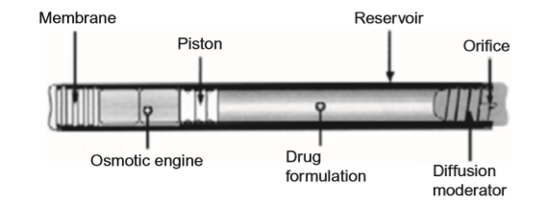
DUROS®, a long-term zero-order drug delivery system designed by Alza, was the first implantable osmotic pump to be used in humans.
It is a small pump (4 mm diameter × 45 mm length) composed of a titanium alloy cylinder and capped on one side by a rate-controlling semipermeable membrane (polyurethane polymer), and on the other by a plug with a hole for active agent delivery.
Only water can permeate the membrane.
A piston made of elastomeric materials is located on the side of the pump, separating the osmotic site (normally containing sodium chloride) from the active agent reservoir.
The extracellular body fluids activate the osmotic engine and the piston displaces, resulting in delivery of the active agent.
Viadur® (leuprolide acetate) was the first therapeutic application of the DUROS® osmotic pump.
The implantation system was designed for the treatment of prostate cancer, displaying the property to provide the delivery of leuprolide acetate continuously at a rate of 125 μg/day for 1 year.
Moreover, this technology was extended to the controlled delivery of active agents in the rectum by zero-order kinetics, avoiding the hepatic first-pass metabolism
Illustration showing the cross-sectional view of DUROS® implantable osmotic system.

Slide 27
Bio/mucoadhesive DDS

Slide 28
Bioadhesion can be defined as the state in which two biological materials, or a biological and a synthetic material, are maintained together for a prolonged time period by means of interfacial forces.
When there is the presence of mucous tissue, the bioadhesion is named mucoadhesion
Therefore, the term bioadhesion is inclusive and used to describe adhesive interactions with any biological or biologically derived substance. In addition, the term mucoadhesion describes the interaction between the systems and mucus or mucous tissue
Bio/mucoadhesive drug delivery systems are obtained by the incorporation of bioadhesive molecules into some kind of pharmaceutical system intended to stay in close contact with the absorption tissue, releasing the drug near the action site, thereby increasing its bioavailability and promoting local or systemic effects

Slide 29
The bioadhesive process is dependent on the presence of bonds between the two surfaces.
It is very important to understand the forces involved in this process of bond formation.
Moreover, it is necessary to consider that different types of biological surfaces such as mucosal membranes and epithelial cells may be present.
Thus, the process of bond formation is dependent on the wetting and swelling of polymeric material; the interpenetration of bioadhesive polymer chains, conducing to entanglement with the mucin chains; and the formation of weak chemical bonds between the entangled chains

Slide 30
For this process, the polymeric material needs to have;
Sufficient amounts of hydrogen-bonding chemical groups (OH and COOH),
Surface charges,
High molecular weight,
High chain flexibility
Surface tensions that will spread into the mucus layer
Chemical bonds are strong primary bonds, such as covalent bonds, and weaker secondary forces e.g.,
Ionic bonds,
Van der waals interactions,
Hydrogen bonds
Mechanical interactions can be useful to make connections between surfaces, involving the inclusion of a substance in the crevices of another.
Microscopically, the interpenetration of mucin strands into a porous polymer surface and/or physical entanglement of mucin strands with flexible polymer chains can occur.
These processes are dependent on the chain flexibility and diffusion coefficients of each material.

Slide 31
Mechanism of bioadhesion
Mechanism of mucoadhesion i.e. bioadhesion of polymers or macromolecules with surface of mucus membrane is has not been properly understood yet. But it is known that the forces of attraction must overcome the forces of repulsion for successful utilization. For close contact and increased surface area, the diffusion of the substrate chains have to be promoted and therefore, the mucoadhesive must properly spread on the substrate.

Slide 32
Some theories have been proposed to explain the complex phenomenon of bioadhesion.
Wetting Theory:
Wetting refers to the bonding between the drug and surface tissue and is caused by interaction at intermolecular level as well as interfacial tension. Low viscous mucoadhesive systems including liquids conform to this theory. It is essentially gives the spreadability of the drug delivery system.
Mechanical Interlocking Theory:
Only the adhesion between rough or porous surface and liquid is considered for this theory. The theory suggests that interlocking of adhesive onto the irregular or porous substrate surface results in adhesion.
Electronic Transfer Theory:
The transfer of electrons between mucus and the mucoadhesive platform forms a double-layered electronic charge at the interface and causes mucoadhesion. According to electronic transfer theory, bond adhesions are primarily due to electrostatic forces.

Slide 33
Adsorption Theory:
Many surface interactions such as primary bond (ionic and covalent bonds) and secondary bond (van der Waals forces, hydrogen bonding, electrostatic attraction, and hydrophobic interactions) result in adhesion. In mucoadhesion, primary bonds form a strong energy barrier, and are undesirable since they can lead to permanent interactions with mucus or tissue layer. Secondary bonds are weaker and cause semi permanent interactions which is an important criterion for drug delivery systems.
Fracture Theory:
The fracture strength or adhesive strength is related to the separation force of mucus surfaces and platform. Fracture strength can be determined if Young’s modulus of elasticity, the fracture energy and the critical crack length are known.
Diffusion-Interpenetration Theory
This is one of the most widely used theories for explaining mucoadhesion. Interpenetration and entanglement between the polymer and mucus chains is used for understanding. The first step is the creation of initial contact between both chains and is dominated by weak forces. This is followed by interpenetration of polymer chains from drug delivery system.

Slide 34
These theories are used together to understand and explain bioadhesion.
Despite the need for bioadhesive formulations for dermal administration when prolonged cutaneous action is desired, the mucous membrane is the main administration site for bioadhesive systems.
In this context, human mucous membranes are characterized by an epithelial layer covered by mucus, showing relative permeability and allowing fast absorption of active agents.
Mucus has the important function of epithelium protection and lubrication, being composed of;
glycoproteins,
lipids,
inorganic salts
95% water by mass,
making it a highly hydrated system.
The most important glycoprotein of mucus is mucin, which is responsible for mucus structure.
The thickness of the mucus layer varies from 50 to 450 μm in the stomach to less than 1 μm in the oral cavity.

Slide 35
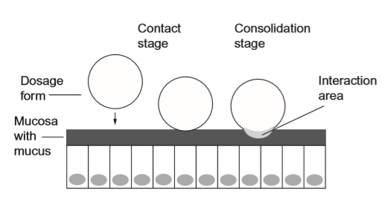
Considering the bioadhesion theories, the mechanism of mucoadhesion is generally divided into two stages:
the contact stage
the consolidation stage.
The first stage is characterized by contact between the mucoadhesive and the mucous membrane, with spreading and swelling of the formulation, initiating its deep contact with the mucus layer.
In some cases, such as for ocular or vaginal formulations, the delivery system is mechanically attached over the membrane.

Slide 36
In other cases, the deposition is promoted by the aerodynamics of the organ to which the system is administered, such as for the nasal route.
On the other hand, in the gastrointestinal tract, direct formulation attachment over the mucous membrane is not feasible. Some physiological phenomena can contribute to mucoadhesion, like peristaltic motions that contribute to the contact.
However, undesirable adhesion in the esophagus can occur.
In these cases, mucoadhesion can be explained by peristalsis, the motion of organic fluids in the organ cavity, or by Brownian motion.
During the consolidation stage, the mucoadhesive materials are activated by the presence of moisture, which plasticizes the system, allowing the mucoadhesive molecules to break free and to link up by weak van der Waals and hydrogen bonds.

Slide 37
The diffusion theory and the dehydration theory explain the consolidation step.
The mucoadhesive molecules and the glycoproteins of the mucus mutually interact by means of interpenetration of their chains and the building of secondary bonds.
In addition, the mucoadhesive material wets, swells and dehydrates (dehydration theory) the mucus, due to the difference of osmotic pressure.
The difference in concentration gradient draws the water into the formulation until the osmotic balance is reached.
This formulation and mucus are mixed and, therefore, increase the contact time of the material with the mucous membrane.
However, the dehydration theory is not applicable for highly hydrated systems

Slide 38
During the process of residence time, the system will have equilibrium between the adhesive forces and the forces of removal.
Adhesive failure normally occurs at the weakest component of the joint. When the bioadhesive system is weaker, the failure will be in the mucoadhesive–mucus interface.
On the other hand, for stronger bioadhesive materials, this would initially be the mucus layer, but later may be the hydrating mucoadhesive material
Therefore, the durability and strength of the adhesion depend on the cohesive nature of the weakest region.
Many mucoadhesive polymers over-hydrate when in an aqueous environment and are readily removed.
Thus, it is possible to use cross-linking and introducing hydrophobic entities to control the rate and extent of hydration to render prolonged adhesion.
However, every time, the formulations will be removed by mucus or cell turnover.

Slide 39
BIOADHESIVE MATERIALS
The intrinsic properties of the formulation and the environment in which it is applied influence bioadhesive performance.
Thus, intrinsic factors that affect the bioadhesive performance of a material (normally polymer) are molecular weight, concentration and chain flexibility.
For linear polymers, mucoadhesion increases with molecular weight, but the same relationship does not hold for non-linear polymers.
It has been shown that more concentrated mucoadhesive dispersions are retained on the mucous membrane for longer periods, as in the case of systems formed by in situ gelification.
After application, such systems spread easily, because they present rheological properties of a liquid, but gelify as they come into contact with the absorption site, thus preventing their rapid removal.
Chain flexibility is critical to consolidate the interpenetration between formulation and mucus

Slide 40
Environmental factors affecting the bioadhesive performance of materials include initial contact time, swelling, pH, and physiological variations.
Ionizable groups in polymers as well as the formation of charges on the mucus surface are dependent on pH.
The extent of chain interpenetration is a result of contact time between the mucus layer and the bioadhesive material.
Suitable hydration of the material can lead to good bioadhesive performance.
The thickness of the mucus layer can vary from different sites, and other physiological variations can also occur with diseases

Slide 41
Nowadays, bioadhesive materials are used to increase the residence time of formulation at the site of administration, promote absorption, protect the active agent and control the drug release.
Polymers available on the market (e.g., polyacrylic acids) were the first studied as bioadhesive materials.
The first generation of mucoadhesive materials comprised natural or synthetic hydrophilic molecules containing numerous organic functions that generate hydrogen bonds such as carboxyl, hydroxyl and amino groups, which do not adhere specifically to several surfaces.
They were used in dentistry as denture fixers, and the most known examples are carbomers, chitosans, alginates and cellulose derivatives ti

Slide 42
These materials are normally added to solid formulations (e.g., tablets, transdermal adhesives, and micro- and nanoparticles) and into semi-solid formulations (e.g., gels, ointments, pastes, and suppositories).
They can be classified into three categories: cationic, anionic and non-ionic. Cationic molecules have the important property of interaction with the mucus surface, because it is negatively charged at physiological pH.
For example, the mucoadhesion of chitosan, a cationic polymer, occurs due to the electrostatic interactions of its amino groups with the sialic groups of mucin in the mucus layer.
On the other hand, carbomers (synthetic polymers derived from polyacrylic acid) are negatively charged but are also mucoadhesive.
This is explained by the hydrophobic interactions, hydrogen and van der Waals bonds, which are controlled by pH and ionic compositiont

Slide 43
Carbomers have been extensively studied as semi-solid mucoadhesive systems
They have flexible chains and non-abrasive characteristics when in the partially hydrated state, which decrease the tissue damage caused by friction when they come into contact.
There exist other anionic polymers that are used to prepare bioadhesive systems, like cellulose derivatives (e.g., carboxymethylcellulose) and alginates. Hydroxypropylmethylcellulose,
HEC and methyl cellulose are examples of nonionic polymers used as bioadhesive materials.
They present a weaker mucoadhesion force compared to anionic polymers.

Slide 44
The second generation of bioadhesive materials is composed of material with the ability to incorporate both hydrophilic and lipophilic active agents, show mucoadhesive properties in its solid and liquid forms, inhibit local enzymes or promote absorption, be specific for a particular cellular area or site, stimulate endocytosis and have a broad safety range.
They are considered specific bioadhesives because they adhere to specific chemical structures on the cell or mucus surface.
Lectins, fimbrial proteins, invasins, antibodies, and those obtained by the addition of thiol groups to known molecules are examples

Slide 45
Another type of protein used as bioadhesive material is the group of bacterial fimbrial proteins.
They are able to bond to the epithelial surface of erythrocytes, and this property is useful as an efficient mechanism of improving adhesion of mucoadhesive agents used in release systems .
The presence of conjugated sulfidryl groups increases the mucoadhesive properties of different polymers. This fact is due to the formation of disulfide bridges with cystein domains of glycoproteins of the mucus.
The polymers containing these groups are named “thiolated polymers” and normally also display antiprotease activity due to their binding ability with divalent cations, such as zinc and magnesium, which are cofactors for many proteases.

Slide 46
APPLICATIONS
These bioadhesive systems applied to mucous membranes are frequently defined as mucoadhesive.
However, it is possible to develop a bio(muco)adhesive system in different dosage forms, because the properties of adhesion largely depend on the features of the material used in its preparation.
In this context, several conventional drug delivery systems already in use can become bioadhesive after redesign by including bioadhesive substances in their formulation.
The strategies previously discussed as well as those that will be discussed can be used together with bioadhesion to improve the characteristics of the systems, like their control of the drug release, and therefore improve the therapeutics.
The main application of the bioadhesion strategy is to modify the drug delivery to control the release of the active within a defined period of time.
Thus, in recent years, bioadhesive dosage forms include adhesive solid drug delivery systems (tablets and patches), adhesive semi-solid drug delivery systems and adhesive liquid dispersions.
For example, it is possible to cite
Solid micro- and nanoparticulate systems,
Microemulsions,
Colloidal dispersions of bioadhesive polymers,
Semi-solid systems,
Liquid crystalline mesophases,
Hydrogels,
which can increase the contact time between the preparation and the mucous membrane after they undergo in situ gelation

