Slide 1
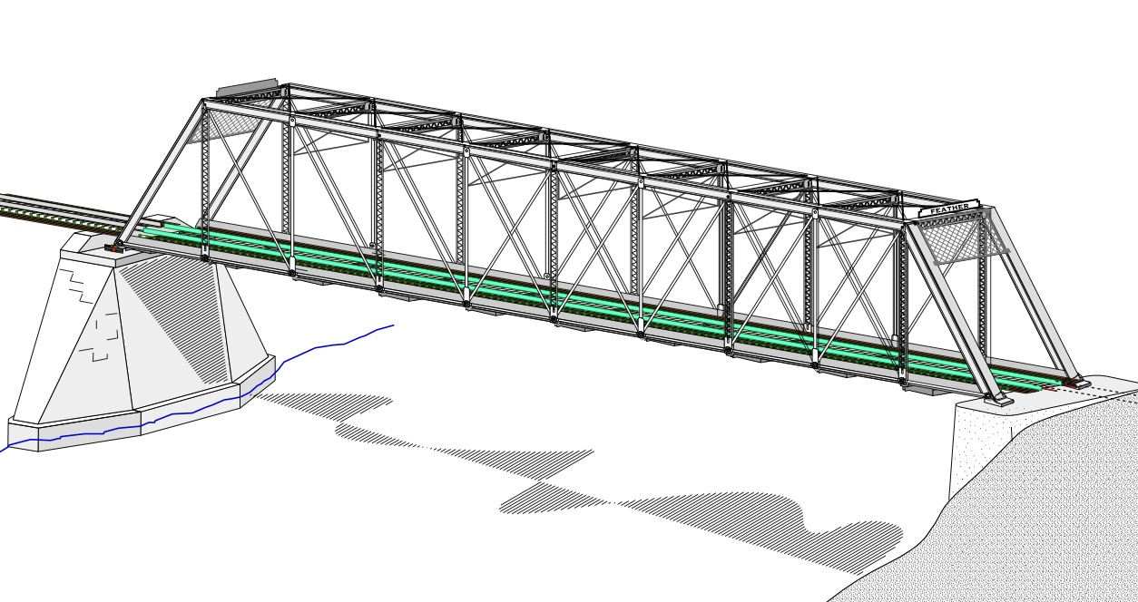
COLLEGE OF ENGINEERING AND TECHNOLOGY UNIVERSITY OF SARGODHA STEEL STRUCTURES (CT-313) (B.S TECHNOLOGY
17-01-2020
LECTURE-28,29 & 30
LOCAL BUCKLING OF COMPRESSION MEMBERS
Engineer Aqeel Ahmed
Lecturer, Civil Engineering Department
CET, UOS, Sargodha

Slide 2
Compression Members………..
In example 4.2, ry < rx and there is excess strength in the x-direction.
Square tubes (HSS) are efficient shapes for compression members because ry=rx and the strength is the same for both axes. Hollow circular shapes are sometimes used as compression members for the same reason.
The mode of failure considered so far is referred to as flexural buckling, as the member is subjected to flexure, or bending, when it becomes unstable.
For some cross-sectional configurations, the member will fail by twisting (torsional buckling) or by a combination of twisting and bending (flexural-torsional buckling).

Slide 3
Compression Members……….. Local Stability
The strength corresponding to any buckling mode can not be developed, however, if the elements of the cross-section are so thin that local buckling occurs.
This type of instability is a localized buckling or wrinkling at an isolated location. If it occurs, the section is no longer fully effective and the member gets failed.
I- and H- shaped cross-sections are more susceptible to this type of phenomenon and their use should be avoided whenever possible. Otherwise the compressive strength given by AISC Equations E3-2 and E3-3 must be reduced.
The measure of this susceptibility is the width-thickness ratio of each cross-sectional element.
Two types of elements must be considered:
Unstiffened elements: which are un supported along one edge parallel to the direction of load and stiffened elements: which are supported along both edges

Slide 4
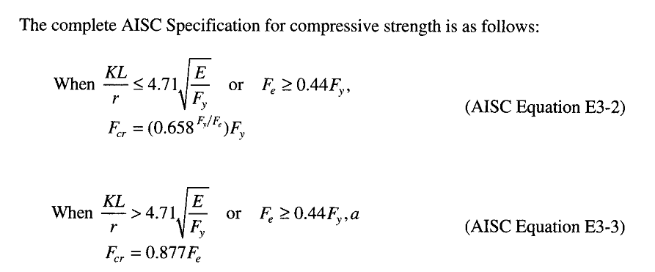
AISC Requirements……..

Slide 5
Compression Members……….. Local Stability……………
Limiting values of width-thickness ratios are given in AISC B4, “Classification of Sections for Local buckling”, where cross sectional shapes are classified as compact, non compact or slender according to the values for ratios.
For uniformly compressed elements as in axially loaded compression member, the strength must be reduced if the shape has any slender elements.
The width-thickness ratio is given the generic name of .
Depending on the particular cross-sectional element, for I and H-shapes is either the ratio .
If is greater than specified limit, denoted the shape is slender and the potential for local buckling must be accounted for.

Slide 6
Compression Members……….. Local Stability……………
For I and H-shapes, the projecting flange is considered to be an unstiffened and its width can be as half the full nominal width.
Using AISC notation gives

Slide 7
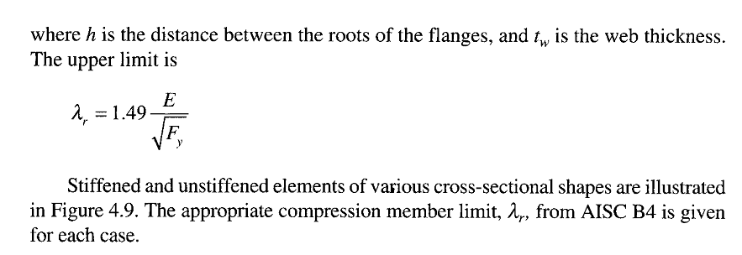
Compression Members……….. Local Stability……………

Slide 8
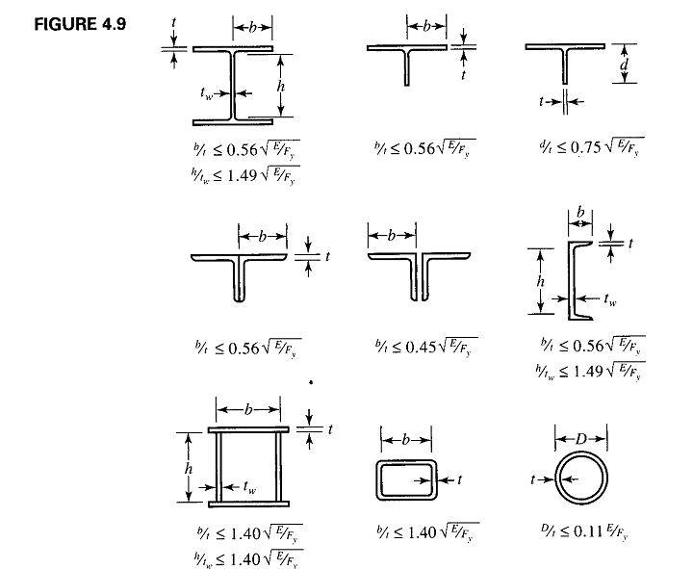

Slide 9
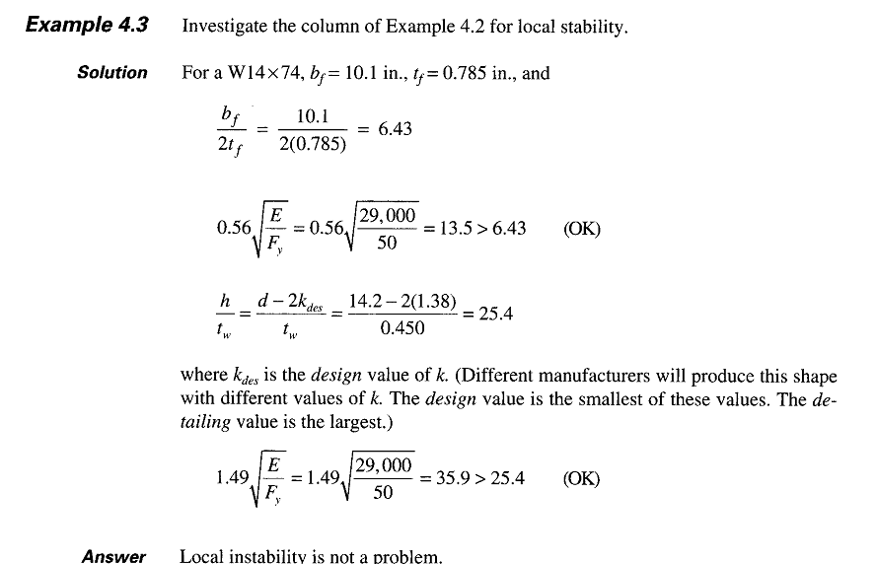

Slide 10
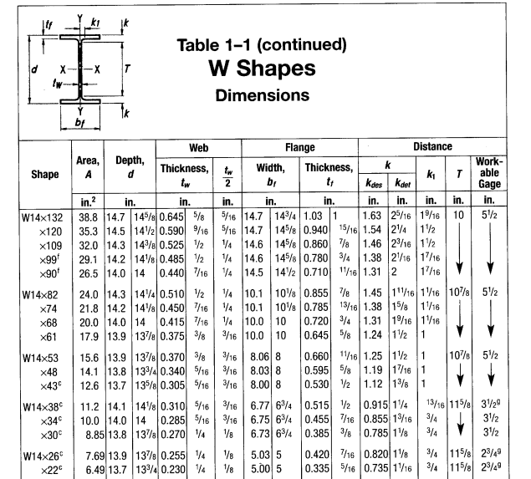

Slide 12
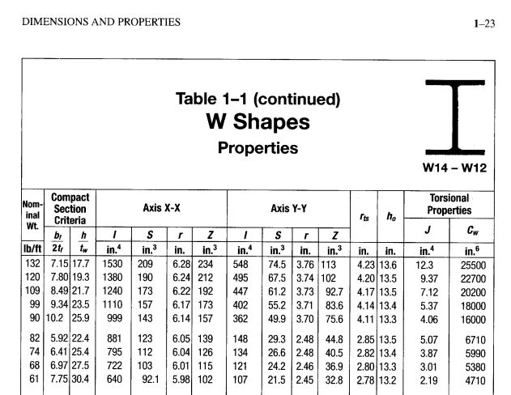

Slide 13
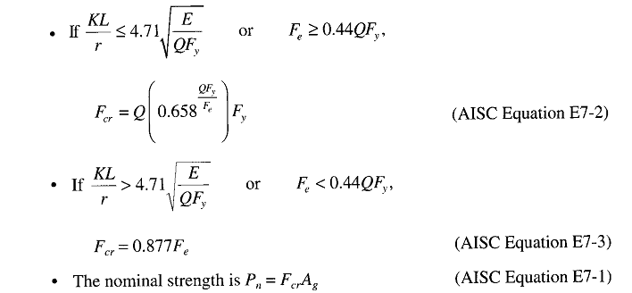

Slide 14
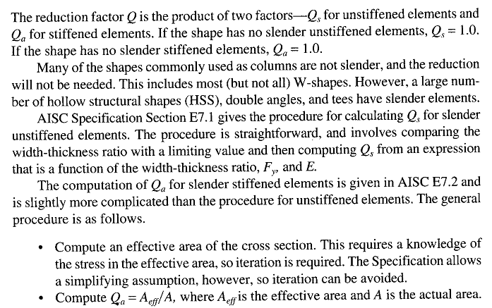

Slide 15
Compression Members……….. Tables for Compression Members
The manual contains many useful tables for analysis and design. For compression members whose strength is governed by flexural buckling (that is not the local buckling).
Table 4-22 in part 4 of the Manual, “Design of Compression Members” can be used.
This table gives values of as a function of KL/r for various values of Fy .
This table stops at the recommended upper limit of KL/r = 200.
The available strength tables, however, are the most useful, these tables which we will refer to as the “column load tables”, gives the available strength of the selected shapes, as a function of effective length KL.
These tables include values of KL up to those corresponding to KL/r = 200.

Slide 16
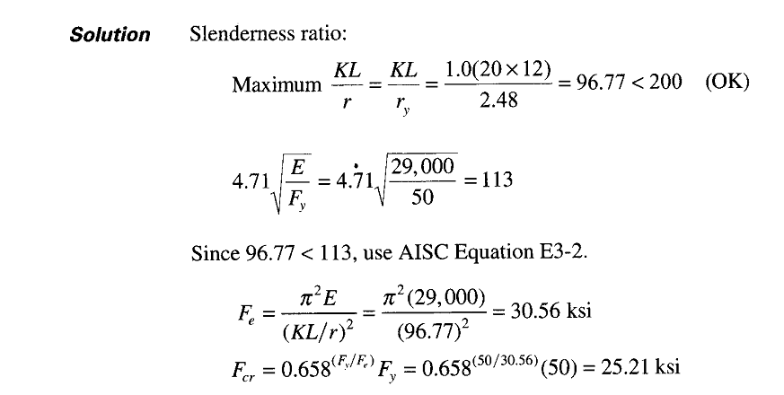

Slide 17
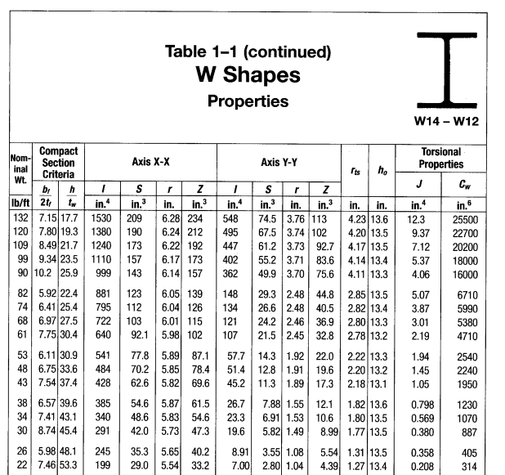

Slide 18
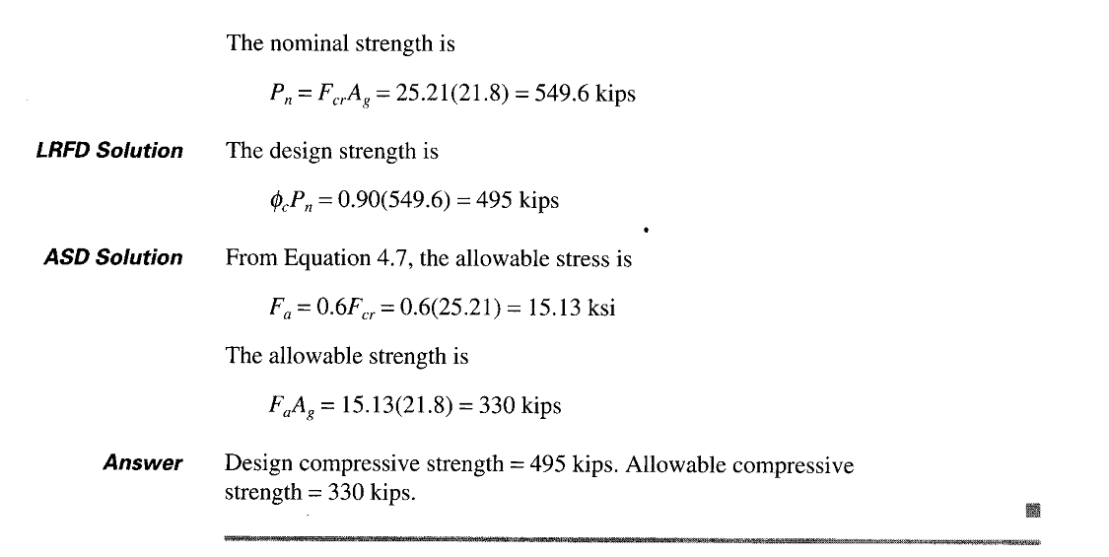

Slide 19
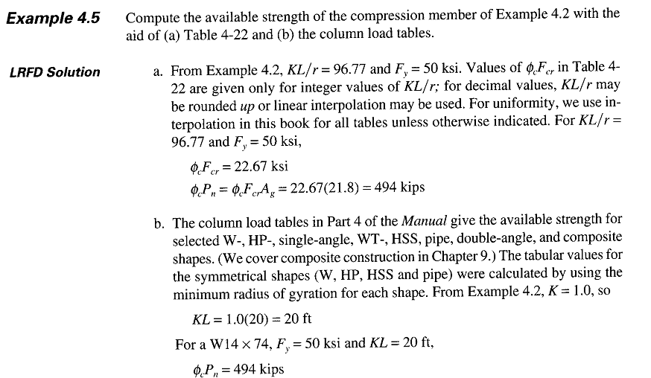

Slide 20
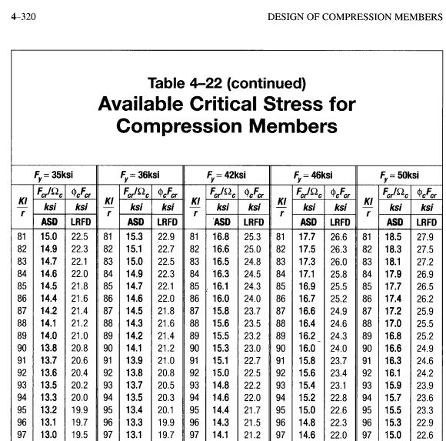

Slide 21
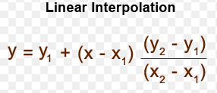
X1= 96 | Y1= 15.3
X= 96.77 | Y= ????? (15.069)
X2= 97 | Y2= 15
X1= 96 | Y1= 22.9
X= 96.77 | Y= ????? (22.669)
X2= 97 | Y2= 22.6

Slide 22
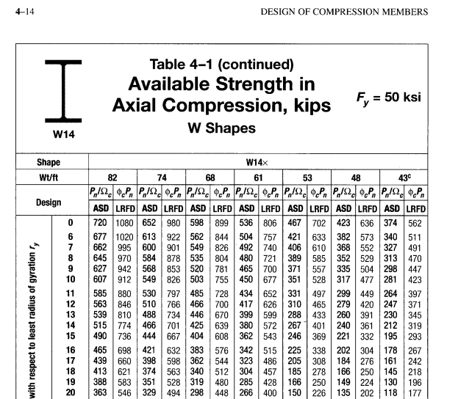

Slide 23
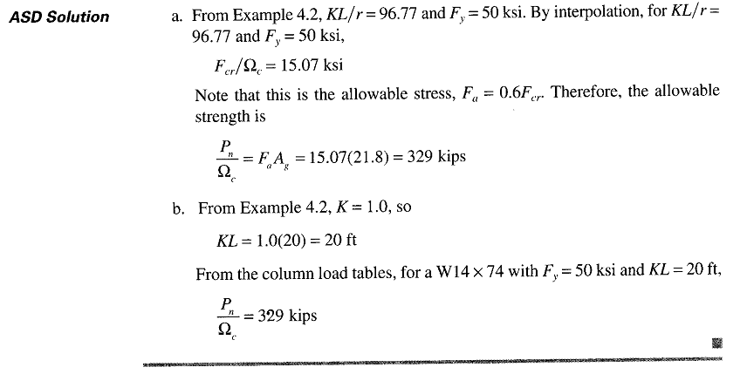

Slide 25
Compression Members……….. Design
The selection of an economical rolled shape to resist a given compressive load is simple with the aid of column load tables.
Enter the table with effective length and move horizontally until you find the desired available strength (or something slightly larger).
In some cases, you must continue the search to be ascertain that you have found the lightest shape.
Usually the category of shape (W, WT etc) will have been decided upon in advance.
Often, the overall nominal dimensions will also be known because of architectural or other requirements.
As pointed out earlier, all tabulated values correspond to a slenderness ratio of 200 or less.
The tabulated unsymmetrical shapes – the structural tees and the single as well as the double angles – requires special consideration.

