Slide 1
Ethical Decision Making

Slide 2
Why Ethical Models / Theories?
No formula to solve Ethical Problems
Ethics helps us not only in distinguishing between right and wrong, but also in knowing why and on what grounds our judgment of human actions is justified
Ethical theories help:
How to decide what is right, what is wrong
To identify important principles or guidelines
You as a computer professional must consider trade-offs and make a decision!
Right, Wrong, and Okay: acts may be ethically obligatory, ethically prohibited, or ethically acceptable
Notes:
a balance achieved between two desirable but incompatible features; a compromise.::a tradeoff is where one thing increases and another must decrease

Slide 3
Ethical Theories:
For centuries in different societies, human actions have been judged good or bad, right or wrong, based on theories or systems of justice developed, tested, revised, and debated by philosophers and/or elders in that society
Such theories are commonly known as Ethical Theories
The processes of reasoning, explanation, and justification used in ethics are based on these theories
Most widely discussed and used:
Consequentialism
Deontology
Relativism
Emotivism

Slide 4
Consequentialism Theory:
Human actions are judged good or bad, right or wrong, depending on the results, outcomes, ends, consequences of such actions
Three Types: Egoism, Utilitarianism, Altruism
Egoism:
Puts an individual’s interests and happiness above everything else
Any action is good as long as it maximizes an individual’s overall happiness
Good for me / Least harm to me
Notes:
Consequential : result

Slide 5
Utilitarianism:
Unlike egoism, this theory puts a group’s interest and happiness above those of an individual, for the good of many
Thus, an action is good if it benefits the maximum number of people
Good for the group, Least harm for the group
utilitarian philosophy, when directed to making social, economic, or political decisions, aims for the betterment of society
Notes:
Util – tarian –ism (greatest happiness for the greatest number of people)
Examples of utilitarianism: Free basic educatio

Slide 6
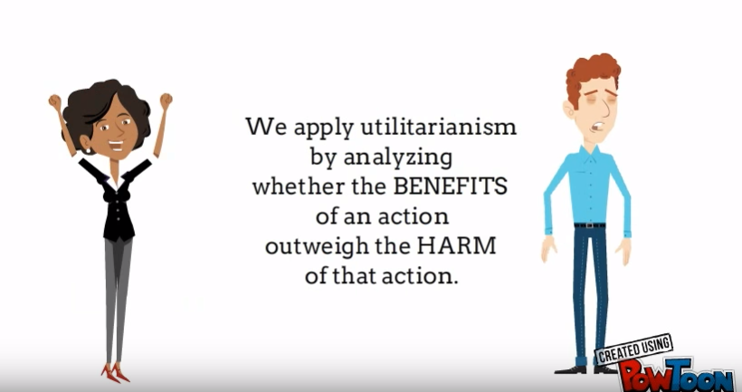
How do apply it in business.
Notes:
And we need to consider all stake holders who will be impacted by the decision”::consumers employees managemet

Slide 8
Altruism:
An action is right if the consequences of that action are favorable to all except the actor.
Good for all, Some harm to me
It is invoked when you sacrifice something for the benefit others.
Another example would be someone giving another person an organ such as a kidney.
charity work
Notes:
Alt -trism

Slide 9
Deontological Theory:
Does not concern with the consequences of the action but rather with the will of the action
According to deontological theory, an act is considered good if the individual committing it had a good reason to do so
E.g. We know that killing is bad, but if an armed intruder enters your house and you kill him or her, your action is good, according to deontologists. You did it because you had a duty to protect your family and property.
Notes:
De – on –tal –logical……(Deon: duty : focuses on the protection of individual or universal rights rather than consequences.

Slide 10
Relativism Theory:
Negatively formulated, denying the existence of universal moral norms.
It takes right and wrong to be relative to society, culture, or the individual.
Relativism also states that moral norms are not fixed in time.
Emotivism Theory:
This theory maintains that ethical statements are neither true nor false and cannot be proven; they are really only statements about how someone understand / feel
Notes:
Ethical relativism is the theory that holds that morality is relative to the norms of one's culture. That is, whether an action is right or wrong depends on the moral norms of the society in which it is practiced. The same action may be morally right in one society but be morally wrong in another.

Slide 11
decision making in Islam
Based on Quran & Sunnah which describes Islamic law: Fiqah
Decisions are made according to Fiqah, if a new or novel situation appears, Islam directs to do Ijtehad, Ijma and Qiyas
Ijtehad: means that knowledgeable people gathers to explore the validity of a given decision in accordance to Fiqah
e.g. A conference was conducted in K.S.A, to determine whether donating organs to save human life is right or not w.r.t Fiqah
Notes:
Hazrat Ma’z bin Jabal (R.A) was sent to Yemen as Governor, Hazrat Muhammad (S.W) asked how will you make decisions? he answered in the light of Quran o Sunnah. Prophet (S.W) asked if you could not find solution for any problem? He (R.A) replied I will do ijtehad

Slide 12
A Framework for Ethical Decision Making

Slide 13
The Framework Overview
Step One: Describe the problem
Step Two: Determine whether there is an ethical issue or an ethical dilemma
Step Three: Identify and rank the key values and principles
Step Four: Gather your information
Step Five: Review any applicable Code of Ethics
Step Six: Determine the options
Step Seven: Select a course of action
Step Eight: Put your plan into action.
Step Nine: Evaluate the results
Don’t forget!
Step Ten: Submit cases to your ethical review team or board regularly for review
Notes:
What is the difference between ethical issues and ethical dilemmas?: (p. 65) Ethicaldilemmas are a problem, situation, or opportunity that requires an individual, group or organisation to choose among several wrong or unethical actions that have no right or ethical choices, whereas ethical issues require a choice among several actions that must be evaluated as right or wrong, ethical or unethical

Slide 14
Step One: Describe the Problem
Ethical problems are always embedded in a context.
Circumstances impact upon the problem definition (for whom does the problem exist? What is the setting?)

Slide 15
Step Two: Determine Whether There Is an Ethical Dilemma
“Dilemma”– greek origin
any situation in which one must choose between unpleasant alternatives
X versus Y
“good” versus “bad” options e.g. trouble shooting by viewing user’s screen LAN, Efficient troubleshooting vs. interfering privacy
“good” versus “good” options e.g. Class lectures accessible vs. less effort to make lectures
“bad” versus “bad” options e.g. drone attacks vs. terrorist threats

Slide 16
Step Two: Determine Whether There Is an Ethical Dilemma
If you find it easy to articulate the perceived best interest as being on one side, you might ask, “who determines what is in the best interest?” You? Courts? Client? Family?
Remember, most individuals will probably perceive their own preferences as being in their own best interest.

Slide 17
Step Three: Identify and Rank the Key Values and Principles
What reasons can you provide for prioritizing one competing value over another?
Understand that a resolution to a dilemma which goes against an individual’s personal set of values has very little chance of success.

Slide 18
Step Four: Gather Your Information
Do you have all the known facts?
Do you understand the applicable laws?
Do you have all relevant policies available to review?
Are you clear about the individual’s views and personal values? E.g. views regarding smoking in workplace
* Don’t hesitate to seek out consultation.

Slide 19
Step Five: Review Any Applicable Code of Ethics
Not legal documents, but professionals are bound to tenets and can be sued for breach
Look for the following:
-- mission statement
-- values base of the organization
-- ethical principles to guide practice
-- ethical standards e.g. ACM
Codes can be revised or updated as needed
Notes:
Tenets :principle
ACM :: Association for computing machinery

Slide 20
Step Six: Determine the Options
List all possible actionable options
Weigh the cost/benefits of each option
Seek out additional points of view

Slide 21
Step Seven: Select a Course of Action
Discard the least desirable option.
Discard any which you can not put into action.
Recognize that your final choice will be impacted by your personal values.

Slide 22
Step Eight: Put Your Plan Into Action
Reflect on the outcomes with a sense that you have truly approached this ethical dilemma with the best of intentions and to the best of your ability.

Slide 23
Step Nine: Evaluate
Evaluate the consequences for each person involved (client, family members, co-workers, agency, etc.)
Consider submitting your most difficult cases to an ethics review board or peer consultants for feedback.

Slide 24
Step Ten
Discuss the case with your ethical review committee or board

Slide 25
Case Study
Suppose company ABC have number of offices across the city, with a distributed application installed at each site. Bhola sb has the responsibility to resolve issues regarding the distributed software, any trouble that might obstructs the work of the employees. Bhola sb has to travel a lot at various sites to troubleshoot the issues, which waste much of time.
Company ABC had recently installed an application xyz which can access all user’s screen and Bhola sb can view and troubleshoot the problem by sitting on one place

Slide 26
This had helped a lot as it had saved time and troubleshooting is being done efficiently. When boss heard of the success of the application, he discusses with Bhola sb that he suspects that smuggling deals have been carried out by some of the employees but there is no proof. By using the application xyz they can trace the user’s activities and they can catch the culprits while communicating the deals. Bhola sb thinks that it would interfere with the privacy of the employees by viewing their screens.

Slide 27
Step 1:
Establish the context of the ethical problem;
Company ABC with a various sites across the city using distributed application.
The Boss suspects that smuggling deals are going on
A new application xyz is being used to view and troubleshoot user’s problems with software usage.
Boss needs to use application xyz to track down the culprits.

Slide 28
Step 2: Is there an ethical dilemma
User’s Privacy vs. Capture Culprits
Step 3: Rank Values
User’s privacy
Reading personal information
Accessing user’s files
Capturing culprits
Smuggling deals damage company’s goodwill
Smuggling deals impacts country’s economics

Slide 29
Step 4: Gather information
All Facts
Applicable laws: User’s data is confidential
Relevant policies: Organizational policy regarding tracing employees online activities
Personal views: smuggling deals being carried out

Slide 30
Step 5: Review Applicable code of Ethics
If company ABC had announced to use any ethical standards e.g. ACM then is it allowed in accordance to that standard that it is allowed to interfere in user’s privacy?
Step 6: Determine Options
Is there any other way to trace down culprits without interfering user’s privacy?
Is it possible to seek police help or warrant to carry out the action?

Slide 31
Step 7: Select course of action
According to ranked values and different options decide what to do and how to do?
Step 8: Plan into action
Bhola sb had approached the ethical situation in unbiased manner without considering that outcomes are favorable to any particular party.

Slide 32
Step 9: Evaluate Consequences
Interfering user’s privacy
Damaging company’s goodwill
Influencing country’s economics

Slide 33
Step 10: Review
Present before board of governors to review your action.

