Slide 1
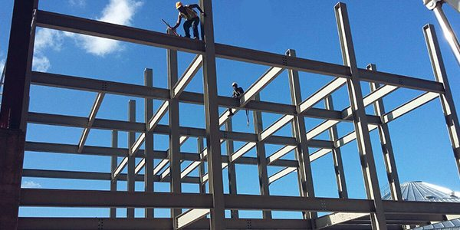
COLLEGE OF ENGINEERING AND TECHNOLOGY UNIVERSITY OF SARGODHA STEEL STRUCTURES (CT-313) (B.S TECHNOLOGY)
LECTURE- 4, 5 & 6
Structural Steel Shapes
and Design Specifications
23-Oct-2020

Slide 2
STRUCTURAL STEEL SHAPES
One of the objectives of the design process is the selection of the appropriate cross sections for the individual members of the structure to be designed.
The Selection should be from the widely available sections rather than requiring fabrication of a shape with unique dimensions and properties.
The selection of “off-the-shelf” item will always be economical even if it means using slightly more material.
The largest category of the sections includes those produces by hot rolling.

Slide 5
Fig-2
Fig-6
Fig-1
Fig-3
Fig-4
Fig-5

Slide 6
HOT ROLLED SECTIONS
Figur-1:- (i) The W-shape also called wide flange shape consists of two parallel flanges separated by single web.
(ii) The orientation of these elements is such that the cross-section has two axes of symmetry.
(iii) A typical designation would be “W18 X 50”, where W indicates the type of shape, 18 is the nominal depth parallel to the web which is approximate depth expressed in whole inches.
(iv) where 50 is the weight in pounds per foot of length.
(V) All of the W-shapes of a given nominal size can be grouped into families that have the same depth from inside-of-flange to inside- of-flange but with different flange thicknesses.

Slide 7
HOT ROLLED SECTIONS
Figur-2:- (i) The American Standard or S-Shape is similar to the W-shape in having two parallel flanges, a single web and two axes of symmetry.
(ii) The difference is in the proportions: The flanges of W are wider in relation to the web than are the flanges of the S. Moreover, the inside faces of the flanges of the S-shape slope with respect to outside face.
(iii) An example of designation of an S-Shape is “S18 X 70” with the S indicating type of shape and two numbers giving depth in inches and the weight in pounds per foot.
(iv) This shape was formerly called an I- shape.

Slide 8
HOT ROLLED SECTIONS
Figur-3&4:- (i) The angle shapes are available in either equal-leg or unequal-leg versions.
(ii) A typical designation would be “L6 X 6 X ¾ “ or “L6 X 4 X 5/8”. The three numbers are the lengths of each of the two legs as measured from the corner of heel, to the toe at the other end of the leg and the thickness, which is the same for both legs.
(iii) In the case of the unequal-leg angle, the longer leg dimension is always given first
(iv) Although this designation provides all of the dimensions, it does not provide the weight per foot

Slide 9
HOT ROLLED SECTIONS
Figur-5:- (i) The American standard channel or C-shape has two flanges and a web with only one axis of symmetry.
(ii) It carries a designation such as “C9 X 20”. This notation is similar to that of W and S-shapes with the first number giving the total depth in inches parallel to the web and the second number the weight in pounds per liner foot.
(iii) For the channel, however, the depth is exact rather than nominal. The inside faces of the flanges are sloping just as with American standard shape.
(iv) Miscellaneous Channels – for example, the MC10 X 25 are similar to American Standard Channels.

Slide 10
HOT ROLLED SECTIONS
Figur-6:- (i) The Structural Tee is produced by splitting an I-shaped member at mid depth. This shape is sometimes referred to as Split Tee.
(ii) The prefix of the designation is either WT, ST or MT depending upon which shape is the “parent”.
(iii) For example, a WT18 X 105 has a nominal depth of 18 inches and weight of 105 pounds per foot and is cut from a W36 X 210. Similarly, an ST10 X 33 is cut from an S20 X 60 and an MT5 X 4 is cut from an M10 X 8.
(iv) The “M” shape is for “Miscellaneous”. The M shape has two parallel flanges and a web but it does not exactly into either the W or S categories.
(v) The HP shape used for bearing piles has parallel flange surfaces approximately the same width and depth, and equal flange and web thicknesses. HP shapes are designated in the same manner as the W-shape. e.g. HP14 X117

Slide 11
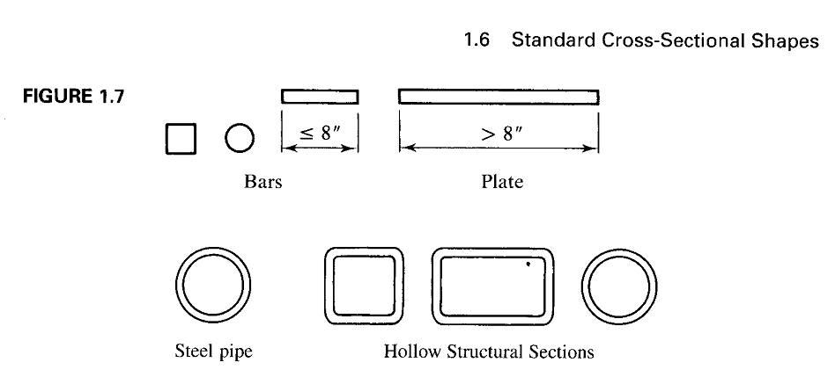

Slide 12
OTHER SECTIONS
Other frequently used cross-sectional shapes:
Bars and plates are formed by hot rolling.
Bars can have circular, square or rectangular cross-sections. If the width of the rectangular shape is 8 inches, it is classified as bar.
If the width is more than 8 inches, the shape is classified as plate.
The usual designation for the both is the abbreviation PL (For plate, even though it could actually be a bar) followed by the thickness in inches, the width in inches and the length in feet and inches.
For example, PL 3/8 X 5 X 3-2 ½”
Although, the plates and bars are available in increments of 1/16 inch, it is customary to specify dimensions to the nearest 1/8 inch.

Slide 13
OTHER SECTIONS
The Hollow shapes are also shown in Figure- 1.7, which can be produced either by bending plate material into the desired shape and welding seam or by hot –working to produce a seamless shape.
Most hollow structural sections available in United states today are produced by cold-forming and welding (Sherman, 1977).
The shapes are categorized as steel pipe, round HSS and square and rectangular HSS.
The designation HSS is for “Hollow Structural Sections”.

Slide 14
STEEL PIPES
Steel pipe is available as standard, extra-strong, or double-extra-strong with designations such as Pipe 5Std, Pipe 5 x-strong, or Pipe 5 XX-strong, where 5 is the nominal outer diameter in inches.
The different strengths correspond to different wall thicknesses for the same outer diameter.
For nominal outer diameters greater than 12 inches, the designation is the outer diameter and wall thickness in inches, expressed to three decimal places, for example, Pipe 14.000 x 0.375.
Round HSS are designated by outer diameter and wall thickness, expressed to three decimal places; for example, HSS 8.625 X 0.250.
Square and rectangular HSS are designated by nominal outside dimensions and wall thickness, expressed in rational numbers; for example, HSS 7 x 5 x 3/8.

Slide 16
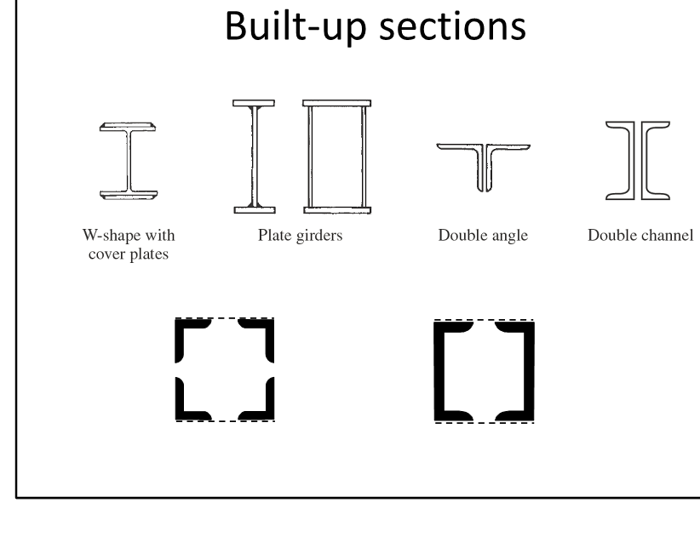

Slide 17
Other shapes are available, but those just described are the ones most frequently used.
In most cases, one of these standard shapes will satisfy design requirements.
If the requirements are especially severe, then a built-up section, such as one of those shown in previous figure, may be needed.
Sometimes a standard shape is augmented by additional cross-sectional elements, as when a cover plate is welded to one or both flanges of a W-shape.
Building up sections is an effective way of strengthening an existing structure that is being rehabilitated or modified for some use other than the one for which it was designed.
Sometimes a built-up shape must be used because none of the standard rolled shapes are large enough; that is , the cross section does not have enough area or moment of inertia.
In such cases, plate girders can be used.

Slide 18
These can be I-shaped sections, with two flanges and a web, or box sections, with two flanges and two webs.
The components can be welded together and can be designed to have exactly the properties needed.
Built-up shapes can also be created by attaching two or more standard rolled shapes to each other.
A widely used combination is a pair of angles placed back-to-back and connected at intervals along their length.
This is called a double-angle shape.
Another combination is the double-channel shape (either American Standard or Miscellaneous Channel).

Slide 19
