Slide 1
DNA Enveloped Viruses

Slide 2
DNA Enveloped Viruses
1) Herpesviruses
Herpes Simplex Virus(HSV) Type1and 2
Varicella Zoster Virus(VZV)
Cytomegalovirus(CMV)
Epstein-Bar Virus(EBV)
Human Herpes Virus-8(Kaposi Sarcoma-
Associated Virus)
Poxviruses
Smallpox Virus
Molluscum Contagiosum Virus
Hepadenaviruses
Hepatitis Virus

Slide 3
DNA Non Enveloped Viruses
They include
Adenoviruses
Papillomaviruses
Polyomaviruses
Parvoviruses

Slide 4
Herpesviruses
Icosahedral core with lipoprotein envelope.
Linear double stranded DNA.
Don’t contain a polymerase.
Replicate in the nucleus. Obtain envelope by budding through nuclear membrane.
Possess a tegument
Latent infections
Latency associated transcripts(LATS) and micro-RNAs. Lifelong persistence
Significant cause of death in immuno-compromised hosts
Some can cause cancers

Slide 5
Herpesvirus Diseases HSV-1 and HSV-2
They can be divided into 3 categories on the basis of types of cells most often infected and the site of latency.
Alpha herpesviruses
HSV 1and 2, and varicella zoster
Beta herpesviruses
CMV, human herpesvirus-6[HHV-6]
Gama herpesviruses
EBV and HHV-8

Slide 6
Herpesvirus Diseases HSV-1 and HSV-2
Herpes Simplex viruses
Two species
HSV-1: oropharyngeal sores (children)
HSV-2: genital herpes (young adults)

Slide 7
Herpesvirus Diseases HSV-1 and HSV-2
Both herpes simplex viruses are structurally and morphologically similar.
Only are distinguished by
Antigenicity
Location of lesions (above waist by HSV-1,
below waist by HSV-2).
Restriction endonuclease patterns of DNA
genome.
Type specific monoclonal antibodies.

Slide 8
Herpesvirus Diseases
Transmission
Generally through direct contact with person shedding virus having active lesions
Some people shed virus despite absence of lesions in both cases
Virus enters through mucosal tissues; cannot penetrate healthy skin

Slide 9
Herpesvirus Diseases
HSV-1 and HSV-2
Pathology
Replicate most commonly in dermal tissues and mucous membranes (herpetic lesions).
Migrate up the neurons by retrograde axonal flow where latency occurs in sensory ganglions.
Vesicles containing serous fluid filled with virus particles and cell debris are found.
Cell fusion followed by cell lysis results in multinucleated giant cells. Intra nuclear inclusion bodies are also seen
Inflammatory response

Slide 10
Herpesvirus Diseases HSV-1 and HSV-2
Latent infections
Virus sequesters in nerve tissues (immunoprivileged site)
HSV-1 in trigeminal ganglia
HSV-2 in sacral and lumbar ganglia
Very few genes are expressed by infected cells
Immunity is type specific, it is incomplete
Re-infection and reactivation occurs even in the presence of IgG
CMI plays an important role

Slide 11
Herpesvirus Diseases
HSV-1
Clinical conditions
Oropharangeal disease
Symptoms: fever, vesicular and ulcerative lesions, edema, gingivostomatitis, lymphadenopothy, malaise. Primary disease is more severe than recurrences
Herpes labialis or cold sores is the recurrent form. In some people throughout adult life
Keratoconjunctivitis ( autoinoculation) to eye
causes lesions
Recurrences can cause scarring, vision impairment and blindness
Can lead to an autoimmune response against the eyes

Slide 12
Herpesvirus Diseases HSV-1
Encephalitis
Herpetic whitlow
Herpes gladiatorum
Eczema herpeticum
Disseminated infections
Genital herpes

Slide 13
Herpesvirus Diseases HSV-2
Genital herpes
Similar lesions and recurrence
Neonatal herpes
Transmission: in-utero, during birth, after birth
High fatality rate if untreated (50%)
Aseptic meningitis
Erythema multiforme and Stevens-Johnson syndrome is caused by both HSV-1, HSV-2

Slide 14
Herpesvirus Diseases
Immunity
Immune response is not sterilizing
IgG, IgA, IgM
CTL responses are impaired

Slide 15
Herpesvirus Diseases
Laboratory Diagnosis
Cytopathology (Tzanck smear)
Multinucleated giant cells from skin scrapings
Virus isolation
Cytopathic effect
Immuno-fluorescence
ELISA Using monoclonal antibody against G glycoprotein
PCR
Used for systemic or encephalitic disease
Serology
IgG appears in 4-7 days
Cannot discriminate HSV-1 from HSV-2

Slide 16
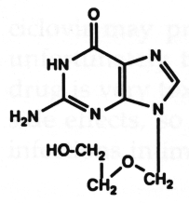
Herpesvirus Diseases
Treatment, prevention and control
Chemotherapy
Acyclovir drug of choice
Nucleoside analogue
Dramatic impact on reduction of transmission and survival against neonatal, visceral and encephalitic HSV infections.
Foscarnet is used in resistant cases
No vaccine is available
Prophylactic, long term use of acyclovir or famciclovir or valacyclovir can suppress clinical recurrences

Slide 17
Herpesvirus Diseases HSV-1 and HSV-2
Prevention
Avoid contact with vesicular lesions.
Cesarean section is recommended for full term females who have genital lesions or positive viral cultures.

Slide 18
Herpesvirus Diseases Varicella-Zoster virus (VZV)

Slide 19
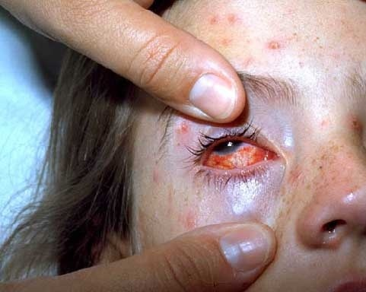
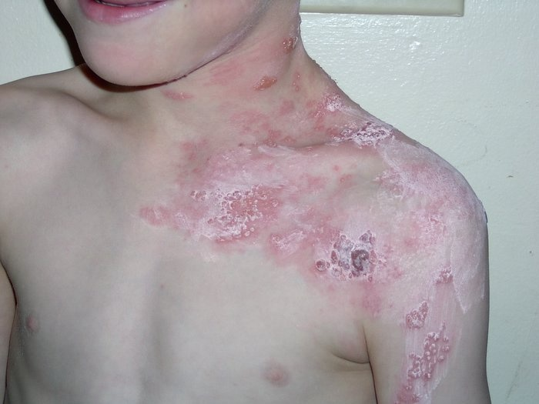
Herpesvirus Diseases
Varicella-Zoster virus
Varicella-Zoster virus
Varicella (“chickenpox”) the primary disease
Zoster (“shingles”) is the recurrent form

Slide 20
Herpesvirus Diseases Varicella-Zoster virus
Pathogenesis
Varicella
Respiratory transmission
Highly contagious disease of childhood
Replication in regional lymphoid tissue (e.g. mediastinal LN)
Viremia
Infected mononuclear cells take virus to skin where lesions form……vesicular rash
Virus sequesters in dorsal root ganglia…..latent phase
Immunity is usually life-long
Zoster
Recurrence of virus in adults
Inflammation of ganglia and sensory neurons
Vesicular skin lesions and nerve pain of zoster

Slide 21
Herpesvirus Diseases Varicella-Zoster virus
Varicella
Clinical spectrum
10-21 day incubation
Malaise, fever followed by maculo-papulo-vesicular rash in crops for about 5 days. Pruritis is a prominent symptom.
Complications are rare
Ocular infections, varicella pnumonia and encephalitis
Primary infection in an adult is usually more serious
Reye’s syndrome

Slide 22
Chicken Pox

Slide 23
Herpesvirus Diseases Varicella-Zoster virus
Zoster/Shingles
Usually occurs in aged or immuno-deficient persons
Prodromal illness of pain and paresthesias. Often starts as painful vesicles along the course of a sensory nerve of head or trunk.
Erythematous macules and papules develop and progress to vesicles within 24 hours.
The vesicles eventually crust and resolve without complications.
Pain and sensory loss are the usual symptoms
Pain lasts for weeks( Post-zoster neuralgia or post herpetic neuralgia)

Slide 24
Shingles

Slide 25
Ramsay-Hunt syndrome
This syndrome occurs when the geniculate ganglion is involved. The clinical presentation includes the following:
A peripheral facial palsy
Pain in the ear and face
Vesicles on tympanic membrane and in the external ear canal (not always present)
Additional auditory and vestibular symptoms in some cases

Slide 26
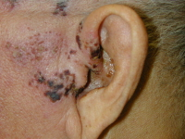

Slide 27
Herpesvirus Diseases Varicella-Zoster virus
Laboratory diagnosis
Most commonly diagnosis is clinical
Usually not necessary except for immuno-compromised
T-zanck smear
PCR to detect viral DNA
DFA on skin speimens
Virus isolation in cell cultures
Serology

Slide 28
Herpesvirus Diseases Varicella-Zoster virus
Treatment
No treatment is required for healthy persons (except eye infections) but in severe cases acyclovir is given
Immuno-compromised patients or patients with disseminated infections should be treated with acyclovir
Also can get immune globulin (passive immunization)
Other drugs as famciclovir or valacyclovir can also be given
PNH drugs to reduce neuralgia are gabapentin and lidocaine patches

Slide 29
Herpesvirus Diseases Varicella-Zoster virus
Vaccination
Vaccine was approved for use in the U.S. in 1995
Now recommended for children (MMRV tetravalent)
3 types of vaccine is avaiable
Varivax
Zostavax
Both contain live attenuated VZV but Zostavax contain 14 times more virus than Varivax.
Shigrix a recombinant vaccine

Slide 30
Recommendations for the use of varicella-zoster immune globulin (VZIG)
Post exposure prophylaxis for those at high risk for severe varicella. Use is recommended within 4 to 10 days after exposure.
Other recommendations
Immuno-compromised patients
Newborn infants whose mothers have varicella symptoms between 5 days before and 2 days after delivery.

Slide 31
Cytomegalovirus(CMV)

Slide 32
Herpesvirus Diseases Cytomegalovirus(CMV)
Causes cytomegalic inclusion disease in neonates
Most common cause of congenital abnormalities in USA
Important cause of heterophil negative mononucleosis in immuno-competent people.
Systemic infections especially pharangitis, pneumonitis and hepatitis in immunosuppressed persons
In AIDS patients……intractable colitis with diarrhoea

Slide 33
Herpesvirus Diseases Cytomegalovirus(CMV)
Epidemiology and transmission
Worldwide
Humans are only known host
Transmission through close contact (oral/sexual), transplacental, during birth and through breast milk
Also by blood transfusion and organ transplant

Slide 34
Herpesvirus Diseases Cytomegalovirus(CMV)
Pathogenesis
Cytomegalic inclusion disease of fetus is characterized by multinucleated giant cells with prominent intra-nuclear inclusions.
Primary infection during 1st trimester can lead to multiple congenital abnormalities.
Viremia leads to wide spread tissue distribution
Latent phase occurs primarily in monocytes but it can occur in a variety of tissues too
Immune evasion

Slide 35
Herpesvirus Diseases Cytomegalovirus
Clinical spectrum
Usually mild disease in immuno-competent people. Can cause heterophil-negative mononucleosis (fever, lethargy, abnormal lymphocytes)
Immuno-suppressed can develop systemic disease (pneumonitis and hepatitis)
AIDS patients develop intractable colitis, diarrhoea and retinitis
Congenital infections are sometimes fatal
20% infants develop IUGR, microcephaly, seizures, mental retardation, deafness, jaundice and purpura (blue-berry muffin) with hepato-splenomegaly

Slide 36
Herpesvirus Diseases Cytomegalovirus
Immunity
IgM, IgG
Virus becomes latent with episodes of recurrence
Laboratory diagnosis
PCR is method of choice
Viral isolation is done by culturing in shell vials
Fluorescent antibody and histologic staining of giant cells with intra-nuclear inclusions (owl’s eye shape) in the giant cells in urine and in tissue
CMV antigenemia (pp65…..infected leukocyte)
Serology is usually not informative
Treatment
Ganciclovir for life threatening infections

Slide 37
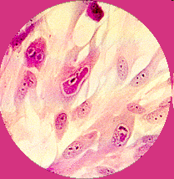
CMV

Slide 38
Herpesvirus Diseases Cytomegalovirus
Prevention
No vaccine
Ganciclovir can suppress progressive retinitis in AIDS patients
Infected infants are kept isolated
CMV antibody negative donors for blood transfusions and for organ transplant
A high titer immune globulin preparation (CytoGam) given in organ transplant recipients

Slide 39
Herpesvirus Diseases Epstein-Barr virus(EBV)
Properties
Structurally and morphologically similar to other herpes viruses but antigenically different.
Viral capsid antigen (VCA)
Early antigens (EA)
Epstein bar nuclear antigen (EBNA)
Lymphocyte determined membrane antigen
Viral membrane antigen

Slide 40
Herpesvirus Diseases
Epstein-Barr virus(EBV)
Epstein-Barr virus
Targets B cells
Can also infect epithelial cells of oropharynx, parotid gland, cervix
Usually becomes latent in the B cell
Can cause transformation
Used to make immortalized human B cells that secrete monoclonal antibodies

Slide 41
Herpesvirus Diseases Epstein-Barr virus(EBV)
Transmission through saliva
Initial replication in epithelial cells
B cells in lymphoid tissues
“Atypical lymphs”
Most young adults are infected
Epidemiology
Worldwide

Slide 42
Herpesvirus Diseases Epstein-Barr virus(EBV) Pathogenesis
Infection begins in pharyngeal epithelium
Spreads to cervical lymph nodes
Travels via blood to liver and spleen
Establishes latency in B lymphocytes
Cytotoxic T cells react against B cells
Atypical T cells are the “atypical lymphs”

Slide 43
Herpesvirus Diseases Epstein-Barr virus(EBV) Pathogenesis
Once infected, a lifelong carrier state develops. Whereby a low grade infection (EBV-immortalized B-cells) is kept in check by the immune defenses.
Low grade virus replication and shedding can be demonstrated in the epithelial cells of the pharynx of all seropositive individuals.
EBV is able to immortalize B-lymphocytes in vitro and in vivo.
EBV is associated with several very different diseases where it may act directly or by one of several co-factors.

Slide 44
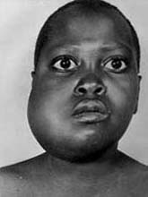
Herpesvirus Diseases
Epstein-Barr virus
Clinical spectrum
Infectious mononucleosis or glandular fever
Lengthy incubation period of up to 50 days
Sore throat, lymphadenopathy, fever, malaise
Splenomegaly, hepatitis, anorexia
Aggressive form seen in X-linked lymphoproliferative syndrome
Oral hairy leukoplakia in HIV patients (epithelial cells)
Burkitt’s lymphoma, Hodgkin’s lymphoma
Nasopharyngeal carcinoma
PTLD

Slide 45
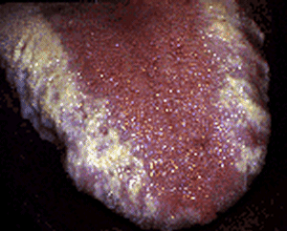
Herpesvirus Diseases
Epstein-Barr virus
Clinical spectrum
Oral hairy leukoplakia in HIV patients (epithelial cells)
Burkitt’s lymphoma, Hodgkin’s lymphoma
Nasopharyngeal carcinoma
PTLD

Slide 47
Herpesvirus Diseases
Epstein-Barr virus
Laboratory diagnosis
In peripheral blood smear absolute lymphocytosis with 30% atypical lymphs
Monospot test (heterophil antibodies)
EBV specific antibody tests…..IgM VCA, IgG VCA
Virus isolation (slow)
Treatment
High doses of acyclovir may be useful in life threatening EBV infections
Prevention and control
No vaccine available
Acyclovir has no effect

Slide 48
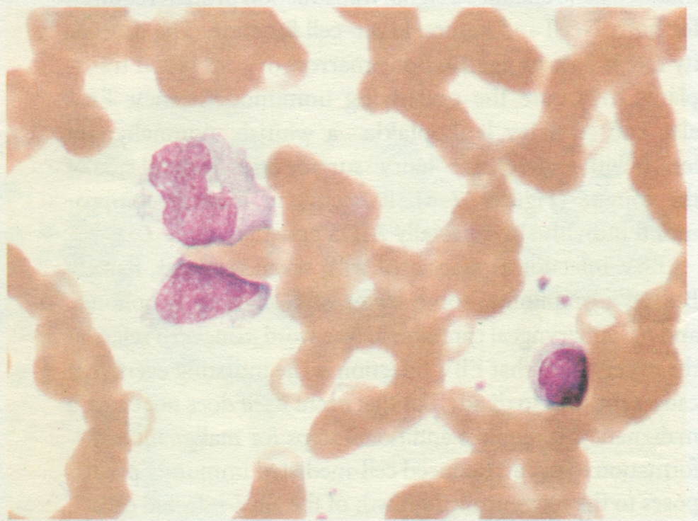

Slide 49
Disease Association
1. Infectious Mononucleosis
2. Burkitt's lymphoma
3. Nasopharyngeal carcinoma
4. Lymphoproliferative disease and lymphoma in the immunosuppressed (PTLD)
5. X-linked lymphoproliferative syndrome
6. Chronic infectious mononucleosis
7. Oral leukoplakia in AIDS patients
8. Chronic interstitial pneumonitis in AIDS patients.

Slide 50
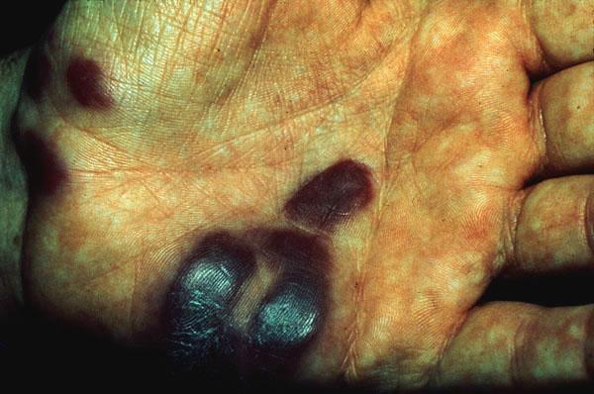
Herpesvirus Diseases
Other herpesviruses
HHV-6
Infects Tcells
Causes roseola
Only a problem in immunocompromised patients
HHV-7
Infects T cells
No known disease
HHV-8
Kaposi’s sarcoma virus
Before HIV disease, only known to cause disease in men of Mediterranean descent and chemotherapy patients
Isolated from HIV patients

Slide 51
POX VIRUSES
Pox viruses are the largest and most complex viruses
Smallpox virus
Molluscum contagiosum virus(MCV)
Vaccinia virus

Slide 52
POX VIRUSES
Smallpox virus (variola virus)
It causes disease named as small pox
This disease has been eradicated
Brick-shaped enveloped particles with linear double stranded DNA
It has a single and stable serotype
Pox viruses replicate in cytoplasm which is unusual for DNA viruses
Transmitted by respiratory aerosol, direct contact with virus
It infects only humans, there is no animal reservoir

Slide 53
POX VIRUSES
Pathogenesis
Infects upper respiratory tract+local lymph nodes…..primary viremia ……internal organs…..secondary viremia……..skin
These events occur during incubation period
Rash is due to viral replication in skin followed by cytotoxic Tcell (CD8) attack
Immunity is life long

Slide 54
POX VIRUSES
Clinical findings
Incubation period 7-14 days
Prodromal phase….fever and malaise
Followed by rash which is worse on face and extremities than on trunk
Centrifugal distribution
Macules to papules, vesicles, pustules….crusts in 2 to 3 weeks

Slide 55
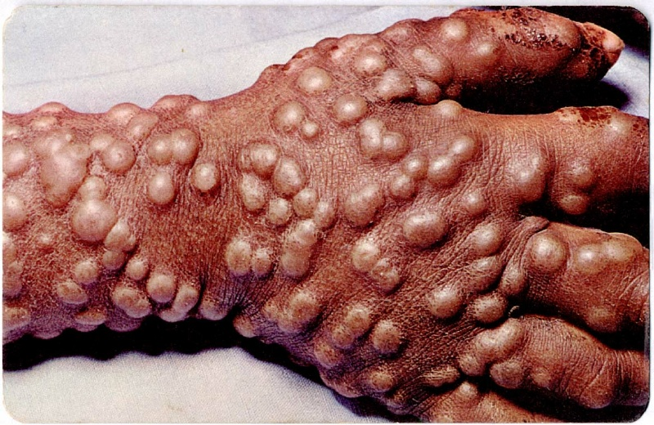

Slide 56
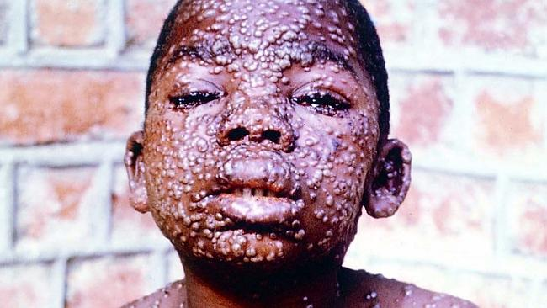

Slide 57
POX VIRUSES
Prevention
Live attenuted vaccinia virus in vaccine
Vaccinia immune globulins (VIG) can be used to treat complications of vaccination

Slide 58
POX VIRUSES
Molluscum contagiosum virus (MCV)
Transmitted by close personal contact
Produces small(2-5 mm), flesh colored umbilicated papule on skin or mucus membrane
Painless, non pruritic and not inflammed
Lesions are found around eyes and on trunk(children) and in genital area (adults)
Cytoplasmic inclusions are seen

Slide 59
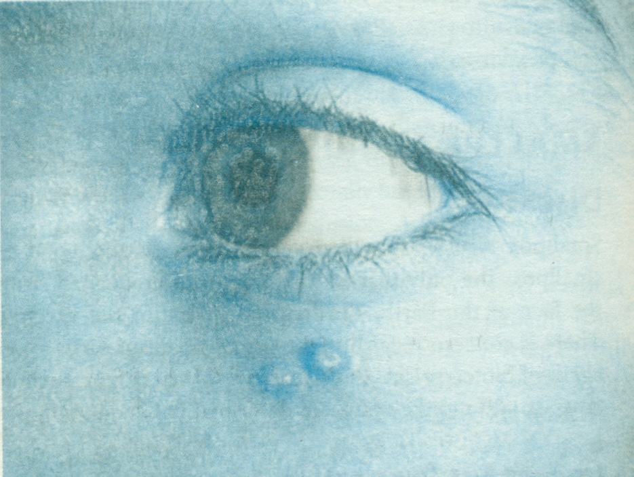

Slide 60
POX VIRUSES
Treatment
By curettage or with liquid nitrogen
No established treatment
Cidofovir ……immunocompromised patients.
AIDS ……retroviral therapy
No vaccine is available

Slide 61
HEPADNAVIRUS FAMILY
Includes Hepatitis B Virus

Slide 62
DNA Non Enveloped Viruses

Slide 63
DNA Non enveloped Viruses
They include
Adenoviruses
Papillomaviruses
Polyomaviruses
Parvoviruses

Slide 64
DNA Nonenveloped Viruses
PAPILLOMAVIRUSES
100 serotypes of human papilloma viruses
HPV-1,2,3,4 cause benign skin warts
HPV-6 and 11 cause genital warts(condylomata acuminata). They also cause respiratory tract papillomas
HPV-16 and 18 cause carcinoma of cervix, penis and anus
E6 and E7 two early genes are involved in carcinogenesis
Inactivation of p53 and RB proteins is an important step
Koilocytes

Slide 65
DNA Nonenveloped Viruses
PAPILLOMAVIRUSES
CIN(cervical intra epithelial neoplasia), PIN(penile intraepithelial neoplasia)
Skin and planter warts
Genital warts or condylomata accuminata
Respiratory tract papillomas in children
Labs :Presence of koilocytes in lesions
PCR and pap smear

Slide 66
DNA Nonenveloped Viruses
PAPILLOMAVIRUSES
Treatment and prevention
For skin warts….liquid nitrogen
Planter warts …..surgical removal, or with salicylic acid topically
Genital warts….podophyllin, alpha interferon
Two vaccines…. Gardasil 9, a recombinant vaccine and Cervarix also a recombinant vaccine

Slide 67
Parvo virus B19
Causes erythema infectiosum, or fifth disease, a mild febrile exanthematous disease that occurs in children (it was the fifth of the childhood exanthems; the first four being scarlet fever, rubella, roseola, and measles).
Also responsible for episodes of aplastic crisis in patients with chronic hemolytic anemia and is associated with acute polyarthritis in adults.
Intrauterine infection of a fetus may cause abortion.

Slide 68
Parvo virus B19
The smallest of the deoxyribonucleic acid (DNA) viruses, nonenveloped with icosahedral capsid.
Only one member of the Parvoviridae, B19, is known to cause human disease.
One linear, single and negative stranded DNA molecule has “hairpin” loops at both ends
Only one serotype of B19 is known to exist.
Transmitted primarily by respiratory ; by transplacental and by blood transfusion can also occur

Slide 69
Epidemiology
Approximately 65% of the adult population have been infected with B19 by 40 years of age.
Erythema infectiosum is most common in children and adolescents ages 4 to 15 years.
Arthralgia and arthritis are likely to occur in adults.
Disease usually occurs in late winter and spring.

Slide 70
Pathogenesis and Immunity
B19 targets and is cytolytic for erythroid precursor cells and for endothelial cells.
First replicates in the nasopharynx or upper respiratory tract, then spreads by viremia to the bone marrow and elsewhere.
Disease is determined by the direct killing of these cells and the subsequent immune response to the infection (rash and arthralgia).

Slide 71
Pathogenesis and Immunity
The initial febrile stage is infectious stage. During this time, erythrocyte production is stopped for approximately 1week.
A large viremia occurs and is accompanied by nonspecific flulike symptoms. Antibody stops the viremia and is important for resolution.
The second, symptomatic stage is immune mediated. The rash and arthralgia coincide with the appearance of virus-specific antibody and the formation of immune complexes.
Hosts with chronic hemolytic anemia are at risk for aplastic crisis.

Slide 72
Clinical Syndromes: Erythema infectiosum (fifth disease)
Starts with a prodromal period of 7 to 10 days, during which the person is contagious: fever and nonspecific symptoms (sore throat, coryza, chills, malaise, and myalgia) as well as a slight decrease in hemoglobin levels.
This period is followed by a distinctive rash on the cheeks, which appear as if they have been slapped.

Slide 73
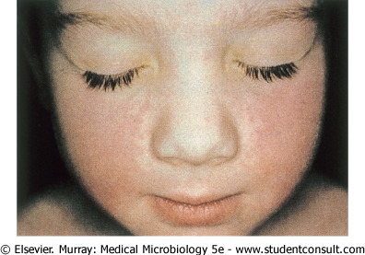
Erythema infectiosum (fifth disease)
A "slapped-cheek" appearance is typical of the rash for erythema infectiosum.
The less intense “lacy”rash then usually spreads, especially to exposed skin such as the arms and legs, and then subsides over 1 to 2 weeks. Relapse of the rash is common.

Slide 74
Clinical Syndromes
In adults causes polyarthritis. Arthritis of the hands, wrists, knees, and ankles predominates.
Infection of immunodeficient people may result in chronic disease.
The most serious complication: the aplastic crisis that occurs in patients with chronic hemolytic anemia (e.g., sickle cell anemia).

Slide 75
Clinical Syndromes
B19 infection of a seronegative mother increases the risk for fetal death.
Infect the fetus and kill erythrocyte precursors, causing anemia and congestive heart failure (hydrops fetalis).
Infection of seropositive pregnant women often has no adverse effect on the fetus. There is no evidence that B19 causes congenital abnormalities.

Slide 76
Laboratory Diagnosis
Specific immunoglobulin M (IgM) or viral DNA must be detected (i.e., to distinguish the rash of B19 from that of rubella in a pregnant woman).
Enzyme-linked immunosorbent assays for B19 IgM and IgG are available.
The polymerase chain reaction test is a very sensitive method for detecting the B19 genome in clinical samples.

Slide 77
Treatment, Prevention, and Control
No specific antiviral treatment or means of control is available.
Pooled immune globulins in immunodeficient people with chronic B19 infections

Slide 78
DNA Nonenveloped Viruses
POLYOMAVIRUSES
JC and BK viruses
SV40 virus

Slide 79
DNA Nonenveloped Viruses
ADENOVIRUSES
Cause upper and lower respiratory tract diseases as well as other diseases, such as
Pharyngitis
Common cold
Pneumonia
Conjunctivitis (pink eye)
Keratoconjunctivitis
Hemorrhagic cystitis
Gastroenteritis mainly occurs in children <2years of age

Slide 80
ADENO VIRUSES
Approximately 100 serotypes have been recognized, at least 47 of which infect humans
Linear, double-stranded DNA
The virions are nonenveloped icosadeltahedrons
The fiber contains the viral attachment proteins and can act as a hemagglutinin.
Fiber protein is type-specific antigen

Slide 81
Electron micrograph of adenovirus virion with fibers

Slide 82
ADENO VIRUSES
3,4,7,21 serotypes….respiratory disease
8,19 serotypes…..epidemic keratoconjunctivitis
11,21 serotypes….hemorrhagic cystitis
40,41 serotypes….infantile gastroenteritis

Slide 83
Epidemiology
Spread mainly is by respiratory, fecal-oral, by fingers, by fomites, by contact from human to human.
Close interaction among people, as occurs in classrooms and military barracks, promotes out breaks
Adenoviruses 1 through 7 are the most prevalent serotypes
Resist drying, detergents, gastrointestinal tract secretions (acid, protease and bile) and even mild chlorine treatment.

Slide 84
Pathogenesis
Capable of causing lytic (e.g., mucoepithelial cells), latent (e.g., lymphoid and adenoid cells, Peyer's patches, and can be reactivated in immunosuppressed patients) and transforming (hamster, not human) infections.
The viral fiber proteins determine the target cell specificity
Infects mucosal epithelium of respiratory tract, GI tract and the conjunctivas

Slide 85
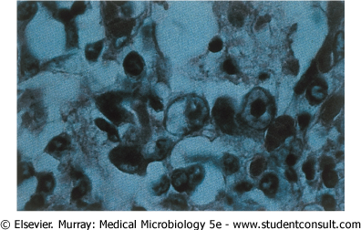
Pathogenesis
The histologic hallmark is a dense, central intranuclear inclusion within an infected epithelial cell that consists of viral DNA and protein

Slide 86
CLINICAL FINDINGS
Causes pharyngitis, which is often accompanied by conjunctivitis (pinkeye) and pharyngoconjunctival fever.
Pharyngitis alone occurs in young children, particularly those younger than 3 years, and may mimic streptococcal infection.
Patients have mild, flulike symptoms (including nasal congestion, malaise, fever, myalgia, and headache).

Slide 87
ACUTE RESPIRATORY DISEASE
A syndrome consisting of fever, cough, pharyngitis and cervical adenitis.
Usually caused by adenovirus serotypes 4 and 7.
OTHER RESPIRATORY TRACT DISEASES:
Cold like symptoms, laryngitis, bronchiolitis, bronchitis and atypical pneumonia .
They can also cause a pertussis-like illness.

Slide 88
CONJUNCTIVITIS AND EPIDEMIC KERATOCONJUNCTIVITIS
Irritation of the eye by a foreign body, dust, debris is a risk factor for the acquisition of this infection.
Cause a follicular conjunctivitis in which the mucosa of the palpebral conjunctiva becomes nodular
Swimming pool conjunctivitis

Slide 89
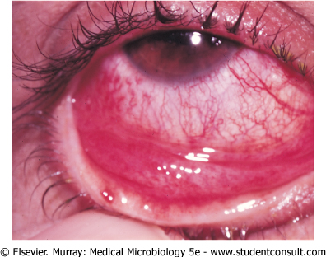

Slide 90
GASTROENTERITIS AND DIARRHEA
Major cause of acute viral gastroenteritis; 15% of the cases of gastroenteritis in hospitalized patients.
Serotypes 40 and 41 appear to be responsible for episodes of diarrhea in infants.

Slide 91
Laboratory Diagnosis
Should be obtained from a site or secretion relevant to the disease symptoms.
Isolation of virus in cell culture and 4-folds rise in antibody titer.
Serologic testing by complement fixation and hemagglutination inhibition.
Fluorescent antibody assays and the polymerase chain reaction can be used to detect type and group the virus.

Slide 92
Treatment, Prevention, and Control
There is no approved treatment for adenovirus infection.
3 Live, oral vaccines have been used to prevent infections, given individually at different occasions, with adenovirus types 4,7 and 21 in military recruits.

