Slide 1
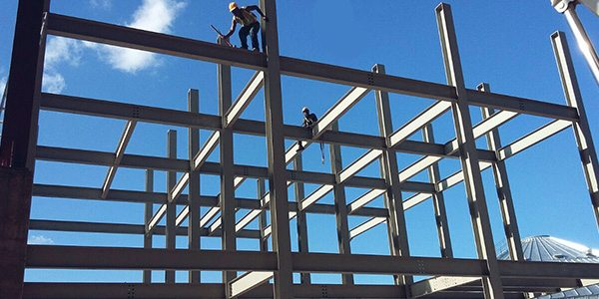
COLLEGE OF ENGINEERING AND TECHNOLOGY UNIVERSITY OF SARGODHA Theory Of Structures (CT-226) (B.S TECHNOLOGY)
ONLINE LECTURE-1
Trusses
Engr. Aqeel Ahmed
Lecturer, CET, UOS, Sargodha
26-March-2020

Slide 4
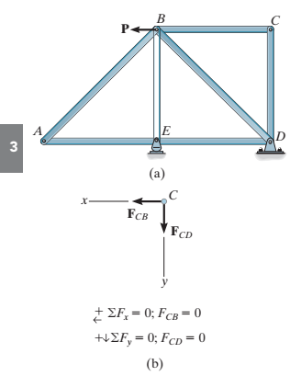
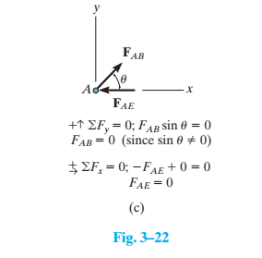

Slide 5
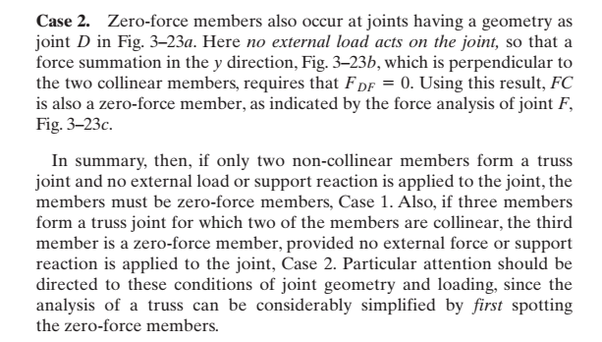

Slide 7
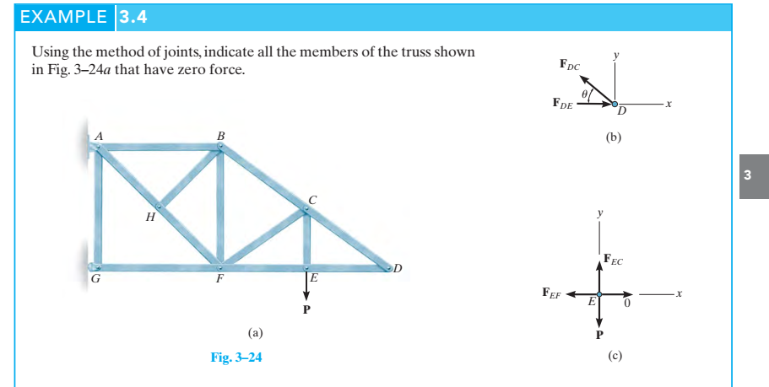

Slide 8
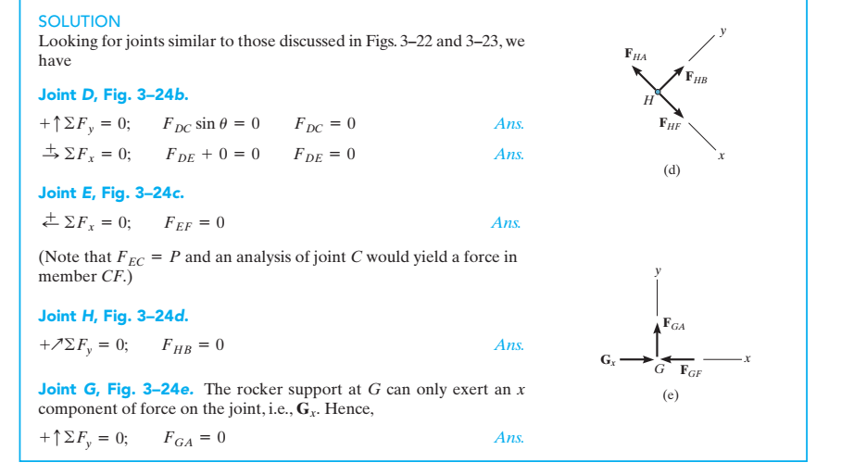

Slide 9
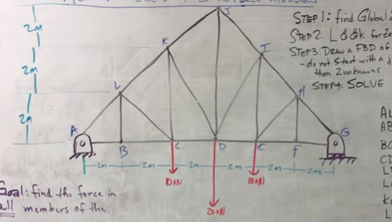

Slide 10
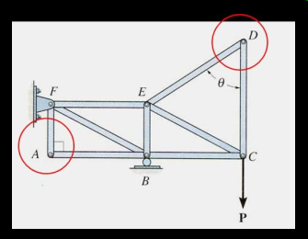
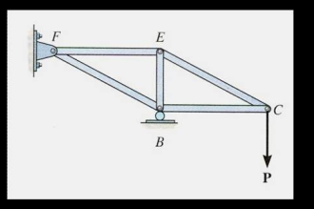

Slide 11
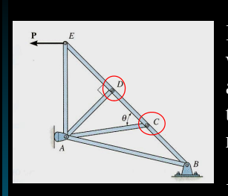
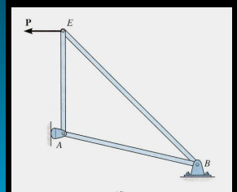

Slide 14
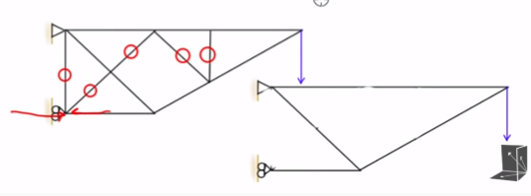

Slide 15
VIDEO

Slide 17
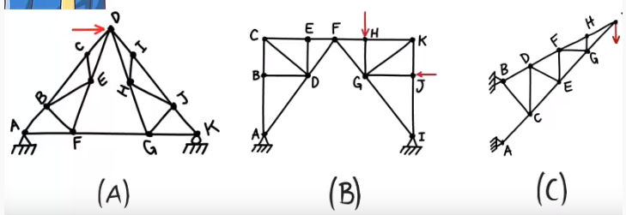
Assignment

