Slide 1
—
INTRODUCTION TO ACCOUNTING

Slide 2
® Accounting is the process of summarizing, analyzing and reporting the financial transactions in a manner that adheres to certain accepted standard formats, helping to evaluate a past performance, present condition, and future prospects as well.

Slide 3
M
O
® In all activities and organizations (business or non-business) which require money and other economic resources, accounting is required to account for these resources.
® In other words, wherever money is involved, accounting is required to account for it.
® Accounting is often called the language of business. The basic function of any language is to serve as a means of communication. Accounting also serves this function.

Slide 4
o
® Accounting helps answering questions like;
■ Am I making or losing money from my business?
■ How much am I worth?
■ Should I put more money in my business or sell it and go into another business?
■ How much is owed to me, and how much do I owe?
■ How can I change the way I operate to make more profit?

Slide 5
® Objective of accounting may differ from business to business depending upon their specific requirements. However, the following are the general objectives of accounting.
■ Keeping systematic record.
■ Ascertain the results of the operation.
■ Ascertain the financial position of the business.
■ Portray the liquidity position.
■ To protect business properties.
■ To facilitate rational decision - making.
■ To satisfy the requirements of law.

Slide 6
®Owners: The owners provide funds or capital for the organization. They possess curiosity in knowing whether the business is being conducted on sound lines or not, and whether the capital is being employed properly or not. Owners, being businessmen, always keep an eye on the returns from the investment. Comparing the accounts of various years helps in getting good pieces of information.

Slide 7
® Management: The management of the
business is greatly interested in knowing the position of the firm. The accounts are the basis, the management can study the merits and demerits of the business activity. Thus, the management is interested in financial accounting to find whether the business carried on is profitable or not. The financial accounting is the “eyes and ears of management and facilitates in drawing future course of action, further expansion etc. ”

Slide 8
®Creditors: Creditors are the persons who supply goods on credit, or bankers or lenders of money. It is usual that these groups are interested to know the financial soundness before granting credit. The progress and prosperity of the firm, two which credits are extended, are largely watched by creditors from the point of view of security and further credit. Profit and Loss Account and Balance Sheet are nerve centers to know the soundness of the firm.

Slide 9
® Employees: Payment of bonus
depends upon the size of profit earned by the firm. The more important point is that the workers expect regular income for the bread. The demand for wage rise, bonus, better working conditions etc. depend upon the profitability of the firm and in turn depends upon financial position. For these reasons, this group is interested in accounting.

Slide 10
®Investors: The prospective investors, who want to invest their money in a firm, of course wish to see the progress and prosperity of the firm, before investing their amount, by going through the financial statements of the firm. This is to safeguard the investment. For this, this group is eager to go through the accounting which enables them to know the safety of investment.

Slide 11
©Government! Government keeps a close watch on the firms which yield good amount of profits. The state and central Governments are interested in the financial statements to know the earnings for the purpose of taxation. To compile national accounting is essential.

Slide 12
©Consumers; These groups are interested in getting the goods at reduced price. Therefore, they wish to know the establishment of a proper accounting control, which in turn will reduce to cost of production, in turn less price to be paid by the consumers. Researchers are also interested in accounting for interpretation.

Slide 13
® Research Scholars: Accounting information, being a mirror of the financial performance of a business organization, is of immense value to the research scholar who wants to make a study into the financial operations of a particular firm as such study needs detailed accounting information relating to purchases, sales, expenses, cost of materials used, current assets, current liabilities, fixed assets, long-term liabilities and share-holders funds which is available in the accounting record maintained by the firm.

Slide 14
® Sole Proprietorship: is a business wholly owned by a single individual. It is the easiest and the least expensive way to start a business and is often associated with small storekeepers, service shops, and professional people such as doctors lawyers, or
accountants.
® One major disadvantage of sole
proprietorship is unlimited liability since the owner and the business are regarded as the same, from a legal standpoint.

Slide 15
® Partnerships: A partnership is a legal association of two or more individuals called partners and who are co-owners of a business for profit. Like proprietorships, they are easy to form. This type of business organization is based upon a written agreement that details the various interests and right of the partners and it is advisable to get legal advice and document each person’s rights and responsibilities.

Slide 16
® Corporations: is the most dominant form of business organization in our society. A Corporation is a legally chartered enterprise with most legal rights of a person including the right to conduct business, own, sell and transfer property, make contracts, borrow money, sue and be sued, and pay taxes. Since the Corporation exists as a separate entity apart from an individual, it is legally responsible for its actions and debts.

Slide 17
® The strength of a Corporation is that its ownership and management are separate. In theory, the owners may get rid of the Managers if they vote to do so. Conversely, because the shares of the company known as stock can sold to someone else, the Company’s ownership can change drastically, while the management stays the same. The Corporation’s unlimited life span coupled with its ability to raise money gives it the potential for significant growth.

Slide 18
® Some of the disadvantages of Corporations are that incorporated businesses suffer from higher taxes than unincorporated businesses. In addition, shareholders must pay income tax on their share of the Company’s profit that they receive as dividends. This means that corporate profits are taxed twice.

Slide 19
® Cash Based Accounting:
■ Most of us use the cash method to keep track of our personal financial activities. The cash method recognizes revenue when payment is received, and recognizes expenses when cash is paid out. For example, your personal checkbook record is based on the cash method. Expenses are recorded when cash is paid out and revenue is recorded when cash or check deposits are received.

Slide 20
® Accrual Accounting :
■ The accrual method of accounting requires that revenue be recognized and assigned to the accounting period in which it is earned. Similarly, expenses must be recognized and assigned to the accounting period in which they are incurred.
■ A Company tracks the summary of the accounting activity in time intervals called Accounting periods. These periods are usually a month long. It is also common for a company to create an annual statement of records. This annual period is also called a Fiscal or an Accounting Year.

Slide 21
■ The accrual method relies on the principle of matching revenues and expenses. This principle says that the expenses for a period, which are the costs of doing business to earn income, should be compared to the revenues for the period, which are the income earned as the result of those expenses. In other words, the expenses for the period should accurately match up with the costs of producing revenue for the period.

Slide 22
® Financial Accounting:
■ The accounting system concerned only with the financial state of affairs and financial results of operations.
■ It is the original form of accounting. It is mainly concerned with the preparation of financial statements for the use of outsiders like creditors, debenture holders, investors and financial institutions.

Slide 23
■ The accounting system uses Accounts to keep track of information. Here is a simple way to understand what accounts are. In your office, you usually keep a filing cabinet. In this filing cabinet, you have multiple file folders. Each file folder gives information for a specific topic only.
■ For example you may have a file for utility bills, phone bills, employee wages, bank deposits, bank loans etc. A chart of accounts is like a filing cabinet. Each account in this chart is like a file folder. Accounts keep track of money spent, earned, owned, or owed. Each account keeps track of a specific topic only.

Slide 24
® Revenue:
■ It means the amount which, as a result of operations, is added to the capital. It is defined as the inflow of assets which result in an increase in the owner’s equity. It includes all incomes like sales receipts interest, commission, brokerage etc., However, receipts of capital nature like additional capital, sale of assets etc., are not a pant of revenue.

Slide 25
■ The terms ‘expense’ refers to the amount incurred in the process of earning revenue. If the benefit of an expenditure is limited to one year, it is treated as an expense (also known is as revenue expenditure) such as payment of salaries and rent.

Slide 26
■ An Asset is a property of value owned by a business. Physical objects and intangible rights such as money, accounts receivable, merchandise, machinery, buildings, and inventories for sale are common examples of business assets as they have economic value for the owner. Accounts receivable is an unwritten promise by a client to pay later for goods sold or services rendered.

Slide 27
®Assets are generally divided into three main groups:
■ Current
■ Fixed
■ Intangible

Slide 28
® Refer to cash and other items that can be turned back into cash within a year are considered a current asset such as;
■ Cash - includes funds in checking and savings accounts
■ Marketable securities such as stocks, bonds, and similar investments
■ Accounts Receivables, which are amounts due from customers
■ Notes Receivables, which are promissory notes by customers to pay a definite sum plus interest on a certain date at a certain place.
■ Inventories such as raw materials or merchandise on hand
■ Prepaid expenses - supplies on hand and services paid for but not yet used (e.g. prepaid insurance)

Slide 29
® Refer to tangible assets that are used in the business. Commonly, fixed assets are long-lived resources that are used in the production of finished goods such as;
■ Buildings.
■ Land
■ Equipment
■ Furniture

Slide 30
® Certain long-lived assets such as machinery, cars, or equipment slowly wear out or become obsolete. The cost of such as assets is systematically spread over its estimated useful life. This process is called depreciation if the asset involved is a tangible object such as a building or amortization if the asset involved is an intangible asset such as a patent. Of the different kinds of fixed assets, only land does not depreciate.

Slide 31
® Refers to assets that are not physical assets like equipment and machinery but are valuable because they can be licensed or sold outrighfTo others, such as;
■ Copyrights
■ Patents
■ Trademarks
■ Goodwill
> Goodwill is not entered as an asset unless the business has been purchased. It is the least tangible of all the assets because it is the price a purchaser is willing to pay for a company’s reputation especially in its relations with customers

Slide 32
®A Liability is a legal obligation of a business to pay a debt. Debt can be paid with money, goods, or services, but is usually paid in cash. The most common liabilities are notes payable and accounts payable.
® Accounts payable is an unwritten promise to pay suppliers or lenders specified sums of money at a definite future date.

Slide 33
® Current Liabilities are liabilities that are due within a relatively short period of time. The term Current Liability is used to designate obligations whose payment is expected to require the use of existing current assets. Among current liabilities are Accounts Payable, Notes Payable, and Accrued Expenses.

Slide 34
a
® Long-Term Liabilities are obligations that will not become due for a comparatively long period of time. The usual rule of thumb is that long-term liabilities are not due within one year. These include such things as bonds payable, mortgage note payable, and any other debts that do not have to be paid within one year.
® You should note that as the long-term obligations come within the one-year range they become Current Liabilities.

Slide 35
® Capital, also called net worth, is essentially what is yours - what would be left over if you paid off everyone the company owes money to. If there are no business liabilities, the Capital, Net Worth, or Owner Equity is equal to the total amount of the Assets of the business.

Slide 36
 | in
 | J1
® Now let us discuss the accounting equation, which keeps all the business accounts in balance.
Assets = Liabilities + Owner’s Equity

Slide 37
® Now the Assets of the company consist of the money invested by the owner, (i.e. Owner’s Equity), and for example a loan taken from the bank, (i.e. a Liability). The company’s liabilities are placed before the owners’ equity because creditors have first claim on assets.
® If the business were to close down, after the liabilities are paid off, anything left over (assets) would belong to the owner.

Slide 38
® Recording of transactions require a thorough understanding of the rules of debit and credit relating to accounts.
® Both debit and credit may represent either increase or decrease, depending upon the nature of account.
® For convenience ‘Dr’ is used for debit and ‘Cr’ is used for credit.

Slide 39
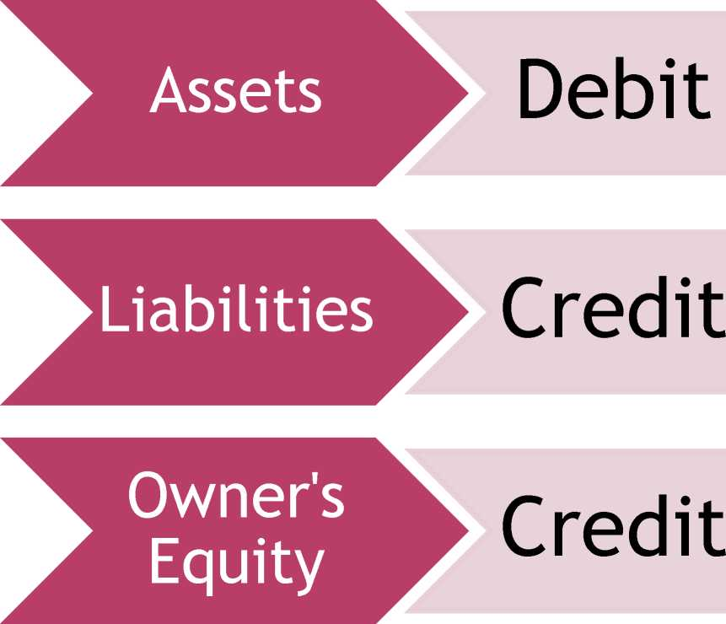

Slide 40
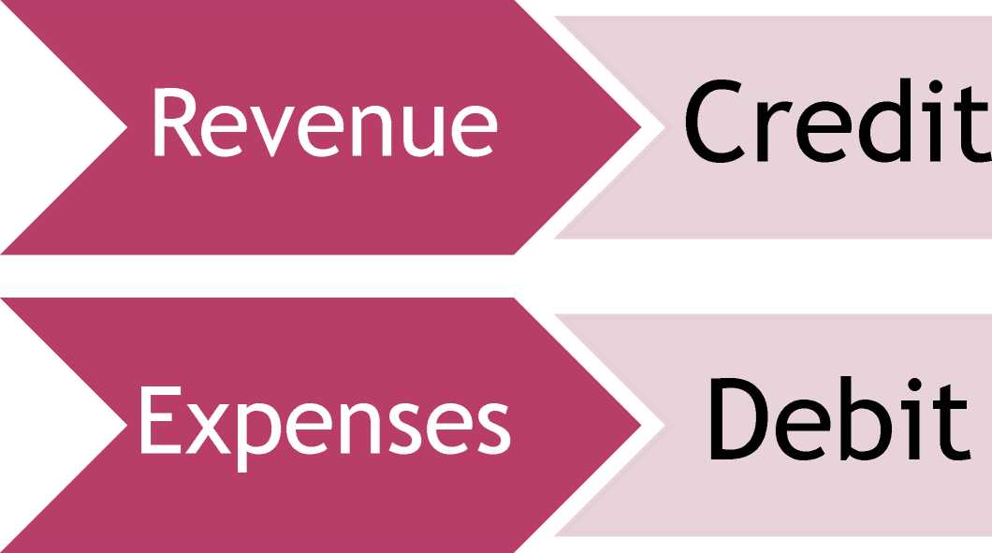

Slide 41
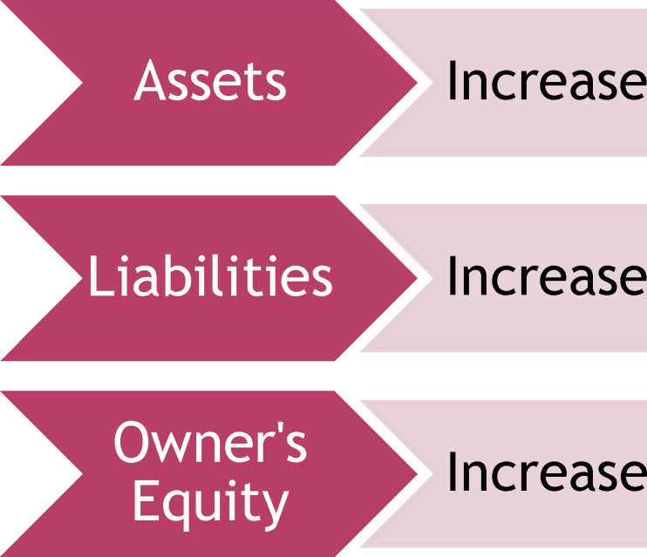
DT MP
Debit
Credit
Credit

Slide 42
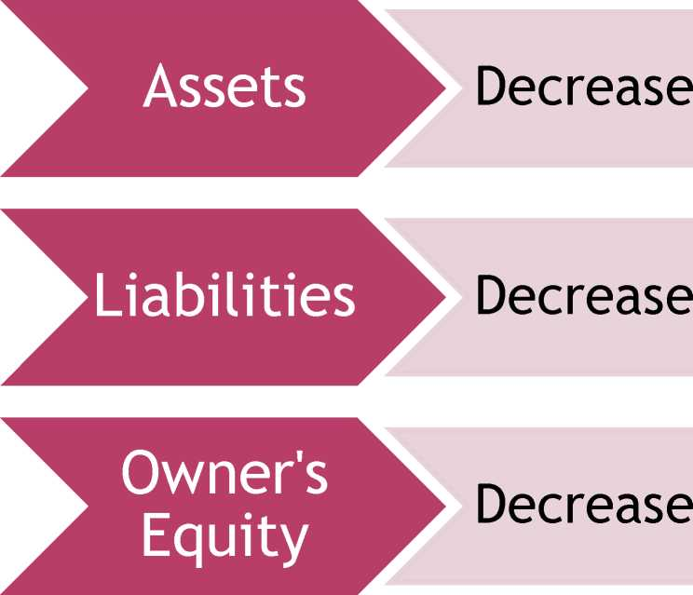
DT MP
Credit
Debit
Debit

Slide 43
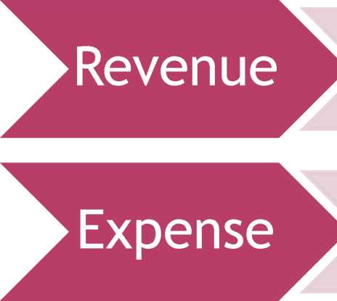
DT MP
► Increase
Credit
Debit
► Increase

Slide 44
DT MP
► Decrease
Debit
► Decrease
Credit

Slide 45
■ Net Income Statement (Profit & Loss): used to inform you about income earned, expenses incurred and total profit or loss in a particular period.
■ Balance Sheet: A Balance sheet is like a “snapshot” that gives the overall picture of the financial health of a company at one moment in time. This report lists the assets, liabilities, and owner’s equity.
■ Cash Flow: Provides data regarding all cash inflows a company receives from both its ongoing operations and external investment sources, as well as all cash outflows that pay for business activities and investments during a given period of time.

Slide 46
MET DM
)>
® Answers the question
■ How much did we earn?
r ^
Sales Revenue
L_J
® Is a period statement
■ Like a movie, shows what happened over a period of time.
Expenses
® The “Matching Principle”
■ Expenses are “matched” to their associated revenues in the same period.
Income

Slide 47
Joe's Bicycle Company 123 Main Street Any Town CA 99999
Income Statement
Income
Income from Sales Income fr om Freight Other Income
15.000.00
1.000.00
250.00
Total Income
16,250.00
Expenses
Cost of Sales Office Supplies Telephone Expense Utilities Consulting Fees Maintenance Insurance
Miscellaneous Expenses Travel & Entertainment Bank Charges Payroll Expense Tax Expense Total Expenses
2.000.00
250.00
500.00
100.00
750.00
300.00
250.00
375.00
650.00 25.00
4.000.00
2.500.00
11,700.00
Net Income/Loss
4.550.00

Slide 48
E
EEET
The Balance Sheet is a Snap shot showing what the company owns and owes at a particular point of time.
How much did we invest.
How is the investment being financed.

Slide 49
⁷a\
o
Liabilities
Probable future economic sacrifice as a result of a past transaction or event
Owners’ Equity
Paid in capital Retained earnings
Assets
Probable future economic benefits controlled by the company as a result of a past transaction or event

