Slide 3
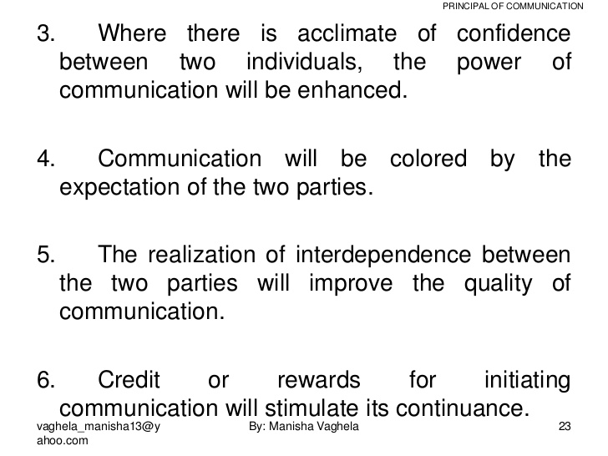

Slide 5
communication fidelity
Degree of correspondence between the meaning intended by the sender of a message and the meaning understood by its receiver.

